Slide 1
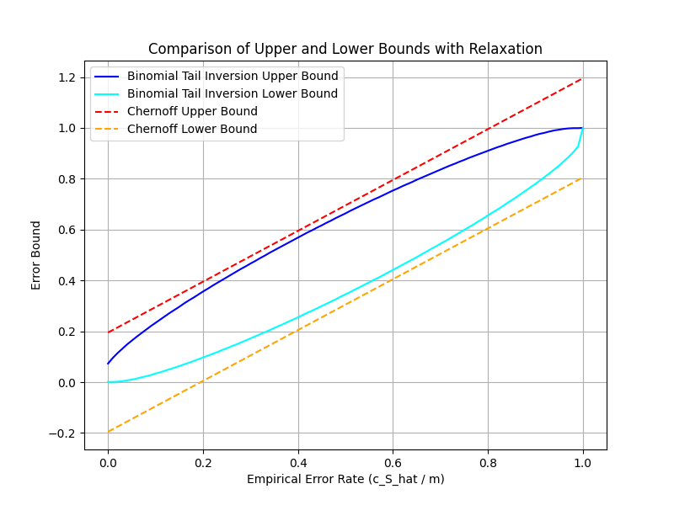
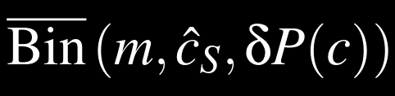
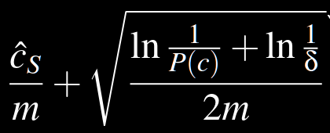
Chernoff Relaxation

Slide 2

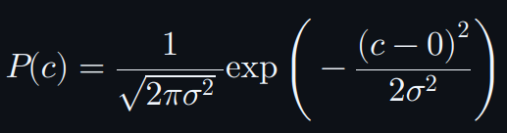
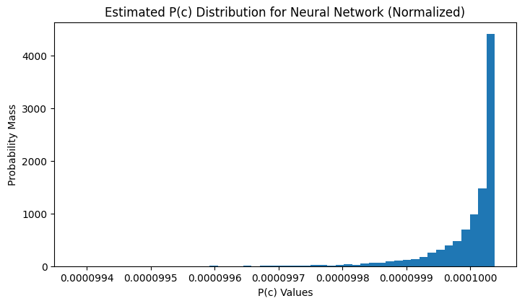
Generate 10000 sets of weights (1284 parameters each).
Calculate the mean for each set. Therefore, there are 10000 means.
Transfer the means to P(c) based on
0.0001000266 ~ 0.0001000398

Slide 3
Step 1.
Load the weight.
Step 2.
Assume the distribution. N(0, sigma^2)
Step 3.
Calculate the probability of this combination.
c_star = [ 0.03673643 -0.08081431 0.06386845 ... -0.03994802 0.10058571 0.03061383]
P(c*) = 9.463245908196897e-138

Slide 5
structure
complexity
P(c)
Bounds
spectral norm
Frobenius
Path norm
...
Boltzmann
...
Bin_bar
Chernoff relaxation
...

Slide 6

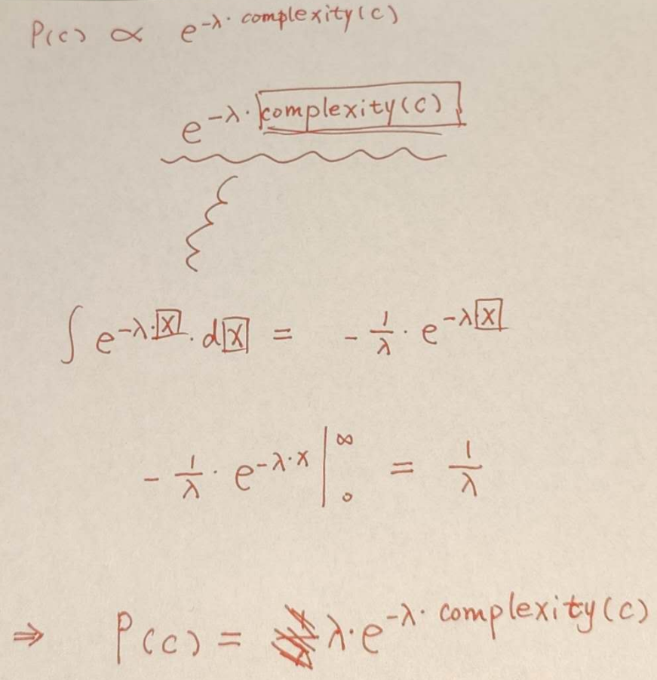

structure
complexity
P(c)
Bounds
spectral norm
Frobenius
Path norm
...
Boltzmann
...
Bin_bar
Chernoff relaxation
...
spectral norm
Boltzmann
Chernoff relaxation

Slide 7
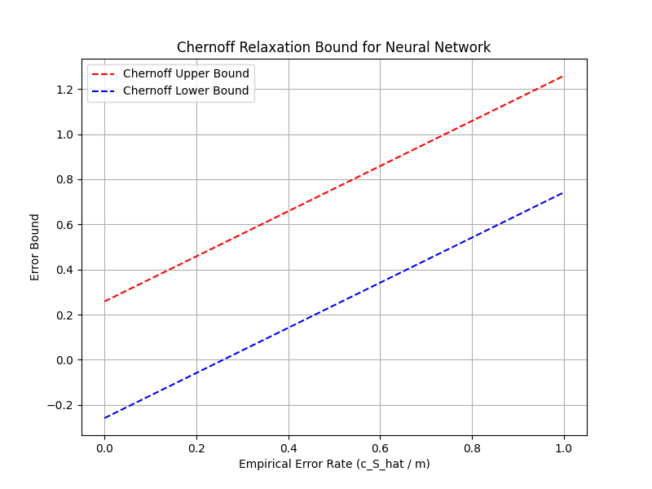

structure
complexity
P(c)
Bounds
spectral norm
Frobenius
Path norm
...
Boltzmann
...
Bin_bar
Chernoff relaxation
...
spectral norm
Boltzmann
Chernoff relaxation

Slide 8
Next:
structure
complexity
P(c)
Bounds
Complete
Complete
Complete
Apply to the Flexible Robots
bound from the test set

Slide 9
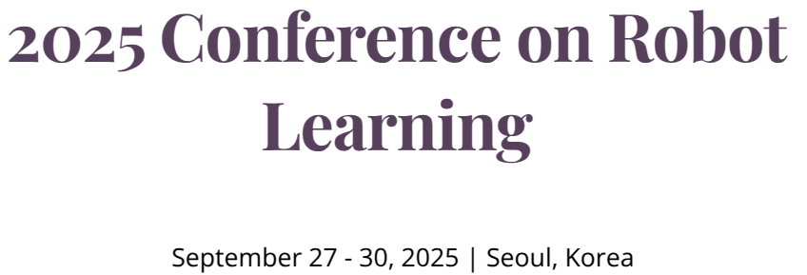
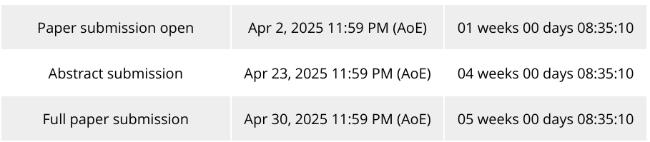
ICRA due around September 2025
Share with my friend

