Slide 1
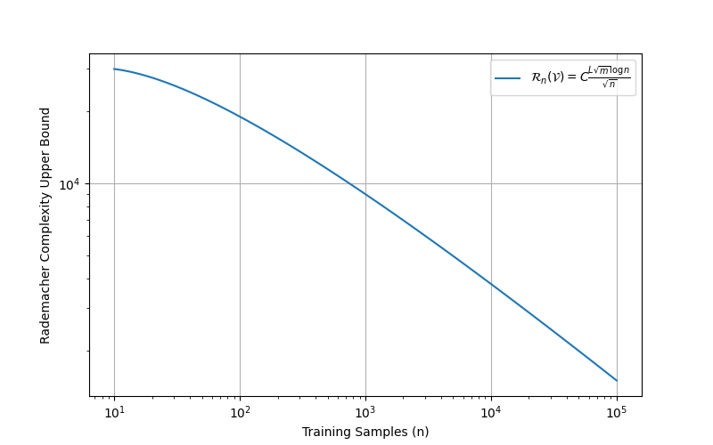
def compute_rademacher_bound(n, L, C=2): # C is from experience
m = 1251
result = C * (L * np.sqrt(m) * np.log(n)) / np.sqrt(n)
return result

Slide 2
