Slide 1
Software Engineering of Web Applications
Final Presentation
By group 5

Slide 2
What we are doing today
System overview revisited
User interface
Data mining and the DB Schema
Web Services and invoking them
Our Neural Network Stock Prediction Model
Indicators
Comments and Questions

Slide 3
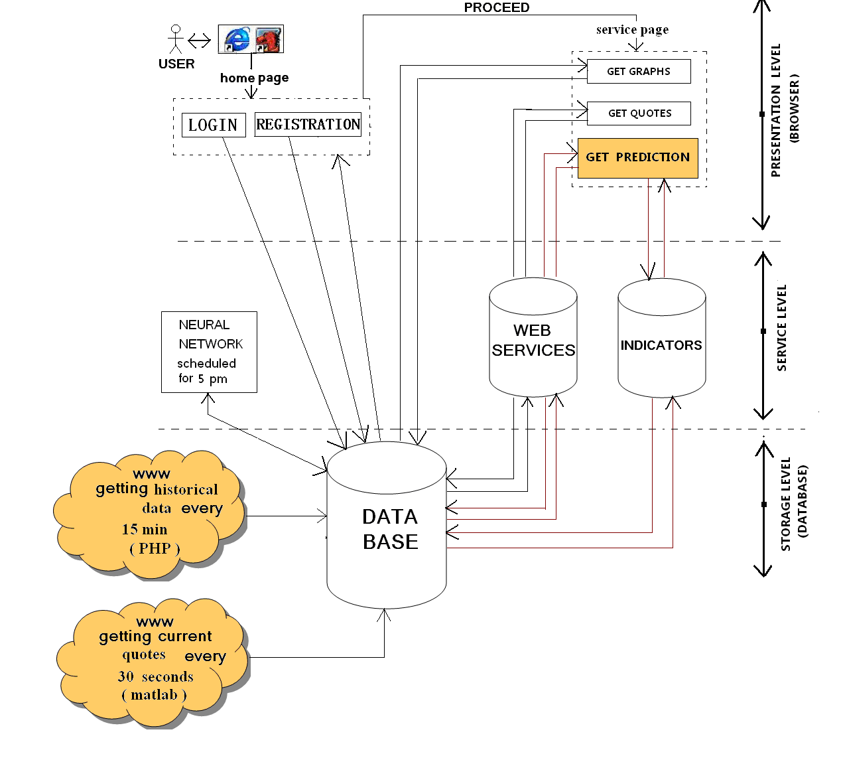
How our System looks like

Slide 4
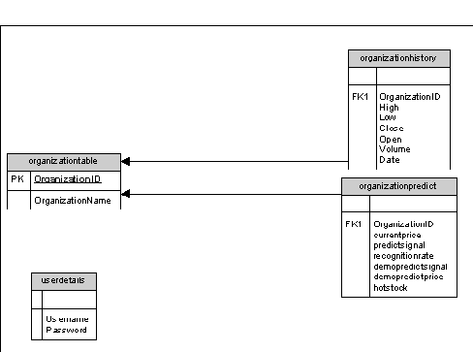
Database Schema Design

Slide 5
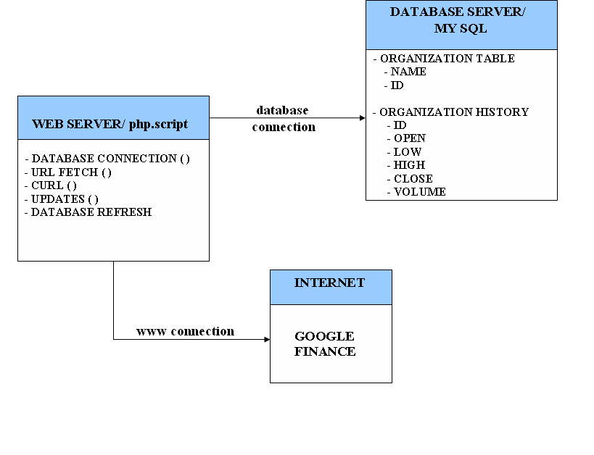
What our Web Service does

Slide 6
Steps: Neural Network Prediction
Start MATLAB: 5 p.m
Connect MATLAB to MYSQL database
Initiate Neural Network
Train Sequences
Testing Phase
Prediction – Buy or Sell Signal and Price
Hotstock
Update DB

Slide 7
STOCK PREDICTION USING TECHNICAL INDICATORS
RELATIVE FLOW INDEX
STOCHASTIC OSCILLATOR
MOVING AVERAGES
PRICE MOMENTUM OSCILLATOR

Slide 8
STOCK PREDICTION USING TECHNICAL INDICATORS
MONEY FLOW INDEX
DEMARKER INDICATOR
WILLIAMS INDICATOR
COMMODITY CHANNEL INDEX
AROON INDICATOR

Slide 9
STOCK PREDICTION USING TECHNICAL INDICATORS
RATE OF CHANGE
MOVING AVERAGES CONVERGENCE/DIVERGENCE
ACCUMULATION/DISTRIBUTION LINE
PRICE CHANNEL
ULTIMATE OSCILLATOR

Slide 10
Thank You!!!!

