Slide 1


Your Story
LIVE
Nickname
Nickname
Nickname
Top Instagram Influencers Data
Your Nickname
Location
Data Analytics Project by HANSA WALI
100 Likes

Slide 2
INTRODUCTION
The rise of social media has transformed the digital marketing landscape, with influencers playing a crucial role.
This project aims to analyze Instagram influencer data to understand factors impacting their influence and predict influence scores.
Key objectives:
Understand key metrics driving influence
Build a predictive model for influence score
Extract actionable insights for influencer marketing strategies

Slide 3
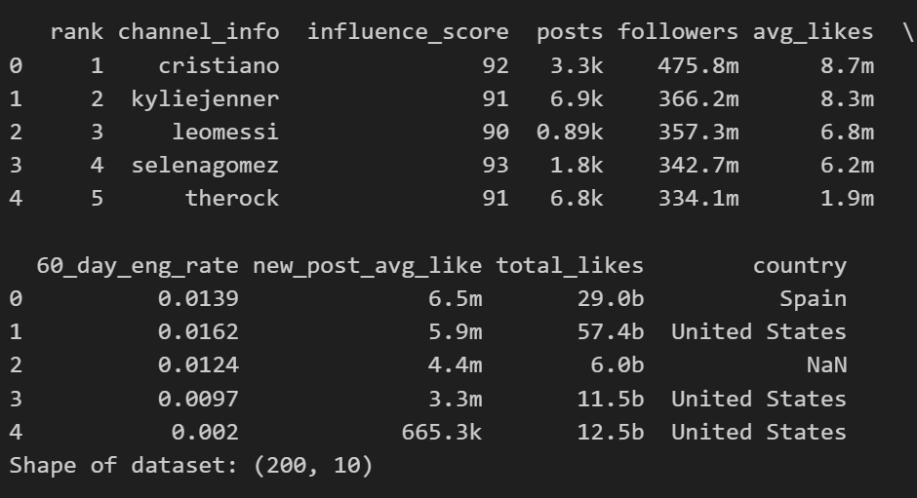
DATA ACQUISITION AND UNDERSTANDING
Initial Data Check:
Shape: [Total rows, Total columns]
Key columns: Followers, Influence Score, 60-Day Engagement Rate, Total Likes, Country
Challenges Identified:
Missing values
Outliers
High cardinality in categorical features

Slide 4
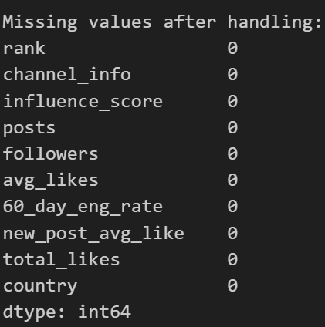
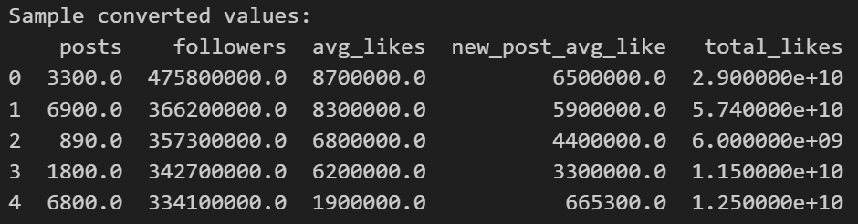
DATA PREPROCESSING
Handling Missing Values: No missing values present after preprocessing.
Data Type Conversion: Converted human-readable numeric values (e.g., "1.2M", "5K") into numerical format for consistency

Slide 5
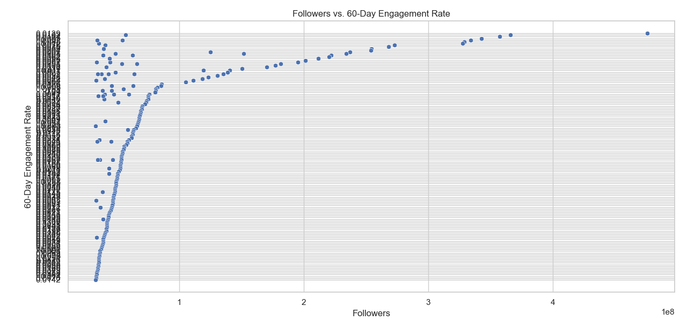
EXPLORATORY DATA ANALYSIS(EDA)
Follower vs. 60-Day Engagement Rate:
Observation: High engagement for smaller accounts, sharp decline as follower count increases
Suggests a typical pattern where niche influencers have stronger audience connections.

Slide 6
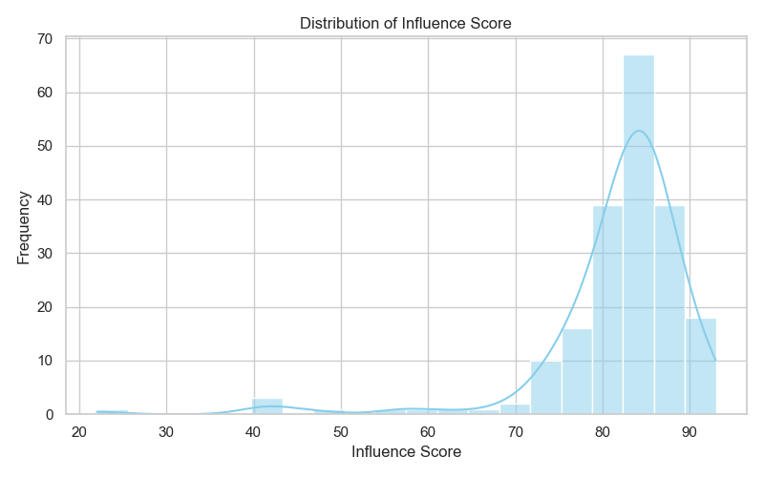
EXPLORATORY DATA ANALYSIS(EDA)
Distribution of Influence Score:
Skewed distribution with most scores clustering around 80-90
Indicates high influence concentration in a few top-performing influencers

Slide 7
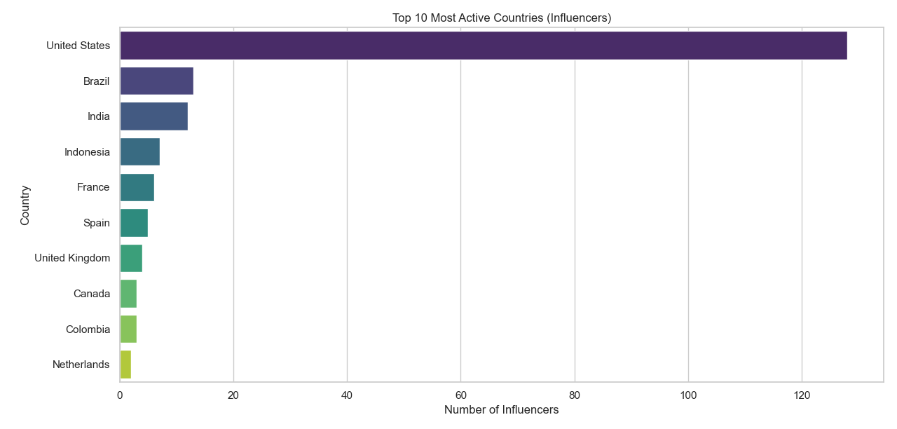
EXPLORATORY DATA ANALYSIS(EDA)
Top 10 Most Active Countries:
US dominates the influencer landscape, followed by Brazil and India

Slide 8
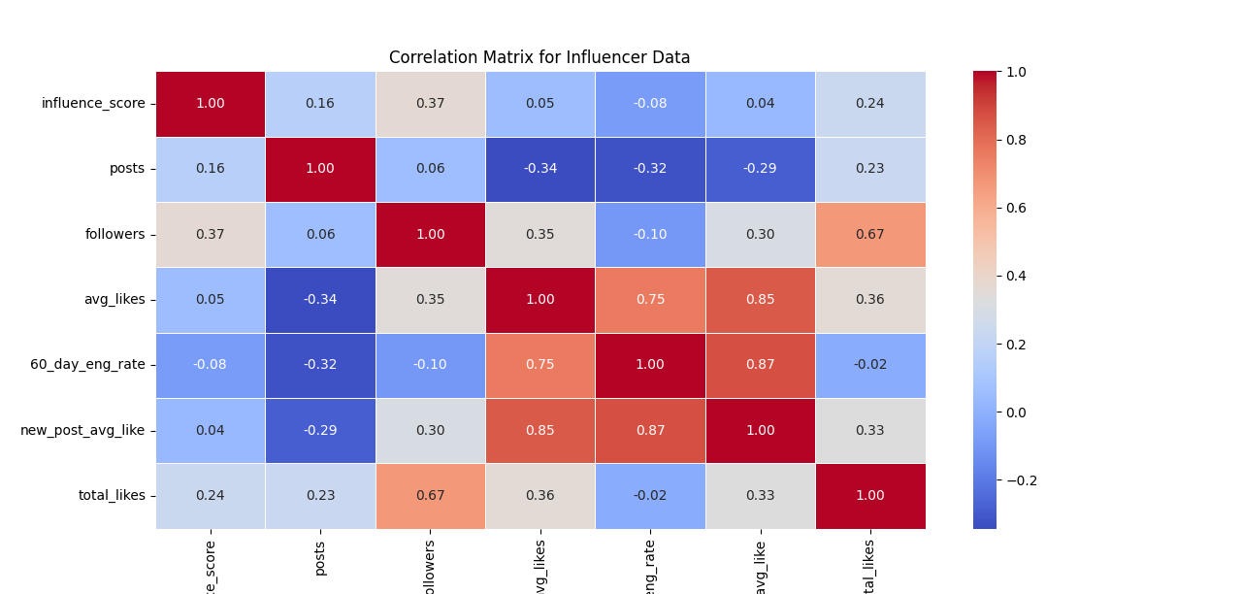
CORRELATION ANALYSIS
Key Observations from Correlation Matrix:
Followers have a moderate positive correlation with influence score (0.37)
Total likes also positively correlated, indicating a strong content impact
60-day engagement rate shows a weak negative correlation with influence score, highlighting a potential gap in engagement for larger accounts

Slide 9
MODEL BUILDING AND EVALUATION
Model Used: Linear Regression
Performance Metrics:
Train RMSE: 5.86 (indicates average error in training predictions)
Test RMSE: 13.26 (significantly higher than train RMSE, suggesting overfitting)
Train R²: 0.37 (model explains 37% of the variance in training data)
Test R²: -0.04 (negative value indicates the model performs worse than a simple mean model on test data)

Slide 10
MODEL BUILDING AND EVALUATION
Model Used: Random Forest Regressor (Hyperparameter Tuned)
Performance Metrics:
Train RMSE: 2.69 (excellent fit on training data, indicating strong model capacity)
Test RMSE: 12.77 (higher than train RMSE, suggesting some overfitting or data complexity)
Train R²: 0.87 (captures 87% of the variance in training data, a strong result)
Test R²: 0.04 (positive but low, indicating limited generalization on unseen data)

Slide 11
CONCLUSION
Influencer Engagement Dynamics:
Smaller influencers tend to have higher engagement rates, indicating a more loyal and responsive follower base.
Brands targeting niche audiences can achieve higher ROI by collaborating with micro and nano influencers.
Market Distribution:
The dominance of US-based influencers suggests a significant market opportunity for brands targeting US audiences.
Emerging markets like Brazil, India, and Indonesia also present growing potential for influencer marketing.
Content Quality and Influence Score:
The moderate correlation between Followers and Influence Score (0.37) suggests that follower count alone is not a sufficient measure of influence.
Total Likes and Average Likes have a strong positive impact, emphasizing the importance of engaging content.
The Random Forest model showed a much stronger fit on training data (87% R²), indicating its potential for more accurate prediction with further tuning.

Slide 12
Your Story
LIVE
Nickname
Nickname
Nickname
Your Nickname
Location
THANK YOU
100 Likes

