Slide 1
Multi‑model Severe Weather Event Cost Prediction
CS 555 Final Project Presentation
CONRAD PRISBY | Hansaka ALUVIHARE | MARCUS Chuaunsu | DEAN DCRUZ

Slide 2
Introduction
This project focuses on using machine learning models to classify and predict The Cost of Damage from severe weather events based on historical data from the NOAA Storm Events Database. By training and evaluating multiple classifiers, the aim was to determine which techniques are best suited for weather-based classification tasks.

Slide 3
Project Overview
Leverage historical storm event data from NOAA
Predict the cost of events like tornado, hail, flood, and thunderstorm winds
Compare classical ML models using RMSE and R²
Explore real-world deployment potential for disaster cost prediction systems

Slide 4
Project Scope
Only data points with at least 1 injury or death are used
Only data points in the United States are used
Only specific event types are examined:
Tornado
Hail
Flash flood
Thunderstorm winds

Slide 5
Dataset & Preprocessing

Slide 6
Dataset Insights
The NOAA dataset included features such as event type, location, time, property damage, and casualties. Preprocessing involved label encoding, class balancing, and normalization.
Dataset: NOAA Storm Events
Preprocessing: Label encoding of categories
Balanced dataset via under-sampling
Removed irrelevant features like location strings

Slide 7
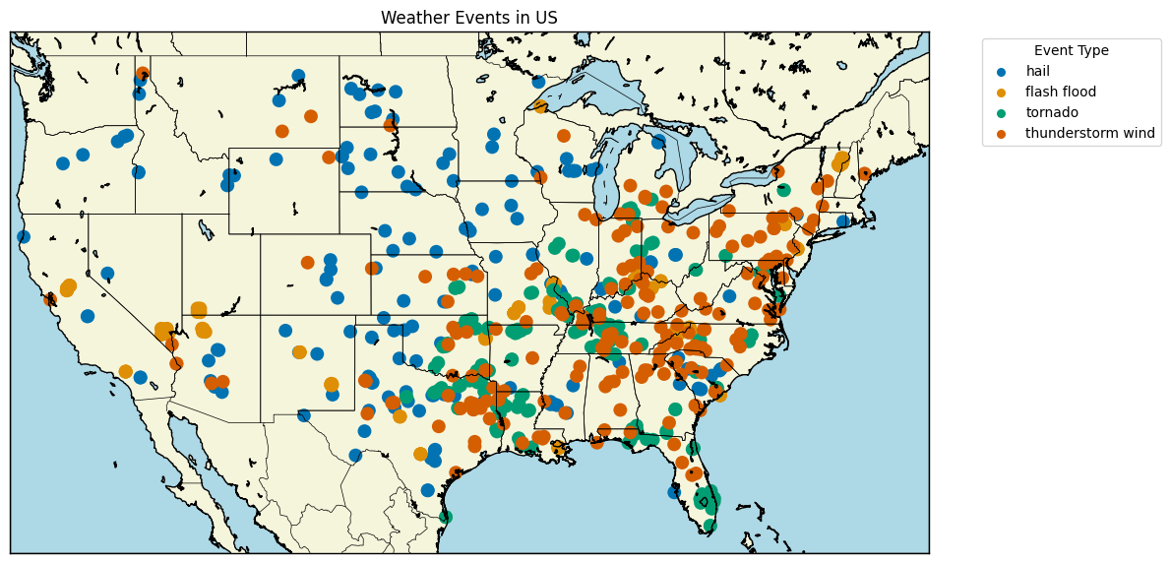
Event Locations

Slide 8
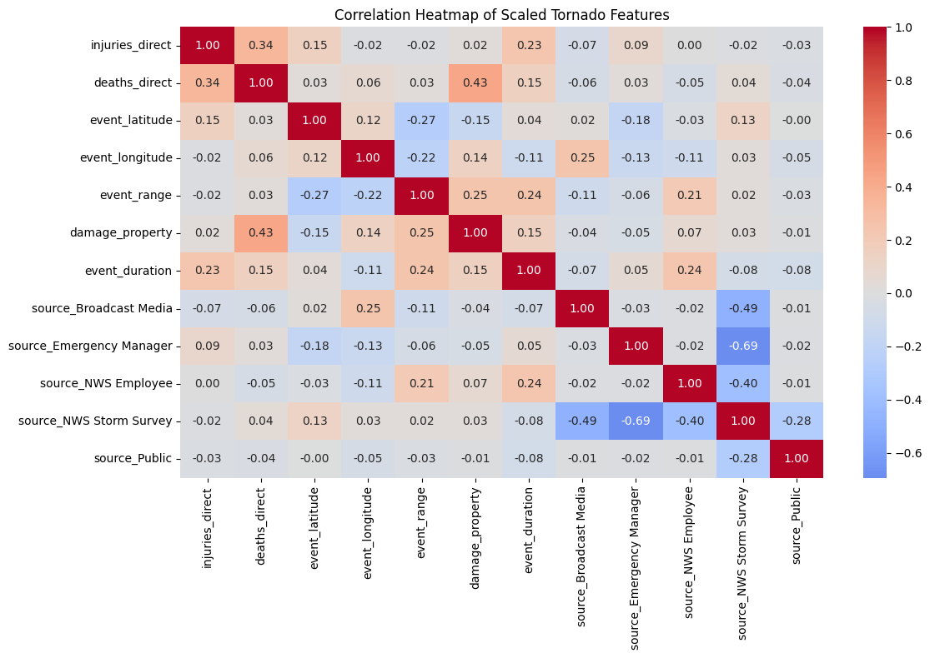
Tornado – Correlation Matrix

Slide 9
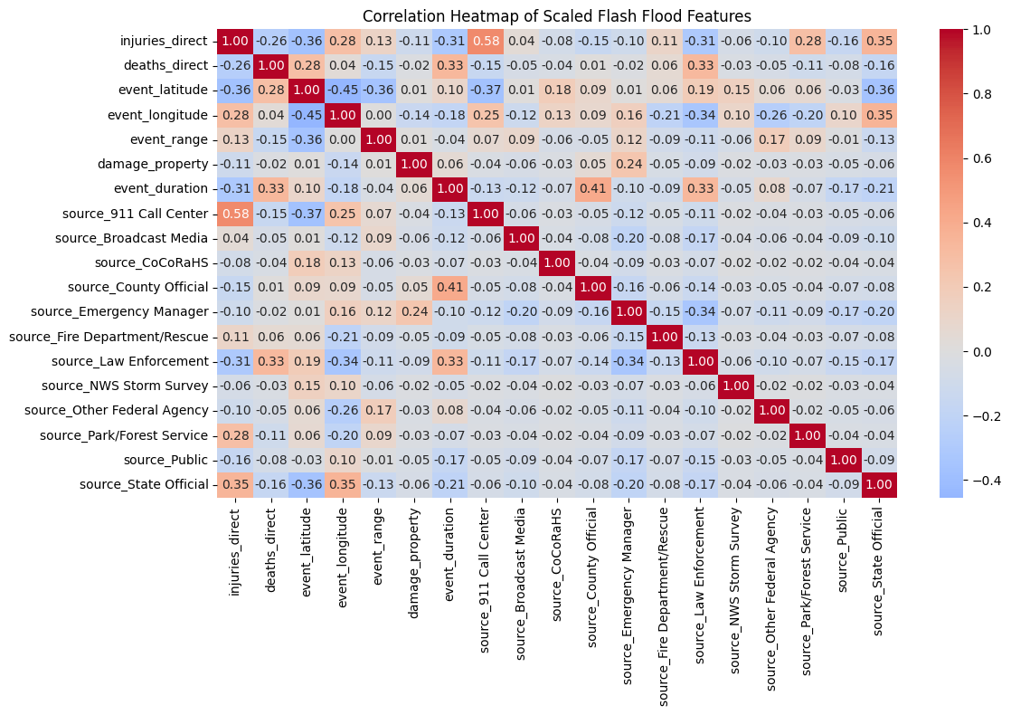
Flash Flood – Correlation Matrix

Slide 10
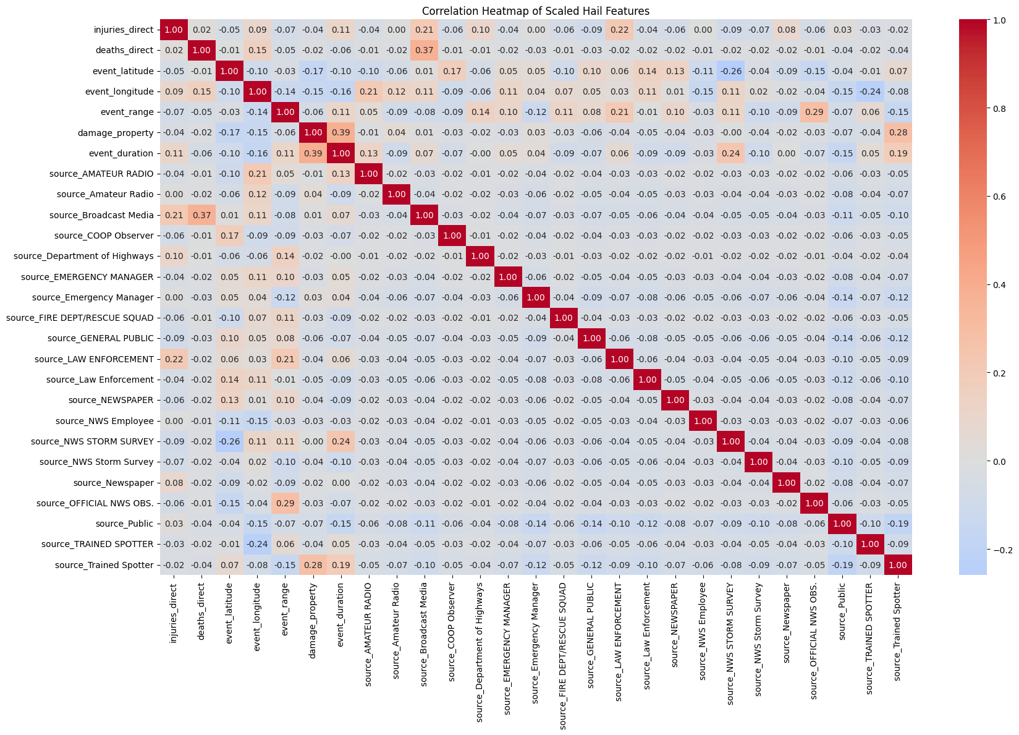
Hail – Correlation Matrix

Slide 11
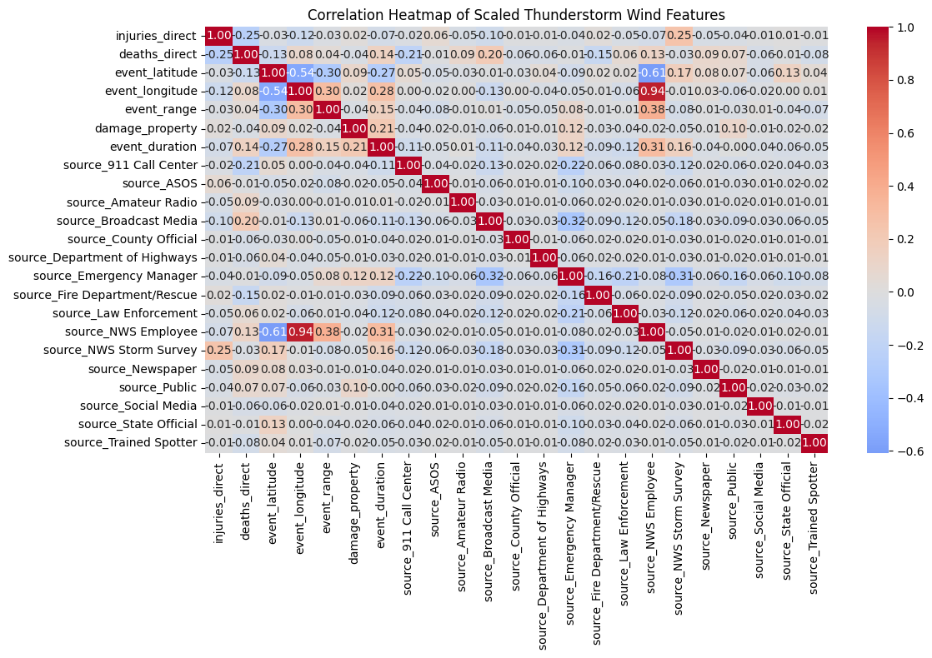
Thunderstorm Winds– Correlation Matrix

Slide 12
Models & Methodology

Slide 13
Machine Learning Models
Linear Regression & Random Forest Regressor – Baseline model and ensemble averaging technique for capturing nonlinear patterns
Neural Network Regressor – Deep learning model for complex feature interactions
XG Boost Regressor – Gradient boosting technique optimized for performance and accuracy
Support Vector Regression (SVR) – Margin-based regression with kernel trick
AdaBoost Regressor – Adaptive boosting that focuses on correcting errors of weak learners
K-Nearest Neighbors (KNN) – Instance-based method
Notes:
A series of machine learning models were trained to classify events. Emphasis was placed on comparing individual classifiers to ensemble models and boosted learners. The following models were used:

Slide 14
Methodology
Data Preprocessing:
Filtered missing values and outliers
Converted timestamps to calculate event duration
One-hot encoded categorical variables (sources)
Scaled numerical features for model compatibility
Target: Damage Property ($)
Parameters: Injuries, Death, Location, Range, Duration, Sources
Implemented and evaluated multiple regressors:
Linear Regression, Random Forest, SVR, XGBoost, AdaBoost, KNN, Neural Network
Used log-transform on the target to reduce skewness
Split data into training and test sets (80/20)
Metrics:
R² Score (variance)
RMSE (Root Mean Squared Error)
Compared performance across models to determine best fit

Slide 15
Evaluation & Results

Slide 16
*Demonstration*

Slide 17
Model Accuracy Summary
RMSE | Linear Regression | Random Forest Regressor | Neural Network Regressor | XG Boost Regressor | Support Vector Regression | AdaBoost Regressor | K-Nearest Neighbors
Tornado | 5.15 | 2.90 | 4.58 | 2.17 | 4.70 | 5.62 | 6.77
Flash Flood | 5.15 | 0.79 | 0.35 | 0.56 | 4.09 | 3.51 | 3.84
Hail | 8.66 | 6.64 | 10.26 | 6.37 | 8.52 | 7.48 | 8.82
Thunderstorm Winds | 5.31 | 4.52 | 4.84 | 4.85 | 6.48 | 5.68 | 6.04
R² | Linear Regression | Random Forest Regressor | Neural Network Regressor | XG Boost Regressor | Support Vector Regression | AdaBoost Regressor | K-Nearest Neighbors
Tornado | 0.241 | 0.758 | 0.759 | 0.865 | 0.368 | 0.094 | -0.314
Flash Flood | 0.343 | 0.984 | 0.984 | 0.992 | 0.585 | 0.696 | 0.636
Hail | -0.796 | -0.056 | -0.056 | 0.031 | -0.736 | -0.336 | -0.861
Thunderstorm Winds | 0.027 | 0.294 | 0.293 | 0.188 | -0.447 | -0.113 | -0.258
Notes:
Damage Property is Log Scaled since values range from 0 to 500000000
Hail data is super inconsistent – explain why

Slide 18
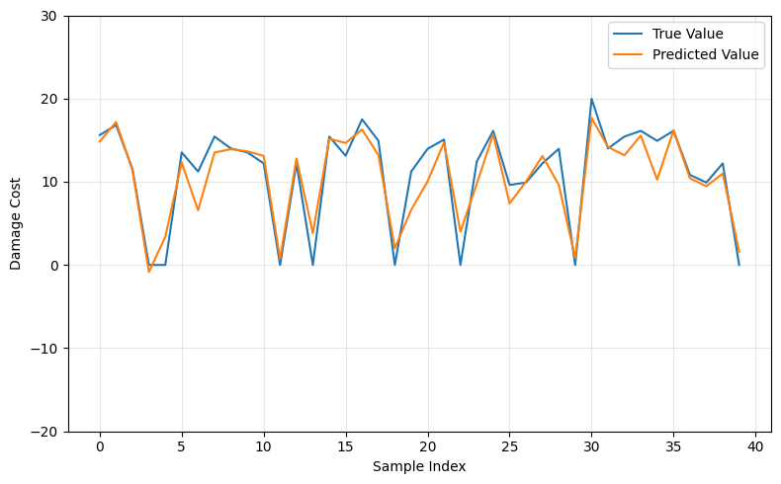
Tornado – Best Model
XG BOOST Regression

Slide 19
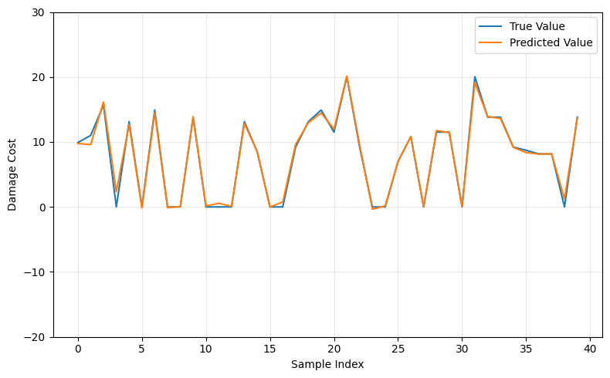
Flash Flood – Best Model
Neural Network Regression

Slide 20
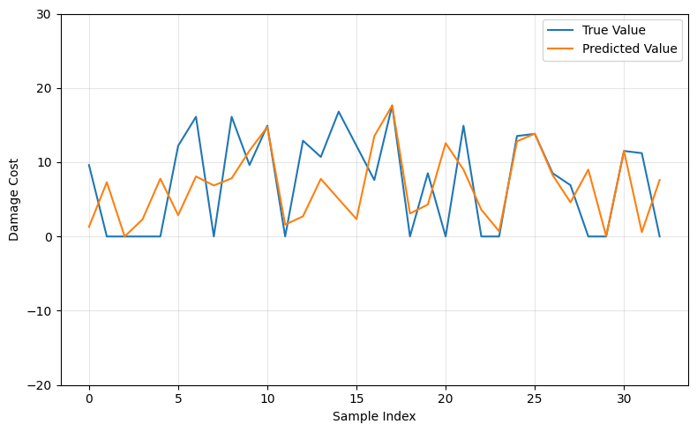
Hail – Best Model
XG BOOST Regression

Slide 21
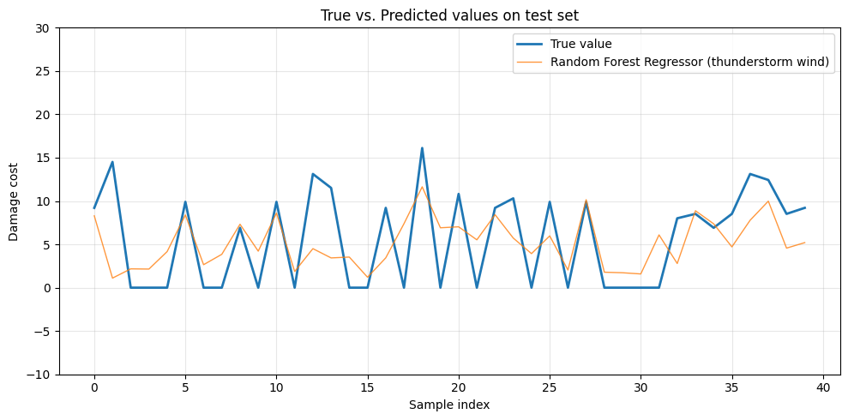
Thunderstorm Winds – Best Model
Random Forest Regression

Slide 22
Conclusion & Findings
Hail predictions had poor performance across all models (negative or near-zero R²). This indicated insufficient patterns in the data or possible noise which would require us to focus on a concentrated region.
Ensemble methods (Random forest, Xgboost) consistently outperformed traditional regression approaches for most weather event types.
R² score (being closest to 1) confirmed that Xgboost, Random forest were more effective in capturing variance as seen in the case for tornadoes and flash floods
Notes:
Focus on more specific area or state where cost doesn’t fluctuate
Try combining the 2 best models (Ensemble)

Slide 23
Future Work
Focusing on specific geographical areas (e.g. by state, region)
Implementing ensemble for models
Filtering data by source type (e.g. agency, social media)
Focusing on specific seasons or times of year
Notes:
Focus on more specific area or state where cost doesn’t fluctuate
Try combining the 2 best models (Ensemble)

