Slide 1

Unit 01 Principles of Chemistry

Slide 2
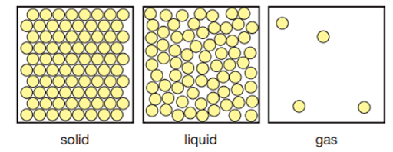
1 States of Matter
1.1 Arrangements of particles ;
Solid
Particles are arranged regularly, packed closely together.
Only vibrates in fixed positions.
Have strong attraction of force to keep the particles together.
The particles in a solid have less kinetic energy than liquid and gas.

