Slide 1

Unit 01 Principles of Chemistry

Slide 2
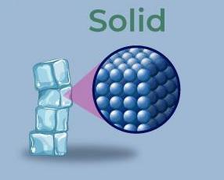
1 States of Matter
1.1 Arrangements of particles ;
Solid
Particles are arranged regularly, packed closely together.
Only vibrates in fixed positions.
Have strong attraction of force to keep the particles together.
The particles in a solid have less kinetic energy than liquid and gas.

Slide 3
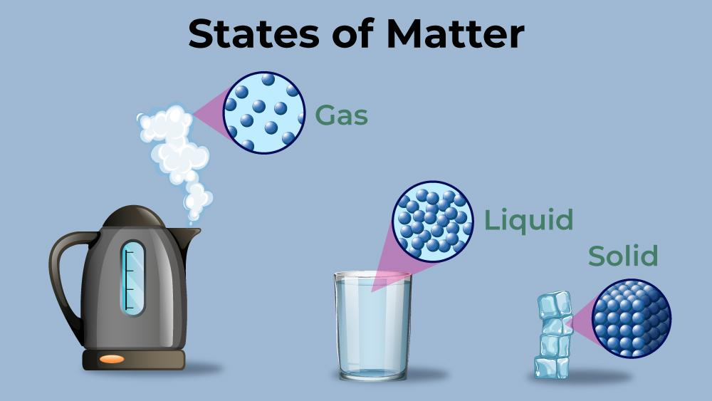
Liquid
The particles are mostly touching, but a small gap can be seen in between the particles.
Therefore, liquids are less dense than solids. (Less dense means that less mass packed into the same amount of space.)
Have less attraction of force in between the liquid particles.
Particles can move around and also arranged randomly.
The particles in a liquid have more kinetic energy than solid and less kinetic energy than gas.

Slide 4
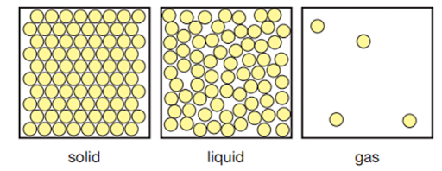
Gas
Particles are moving rapidly.
Particles are much further apart, no forces of attraction involve in between particles.
The particles in a gas high kinetic energy than solid and liquid.

