Slide 1

Week 1 – Introduction to Android
CSC-455: Mobile Application Development

Slide 2

Learning Objectives
Understand the Android ecosystem
Install and configure Android Studio
Explore Android architecture and runtime
Create a basic Hello World app

Slide 3
What is Android?
Android is an open-source mobile operating system developed by Google. It is based on the Linux kernel and powers millions of devices globally including smartphones, tablets, TVs, and wearables.

Slide 4
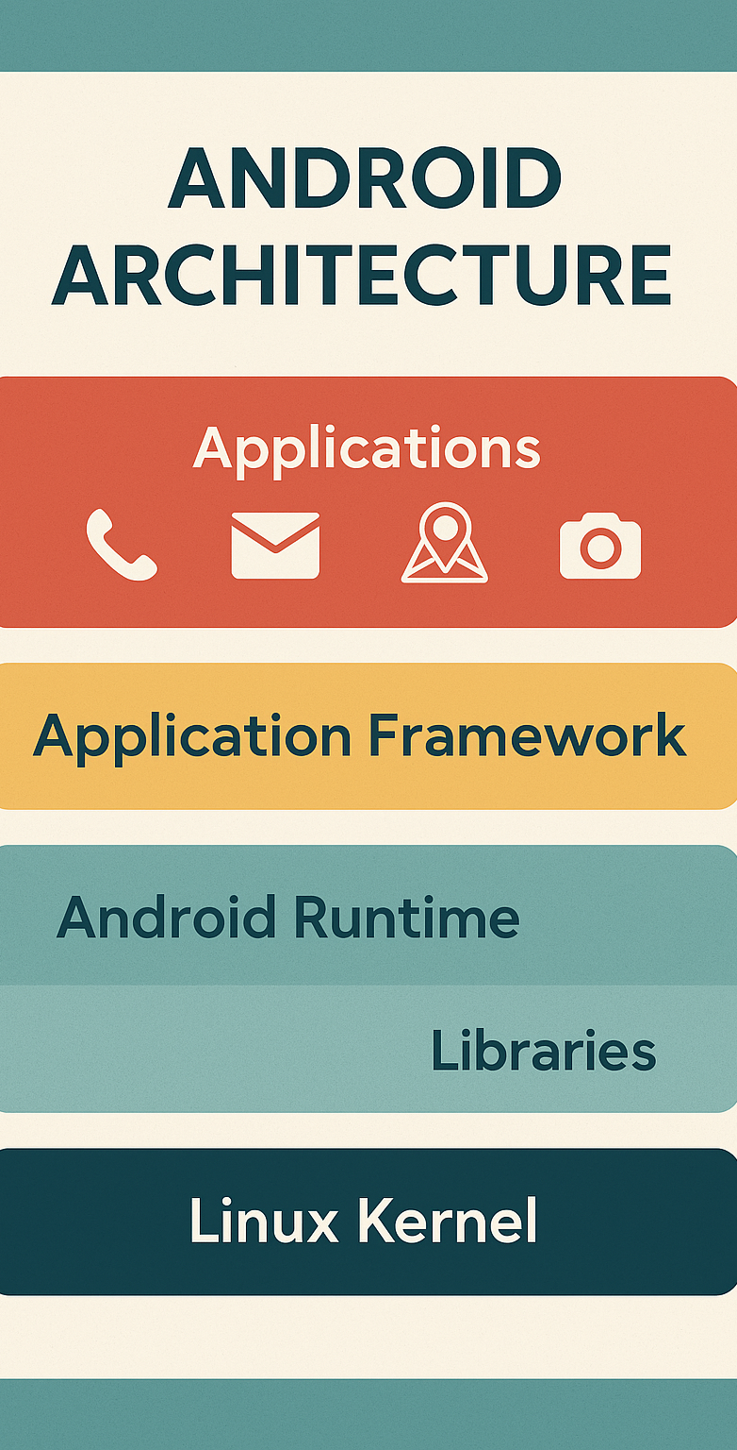
Android Architecture
Android architecture consists of:
Linux Kernel: Hardware abstraction
Libraries: SQLite, WebKit
Android Runtime (ART): Executes app code
Application Framework: Activity Manager, Content Providers
Applications: Built-in and user-installed apps

Slide 5
Android Architecture
Linux Kernel: Foundation of Android OS. Manages device drivers, memory, power, processes, and security.
Native Libraries: Libraries like SQLite (database), WebKit (browser), OpenGL ES (graphics), SSL (security), Media Framework.
Android Runtime (ART): Executes app code using AOT compilation. Includes core libraries for Java/Kotlin.
Application Framework: Provides high-level services: Activity Manager, Content Providers, Resource Manager, Notification Manager, View System.
Applications: User-facing apps such as Phone, Contacts, Camera, and third-party apps like WhatsApp.
Notes:
In Android, AOT stands for Ahead-Of-Time compilation, a process where an app's bytecode is translated into native machine code on the device during the installation process. This compiled, optimized code is then stored and run, resulting in faster app startup times and improved performance compared to older systems that relied more on Just-In-Time (JIT) compilation. ART (Android Runtime) uses AOT, replacing the older Dalvik virtual machine.

Slide 6
Installing Android Studio
Steps to install Android Studio:
1. Download from developer.android.com
2. Install SDK and emulator
3. Configure virtual device
4. Start a new project

Slide 7
Hello World App – Code Snippet
Kotlin Code:
class MainActivity : AppCompatActivity() {
override fun onCreate(savedInstanceState: Bundle?) {
super.onCreate(savedInstanceState)
setContentView(R.layout.activity_main)
}
}
XML Layout:
<TextView
android:id="@+id/helloText"
android:layout_width="wrap_content"
android:layout_height="wrap_content"
android:text="Hello World!" />

Slide 8
Running Your First App
- Use emulator or physical device
- Build and run from Android Studio
- Check for errors in Logcat

Slide 9

Lab Tasks
1. Install Android Studio and create a new project.
2. Build and run a Hello World app using TextView.
3. Explore Android Studio interface and emulator settings.

Slide 10
Summary
- Android is a powerful mobile OS
- Android Studio is the development environment
- You’ve built and run your first app

Slide 11

Quiz / Discussion
- What are the layers of Android architecture?
- How do you install Android Studio?
- What does setContentView() do?

