Slide 1

LinearLayout in Android
Organizing user interface elements efficiently and simply
Notes:
AI-generated content may be incorrect. ---

Slide 2
Understanding LinearLayout
Notes:
--- This slide references information from the following file: https://www.geeksforgeeks.org/android/linearlayout-and-its-important-attributes-with-examples-in-android/ Introduction to LinearLayout, Orientation in LinearLayout

Slide 3

Introduction to LinearLayout
LinearLayout Basics
LinearLayout arranges child views in a single vertical or horizontal direction using android:orientation.
Use Cases for LinearLayout
Ideal for simple UI designs like forms, lists, and toolbars due to its linear stacking of elements.
Performance Considerations
Nesting multiple LinearLayouts can cause performance issues; ConstraintLayout is better for complex designs.
Notes:
--- This slide references information from the following file: https://www.geeksforgeeks.org/android/linearlayout-and-its-important-attributes-with-examples-in-android/ LinearLayout is one of the most fundamental layout structures in Android development. It is a ViewGroup that arranges its child views in a single direction—either vertically or horizontally—based on the value of the android:orientation attribute. This layout is particularly useful for creating simple user interfaces where elements need to be displayed in a linear sequence. For example, a vertical LinearLayout will stack elements from top to bottom, while a horizontal LinearLayout will arrange them from left to right. This simplicity makes LinearLayout ideal for straightforward UI designs such as forms, lists, or toolbars. However, developers must be cautious when nesting multiple LinearLayouts, as this can lead to performance issues due to increased layout complexity. Instead, Android recommends using ConstraintLayout for more complex designs. Despite its limitations, LinearLayout remains a popular choice for its ease of use and clarity in layout structure.

Slide 4

Orientation in LinearLayout
Orientation Attribute
android:orientation attribute controls child view arrangement direction, either vertical or horizontal.
Vertical Orientation
Vertical orientation stacks child views top to bottom, ideal for forms and lists.
Horizontal Orientation
Horizontal orientation arranges views left to right, perfect for toolbars and navigation menus.
Combining Orientations
Combining different orientations in nested LinearLayouts creates complex layouts but should avoid deep nesting for performance.
Notes:
--- This slide references information from the following file: https://www.geeksforgeeks.org/android/linearlayout-and-its-important-attributes-with-examples-in-android/ The orientation of a LinearLayout determines the direction in which its child views are arranged. This is controlled by the android:orientation attribute, which can be set to either 'vertical' or 'horizontal'. When set to 'vertical', the layout stacks child views from top to bottom, creating a column-like structure. Conversely, setting it to 'horizontal' arranges the views from left to right, forming a row. This attribute is crucial for defining the visual flow of the user interface. For instance, a vertical orientation is commonly used in forms where input fields are stacked, while a horizontal orientation is suitable for toolbars or navigation menus. Developers can switch between these orientations depending on the design requirements. Additionally, combining LinearLayouts with different orientations can help achieve more complex layouts, although excessive nesting should be avoided to maintain performance.

Slide 5
Key Attributes of LinearLayout
Notes:
--- This slide references information from the following file: https://www.geeksforgeeks.org/android/linearlayout-and-its-important-attributes-with-examples-in-android/ Essential XML Attributes, Using layout_weight and weightSum

Slide 6

Essential XML Attributes
Layout Size Attributes
android:layout_width and android:layout_height define the size of the LinearLayout container.
Orientation and Weight
android:orientation sets child arrangement direction; layout_weight distributes space proportionally among children.
Alignment and Baseline
android:layout_gravity aligns children within parent; baselineAligned controls text baseline alignment among children.
Notes:
--- This slide references information from the following file: https://www.geeksforgeeks.org/android/linearlayout-and-its-important-attributes-with-examples-in-android/ LinearLayout supports several important XML attributes that control its behavior and appearance. The android:layout_width and android:layout_height attributes define the size of the layout. The android:orientation attribute specifies the direction of child view arrangement. The android:layout_weight attribute is used to distribute remaining space among child views proportionally. For example, assigning a higher weight to a view gives it more space relative to others. The android:weightSum attribute sets the total weight sum for the layout, which helps in calculating the space distribution. Another useful attribute is android:layout_gravity, which determines the alignment of child views within the parent layout. It can take values like center, top, bottom, start, and end. Lastly, android:baselineAligned is a boolean attribute that controls whether the layout aligns its children based on their text baselines. These attributes provide developers with fine-grained control over layout behavior, enabling the creation of responsive and well-structured user interfaces.

Slide 7
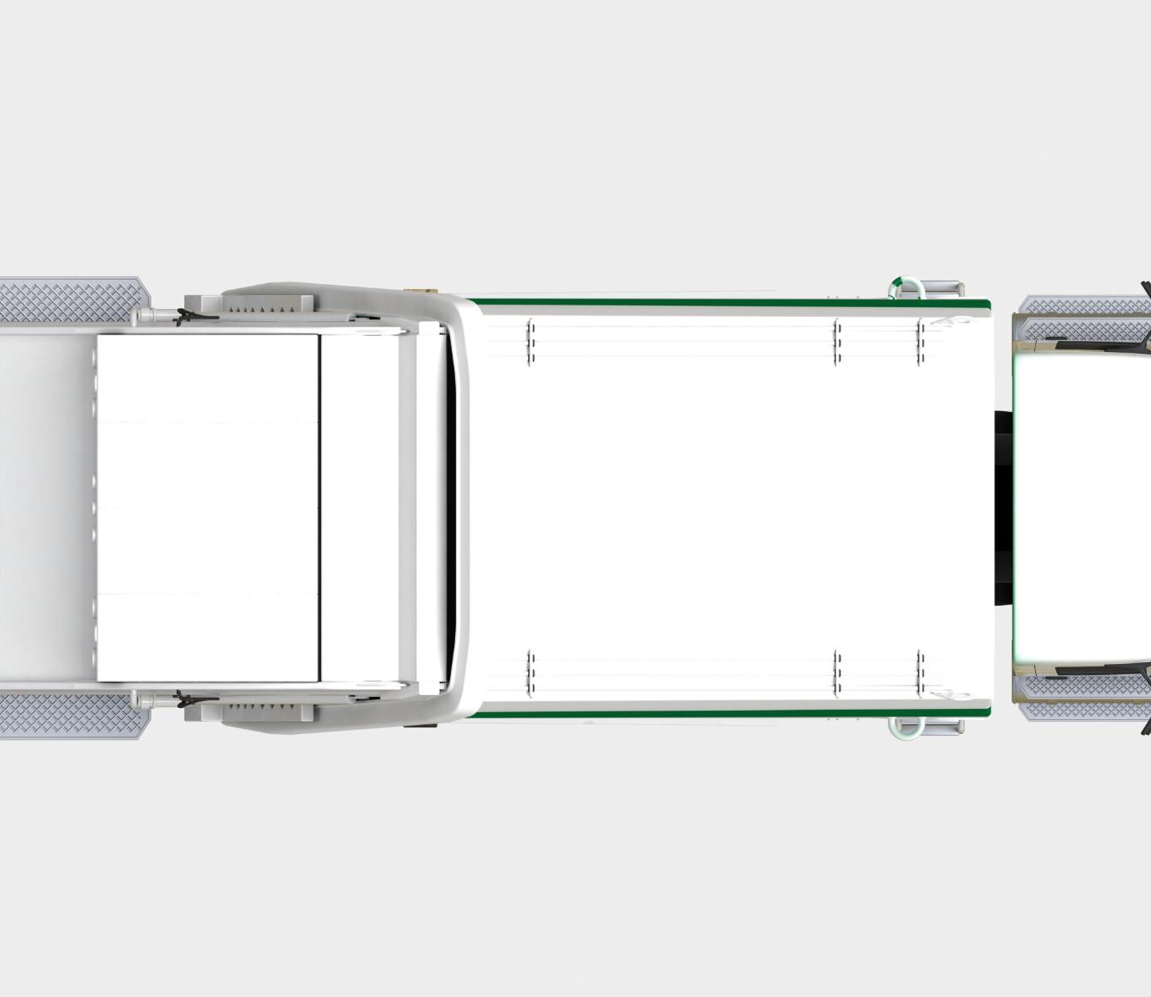
Using layout_weight and weightSum
Layout_weight Function
layout_weight assigns space proportionally to child views based on assigned weight values in LinearLayout.
WeightSum Role
weightSum defines the total weight for the parent layout to distribute space precisely among children.
Adaptive UI Design
Using these attributes creates flexible UIs that adjust well to various screen sizes and orientations.
Best Practices
Proper use avoids unexpected layout behavior and ensures visual balance and usability in applications.
Notes:
--- This slide references information from the following file: https://www.geeksforgeeks.org/android/linearlayout-and-its-important-attributes-with-examples-in-android/ The layout_weight and weightSum attributes in LinearLayout are powerful tools for distributing space among child views. The layout_weight attribute is assigned to individual child views and determines how much of the remaining space each view should occupy. For instance, if one view has a weight of 3 and two others have a weight of 1, the first view will take up three times more space than each of the others. The weightSum attribute, defined in the parent LinearLayout, sets the total weight value that the layout should consider when distributing space. This helps in achieving precise control over layout proportions. These attributes are especially useful in creating flexible and adaptive UIs that adjust to different screen sizes. However, developers should use them judiciously, as improper use can lead to unexpected layout behavior. Understanding and applying these attributes effectively can significantly enhance the visual balance and usability of an Android application.

Slide 8
Practical Implementation
Notes:
--- This slide references information from the following file: https://www.geeksforgeeks.org/android/linearlayout-and-its-important-attributes-with-examples-in-android/ XML Examples of LinearLayout, Java and Kotlin Integration

Slide 9
XML Examples of LinearLayout
Basic LinearLayout Structure
LinearLayout arranges child views in a single direction, either vertically or horizontally.
Orientation Attribute
The orientation attribute controls layout direction, switching between vertical and horizontal stacks.
Layout Weight Usage
layout_weight enables child views to expand proportionally, improving flexible space distribution.
Alignment and Gravity
layout_gravity controls child view alignment within the LinearLayout for better UI design.
Notes:
--- This slide references information from the following file: https://www.geeksforgeeks.org/android/linearlayout-and-its-important-attributes-with-examples-in-android/ Implementing LinearLayout in XML is straightforward and involves defining the layout and its child views within the layout file. A basic vertical LinearLayout might look like this: <LinearLayout android:layout_width="match_parent" android:layout_height="match_parent" android:orientation="vertical"> <TextView android:layout_width="wrap_content" android:layout_height="wrap_content" android:text="Hello World" /> </LinearLayout>. This structure creates a vertical stack of views. For horizontal orientation, simply change the orientation attribute to 'horizontal'. Developers can also include attributes like layout_weight and layout_gravity to control spacing and alignment. For example, using layout_weight allows views to expand and fill available space proportionally. These XML examples serve as templates for building more complex layouts and are essential for understanding how LinearLayout behaves in different scenarios. By experimenting with these examples, developers can gain hands-on experience and better grasp the nuances of Android UI design.

Slide 10

Java and Kotlin Integration
Accessing Views in Java
Java uses findViewById to reference XML views, enabling dynamic UI manipulation and event handling.
Accessing Views in Kotlin
Kotlin accesses views similarly with findViewById, providing concise syntax for UI element references.
Dynamic UI Interaction
Setting properties and event listeners like onClickListener allows interactive and responsive applications.
Notes:
--- This slide references information from the following file: https://www.geeksforgeeks.org/android/linearlayout-and-its-important-attributes-with-examples-in-android/ Integrating LinearLayout with Java or Kotlin involves accessing and manipulating the layout and its child views programmatically. In Java, developers use the findViewById method to reference views defined in XML. For example: TextView txt = findViewById(R.id.txtVw); EditText edit = findViewById(R.id.editText);. Similarly, in Kotlin, views can be accessed using val txt: TextView = findViewById(R.id.txtVw). These references allow developers to set properties, handle events, and update UI elements dynamically. For instance, a Button can be assigned an onClickListener to perform actions when clicked. This integration is crucial for creating interactive applications where the UI responds to user input. Understanding how to bridge XML layouts with Java or Kotlin code is a fundamental skill in Android development. It enables developers to build functional and responsive applications that provide a seamless user experience.

Slide 11
Best Practices and Recommendations
Notes:
--- This slide references information from the following file: https://www.geeksforgeeks.org/android/layouts-android-ui-design/ Optimizing LinearLayout Usage

Slide 12

Optimizing LinearLayout Usage
Avoid Deep Nesting
Deep nesting of LinearLayouts increases rendering time and reduces app performance significantly.
Use ConstraintLayout
ConstraintLayout offers better performance for complex UI designs compared to multiple nested LinearLayouts.
Proper Weight Usage
Setting layout_weight and weightSum correctly avoids layout inconsistencies and improves alignment.
Testing and Clean Code
Test layouts on different screen sizes and keep XML clean and commented for maintainability.
Notes:
--- This slide references information from the following file: https://www.geeksforgeeks.org/android/layouts-android-ui-design/ While LinearLayout is easy to use and understand, developers should follow best practices to ensure optimal performance and maintainability. One key recommendation is to avoid deep nesting of LinearLayouts, as this can lead to increased layout rendering time and reduced app performance. Instead, consider using ConstraintLayout for more complex UI structures. When using layout_weight, ensure that the weightSum is appropriately set to avoid layout inconsistencies. Also, use layout_gravity and gravity attributes to align views effectively within the layout. It's important to test layouts on different screen sizes to ensure responsiveness. Additionally, keeping the layout XML clean and well-commented helps in future maintenance and collaboration. By adhering to these best practices, developers can leverage the simplicity of LinearLayout while building efficient and user-friendly Android applications.

