Slide 1
Design and Analysis of Algorithms
Lectures Week 9 & 10

Slide 2
Transform and conquer algorithms
Definition: Transform and Conquer is a problem-solving technique where we:
Transform the given problem into a simpler or more familiar form.
Conquer the transformed problem using known methods.
Transform and conquer is a strategy in algorithm design where the original problem is transformed into a different (usually simpler or more manageable) version, and then solved efficiently.
We apply this approach in various data structures to improve performance and maintain balance during operations like search, insert, and delete.
Example:
Problem: Searching for an element in a list.
Transform: Sort the list first (transformation).
Conquer: Use Binary Search (efficient search in sorted lists).

Slide 3
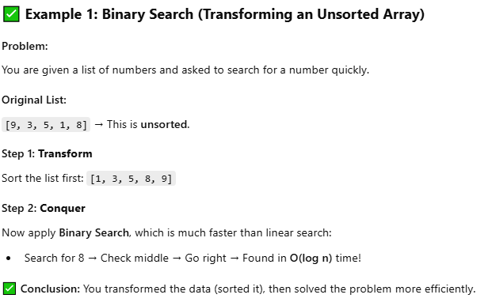
Example.

Slide 4
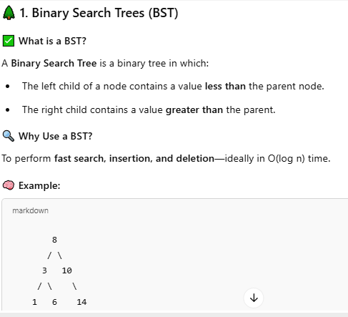
BST

Slide 5
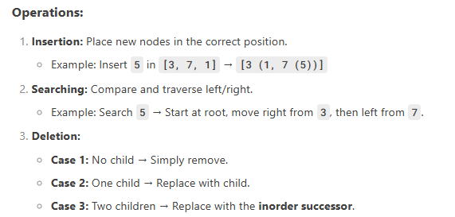
Binary Search Trees (BST)
A BST is a tree where:
Left subtree contains nodes with values less than the parent.
Right subtree contains nodes with values greater than the parent.
Time Complexity:
Best/Avg Case (Balanced BST): O(log n)
Worst Case (Skewed BST): O(n)

Slide 6
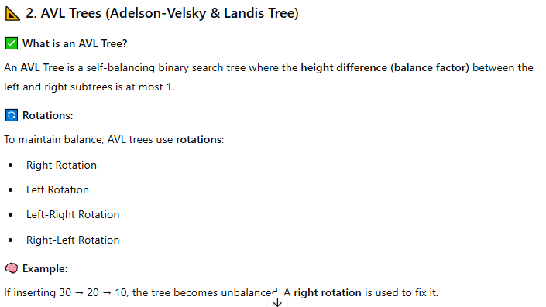
AVL

Slide 7
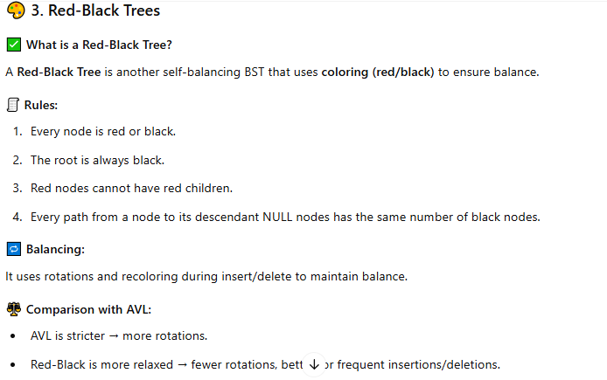
RBT

Slide 8
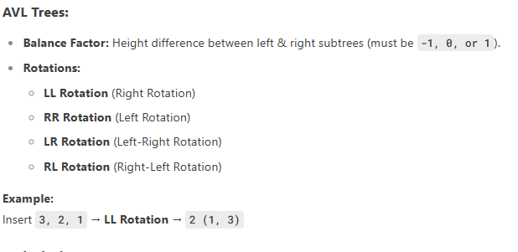
Self-Balancing Trees (AVL & Red-Black Trees)
Why Balancing?
Unbalanced BSTs degrade to O(n) search time.
Solution: Use AVL or Red-Black Trees to maintain balance.

Slide 9
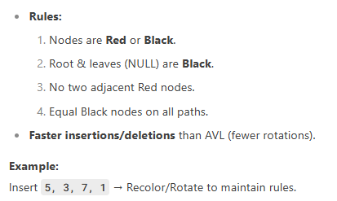
Red-Black Trees:

Slide 10
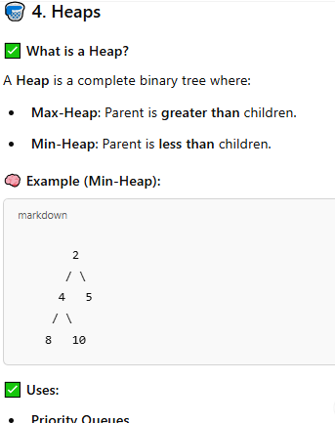
Heap
Uses:
Priority Queues
Heap Sort
Dijkstra’s Algorithm (for shortest paths)

Slide 11
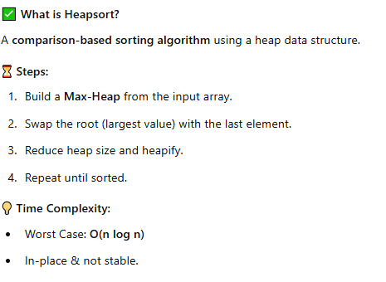
Heapsort

Slide 12

Hash Tables – Definition and Explanation
✅ Definition:
A Hash Table is a data structure that maps keys to values using a hash function. It allows fast access, insertion, and deletion (on average in O(1) time), making it ideal for use in scenarios where fast lookups are critical.
✅ Real-Time Example:
Phone Contacts App: When you search for a name in your contacts, the app quickly locates it using a hash table behind the scenes.

Slide 13
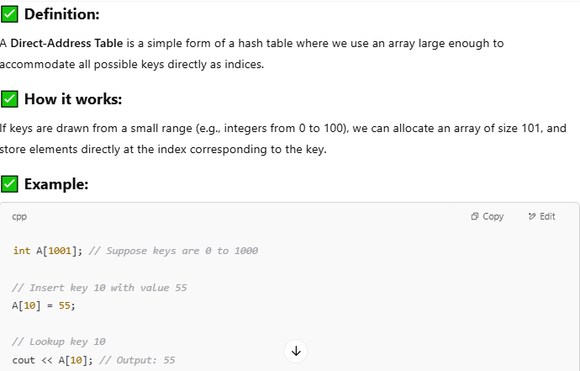
Direct-Address Tables

Slide 14
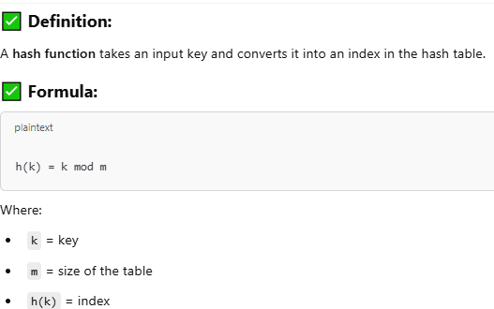
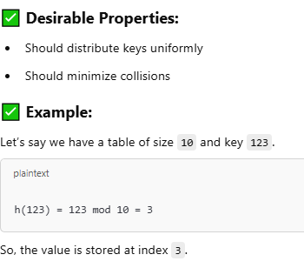
Hash Functions

Slide 15
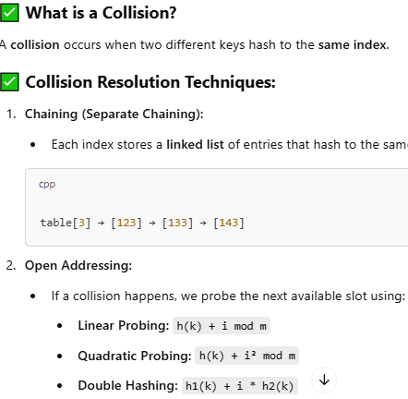

Slide 16
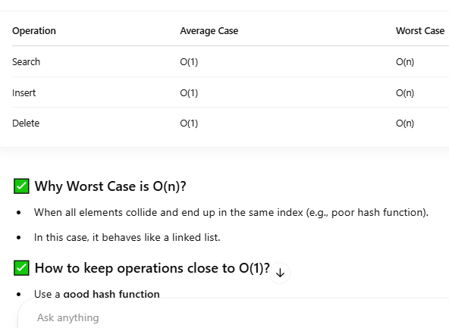
Time Complexity

Slide 17
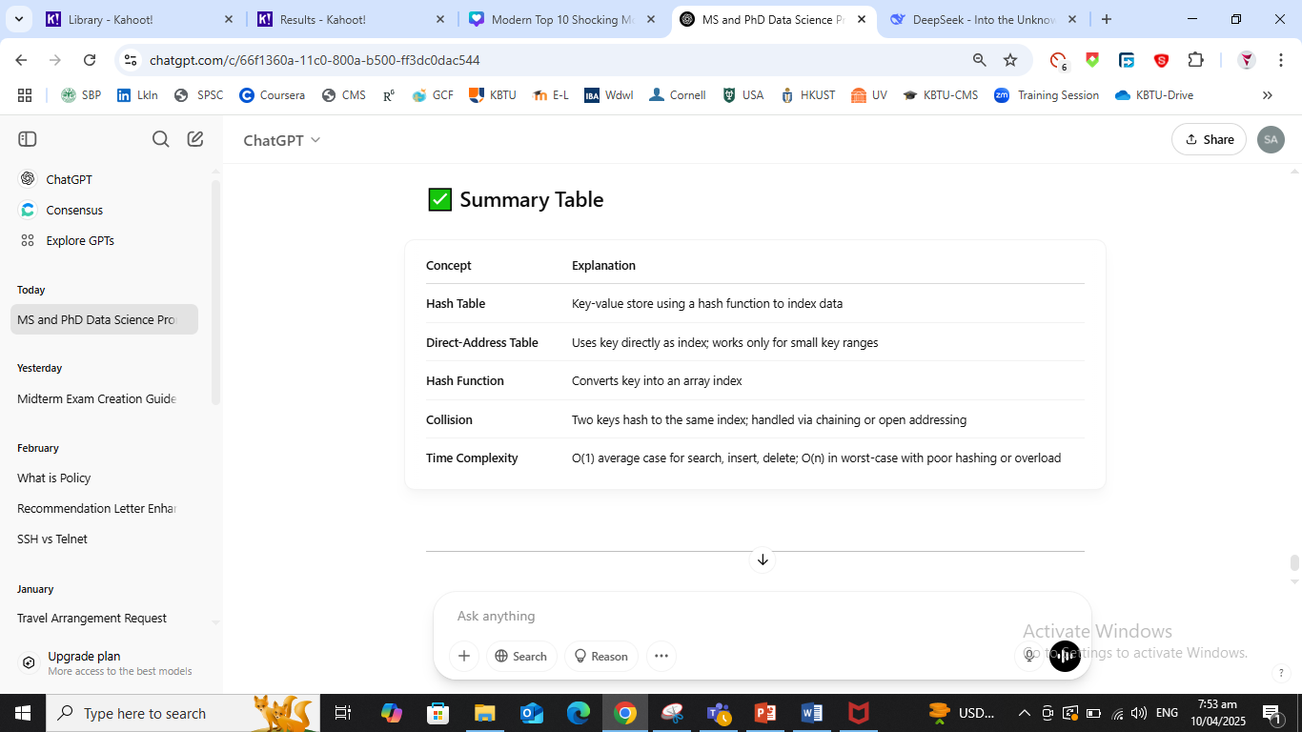
Summary

Slide 18
Problem 1: Transform and Conquer – Real Life Scenario (Library Search)
Scenario: You are managing a digital library system. Initially, all book records are unsorted. Students complain about slow search times.
Task: Explain how you would apply the Transform and Conquer approach to improve the search speed, and what transformation you would perform on the data.
Guiding Questions:
What would be your first step before allowing any search operation?
How would Binary Search help after this step?
What is the time complexity before and after applying the transformation?

Slide 19
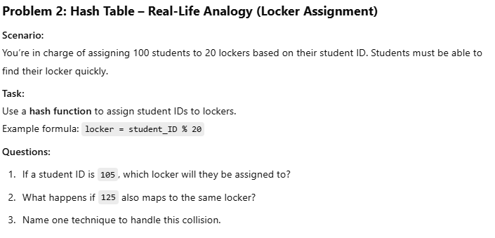

Slide 20
Elementary Graph Algorithms
Graphs are used to model relationships and connections — such as cities and roads, webpages and links, or tasks and dependencies. Let's explore three core algorithms for working with graphs:
What is BFS?
Breadth-First Search (BFS) is a graph traversal algorithm that explores all the neighboring nodes level by level before moving to the next level.
Why use BFS?
To find the shortest path in an unweighted graph.
To explore all nodes reachable from a given source.
How it works:
Start from the source node.
Use a queue to explore neighbors.
Mark nodes as visited to avoid repetition.
🌐 Real-Life Example: Imagine you are using Google Maps to find the shortest number of roads between two cities — BFS helps in exploring all possible routes in levels.

Slide 21
Depth-First Search (DFS)
What is DFS?
Depth-First Search (DFS) explores as far as possible along a branch before backtracking.
Why use DFS?
To detect cycles in a graph.
To explore connected components.
Useful in topological sorting, maze solving, and puzzle solving.
How it works:
Start from the source node.
Use recursion or a stack to go deep.
Backtrack when no unvisited neighbors remain.
🌐 Real-Life Example: Imagine exploring all paths in a maze — DFS dives deep into one path before trying alternatives.

Slide 22
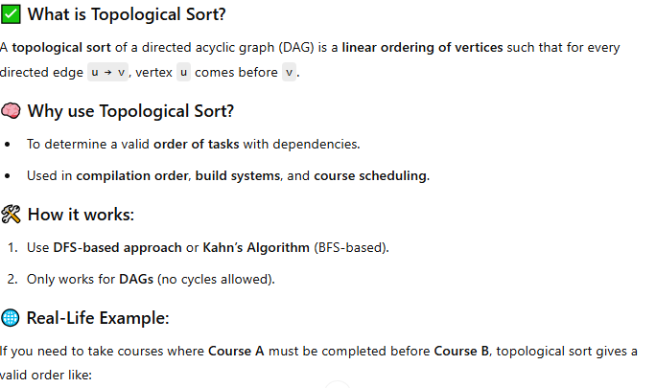
Topological Sort

Slide 23
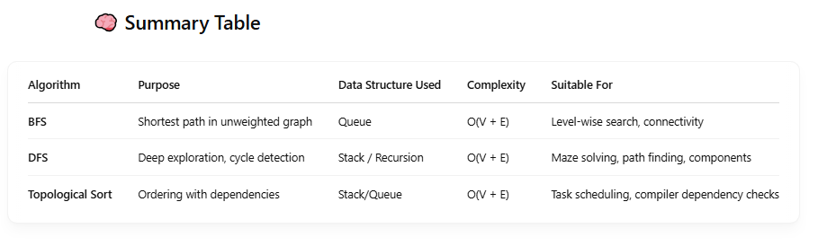

Slide 24
Elementary Graph Algorithms Topics: BFS, DFS, Topological Sort

Slide 25
Introduction to Graphs
A graph is a collection of nodes (vertices) and edges (connections).
Can be directed or undirected.
Used to represent networks, relationships, and connections.
Real-Life Examples:
Social networks (people as nodes, friendships as edges)
Maps (cities as nodes, roads as edges)

Slide 26
Why Graph Algorithms?
Efficient exploration and understanding of data
Helps solve real-world problems:
Navigation and routing
Network connectivity
Scheduling tasks

Slide 27
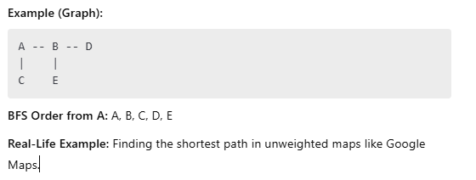
Breadth-First Search (BFS)
Definition: Explores a graph layer by layer (level-order)
Data Structure Used: Queue
Time Complexity: O(V + E)
Steps:
Start at a source node.
Visit all its neighbors.
Move to the next level of neighbors.

Slide 28
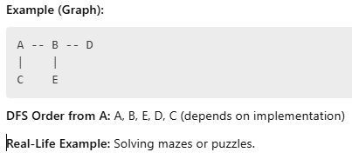
Depth-First Search (DFS)
Definition: Explores a graph by going deep into a branch before backtracking.
Data Structure Used: Stack (or recursion)
Time Complexity: O(V + E)
Steps:
Start at a source node.
Explore as deep as possible along one branch.
Backtrack when no further nodes are reachable.

Slide 29
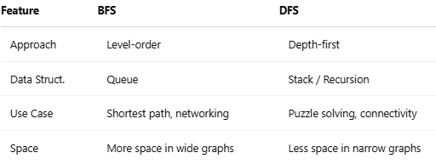
Compression

Slide 30
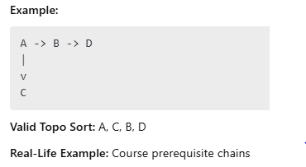
Topological Sort
Definition: Linear ordering of nodes such that for every directed edge u -> v, u comes before v.
Applies to: Directed Acyclic Graphs (DAGs)
Use Case: Scheduling tasks with dependencies
Steps (Using DFS):
Perform DFS.
Add finished nodes to stack.
Reverse the stack for topological order.

Slide 31
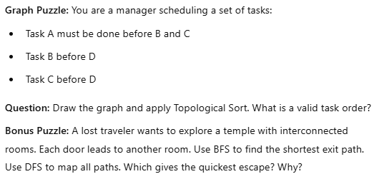
Class Practice

