Slide 1
Design and Analysis of Algorithms
Lectures Week 3 & 4

Slide 2
Fundamentals of the Analysis of Algorithm Efficiency - The analysis framework
The term “analysis of algorithms” is usually used in a narrower, technical sense to mean an investigation of an algorithm’s efficiency with respect to two resources: running time and memory space.
Three notations: O (“big oh”), (“big omega”), and (“big theta”). Borrowed from mathematics, these notations have become the language for discussing the efficiency of algorithms.
Key Takeaways:
✔ Big O (O) helps in understanding worst-case performance (upper bound).
✔ Theta (Θ) gives a tight bound (average-case behavior).
✔ Omega (Ω) helps analyze best-case performance (lower bound).

Slide 3
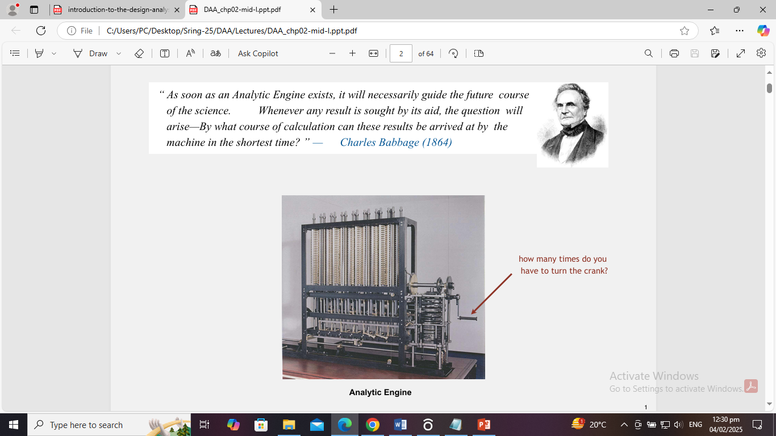

Slide 4
The analysis framework
There are two kinds of efficiency: time efficiency and space efficiency.
1. Time efficiency, also called time complexity, indicates how fast an algorithm min question runs.
2. Space efficiency ,also called space complexity, refers to the amount of memory units required by
the algorithm in addition to the space needed for its input and output.
In the early days of electronic computing, both resources—time and space—were at a premium. The time issue has not diminished quite to the same extent, however. In addition, the research experience has shown that for most problems, we can achieve much more spectacular progress in speed than in space.

Slide 5
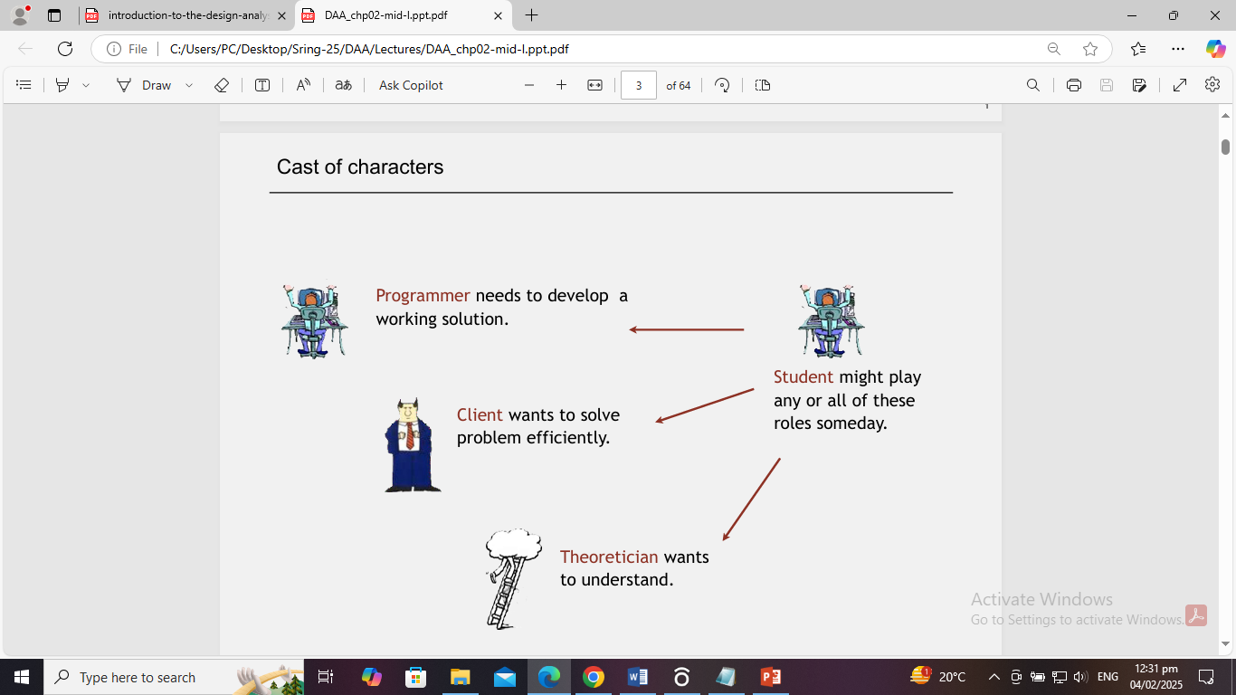

Slide 6
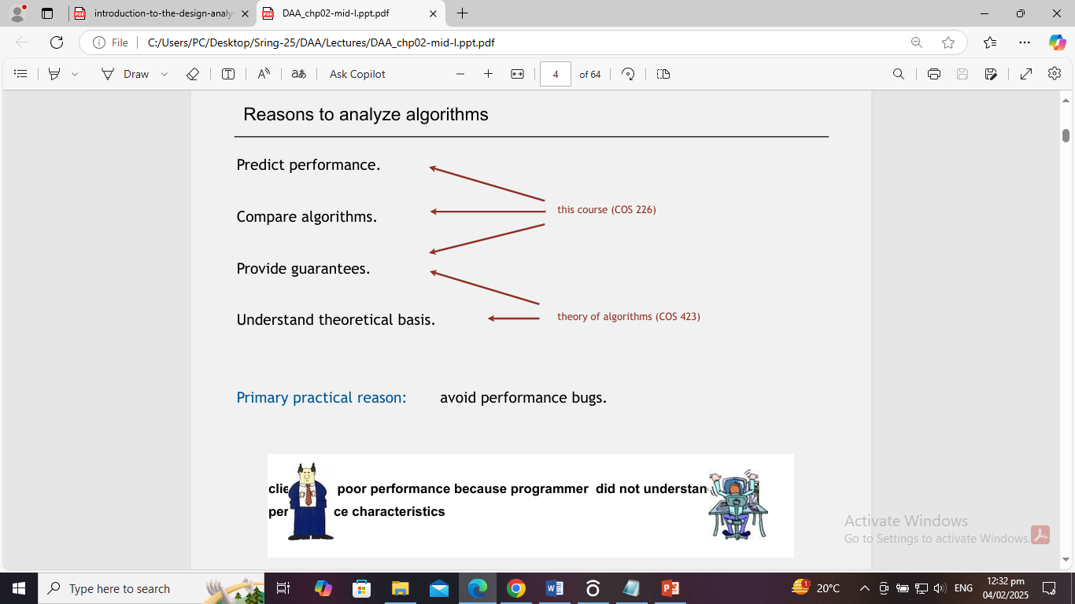

Slide 7
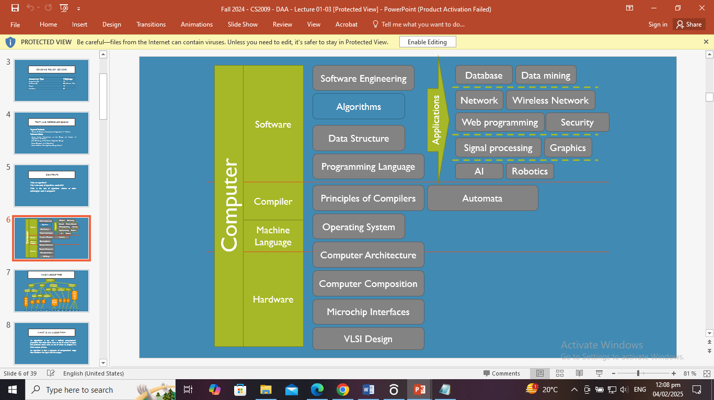

Slide 8
Knowledge Tree
Algorithms
Analysis
Design
Algorithms for classic problems
Classic data structure
Sorting
Shortest path
Matrix multiplication
…
Asymptotic notations
Probabilistic analysis
Heap,
Hashing,
Binary Search Tree,
RBT,
….
Divide & Conquer
Greedy
Dynamic Programming
O(),
o(),
Θ(), Ω(),
ω()
Quicksort,
Heapsort,
Mergesort,
…
…
…
…
…
…
…
…
…
…
…
…
…
…
…
…
…
…
…
…

Slide 9
What is an algorithm?
E.g.
  The algorithm to walk
  The algorithm to cook instant noodle
  The algorithm to sort N integers
Algorithm: walk to a destination
  while(have not arrived at the destination)
  {
    put the back foot in front of the front foot
    }

Slide 10

What is an algorithm?
Algorithm: cook a cup of instant noodles.
  1. Pull back lid to the dotted line
  2. Fill the cup to the inside line with boiling water from a kettle or from the microwave
  3. Close lid and let stand for 3 minutes
  4. Stir well and add a pinch of salt and pepper to taste

Slide 11
How to measure an algorithm?
The number of key operations
The number of space units needed
What if the input is uncertain?
E.g. Search a book in a box of books
  Key operation: check the title of a book
  Space unit: the space for one book

Slide 12


Why is the study of algorithms worthwhile?
Personalized Recommendations
More than 70% of what people watch on YouTube is determined by its “Recommendation Algorithm”.
News Feed, Friend Suggestions

Slide 13
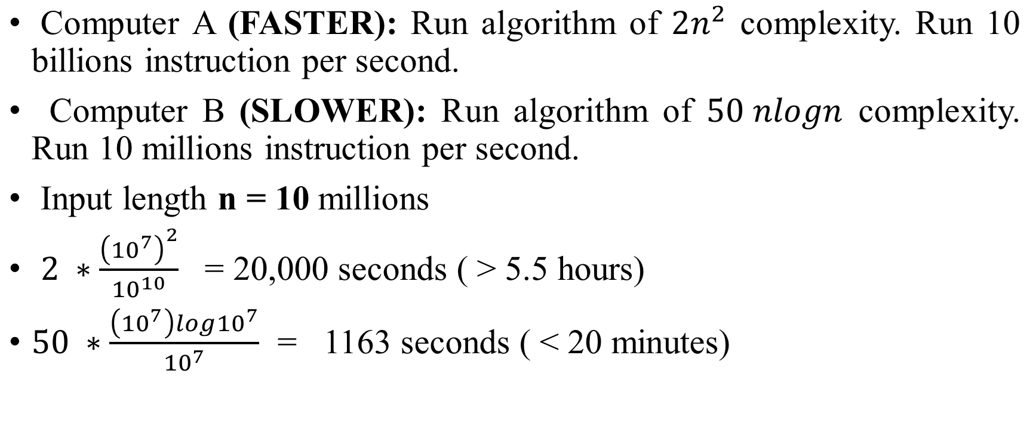
Which running time is better?

Slide 14
How to write an algorithm
Algorithm swap(a , b)
Begin
  temp <- a;
  a <- b;
  b <- temp;
  End

Slide 15
Class Activity: Fundamentals of Algorithmic Problem Solving
Old World Puzzle A peasant finds himself on a river bank with a wolf a goat, and ahead of cabbage. He needs to transport all three to the other side of the river in his boat. However, the boat has room for only the peasant himself and one other item (either the wolf, the goat, or the cabbage). In his absence, the wolf would eat the goat, and the goat would eat the cabbage. Solve this problem for the peasant or prove it has no solution. (Note: The peasant is a vegetarian but does not like cabbage and hence can eat neither the goat nor the cabbage to help him solve the problem. And it goes without saying that the wolf is a protected species.)

Slide 16
Puzzle:
There are four people who want to cross a rickety bridge; they all begin on the same side. You have 17 minutes to get them all across to the other side. It is night, and they have one flashlight. A maximum of two people can cross the bridge at one time. Any party that crosses, either one or two people, must have the flash light with them. The flash light must be walked back and forth; it cannot be thrown, for example.
Person 1 takes 1 minute to cross the bridge, person 2 takes 2 minutes, person 3 takes 5 minutes, and person 4 takes 10 minutes.
A pair must walk together at the rate of the slower person’s pace.
(Note: According to a rumor on the Internet, interviewers at a well-known software company located near Seattle have given this problem to interviewees.

Slide 17
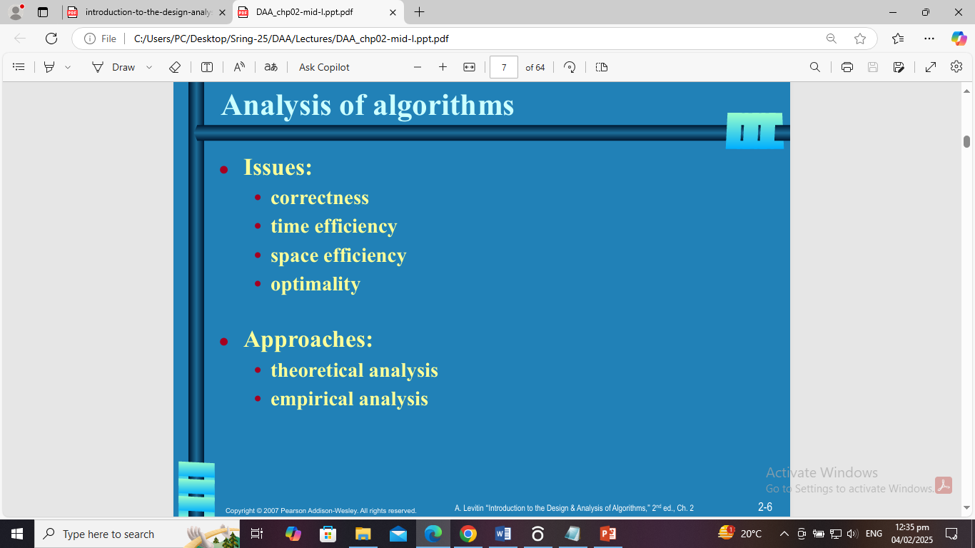

Slide 18
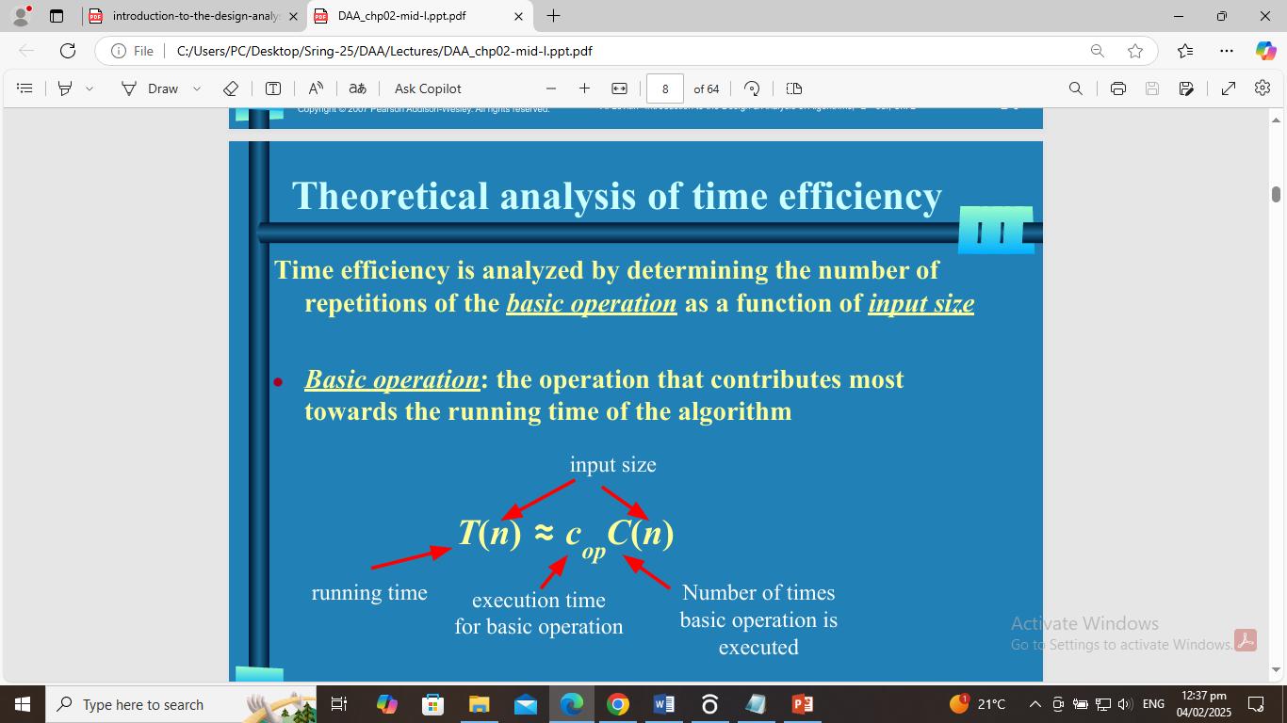

Slide 19
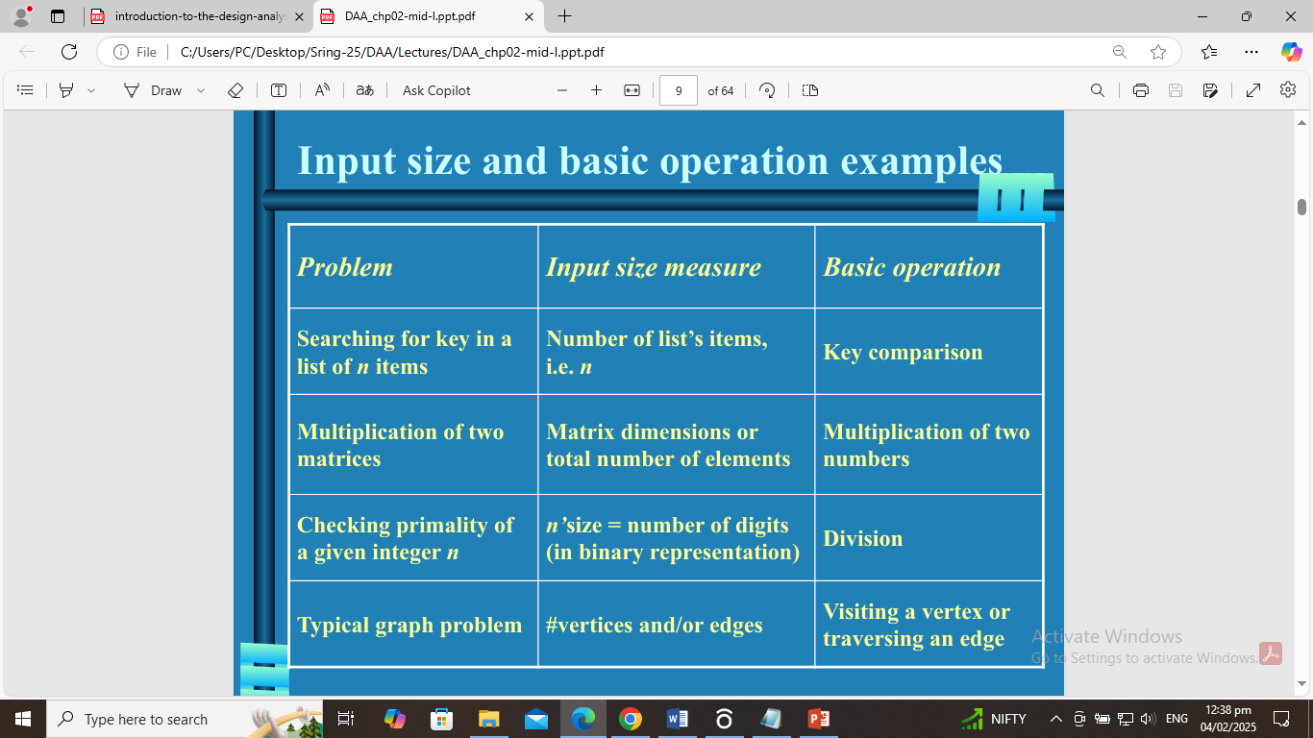

Slide 20
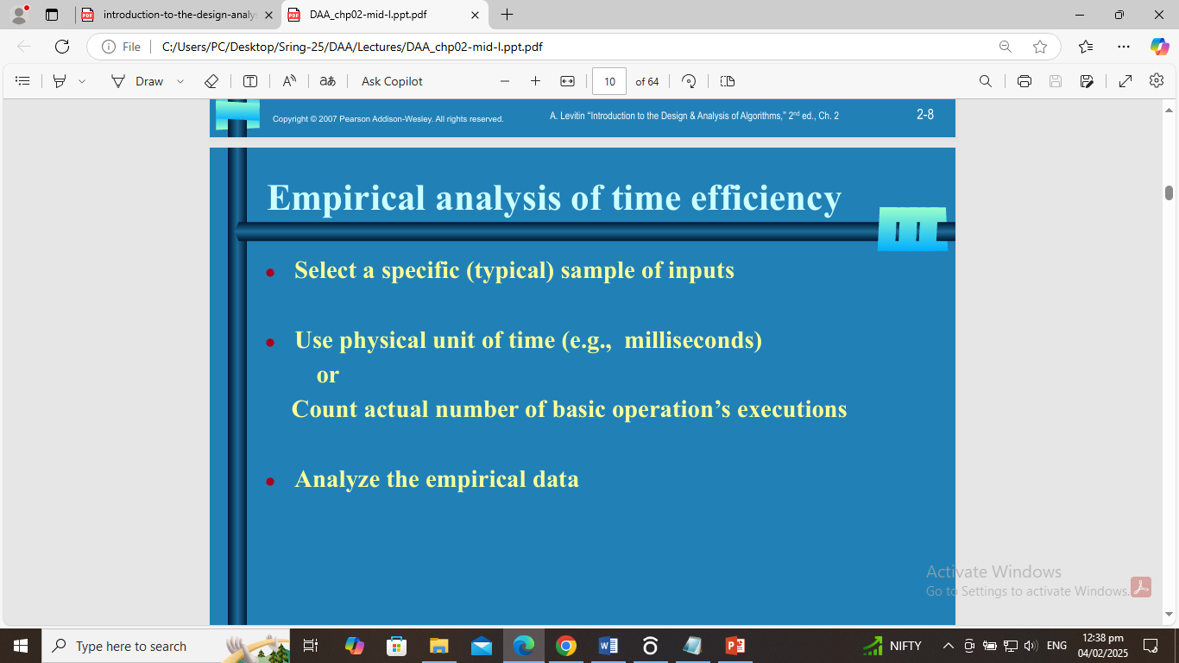

Slide 21
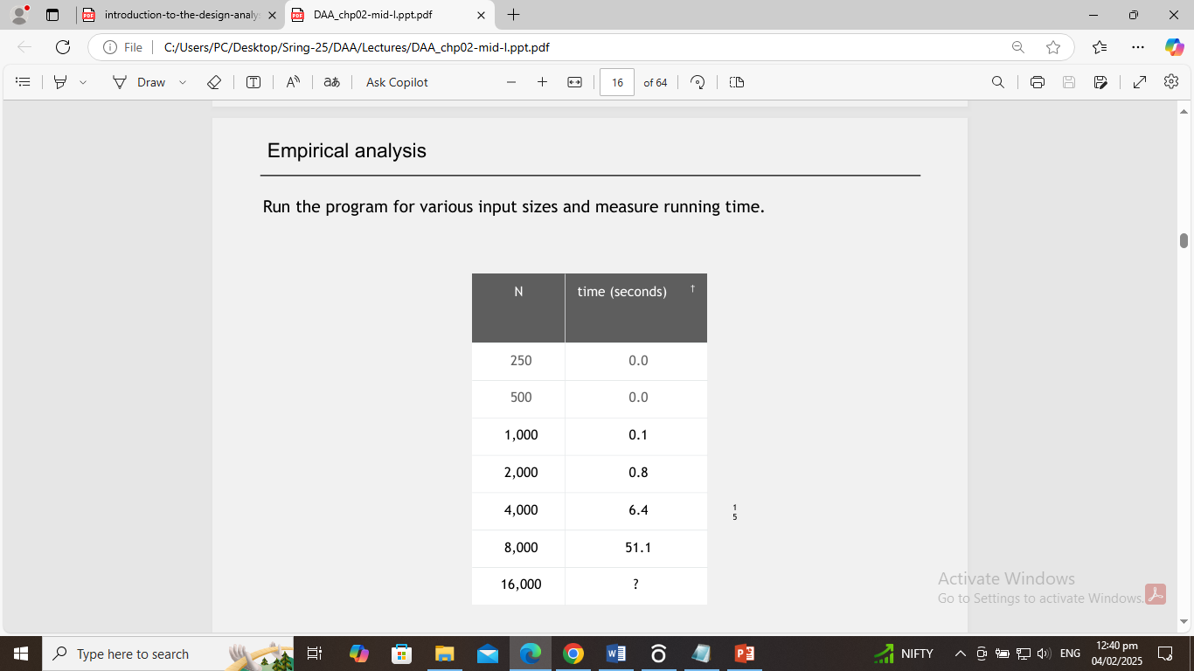

Slide 22
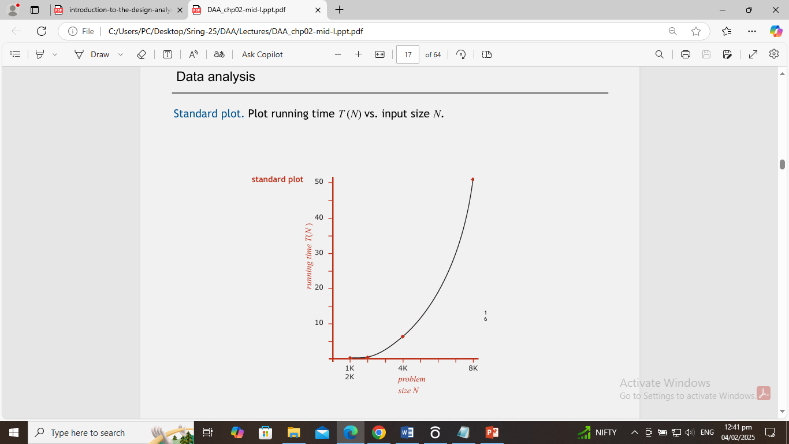

Slide 23
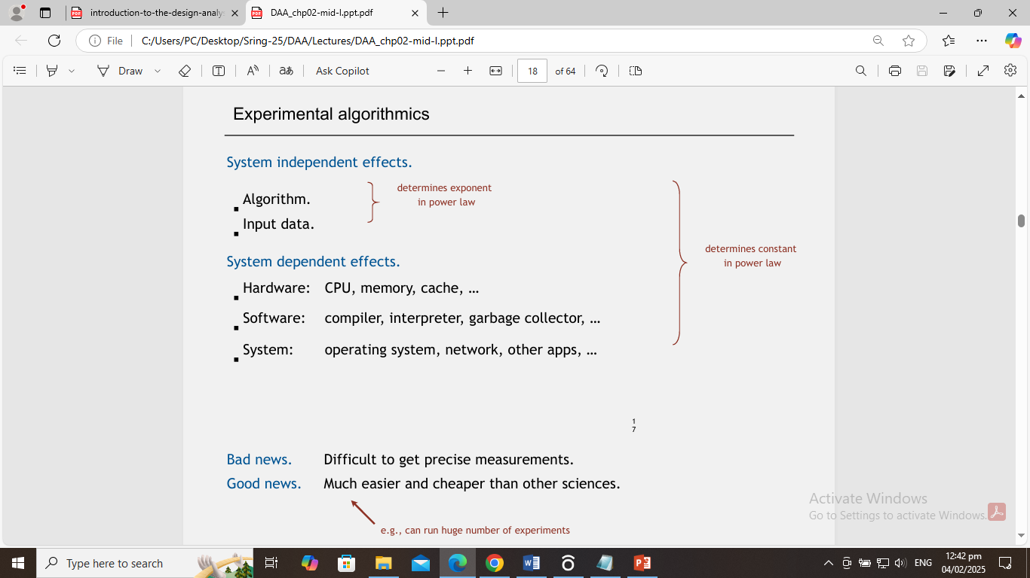

Slide 24
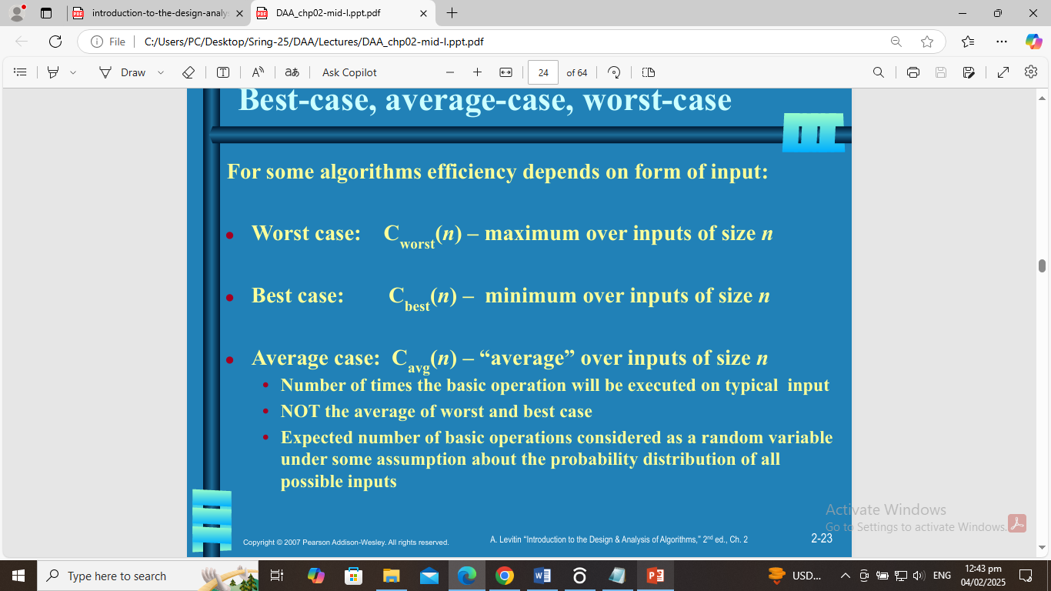

Slide 25
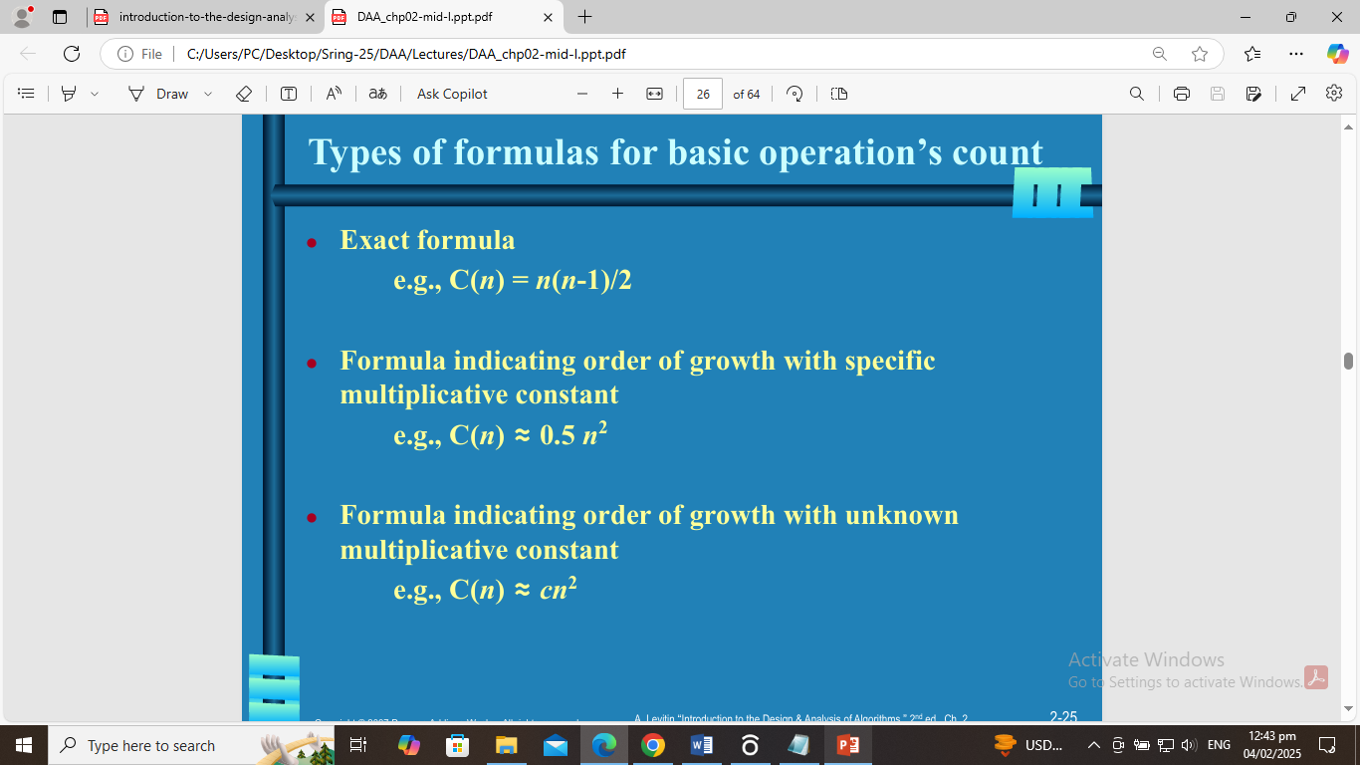

Slide 26
Summarize the main points of the framework
Both time and space efficiencies are measured as functions of the algorithm’s input size.
Time efficiency is measured by counting the number of times the algorithm’s basic operation is executed.
Space efficiency is measured by counting the number of extra memory units consumed by the algorithm. The efficiencies of some algorithms may differ significantly for inputs of the same size.
For such algorithms, we need to distinguish between the worst-case, average-case, and best-case efficiencies.
The framework’s primary interest lies in the order of growth of the algorithm’s running time (extra memory units consumed) as its input size goes to infinity.

Slide 27
Cont..
Mathematical Analysis of Algorithms
Mathematical analysis of algorithms helps us understand how fast an algorithm runs and how much memory it uses without running it on a computer.
🔹 Example: If an algorithm takes n² steps for an input of size n, we say it has a time complexity of O(n²) (like a nested loop).
Empirical Analysis of Algorithms
This is the process of measuring an algorithm’s performance by actually running it on a computer and recording execution time.
🔹 Example: If you sort a list using Bubble Sort and Quick Sort, and measure the time for both, you can compare which one runs faster in real scenarios.

Slide 28
Con…
Analysis Framework for Iterative Algorithms
An iterative algorithm is one that uses loops (for, while) to solve a problem.
The analysis framework helps calculate the number of times loops execute.
🔹 Example: Simple (for/while loop for number printing)
🔹 This loop runs n times, so its time complexity is O(n).
Analysis Framework for Recursive Algorithms
A recursive algorithm calls itself repeatedly to solve smaller versions of a problem.
The framework helps analyze how many recursive calls are made.
Example: Simple factorial problem
This function calls itself n times, so its time complexity is O(n).

Slide 29
Con..
Solving Recursive Relations by Substitution Method
The substitution method is used to solve recurrence relations by guessing a solution and proving it works.
🔹 Example: If a recursive function follows T(n) = 2T(n/2) + n, we assume a solution like T(n) = O(n log n) and prove it by substitution.
Recursion Tree Method
This method helps visualize recursion as a tree to understand how many levels it has and how much work is done at each level.
🔹 Example:
For T(n) = 2T(n/2) + n, we break n into two smaller problems at each step until reaching the base case. The total work done at all levels gives us the time complexity.
Master Theorem
The Master Theorem provides a shortcut to solve recurrence relations of the form:
T(n) = aT(n/b) + f(n)
🔹 Example: If we have T(n) = 2T(n/2) + n, using the Master Theorem, we find the time complexity is O(n log n) (used in Merge Sort).

