Slide 1
Information Security BS-CS-VI VVEEK-04 & 05 Lectures

Slide 2
IS Policies Importance
Policies are the most crucial element in a corporate information security infrastructure and must be considered long before security technology is acquired and deployed.
Security industry expert Marcus Ranum explains: “If you haven’t got a security policy, you haven’t got a firewall.
Instead, you’ve got a thing that’s sort of doing something, but you don’t know what it’s trying to do because no one has told you what it should do” (Ranum, 2003).

Slide 3
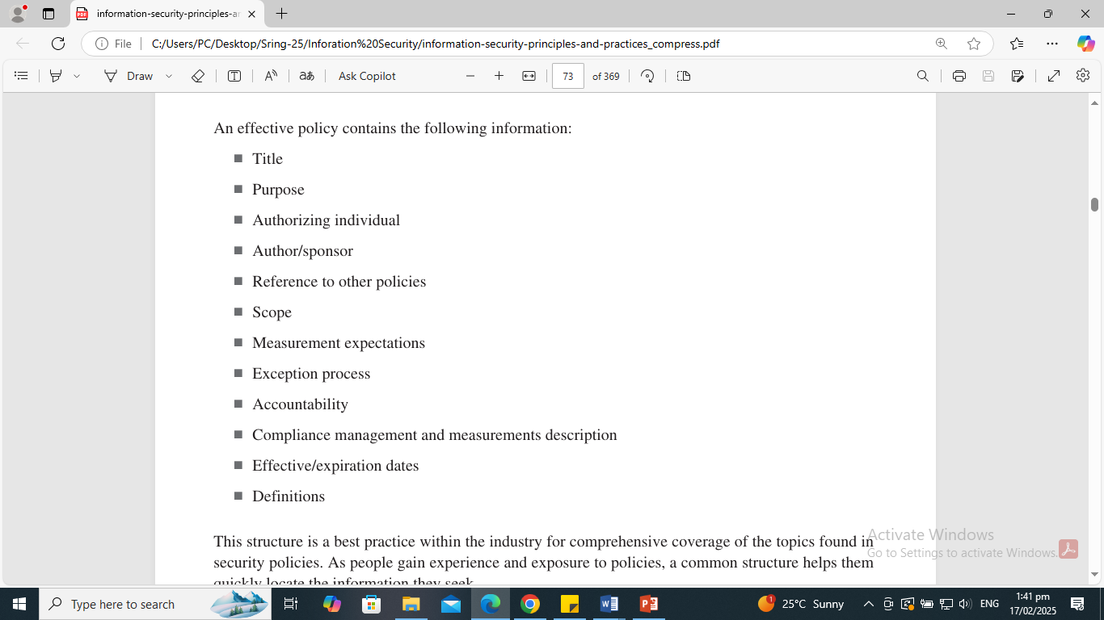
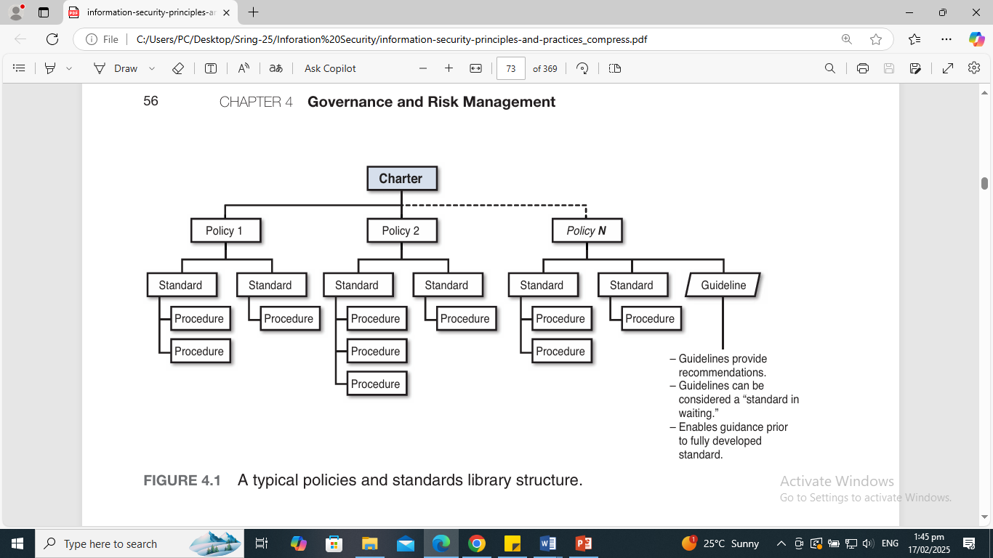
Polices Structure

Slide 4
POLICES
According to the National Institute of Standards and Technology (NIST) Computer Systems Laboratory (CSL), a division of the U.S.
Department of Commerce, computer security policies come in four types.
Policies and the follow-up documents in the library start at a very high level of understanding and become more specific (granular) at the lower levels

Slide 5
1. Program-level policy
Program-level policy is used for creating a management-sponsored computer security pro gram.
A program-level policy, at the highest level, might prescribe the need for information security and can delegate the creation and management of the program to a role within the IT department.
Think of this as the mission statement for the IT security program.

Slide 6
2. Program-framework
Program-framework policy establishes the overall approach to computer security (as a computer security framework).
A framework policy adds detail to the program by describing the elements and organization of the program and department that will carry out the security mission.

Slide 7
3. Issue-specific policy
Issue-specific policy addresses specific issues of concern to the organization.
These issues could be regulatory in nature—for example, the Payment Card Industry (PCI) data security standard.

Slide 8
4. System-specific policy
System-specific policy focuses on policy issues that management has decided for a specific system.

Slide 9
Developing and Managing Security Policies
To develop a comprehensive set of system security policies, a management process is required that derives security rules from security goals, such as a three-level model for system security policy:
Security objectives
Operational security
Policy implementation

Slide 10
Providing Policy Support Documents
Regulations: Laws passed by regulators and lawmakers
Standards and baselines: Topic-specific (standards) and system-specific (baselines) documents that describe overall requirements for security
Guidelines: Documentation that aids in compliance with standard considerations, hints, tips, and best practices in implementation
Procedures: Step-by-step instructions on how to perform a specific security activity (configure a firewall, install an operating system, and others

Slide 11
Suggested Standards Taxonomy
Standards are formal written documents that describe several security concepts that are fundamental to all successful programmes.
The highest level includes the following:
Asset and data classification
Separation of duties
Pre-employment hiring practices
Risk analysis and management
Education, awareness, and training

Slide 12
CLASS Activity
Take a Real Time Example of ORGANIZATION and form/suggest the policy related.

Slide 13
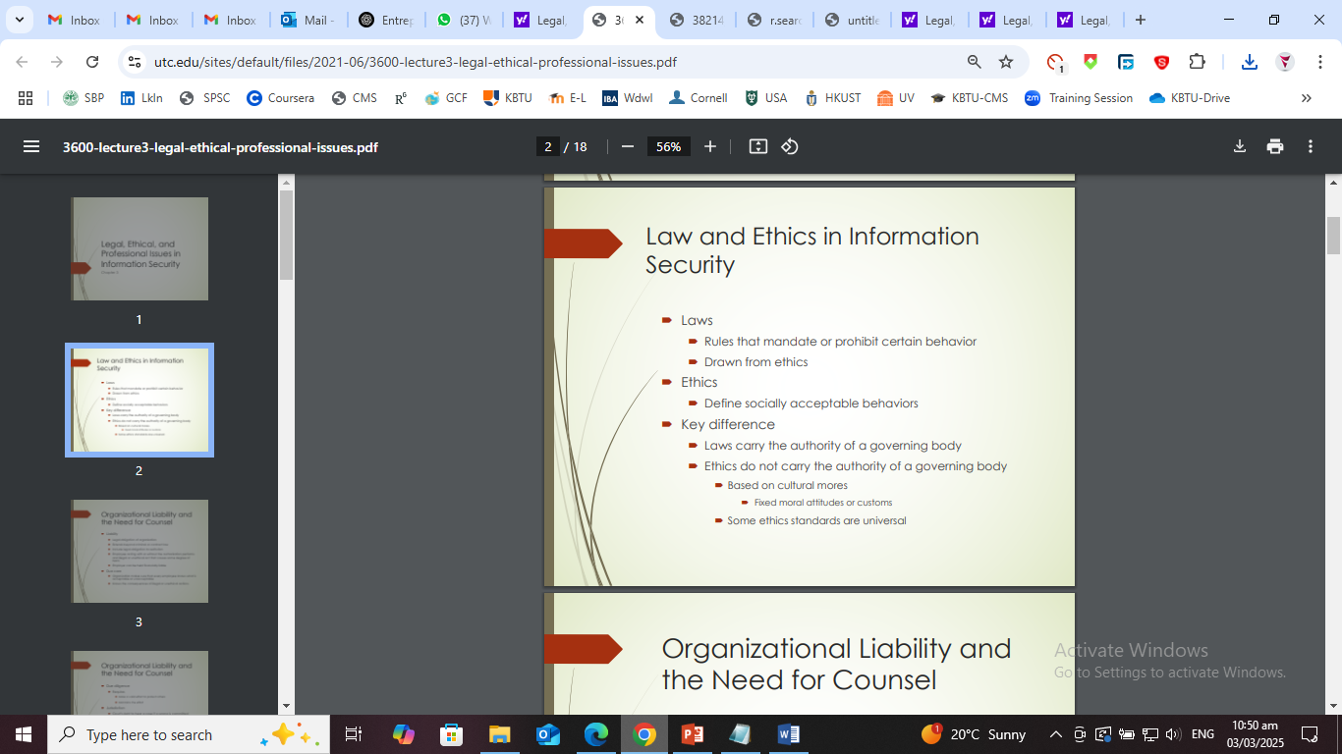

Slide 14
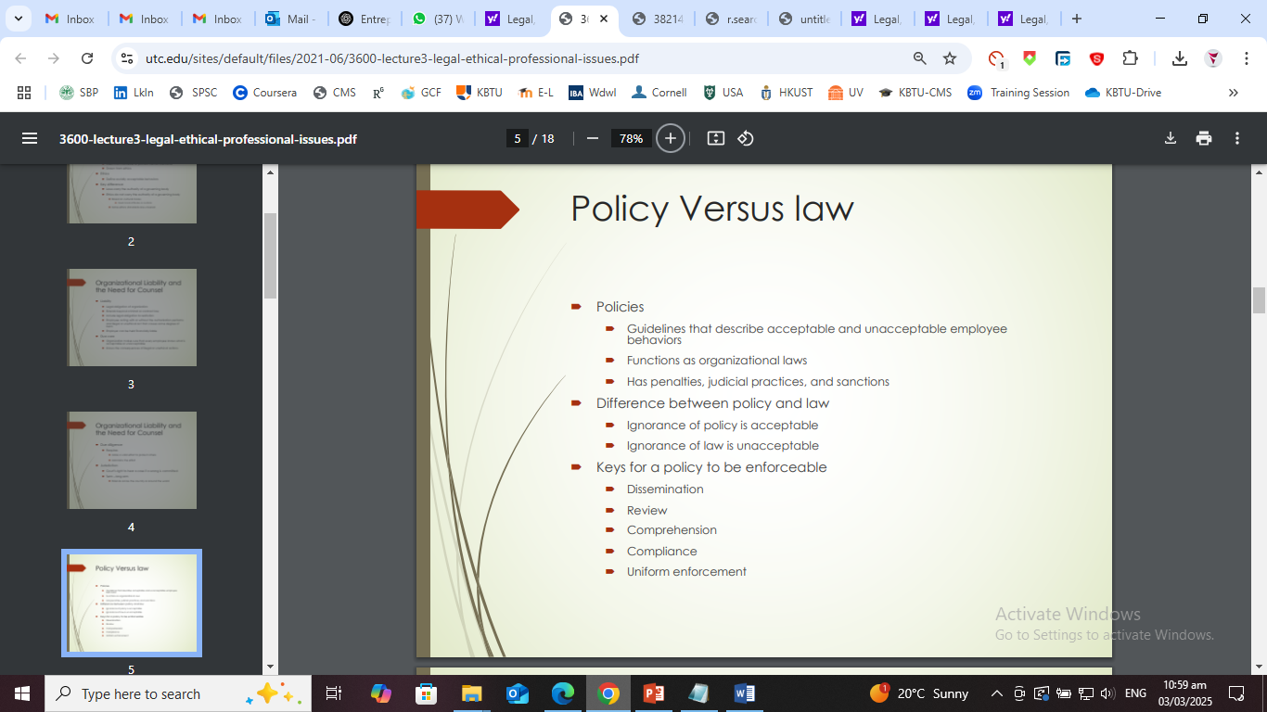

Slide 15
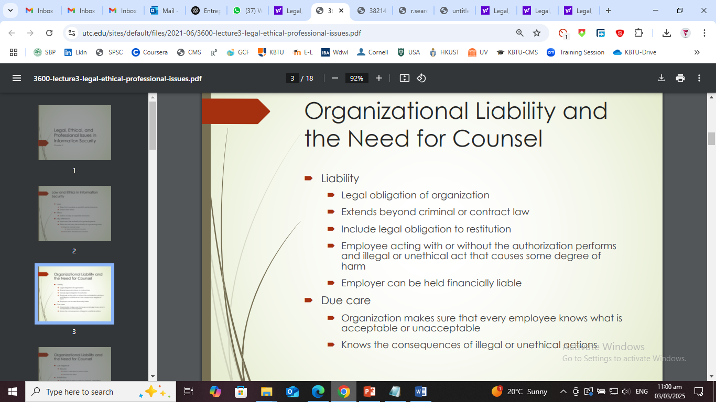

Slide 16
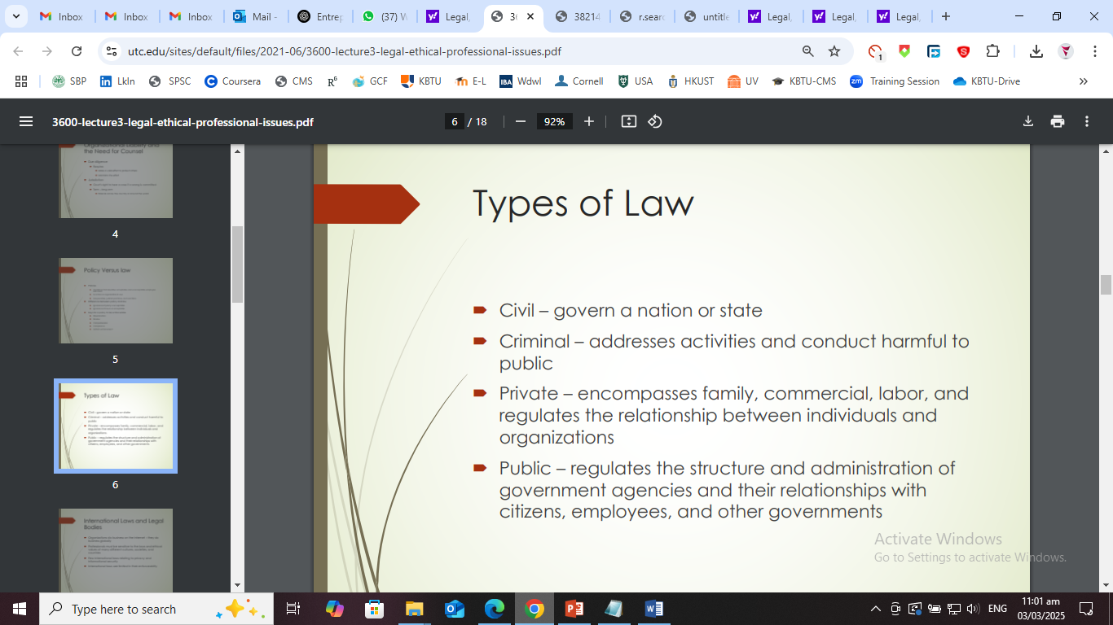

Slide 17
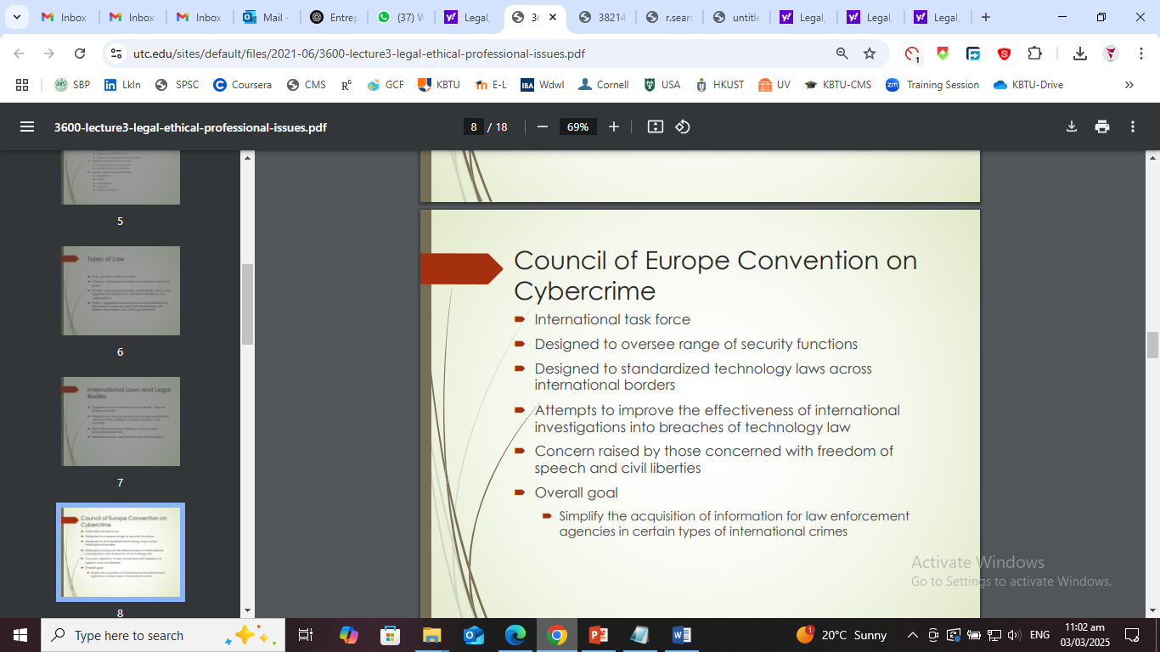

Slide 18
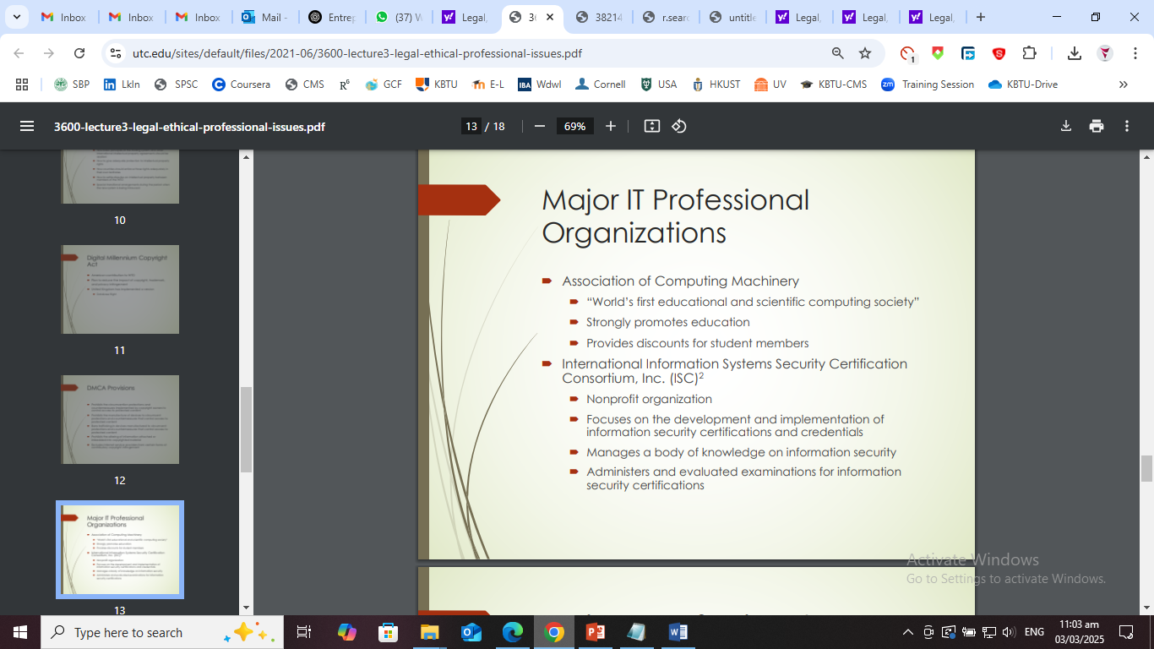

Slide 19
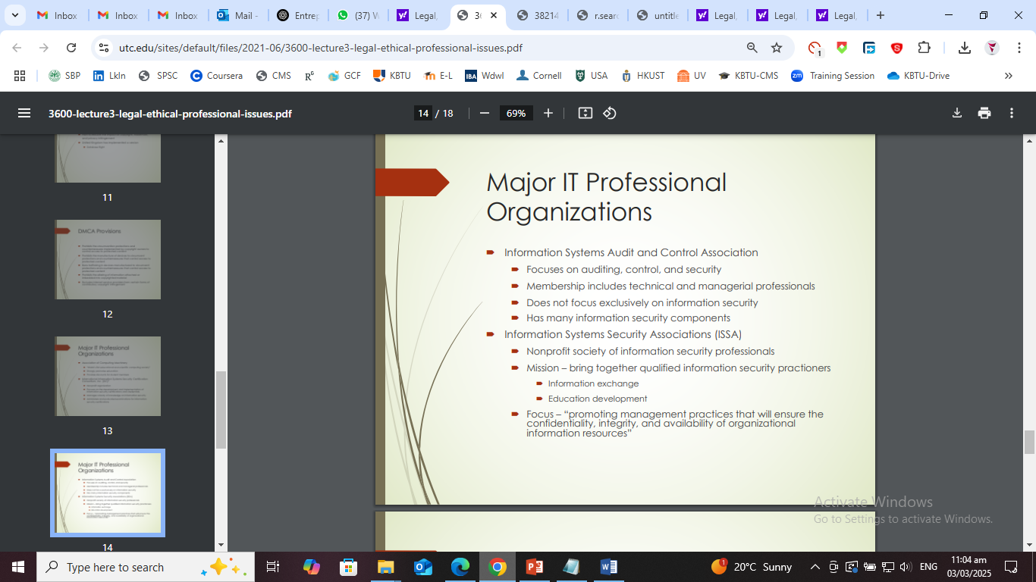

Slide 20
Ethical Decision Evaluation
A scientist developed a theory that required proof through the construction of a computer model. He hired a computer programmer to build the model, and the theory was shown to be correct. The scientist won several awards for the development of the theory, but he never acknowledged the contribution of the computer programmer.
The owner of a small business needed a computer-based accounting system. One day, he identified the various inputs and outputs he felt were required to satisfy his needs. Then he showed his design to a computer programmer and asked the programmer if she could implement such a system. The programmer knew she could implement the system because she had developed much more sophisticated systems in the past. In fact, she thought this design was rather crude and would soon need several major revisions. But she didn’t say anything about her thoughts, because the business owner didn’t ask, and she hoped she might be hired to implement the needed revisions.

Slide 21
Risk Management in Information Security
Risk Management is the process of identifying, assessing, and controlling threats to an organization’s data, systems, and operations. It helps businesses minimize potential losses and improve security.
Identification (Recognizing Risks)
The first step is to identify risks that could harm the organization’s information security.
📌 Common Risks: ✔ Cyber Attacks – Hacking, phishing, malware. ✔ Data Breaches – Unauthorized access to sensitive data. ✔ Human Errors – Accidental deletion, weak passwords. ✔ System Failures – Hardware crashes, network downtime.
🔹 Example: A company storing customer credit card data must identify risks like hacker attacks or insider threats.

Slide 22
Risk Analysis and Management
Security in any system should be in proportion to the risk under which it operates.
The process to determine which security controls are appropriate and cost effective is often a complex and sometimes subjective matter.
One of the prime functions of security risk analysis is to examine this process on a more objective basis.
Two basic types of risk analysis exist: quantitative and qualitative.

Slide 23
Risk analysis
A risk analysis answers three fundamental questions:
What am I trying to protect?
What is threatening my system?
How much time, effort, and money am I willing to spend?

Slide 24
Assessment (Evaluating Risks)
After identifying risks, companies analyze their impact and likelihood to prioritize security efforts.
📌 Key Factors in Risk Assessment: ✔ Likelihood – How often can this risk occur? ✔ Impact – What damage will it cause? ✔ Cost – How expensive is it to fix the issue?
🔹 Example: A hospital might assess that ransomware (which locks patient records) is high-risk due to its severe impact on healthcare services.

Slide 25
Control (Minimizing Risks)
Once risks are assessed, organizations take preventive measures to control them.
📌 Risk Control Strategies: ✔ Preventive Measures – Firewalls, encryption, strong passwords. ✔ Detective Measures – Security audits, intrusion detection systems. ✔ Corrective Actions – Backup recovery plans, employee training.
🔹 Example: A bank might use multi-factor authentication (MFA) to reduce unauthorized access risks.

Slide 26
Decisions (Choosing the Best Action)
After evaluating risks, businesses decide how to respond:
📌 Risk Handling Strategies: ✔ Accept the Risk – If the risk is low and manageable. ✔ Reduce the Risk – Implement stronger security controls. ✔ Transfer the Risk – Get cybersecurity insurance. ✔ Avoid the Risk – Stop using risky technologies.
🔹 Example: An e-commerce company encrypts customer payment details to reduce data breach risks.

Slide 27
Quantitative Risk Analysis
Quantitative or quasi-subjective risk analysis attempts to establish and maintain an independent set of risk metrics and statistics.
Some of the calculations used for quantitative risk analysis include
Annualized loss expectancy (ALE): Single loss expectancy (SLE) multiplied by annualized rate of occurrence (ARO)
Probability: Chance or likelihood, in a finite sample, that an event will occur or that a specific loss value might be realized if the event occurs.
Threat: An event whose occurrence could have an undesired impact.
Control: Risk-reducing measure that acts to detect, prevent, or minimize loss associated with the occurrence of a specified threat or category of threats
5. Vulnerability: The absence or weakness of a risk-reducing safeguard

Slide 28
Qualitative Risk Analysis
Qualitative risk analysis is the most widely used approach to risk analysis. Probability data is not required, and only estimated potential loss is used. Most qualitative risk analysis methodologies make use of interrelated elements:
Threats
Vulnerabilities
Controls

Slide 29
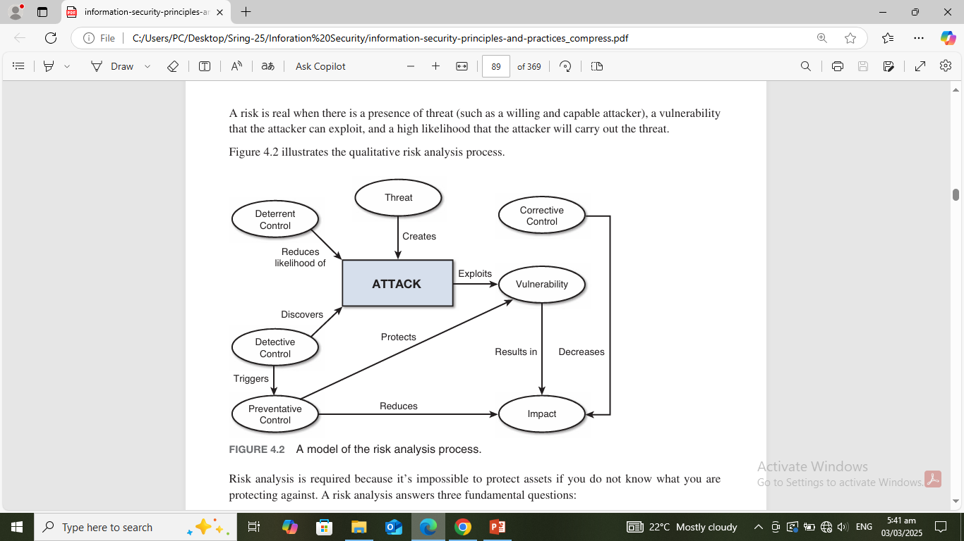

Slide 30
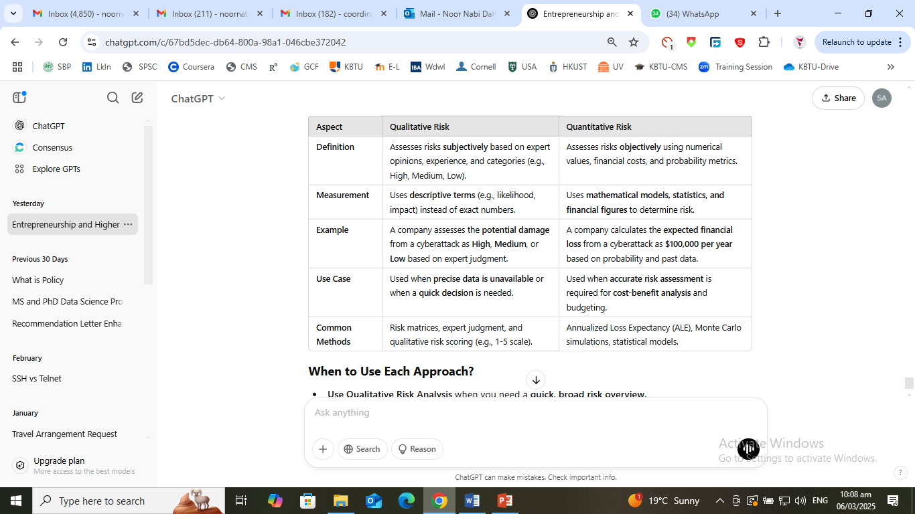
When to Use Each Approach?
Use Qualitative Risk Analysis when you need a quick, broad risk overview.
Use Quantitative Risk Analysis when making data-driven financial decisions regarding security investments.

Slide 31
Policy vs. Law in Information Security
✅ Policy: A policy is a set of internal rules created by an organization to guide employees, users, or stakeholders on how to protect information. It is not legally binding but helps maintain security within a company.
🔹 Example: A company password policy requires employees to use strong passwords (at least 12 characters, including numbers and special symbols). Violating this policy may lead to disciplinary action but not legal punishment.
✅ Law:
A law is an official rule set by a government that applies to everyone within its jurisdiction. Violating an information security law can result in legal penalties, such as fines or imprisonment.
🔹 Example: The General Data Protection Regulation (GDPR) is a law in Europe that protects user data privacy. If a company misuses customer data, it can face millions in fines.

Slide 32
Preview of Some Important Information Security Laws & Relevant Agencies
1. General Data Protection Regulation (GDPR) [Europe]
Protects the personal data of EU citizens.
Example: A company must ask for user consent before collecting personal data.
2. The Computer Fraud and Abuse Act (CFAA) [USA]
Makes it illegal to hack into computers or access systems without permission.
Example: If someone breaks into a government database, they can face jail time.
3. The Health Insurance Portability and Accountability Act (HIPAA) [USA]
Protects medical and health data of patients.
Example: A hospital cannot share patient records without permission.
4. Personal Data Protection Act (PDPA) [Singapore]
Regulates how businesses collect and store personal data.
Example: A company must secure customer phone numbers to prevent leaks.
5. Payment Card Industry Data Security Standard (PCI DSS) [Global]
Ensures secure handling of credit card transactions.
Example: An online store must encrypt payment details to prevent fraud.

Slide 33
Why all these..?
Understanding policies vs. laws helps businesses follow security rules, avoid legal penalties, and protect customer trust. Laws like GDPR, HIPAA, and CFAA ensure that personal data is kept safe from cybercriminals.
Ethical Responsibilities: ✔ Use data transparently. ✔ Prevent unauthorized access. ✔ Follow cybersecurity best practices.
🔹 Example: A social media company must not sell user data without consent.

Slide 34
Who Is Responsible for Security?
Certain individuals, however, have specific information security responsibilities that are established by the security programme:
Chief information security officer (CISO): Establishes and maintains security and risk management programmes for information resources.
Information resources manager: Maintains policies and procedures that provide for security and risk management of information resources.
Information resources security officer: Directs policies and procedures designed to protect information resources (identifies vulnerabilities, develops security awareness programme, and so forth).

Slide 35
Owners of information resources: Have the responsibility of carrying out the programme that uses the resources. This does not imply personal ownership. These individuals might be regarded as programme managers or delegates for the owner.
Custodians of information resources: Provide technical facilities, data processing, and other support services to owners and users of information resources.
Technical managers (network and system administrators): Provide technical support for security of information resources
Internal auditors: Conduct periodic risk-based reviews of information resources security policies and procedures.
Users: Have access to information resources in accordance with the owner-defined controls and access rules

Slide 36
1. Which of the following choices is not part of a security policy?
A. A definition of overall steps of information security and the importance of security
B. A statement of management intent, supporting the goals and principles of information security
C. A definition of general and specific responsibilities for information security management
D. A description of specific technologies used in the field of information security regulations
2. Which of the following is the first step in establishing an information security programme?
A. Adoption of a corporate information security policy statement
B. Development and implementation of an information security standards manual
C. Development of a security awareness training program for employees
D. Purchase of security access control software

Slide 37
3. An effective information security policy should not have which of the following characteristics?
A. It should include separation of duties.
B. It should be designed with a short- to midterm focus.
C. It should be understandable and supported by all stakeholders.
D. It should specify areas of responsibility and authority.
4. Which of the following terms can best be defined as high-level statements, beliefs, goals, and
objectives?
A. Standards
B. Policies
C. Guidelines
D. Procedures
5. A deviation or exception from a security standard requires which of the following?
A. Risk acceptance
B. Risk assignment
C. Risk reduction
D. Risk containment

Slide 38
1: Data Breach at XYZ University
📌 Scenario: XYZ University stores student records, including personal information and academic data, in an online database. Recently, a hacker gained unauthorized access, exposing the data of 10,000 students. The hacker exploited a weak password policy and outdated security measures.
📌 Challenge for Students: 1️. Identify what went wrong in XYZ University's security system. 2️. What information security principles (confidentiality, integrity, availability) were violated? 3️. Propose 3 security measures that could have prevented this breach.

Slide 39
2: Phishing Attack on Bank Employees
📌 Scenario: Employees at ABC Bank received an email that looked like an official request from their IT department. The email contained a link asking for login credentials. Several employees unknowingly entered their details, leading to a security breach where attackers accessed the internal banking system.
📌 Challenge for Students: 1️.Explain how this phishing attack was successful. 2️.What security awareness strategies could have helped employees avoid this? 3️.Suggest technical solutions the bank can implement to prevent future phishing attempts.

Slide 40
3: Ransomware Attack on a Healthcare System
📌 Scenario: A large hospital's network was infected with ransomware, which encrypted all patient records and demanded a $1 million ransom to restore the data. The attack disrupted emergency services, delaying critical treatments. The hospital had no proper data backups and was forced to negotiate with the attackers.
📌 Challenge for Students: 1️. Identify the weaknesses in the hospital's cybersecurity strategy. 2️. How could data backup policies have mitigated this attack? 3️. What legal and ethical considerations should the hospital follow in handling this breach?

Slide 41
4: Insider Threat in a Software Company
📌 Scenario: A disgruntled employee at Tech Solutions Inc. was about to resign. Before leaving, he downloaded confidential client data and shared it with a competitor. The company discovered the breach too late because it had weak access controls and no monitoring system.
📌 Challenge for Students: 1️.How could strong access control policies have prevented this? 2️.What legal actions can the company take against the employee? 3️.Suggest technical security measures to prevent insider threats.

