Slide 1

Digital
Forensics
By Shivani Dawani

Slide 2

Forensics \

Slide 3

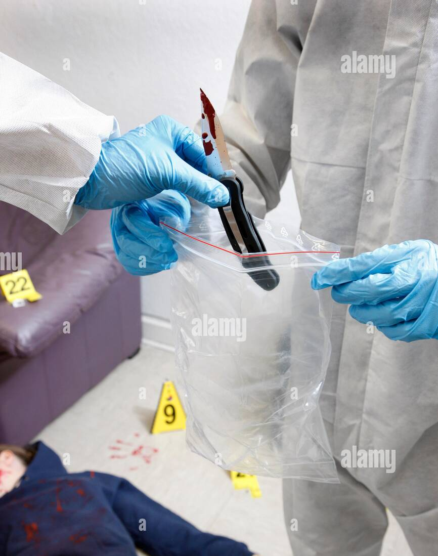
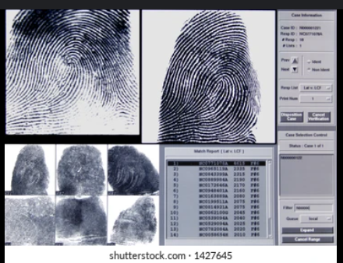

Slide 4

The crime happened on a Device.
That’s what Digital Forensics does — it’s like CID, but for cybercrimes!

Slide 5

Detective 🕵‍♂️ you look for digital clues on computers, phones, or the internet.

Slide 6
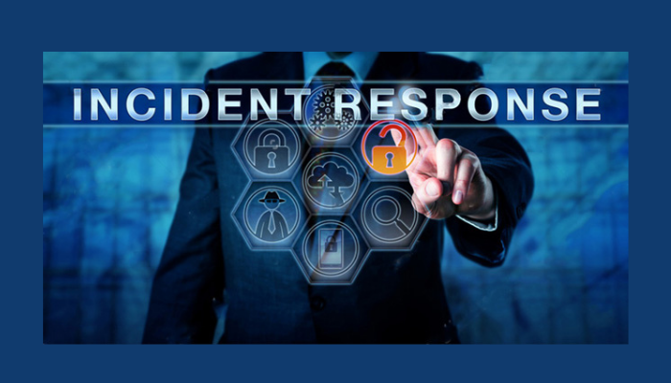
🛡 Role in Information Security
Incident Response Helps detect the cause and scope of a security incident (e.g., malware attack, data breach).

Slide 7

🛡 Role in Information Security
Evidence Collection Collects data in a forensically sound manner to be used in legal proceedings.

Slide 8
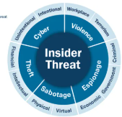
🛡 Role in Information Security
Threat Analysis Assesses how a system was compromised and identifies future vulnerabilities.

Slide 9

🛡 Role in Information Security
Data Recovery Recovers deleted, encrypted, or damaged files that could be crucial to an investigation.

Slide 10
Steps of Digital Forensics
Identification
What data might be evidence?
Preservation
Make sure the data doesn’t change or get damaged.
Analysis
Study the data to figure out what happened.
Documentation
Keep a record of everything.
Presentation 👨‍⚖️
Show the results clearly to police or in court.

Slide 11
Real-Life Scenarios
Case: A Company’s Data Gets Leaked
A company finds their secret files are on the internet.
Digital forensic experts:
Check computer logs
Find that an employee sent the files at midnight
Use email, IP addresses, and file history as proof
The employee is caught and taken to court.
Result: Company finds out how it happened and can prevent it next time.

Slide 12
Real-Life Scenarios
Facebook–Cambridge Analytica Scandal (2018)
What Happened: Data from over 87 million Facebook users was harvested without consent and used for political profiling.
How Forensics Helped:
Data-sharing patterns
deleted files
metadata
uncovered how user information was misused.
Lesson: Digital forensics isn’t just about catching hackers — it can also reveal unethical practices in big tech.

Slide 13

Common Tools Used
FTK (Forensic Toolkit)
EnCase
Autopsy/Sleuth Kit
Wireshark (for network forensics)
Volatility (for memory forensics)
A memory forensics framework used to extract information from RAM dumps like running processes, passwords, or malware.

Slide 14


Slide 15

Common Questions?

Slide 16
What would you do if your phone was hacked and personal photos leaked online?

Slide 17


Inform Authorities
Cyber police are the real-life CID.
.
Use Digital Forensics Experts
They can trace how the hack happened, track the attacker, and gather legal evidence.

Slide 18
If Daya breaks the door and finds no one inside, how do we catch the real criminal?

Slide 19

They leave digital footprints
IP addresses
device logs
Timestamps
login history
browser record
file access trails.

Slide 20
Search and find out:
What’s the most famous case where digital forensics helped solve a murder?

