Slide 1

Motivations and ramifications of cyber terrorism and criminal hacking, “cracking”

Slide 2

Motivations for cyberterrorism
Many of the cyberattacks are not conducted for money, rather the cyberattacks are conducted due to different ideological beliefs and due to wanting to get personal revenge and outrage towards company or individual, the cybercriminal is attacking. An employee might want to get revenge on a company if they were mistreated or wrongfully terminated.

Slide 3
There are many different motives for cyberterrorism, with the majority being for financial reasons. However, there is increasing evidence that hackers are becoming more politically motivated. Cyberterrorists are aware that governments are reliant on the internet and have exploited this as a result.
Other motivations for cybercriminals include:
Political goals
Competition between companies
Cyberwarfare between two countries
Money

Slide 4
Political goals motivate cyber-attackers because they are not happy with candidates and they might want certain candidates to win the election, therefore, they might alter the election voting to help their preferred candidate win.
Competition between two companies can also stir up a cyberattack, as one company can hire a hacker to conduct the attack on a company as they might want to test the rival company's security. This will also benefit a company because it will force their competitor's customers to think that the company is not secure due to them getting cyber attacked effortlessly and they don't want any of their personal credentials getting leaked.

Slide 5
Cyberwarfare is motivation for countries that are fighting each other. This is mainly used to weaken the opposing country by compromising its core systems and the countries data and other vulnerable information.
Money is motivating for cyber attacks for ransomware, phishing, and data theft as the cyber criminals can differently contact the victims and ask for money and in return the data stays safe

Slide 6
Why do hackers hack?

Slide 7
Why do hackers hack?
The reasons why hackers commit crimes fall into these general categories:
Financial motivations
Nation-state sponsored/cyberwarfare
Corporate espionage
Hacktivists
Resource theft
Gamer issues

Slide 8
Types of exploits and methodologies
Social engineering
Unpatched software and hardware vulnerabilities
Zero-day attacks
Browser attacks
Password attacks
Eavesdropping
Denial of service
Physical attacks

Slide 9
What is a Computer Cracker?

Slide 10
What is a Computer Cracker?
A computer cracker, commonly referred to as a hacker, is an individual who exploits vulnerabilities in computer systems and networks with malicious intent. Unlike ethical hackers who work to identify and fix security holes, crackers use their skills to gain unauthorized access to systems for personal gain, such as stealing sensitive information, causing disruptions, or taking control of systems for ransom.

Slide 11
Crackers use various tools and techniques to breach security, including phishing attacks, malware, social engineering, and brute force attacks. Their actions can have serious consequences, including financial loss, damage to reputation, and compromise of personal and corporate data. It is important to understand what is a computer cracker and learn strong security measures to protect these cracking threats.

Slide 12
Example of Cracker in Computer
Let's consider a scenario where a skilled individual named Alex decides to engage in cracking activities. Alex comes across a vulnerable e-commerce website that lacks proper security measures. Intrigued by the challenge, Alex exploits a flaw in the website's code, bypasses authentication, and gains unauthorized access to the site's customer database.
With access to personal and financial information, Alex can sell the data on the dark web, use it for identity theft, or engage in fraudulent transactions.

Slide 13
Hacker vs Computer Cracker
Hacker and computer cracker are two terms that are often used interchangeably, but they are not the same. While both are proficient in computer systems and programming, the difference lies in their intended purpose and objectives.

Slide 14
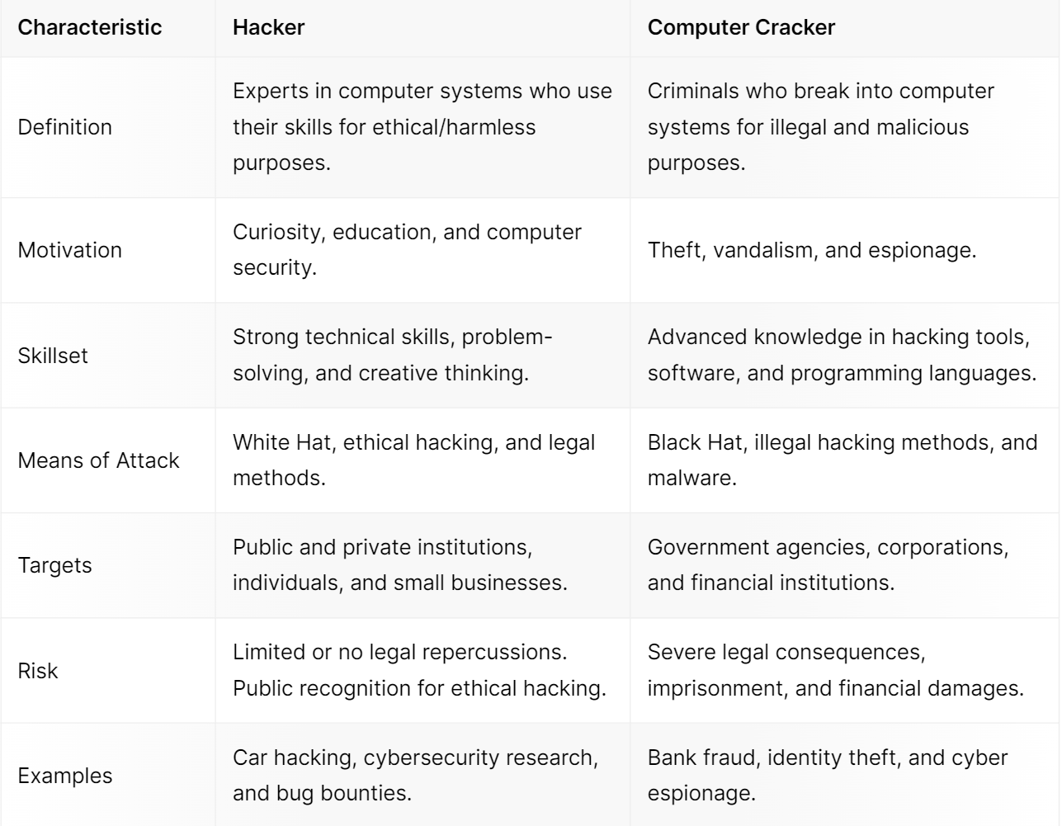
Hacker
vs
Computer Cracker

Slide 15
Types of Cracking Attacks
There are many types of cracking attacks, each targeting different aspects of computer systems and networks. These attacks exploit vulnerabilities in security measures to gain unauthorized access or extract sensitive information.

Slide 16
Here are some common types of cracking attacks:
1. Password Cracking
The most common type of cyber cracking attack is password cracking. This technique involves trying to guess or crack your login credentials, such as your username and password. Hackers can use various methods to crack your passwords, including brute-force attacks, dictionary attacks, and social engineering. Once the hacker cracks your password, they can gain access to your personal information, bank accounts, and other sensitive data.

Slide 17
There are several methods that cyber attackers use to crack passwords.
Dictionary Attacks: They use pre-built dictionaries of common words or phrases to try and guess a password.
Brute Force Attacks: This method involves guessing every combination of characters until the correct password is discovered.
Rainbow Table Attacks: This attack utilizes precomputed sets of encrypted passwords to quickly guess the original password.

Slide 18
Shoulder Surfing: This type of attack involves watching users enter their passwords and taking note of their keystrokes.
Phishing: Cyber criminals use fake login pages or email scams to deceive users into inputting their credentials, giving the attacker access to their passwords.

Slide 19
2. Software Cracking and Piracy
Another type of cracking attack is software cracking and piracy. This technique involves illegally cracking the software's copy protection mechanisms to bypass licensing restrictions. Hackers can then use this cracked software to distribute malware or steal user data.

Slide 20
The following are some common methods of software cracking:
Reverse engineering: This involves analyzing the compiled code of a software application to gain an understanding of how it works and what security measures it has.
Patching: This involves modifying the binary code of a software application to remove copy protection or licensing restrictions.
Keygen programs: These are tools that generate valid serial numbers or activation codes to unlock software applications.

Slide 21
Cracks:
Distribution: Cracked software is often distributed via peer-to-peer (P2P) networks, torrent sites, or other illegal means.

Slide 22
3. Network and System Exploitation
Network and system exploitation is a type of cracking attack that involves infiltrating a local area network (LAN) or exploiting vulnerabilities in a computer system. Commonly known as network cracking or wired equivalent privacy (WEP) cracking, this attack targets poorly secured networks.
For example, an attacker may use a technique called "packet sniffing" to intercept and analyze network traffic, looking for sensitive information such as passwords or financial data.

Slide 23
Why Do People Crack?
1. Financial Gain and Cybercrime
2. Intellectual Property Theft
3. Political and Activist Agendas

Slide 24
Thank you!

