Slide 1

Time transition in communication and Network Usage

Slide 2

Ancient Form of Communication
Ancient Form of Communication
The history of human communication dates back to prehistoric times when our ancestors used various methods to relay messages. Let's dive into some key methods:
Smoke Signals - Smoke signals were extensively used by indigenous tribes to convey messages across long distances. These signals were created by controlling the smoke from a fire, delivering simple messages through coded patterns or a series of stages.
Pigeon Carriers - Pigeons were trained to carry written messages in tiny containers strapped to their legs. This mode of communication became popular during ancient times, with pigeons employing their natural homing capabilities to deliver messages.

Slide 3
Ancient Form of Communication
Ancient Form of Communication (Cont.)
Hieroglyphs and Petroglyphs - Ancient civilizations used hieroglyphs and petroglyphs to convey stories and messages through symbols and drawings. These intricate visual symbols formed the basis for written communication.

Slide 4
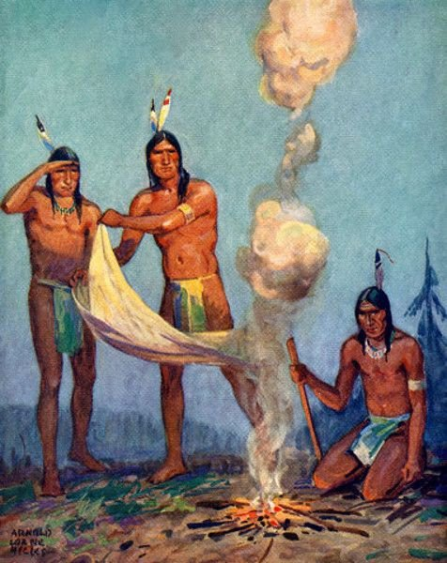
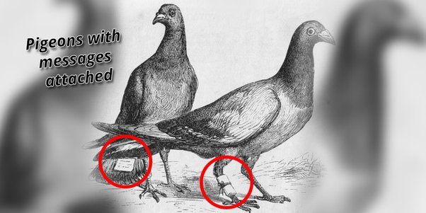
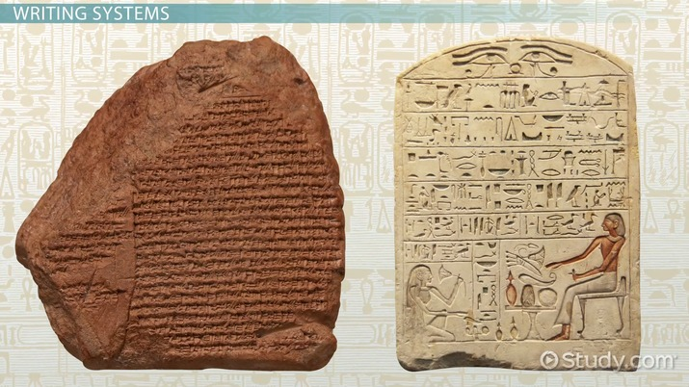
Ancient Form of Communication
Ancient Form of Communication (Cont.)
SMOKE SIGNAL
PIGEON
Hieroglyphs and Petroglyphs

Slide 5
Ancient Form of Communication
The Revolutionary Era: Telegraph and Telephone
In the 19th century, communication witnessed a significant advancement with the advent of the telegraph and telephone. Key highlights during this period include:
Telegraph - In 1837, Samuel Morse invented the telegraph and introduced Morse code, a set of short and long signals representing letters and numbers. The telegraph revolutionized long-distance communication, enabling messages to be relayed within seconds across continents.
Telephone - The invention of the telephone by Alexander Graham Bell in 1876 was a game-changer. It allowed people to communicate through voice, eliminating the need for written messages. The telephone quickly became an indispensable tool.

Slide 6
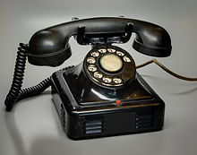
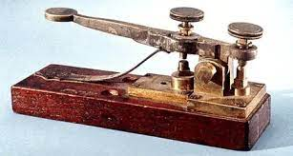
Ancient Form of Communication
The Revolutionary Era: Telegraph and Telephone (Cont.)
TELEGRAPH
TELEPHONE

Slide 7
Ancient Form of Communication
The Digital Age: Internet and Smartphone Revolution
The 20th century witnessed the birth of the internet, which laid the foundation for the digital revolution. Here are some key developments:
Email - With the advent of email, written communication entered the digital landscape. Email provides a faster and more accessible way to send written messages, transforming the way we communicate in both personal and professional settings.
SMS and Instant Messaging - Short Message Service (SMS) and instant messaging platforms like ICQ, AIM, and WhatsApp offer real-time communication using text messages. These services gained immense popularity due to their convenience and affordability.
Smartphones - The introduction of smartphones combined various modes of communication into a single device. Smartphones provide access to email, instant messaging, voice, video calls, social media, and numerous other communication channels, all in one portable device.

Slide 8
Ancient Form of Communication
The Future of Communication
The pace of technological advancement shows no signs of slowing down, hinting at a future where communication will continue to evolve. Here are some exciting trends to watch out for:
5G Technology - The introduction of 5G technology promises faster communication speeds and lower latency. With 5G, communication will become seamless, enabling real-time interactions, Internet of Things (IoT) connectivity, and improved remote communication capabilities.
Virtual and Augmented Reality - Virtual and augmented reality technologies have the potential to transform communication by providing immersive experiences. From virtual meetings to interactive holographic communications, these technologies will revolutionize the way we connect with others.

Slide 9

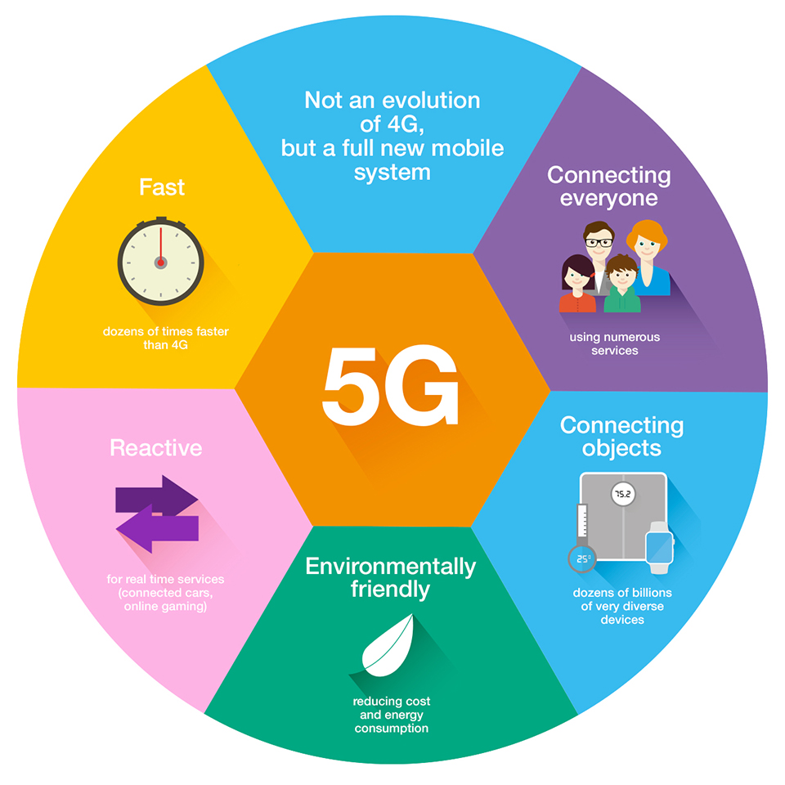
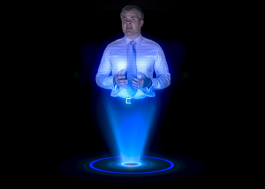
Ancient Form of Communication
The Digital Age: Internet and Smartphone Revolution (Cont.)
Artificial Intelligence - AI-powered communication tools are on the rise. Natural language processing, chatbots, and voice assistants continue to improve, allowing for more personalized and efficient communication experiences.
Virtual and Augmented Reality
Artificial Intelligence
5G

