Slide 1

Hash function and digital signature

Slide 2

Introduction
A hash function is a unique tool in computer science that transforms any input data into a fixed-size string of characters, acting like a digital fingerprint.
Digital signatures build on this by ensuring the authenticity and integrity of digital messages or documents. Using cryptographic methods, they confirm that the content hasn't been tampered with and verify the sender's identity.

Slide 3
What is a Hash Function?
A hash function is a mathematical algorithm that transforms input data of any size into a fixed-size string of characters, which is typically a sequence of numbers and letters. The output is known as a hash value, hash code, or simply a hash. Hash functions are widely used in computer science for various applications, such as data retrieval, encryption, and data integrity verification.

Slide 4
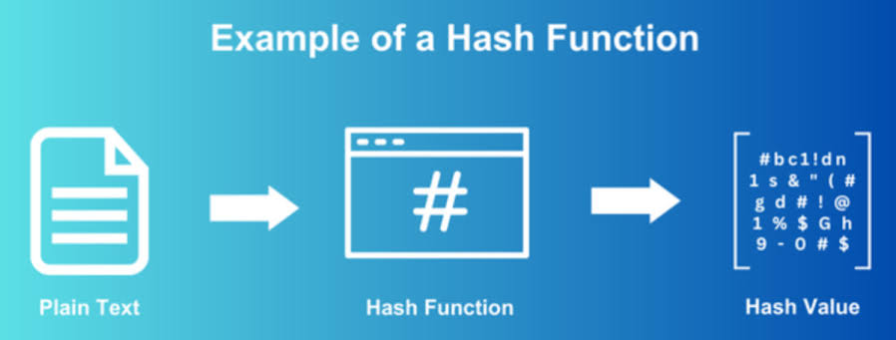

Slide 5
Applications of Hash Functions
Data Integrity: Verify that data hasn’t been altered.
Password Storage: Store hashed passwords.
Digital Signatures: Used in the signing process.

Slide 6
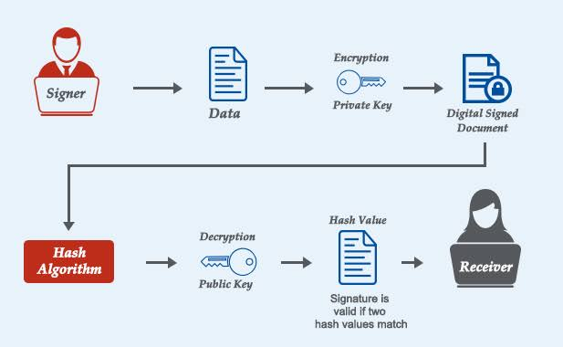

Slide 7
What is a Digital Signature?
A digital signature is an electronic signature that uses a mathematical algorithm to validate the authenticity and integrity of a message, software, or digital document.

Slide 8
Components of Digital Signatures
Key Pair:
Private Key: Used for signing.
Public Key: Used for verification.
Hashing: The document is hashed before signing.

Slide 9
Digital Signature Process
Document is hashed using a hash function.
Hash is encrypted with the signer’s private key.
The digital signature is attached to the document.
Verification of Digital Signatures
Process:
Recipient hashes the received document.
The digital signature is decrypted with the sender's public key.
If the hashes match, the signature is valid.

Slide 10
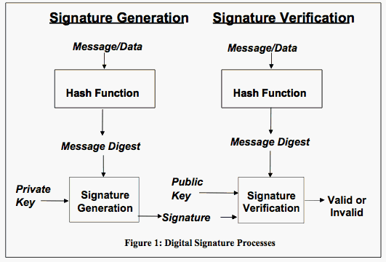

Slide 11
Where Are Digital Signatures Used?
Digital signatures are used in a variety of applications to ensure the authenticity and integrity of digital documents. They are commonly used in areas such as email communication, software distribution, financial transactions, legal contracts, and government documents

Slide 12
Hash Functions in Digital Signatures
Hash functions play a critical role in digital signatures by ensuring data integrity and security. In the process of creating a digital signature, a hash function is used to generate a fixed-size string of characters (a hash value) from the original message. This hash value is unique to the specific content of the message, much like a fingerprint. When a digital signature is created, it is typically applied to this hash value rather than the entire message, making the process more efficient.

