Slide 1
WORK AND EMPLOYMENT TRANSFORMED

Slide 2
Rapid Technology Progress
Beyond traditional industrial automation and advanced robots, new generations of more capable autonomous systems are appearing in environments ranging from autonomous vehicles on roads to automated check-outs in grocery stores. Much of this progress has been driven by improvements in systems and components, including mechanics, sensors and software.

Slide 3
Potential to transform businesses and contribute to economic growth
These technologies are already generating value in various products and services, and companies across sectors use them in an array of processes to:
Personalize product recommendations
Find anomalies in production
Identify fraudulent transactions, and more.

Slide 4
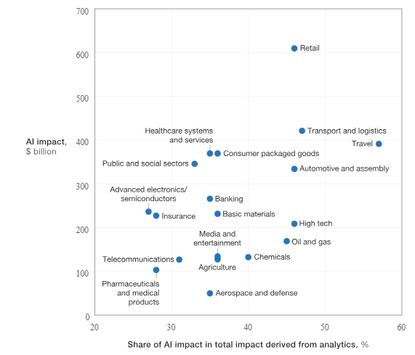

Slide 5
Challenges remain before these technologies can live up to their potential
AI and automation still face challenges. The limitations are partly technical, such as the need for massive training data and difficulties “generalizing” algorithms across use cases. Other challenges are in the use of AI techniques. For example, explaining decisions made by machine learning algorithms is technically challenging, which particularly matters for use cases involving financial lending or legal applications. Potential bias in the training data and algorithms, as well as data privacy, malicious use, and security are all issues that must be addressed.

Slide 6
Adoption of Technology across sectors and countries.
The finance, automotive, and telecommunications sectors lead AI adoption. Among countries:
US - $15 billion to $23 billion
Asia - $8 billion to $12 billion
Europe - $3 billion to $4 billion

Slide 7
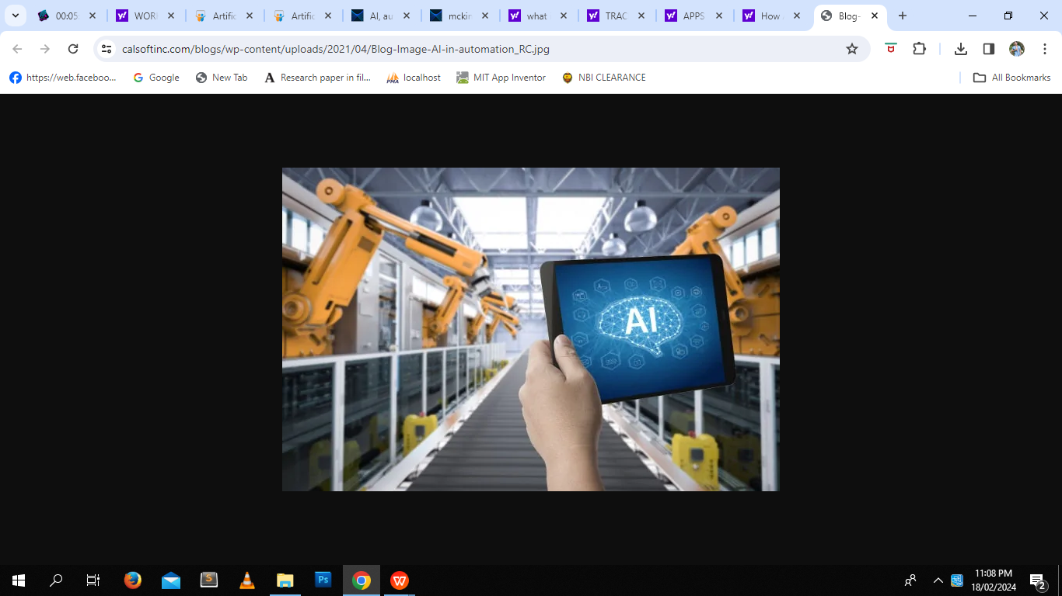
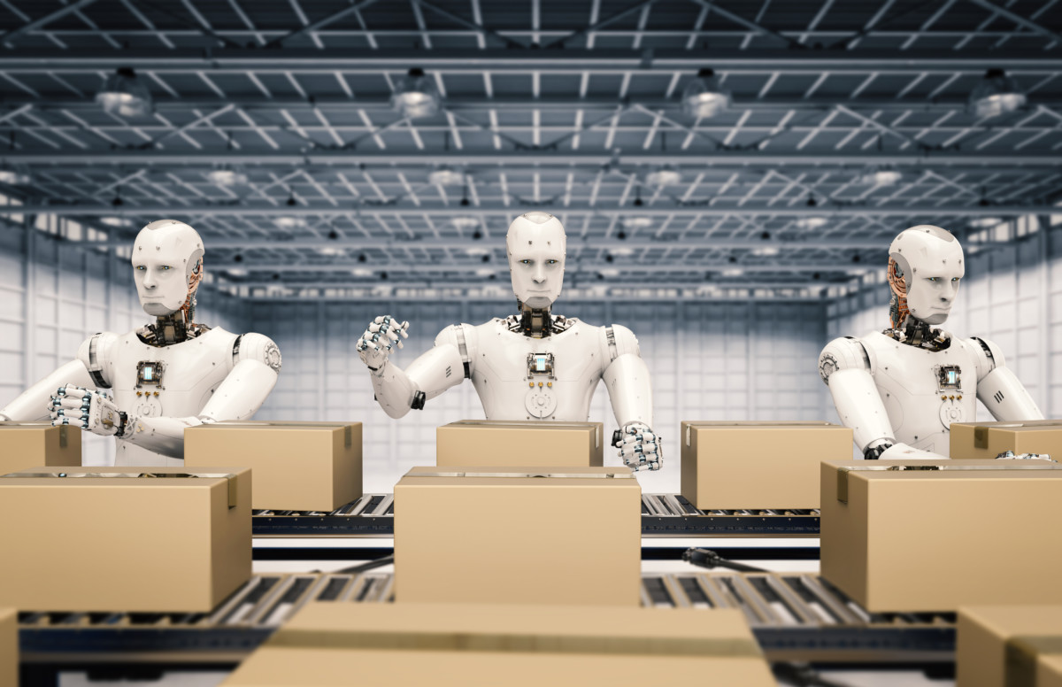
How AI and automation will affect work
Even as AI and automation bring benefits to business and society, we will need to prepare for major disruptions to work.

Slide 8
Many more occupations have portions of their constituent activities that are automatable: we find that about 30 percent of the activities in 60 percent of all occupations could be automated. This means that most workers—from welders to mortgage brokers to CEOs—will work alongside rapidly evolving machines. The nature of these occupations will likely change as a result.

Slide 9
Jobs lost: Some occupations will see significant declines by 2030
Automation will displace some workers. We have found that around 15 percent of the global workforce, or about 400 million workers, could be displaced by automation in the period 2016–2030. This reflects our midpoint scenario in projecting the pace and scope of adoption. Under the fastest scenario we have modeled, that figure rises to 30 percent, or 800 million workers.

Slide 10
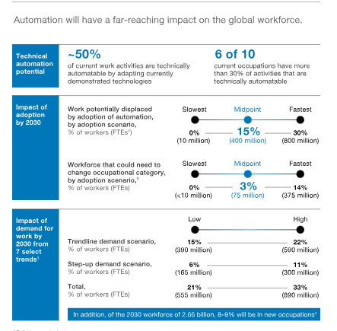

Slide 11
Jobs changed: More jobs than those lost or gained will be changed as machines complement human labor in the workplace.
Partial automation will become more prevalent as machines complement human labor. For example, AI algorithms that can read diagnostic scans with a high degree of accuracy will help doctors diagnose patient cases and identify suitable treatment. In other fields, jobs with repetitive tasks could shift toward a model of managing and troubleshooting automated systems. At retailer Amazon, employees who previously lifted and stacked objects are becoming robot operators, monitoring the automated arms and resolving issues such as an interruption in the flow of objects.

Slide 12
Workplaces and workflows will change as more people work alongside machines
As intelligent machines and software are integrated more deeply into the workplace, workflows and workspaces will continue to evolve to enable humans and machines to work together. As self-checkout machines are introduced in stores, for example, cashiers can become checkout assistance helpers, who can help answer questions or troubleshoot the machines. More system-level solutions will prompt rethinking of the entire workflow and workspace. Warehouse design may change significantly as some portions are designed to accommodate primarily robots and others to facilitate safe human-machine interaction.

Slide 13
Growing body of research has begun to explore the nuanced ways in which technology is influencing the workplace and the workforce, shedding light on both its many benefits and substantial risks.
How Is AI Transforming Hiring?
One of the most significant areas in which technology has transformed the workplace is before new candidates even get in the door. AI tools can help recruiters sift through resumes, review cover letters, and even conduct virtual interviews. But these tools can also introduce new complexities and biases into the hiring process.

Slide 14


Slide 15
AI hiring tools can influence who applies:
In one study, researchers asked more than 500 U.S.-based adults to imagine applying to a job through a system that used AI. They found that candidates who were already excited about the prospective employer and felt positively about AI in general were more likely to complete an application,. Candidates who were anxious or distrustful of AI, or who were less enthusiastic about the employer, were less likely to complete their applications if interaction with AI was required. This suggests that incorporating automated tools into the hiring process can affect different candidates’ experiences differently, influencing who ends up applying in potentially surprising ways.

Slide 16
Automated screening can perpetuate bias:
While the potential for AI-based systems to perpetuate human biases is well-known, a new study found that even when explicitly gendered information (such as names or pronouns) is removed, today’s sophisticated machine learning models can still accurately determine a candidate’s gender. Furthermore, the study found that after controlling for job-relevant traits, when elements of a candidate’s resume did not line up with their gender — i.e., when a woman’s resume included traditionally masculine characteristics — they were less likely to get called back for an interview.

Slide 17
How Does Digital Monitoring Impact Employees?
Of course, the hiring process is hardly the last time that a new employee is likely to find themselves interacting with a digital system. The last several years have seen an explosion in employee monitoring tools, from keystroke tracking apps to wearable GPS monitors. And while proponents praise these tools’ potential to boost efficiency and transparency, recent research has painted a more nuanced picture.

Slide 18
Electronic monitoring can harm both workers and employers:
team of researchers conducted a meta-analysis of results from more than 50 different academic studies and found that being monitored electronically reduces employees’ job satisfaction and increases their stress levels. They also found that monitoring has no effect on performance, but that it does slightly increase the chances that an employee will engage in counterproductive behaviors, such as working less than expected, wasting resources, or mistreating coworkers and supervisors. This is in line with other recent research suggesting that monitoring workers makes them more likely to break rules, because it reduces their sense of responsibility for their own actions.

Slide 19
As with growth in any new technology, the recent explosion in digital workplace tools is neither all good nor all bad. Rather, optimism and enthusiasm for progress must be balanced with an acknowledgement of the very real — and not always positive — impact that these tools can have on the people who interact with them. As new research explores these varied effects, leaders must continuously check their assumptions, avoid oversimplification, and work to ensure that their decisions are driven not by knee-jerk reactions or gut feel alone, but by the latest data and evidence.

Slide 20
DIGITAL DIVIDE

Slide 21
Digital Divide
is the unequal access to digital technology, including smartphones, tablets, laptops, and the internet. The digital divide creates a division and inequality around access to information and resources. In the Information Age in which information and communication technologies (ICTs) have eclipsed manufacturing technologies as the basis for world economies and social connectivity, people without access to the Internet and other ICTs are at a socio-economic disadvantage, for they are unable or less able to find and apply for jobs, shop and learn.

Slide 22
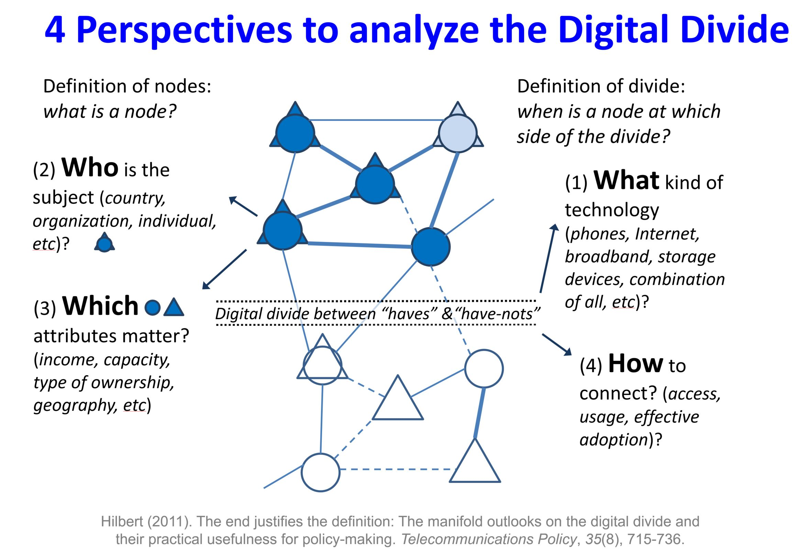

Slide 23
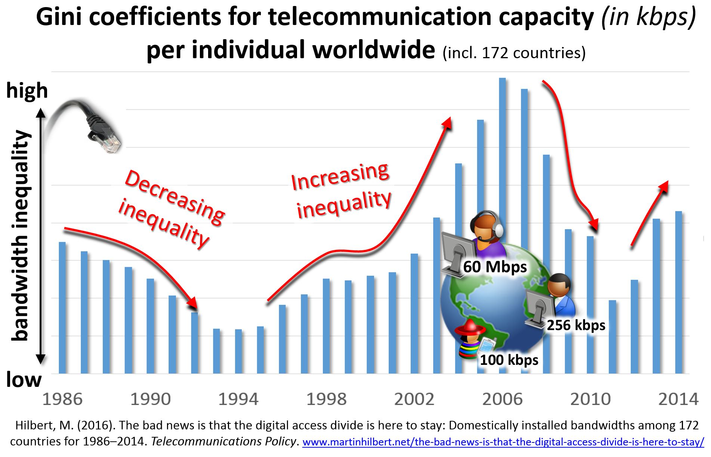

Slide 24
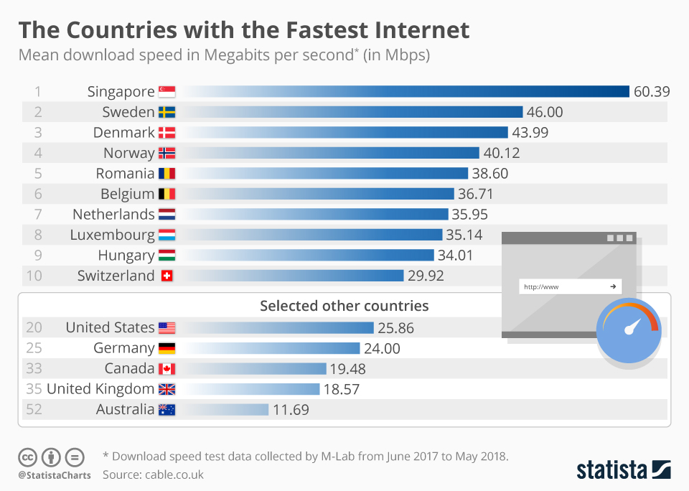

Slide 25
10 COUNTRIES WITH THE FASTEST INTERNET 2023
Liechtenstein has the fastest broadband in the world with an average speed of 246.76Mbps.
Liechtenstein Taiwan
Macau France
Iceland Netherlands
Andorra Slovakia
Luxembourg USA

Slide 26
10 COUNTRIES WITH THE SLOWEST INTERNET 2023
Afghanistan has the slowest broadband in the world with an average speed of just 0.77Mbps. It would take 28 minutes to download a 5GB movie.
Afghanistan Tajikistan
Yemen Cameroon
Syria Ethiopia
East Timor Burundi
Equatorial Guinea South Sudan

Slide 27
In 2017, the Wireless Broadband Alliance published the white paper The Urban Unconnected, which highlighted that in the eight countries with the world's highest GNP about 1.75 billion people had no internet connection, and one third of them lived in the major urban centers. Delhi (5.3 millions, 9% of the total population), São Paulo (4.3 millions, 36%), New York (1.6 mln, 19%), and Moscow (2.1 mln, 17%) registered the highest percentages of citizens who had no internet access of any type.

Slide 28
As of 2021, only about half of the world's population had access to the internet, leaving 3.7 billion people without internet. A majority of those are in developing countries, and a large portion of them are women.Technologies that provide an internet connection through satellite are becoming more common, like Starlink, but they are still not available in many regions.Based on location, a connection may be so slow as to be virtually unusable, solely because a network provider has limited infrastructure in the area. For example, to download 5 GB of data in Taiwan it might take about 8 minutes, while the same download might take 30 hours in Yemen.

