Slide 1
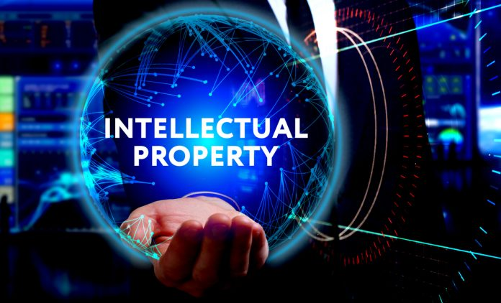

Slide 2
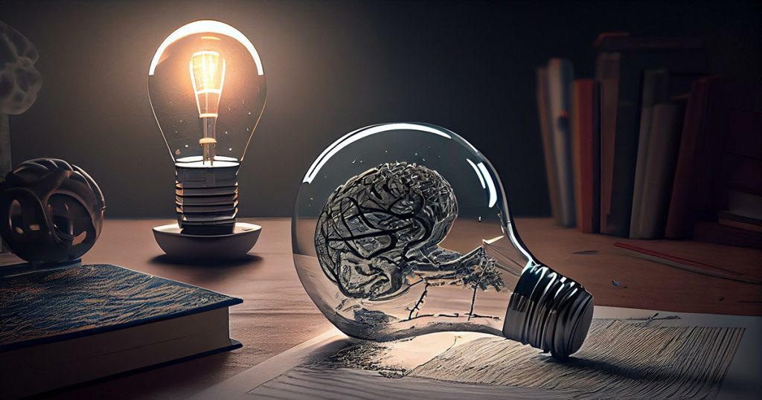
What is Intelectual Property?
Intellectual property rights (IPR) have been defined as ideas, inventions, and creative expressions based on which there is a public willingness to bestow the status of property. IPR provide certain exclusive rights to the inventors or creators of that property, in order to enable them to reap commercial benefits from their creative efforts or reputation. There are several types of intellectual property protection like patent, copyright, trademark, etc.

Slide 3
PHILIPPINE LAWS ON INTELLECTUAL PROPERTY
R.A. 8293 - An Act prescribing the Intellectual Property Code and establishing the Intellectual Property Office, providing for its powers and functions, and for other purposes.
R.A. 165 - An Act creating a patent office, prescribing its powers and duties, regulating the issuance of patents, and appropriating funds therefore

Slide 4
R.A. 166 - An Act to provide for the registration and protection of trade-marks, trade-names, and service marks, defining unfair competition and false marking and providing remedies against the same, and for other purposes.
PRESIDENTIAL DECREE NO. 49
Decree on the protection of intellectual property

Slide 5
PATENT
A patent is an exclusive right granted for an invention, which is a product or a process that provides, in general, a new way of doing something, or offers a new technical solution to a problem. To get a patent, technical information about the invention must be disclosed to the public in a patent application.

Slide 6
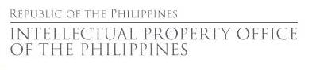


Slide 7
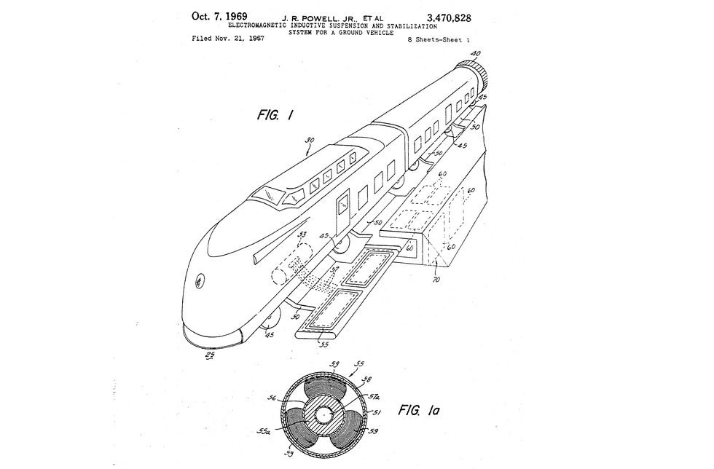
Magnetic Levitation (Maglev)
Patent Name: “Electromagnetic inductive suspension and stabilization system for a ground vehicle”

Slide 8
The story of the maglev train begins with Eric Laithwaite and his work on full-size linear induction motors. The inventor realized a linear motor, which does not require contact with a railroad track, could be used to develop a transportation system based on magnetic fields. Laithwaite tested linear induction motors that could use magnets to achieve both lift and forward thrust.
Laithwaite’s work was widely studied, and in 1967, James Powell and Gordon Danby of the Brookhaven National Laboratory received the first patent for a maglev train.

Slide 9
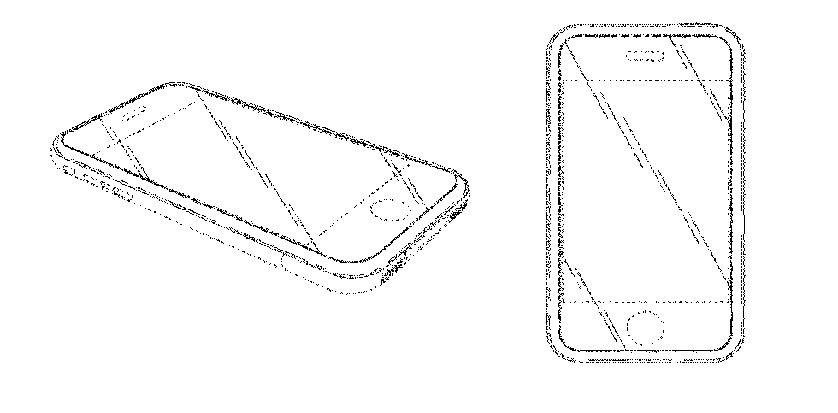
iPhone
Patent Name: Patent Name: “Electronic device”

Slide 10
The patent for the signature device of the 21st century tells you almost nothing about it. In its entirety, Apple’s patent for the original iPhone, listed simply as an “electronic device,” says only that it is an “ornamental design of an electronic device, as shown and described.” The document then labels eight figures of the “electronic device,” telling you only which direction it is shown from, and then cites other relevant patents and documentation.

Slide 11
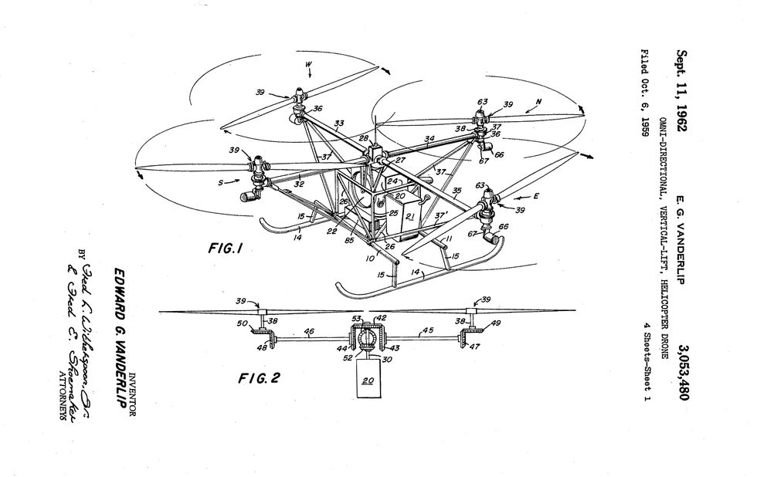
Quadcopter Drone
Patent Name: “Omni-directional, vertical-lift, helicopter drone”

Slide 12
The quadcopter drone, found today buzzing over parks and bothering airplanes, was first patented back in 1962. Edward G. Vanderlip, an engineer for Piasecki Aircraft Corporation. His patent for an “omni-directional, vertical-lift, helicopter drone” outlines a UAV designed to be “extremely simple” to fly.

Slide 13
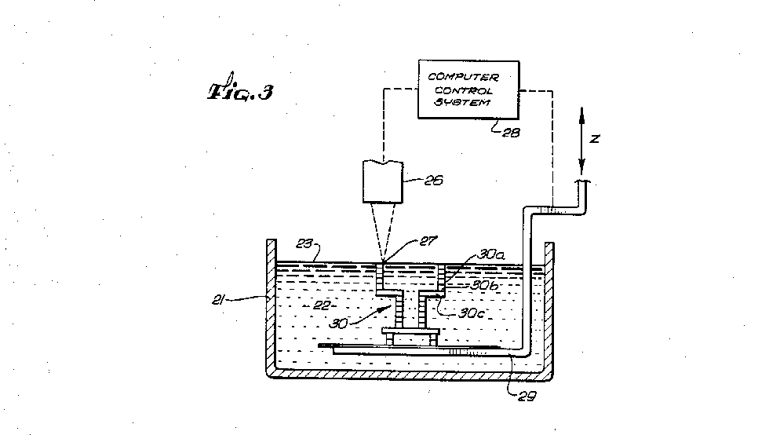
3D Printer
Patent Name: “Apparatus for production of three-dimensional objects by stereolithography”

Slide 14
Issued in 1986, the patent for a 3D-printer was ahead of its time. The document outlines the basic technology used by most 3D printers: stereolithography, or light-solidification of resin.

Slide 15
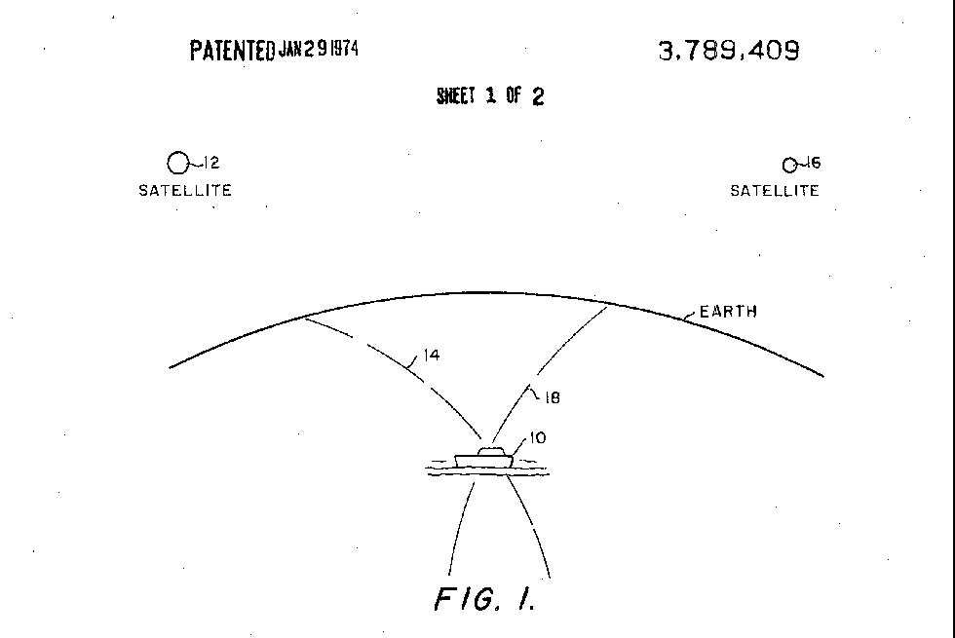
Global Positioning System
Patent Name: “Navigation system using satellites and passive ranging techniques”

Slide 16
The Navy invented GPS satellites, and today, the Air Force operates them. Roger L. Easton was the mastermind behind the Global Positioning System, as he developed technologies in the 1950s for the Naval Research Laboratory (NRL) to track U.S.

Slide 17
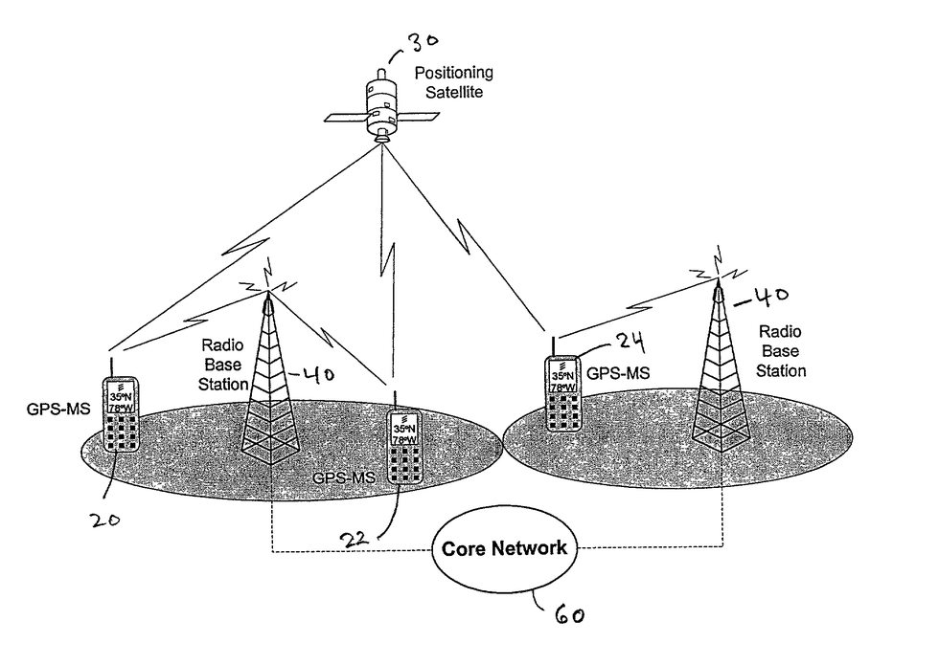
Bluetooth
Patent Name: “Peer to peer information exchange for mobile communications devices”

Slide 18
Jaap Haartsen invented Bluetooth in 1994, allowing electronic devices in close proximity to connect to each other using low-power, ultra high-frequency radio waves. Haartsen has drafted multiple patents relating to Bluetooth, but they have been stymied by lawsuits and patent trolls. This 2013 patent describes how the technology can be used to transmit GPS data.

Slide 19
Solar Panel
Patent Name: “Apparatus for utilizing solar radiant energy”

Slide 20
In the early 19th century, French physicist Edmund Becquerel discovered that certain materials generate a small electric current when exposed to light: the photovoltaic effect. In 1839, he created the first photovoltaic cell by connecting silver chloride placed in an acid solution to platinum electrodes.

Slide 21
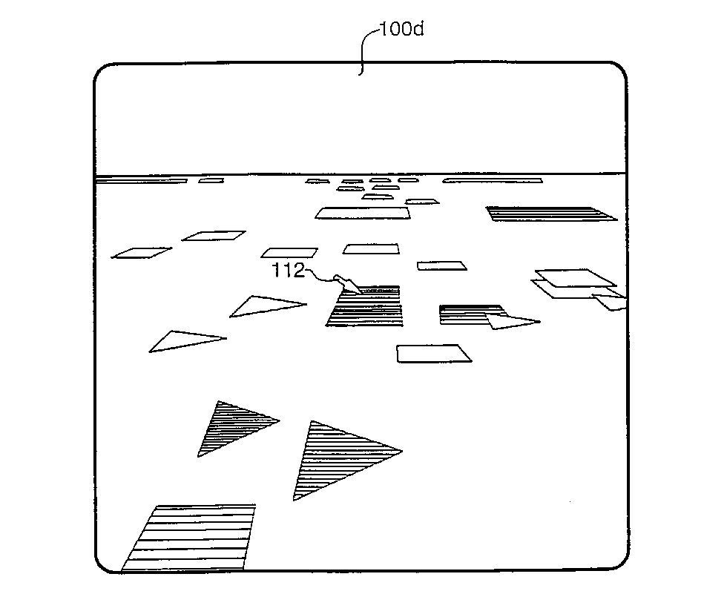
Virtual Reality
Patent Name: “Virtual reality generator for displaying abstract information”

Slide 22
The first proposed VR headset was designed not to play video games or watch sports, but to help users analyze financial data. The 2000 patent for a “virtual reality generator” awarded to inventor Paul Marshall describes a computer-generated world that the user could navigate through “using control devices, such as a trackball or spaceball, an electronic data glove, a magnetic head position tracker, a keyboard, a joystick or a steering wheel.”

Slide 23
COPYRIGHT
Copyright is the right of an author of a creative work to prevent others from copying that work. Creative works include computer code, brochures, manuals, web pages, books, songs, movies, and blog posts.
It is a good idea, however, to include a copyright notice, such as “© David Canton 2022. All rights reserved”.

Slide 24
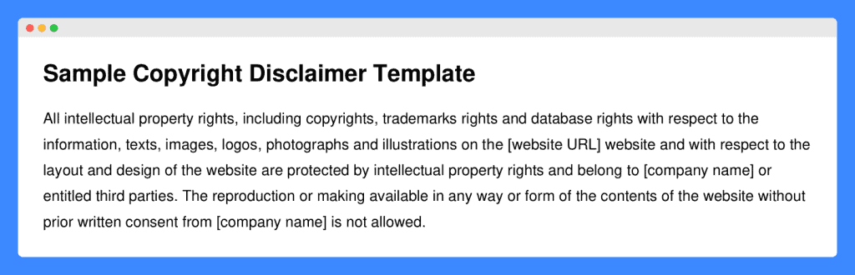

Slide 25
When to Use No Copyright Infringement Intended?
The phrase “no infringement of copyright is intended” is often used as a disclaimer to show that the use of copyrighted material in a certain work was not done with the intention of infringing on the original owner’s rights.

Slide 26
What to Use Instead of “No Copyright Infringement Intended?”
Instead of using “no copyright infringement intended,” you can consider using phrases such as:
“Content used with permission”
“Used under fair use/fair dealing”
“All rights belong to the respective owners”
“Content shared for informational/educational purposes”
“Used with proper attribution”
“Content used in accordance with copyright law”
“Material shared with consent of copyright holder”

Slide 27
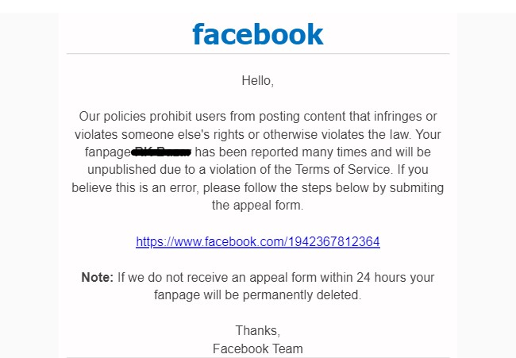
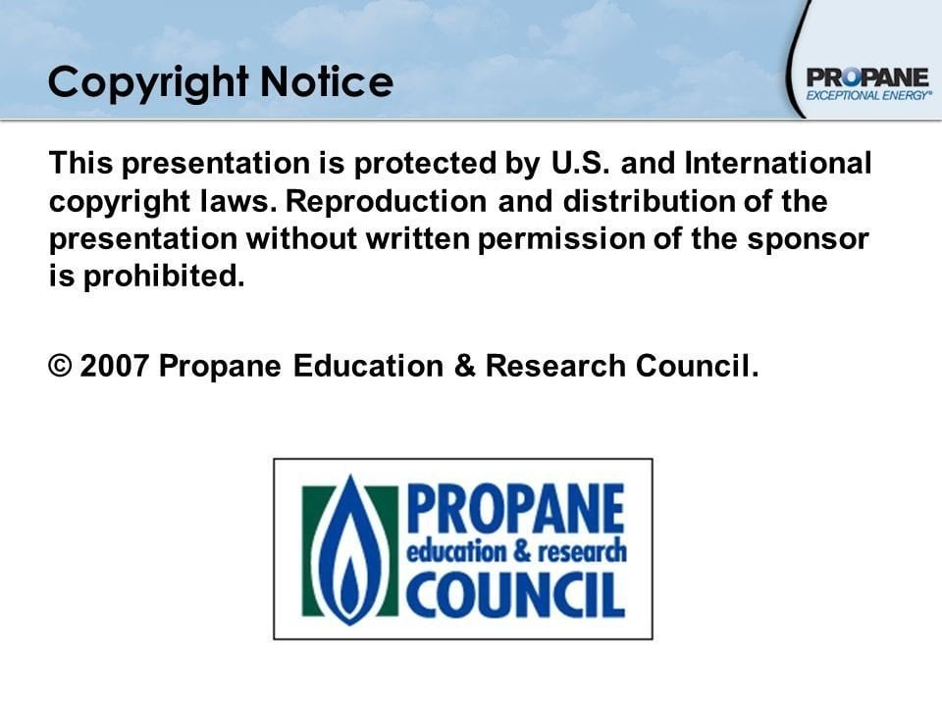

Slide 28
Trade Secret
Trade secrets are a type of intellectual property that includes formulas, practices, processes, designs, instruments, patterns, or compilations of information that have inherent economic value because they are not generally known or readily ascertainable by others, and which the owner takes reasonable measures to keep secret. Intellectual property law gives the owner of a trade secret the right to restrict others from disclosing it.

Slide 29
A trade secret is information that:
Is not generally known to the public;
Confers economic benefit on its holder because the information is not publicly known.
Where the holder makes reasonable efforts to maintain its secrecy.

Slide 30

Examples of trade secrets include the Coca-Cola recipe, search engine algorithms, customer lists or sales methods.

Slide 31


Example:
Google's search algorithm exists as intellectual property in code and is regularly updated to improve and protect its operations

Slide 32

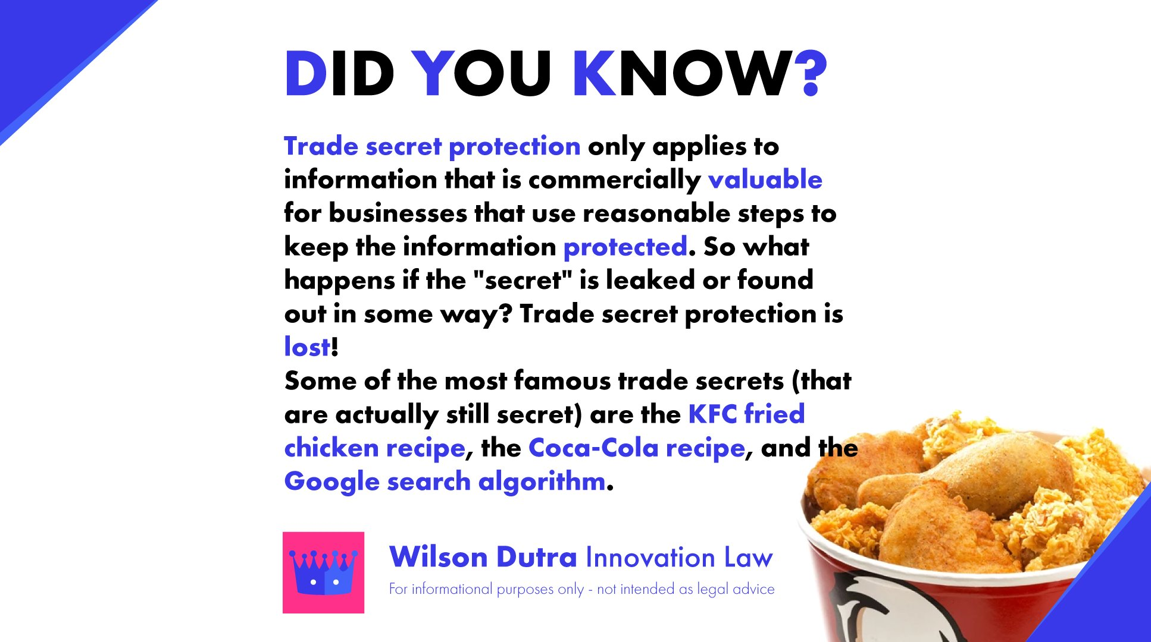

Slide 33
TRADEMARK
The term trademark refers to a recognizable insignia, phrase, word, or symbol that denotes a specific product and legally differentiates it from all other products of its kind. A trademark exclusively identifies a product as belonging to a specific company and recognizes the company's ownership of the brand.

Slide 34
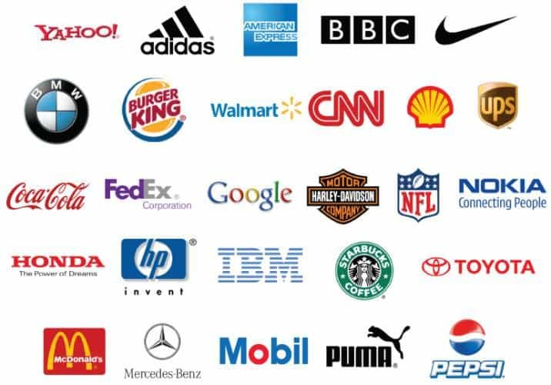
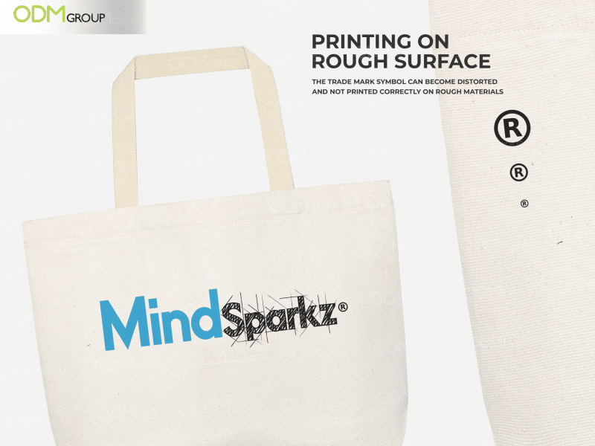
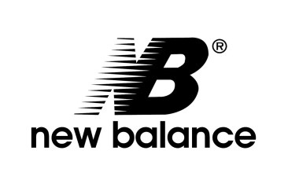



Slide 35
Differences in general Trademarks and Domain Names: What’s the Difference
Trademarks protect a company’s brand or design in order to set it apart from rivals selling identical goods or services.
The words that connect you to a website are known as domain names. To visit a website without domain names, you’d need to know its IP address.
www.trademark.net.ph

Slide 36
PLAGIARISM
Plagiarism is the use of another’s work, words, or ideas without attribution. The word “plagiarism” comes from the Latin word for “kidnapper” and is considered a form of theft, a breach of honesty in the academic community.

Slide 37
Here are some examples of Plagiarism:
Turning in someone else's work as your own.
Copying large pieces of text from a source without citing that source.
Taking passages from multiple sources, piecing them together, and turning in the work as your own.
Copying from a source but changing a few words and phrases to disguise plagiarism.
Paraphrasing from a number of different sources without citing those sources.
Turning in work that you did for another class without getting your professor's permission first.
Buying an essay or paper and turning it in as your own work.

Slide 38
It's important to remember that plagiarism can be both intentional and unintentional. However, unintentional plagiarism carries the same consequences. There are steps you can take to avoid plagiarizing unintentionally:
Plan well: Make sure you give yourself enough time to properly research and write your assignment. This will get rid of the temptation to plagiarize and make you less likely to make a careless mistake.
Take good notes: When taking notes, be sure to keep track of which source your information is coming from, which of your notes are direct quotes and paraphrases, and make sure to note where in the source your information is coming from.

Slide 39
You can avoid plagiarism by:
Keeping track of the sources you consult in your research
Paraphrasing or quoting from your sources (by using a paraphrasing tool and adding your own ideas)
Crediting the original author in an in-text citation and in your reference list
Using a plagiarism checker before you submit
Use generative AI tools responsibly (outputs may be detected by an AI detector)

Slide 40

THANK YOU!

