Slide 1
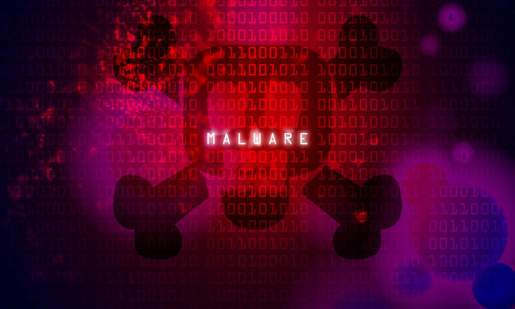
Effects of malware

Slide 2
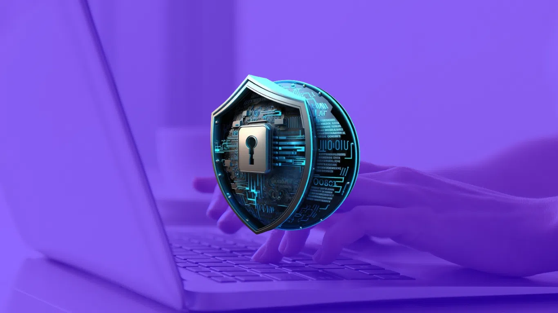
Malware, or malicious software, is any program or file that is intentionally harmful to a computer, network or server. Types of malware include computer viruses, worms, Trojan horses, ransomware and spyware. These malicious programs steal, encrypt and delete sensitive data; alter or hijack core computing functions and monitor end users' computer activity.
What is malware?

Slide 3
What does malware do?
Malware can infect networks and devices and is designed to harm those devices, networks and/or their users in some way.
Depending on the type of malware and its goal, this harm may present itself differently to the user or endpoint. In some cases, the effect malware has is relatively mild and benign, and in others, it can be disastrous.

Slide 4
What are the different types of malware?
Virus - A virus is the most common type of malware that can execute itself and spread by infecting other programs or files.
Worm - A worm can self-replicate without a host program and typically spreads without any interaction from the malware authors.
Trojan horse - A Trojan horse is designed to appear as a legitimate software program to gain access to a system. Once activated following installation, Trojans can execute their malicious functions.

Slide 5
Spyware - Spyware collects information and data on the device and user, as well as observes the user's activity without their knowledge.
Ransomware - Ransomware infects a user's system and encrypts its data. Cybercriminals then demand a ransom payment from the victim in exchange for decrypting the system's data.
Rootkit - A rootkit obtains administrator-level access to the victim's system. Once installed, the program gives threat actors root or privileged access to the system.
Backdoor - A backdoor virus or remote access Trojan (RAT) secretly creates a backdoor into an infected computer system that enables threat actors to remotely access it without alerting the user or the system's security programs.

Slide 6
Adware - Adware tracks a user's browser and download history with the intent to display pop-up or banner advertisements that lure the user into making a purchase. For example, an advertiser might use cookies to track the webpages a user visits to better target advertising.
Keyloggers - Keyloggers, also called system monitors, track nearly everything a user does on their computer. This includes emails, opened webpages, programs and keystrokes.

Slide 7
How to detect malware?
Users may be able to detect malware if they observe unusual activity such as a sudden loss of disk space, unusually slow speeds, repeated crashes or freezes, or an increase in unwanted internet activity and pop-up advertisements.
Antivirus and antimalware software may be installed on a device to detect and remove malware. These tools can provide real-time protection or detect and remove malware by executing routine system scans.
Windows Defender, for example, is Microsoft antimalware software included in the Windows 10 operating system (OS) under the Windows Defender Security Center. Windows Defender protects against threats such as spyware, adware and viruses. Users can set automatic "Quick" and "Full" scans, as well as set low, medium, high and severe priority alerts.

Slide 8
History of malware
The term malware was first used by computer scientist and security researcher Yisrael Radai in 1990. However, malware existed long before this.
One of the first known examples of malware was the Creeper virus in 1971, which was created as an experiment by BBN Technologies engineer Robert Thomas. Creeper was designed to infect mainframes on ARPANET ( Advanced Research Projects Agency Network). While the program did not alter functions or steal or delete data, it moved from one mainframe to another without permission while displaying a teletype message that read, "I'm the creeper: Catch me if you can." Creeper was later altered by computer scientist Ray Tomlinson, who added the ability to self-replicate to the virus and created the first known computer worm.

