Slide 1
Data protection and privacy

Slide 2

Data Protection and privacy
Data protection and privacy are essential for safeguarding individuals' personal information in an increasingly digital world. Data protection involves securing personal data from unauthorized access and misuse, while privacy ensures individuals have control over their personal information. With growing reliance on digital services, regulatory frameworks like the GDPR and CCPA have emerged to protect users’ data rights, requiring organizations to be transparent about data collection and provide options for user consent and data management. Effective data protection builds trust, helps prevent data breaches, and ensures that privacy rights are respected in all digital interactions.

Slide 3
Data classification and labeling
Data Classification is the process of organizing data into categories based on its sensitivity, value, and risk level, helping determine appropriate access and protection measures.

Slide 4
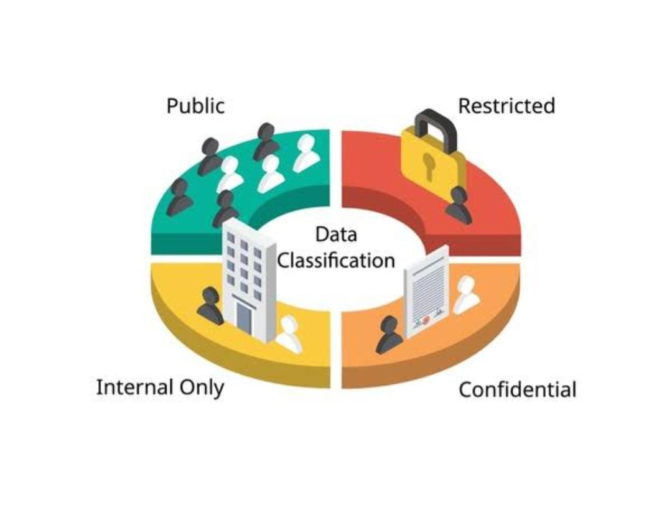

Slide 5
Types of Data Classifications
Public: Openly accessible information.
Internal/Confidential: Limited access, moderate sensitivity.
Sensitive: Potential for harm if breached.
Restricted/Highly Confidential: Highest security level, minimal access.
Data Classification Techniques
Automated Classification: Uses AI and machine learning.
Manual Classification: Human-based classification, often policy-driven.
Role-Based Classification: Access based on user roles.

Slide 6
Data labeling
Data Labeling involves tagging or marking data with metadata to indicate its classification level and handling requirements, ensuring that users and systems treat it according to its sensitivity.

Slide 7
Types of Data Labels
Confidentiality Labels: Indicate sensitivity level (e.g., “Public,” “Confidential”).
Retention Labels: Define retention period and deletion timelines.
Handling Labels: Specify handling rules (e.g., “Encrypt before sharing”).
Labeling Techniques
Manual Labeling: Labels added by users based on data sensitivity.
Automated Labeling: Uses rules and algorithms to assign labels consistently.

Slide 8
Importance of data classification and labeling in security
Access Control: Enforces who can access what data.
Data Loss Prevention (DLP): Helps prevent data breaches and unauthorized sharing.
Compliance: Ensures adherence to regulations like GDPR, HIPAA, CCPA.
Incident Response: Facilitates risk assessment and prioritization during security incidents.

Slide 9
Implementing data classification and labeling
Data Inventory: Identify data assets and sensitivity.
Policies and Guidelines: Set clear policies for consistent classification and labeling.
Technology Integration: Use tools like DLP and IRM to automate and enforce policies.

Slide 10
Challenges in Data classification and labeling
Complexity: Requires understanding data, users, and organizational needs.
User Training: Ensuring everyone follows and understands policies.
Consistency: Maintaining uniform classification and labeling across the organization.

