Slide 1
ETHICAL THEORY AND CONCEPT

Slide 2
Ethical Theory
Ethical theory provides the views from which individuals seek direction when they make decisions, they form part of the decision-making foundation for Decision Making When Ethics Are In Play. Each theory highlights a different aspect a particular decision-making style or a decision rule – such as anticipating the outcome and honoring one's responsibilities to others to achieve what the individual thinks an ethically right option. To comprehend ethical choice making, students must first recognize that not everyone makes judgments in the same way, with the same knowledge, and using the same decision rules

Slide 3
DEONTOLOGY
-Deontology is an ethical theory based on rules that distinguish right from wrong.
-Deontology is based on the word deon that refers to “duty.” It is associated with philosopher Immanuel Kant. Kant believed that ethical actions follow universal moral laws, such as, “Don’t lie. Don’t steal. Don’t cheat.”
-Deontology is simple to apply because it just requires people to follow the rules and do their duty. It doesn’t require weighing the costs and benefits of a situation, thus avoiding subjectivity and uncertainty.

Slide 4
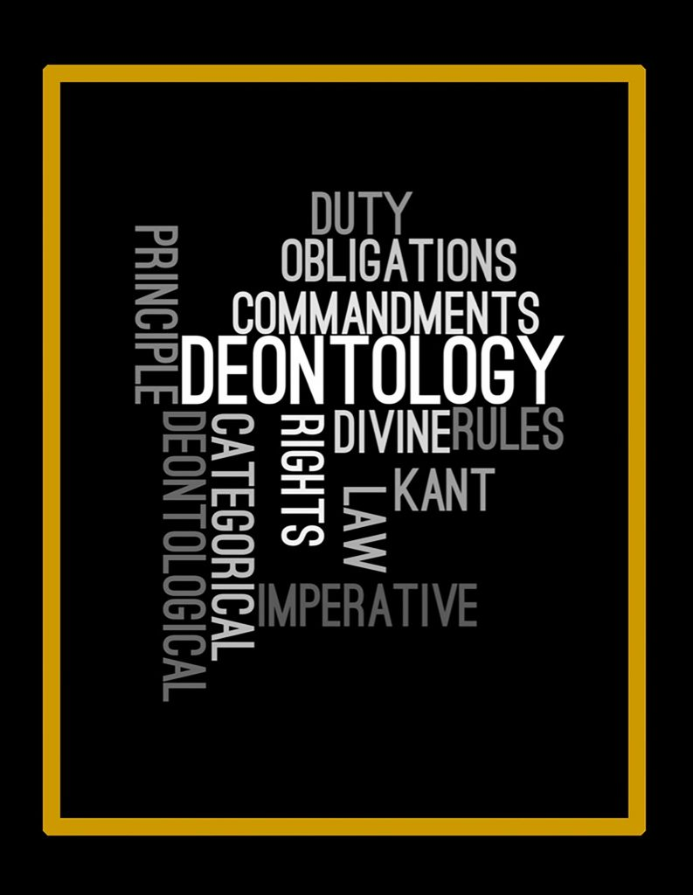
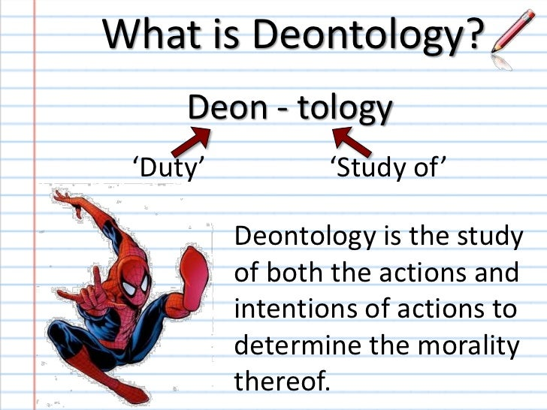
DEONTOLOGY

Slide 5
CONSEQUENTIALISM
Consequentialism is an ethical theory used to determine whether or not an action is right by the consequences of the action.
Example:
Most people agree that lying is wrong, but if telling a lie would help save a person’s life, consequentialism says it’s the right thing to do.

Slide 6

CONSEQUENTIALISM

Slide 7
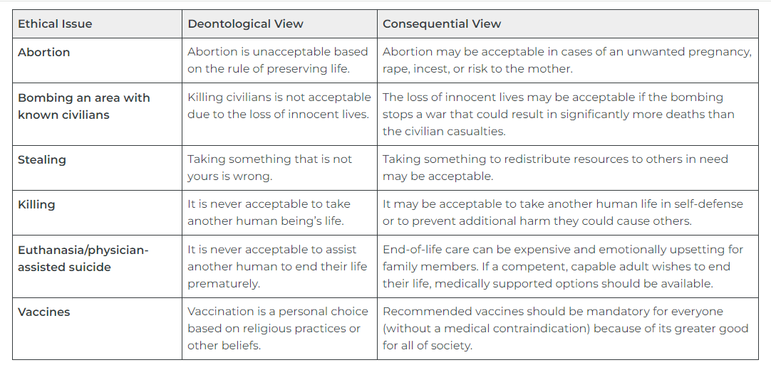
Ethical Issues Through the Lens of Deontological or Consequential Ethical Frameworks

Slide 8
Ethical Principles and Obligations
Types of Ethical Principles
Autonomy
Beneficence
Nonmaleficence
Justice

Slide 9

Autonomy
The ethical principle of autonomy recognizes each individual’s right to self-determination and decision-making based on their unique values, beliefs, and preferences. Ex: The nurse’s primary ethical obligation is client autonomy. Based on autonomy, clients have the right to refuse nursing care and medical treatment.

Slide 10
BENEFICIENCE
The beneficence principle leads the decision maker to do what is right and good. This emphasis on "doing good" creates an ethical viewpoint and a possible solution to an ethical problem. Acceptable conundrum This idea is directly connected to the utility principle, which states believe we should strive to achieve the highest possible ratio of good to evil in the world. This concept states that ethical theories should try to do the best since the best benefits the most people. This concept is mostly involved concerning connected with utilitarian ethical philosophy, which will be examined further in this collection of articles.

Slide 11

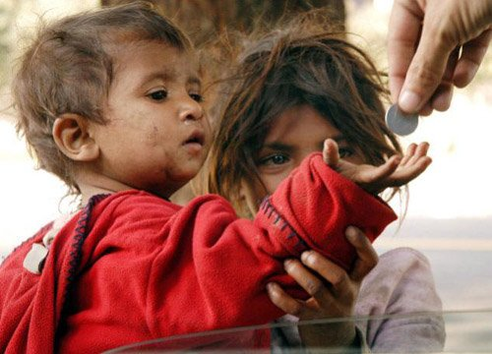
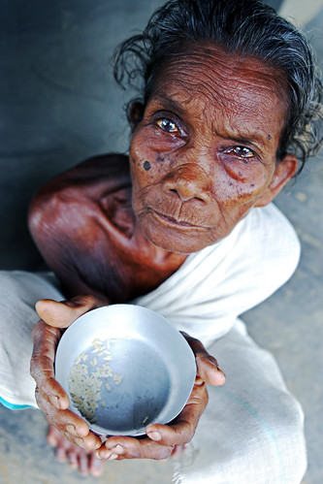

BENEFICIENCE

Slide 12
Nonmaleficence
The bioethical principle that specifies a duty to do no harm and balances avoidable harm with benefits of good achieved.” Ex: An example of doing no harm in nursing practice is reflected by nurses checking medication rights three times before administering medications. In this manner, medication errors can be avoided, and the duty to do no harm is met.

Slide 13
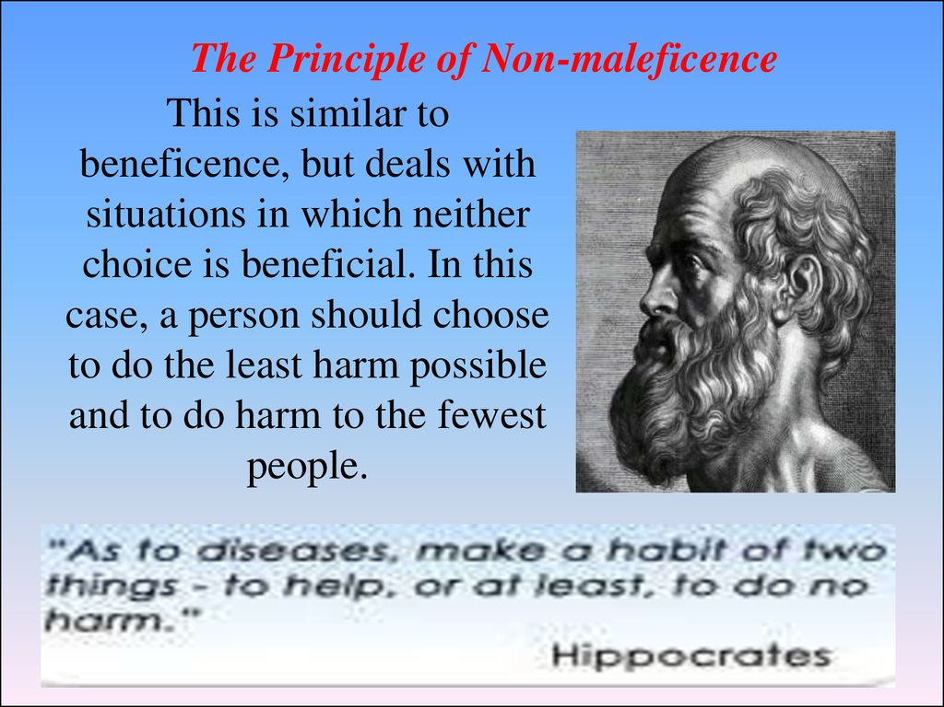
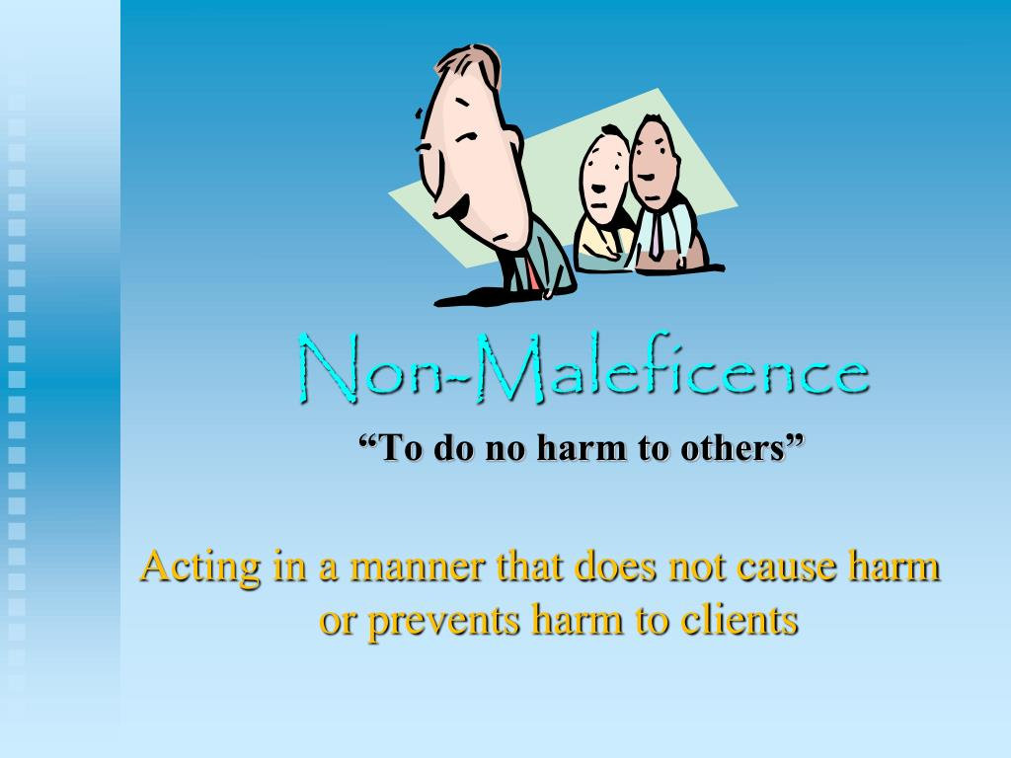
Nonmaleficence

Slide 14
JUSTICE
a moral obligation to act on the basis of equality and equity and a standard linked to fairness for all in society.
The principle of justice requires health care to be provided in a fair and equitable way. Nurses provide quality care for all individuals with the same level of fairness despite many characteristics, such as the individual’s financial status, culture, religion, gender, or sexual orientation.

Slide 15
POLICY VACUUM

Slide 16
Policy vacuum
A vacuum is defined in the Merriam-Webster dictionary as “emptiness of space” and “a space absolutely devoid of matter”. The same dictionary defines policies as “a definite course or method of action selected from among alternatives and in light of given conditions to guide and determine present and future decisions”.Often the reference to policy is really a reference to public policy. Common to definitions of public policy is that it is made and initiated by a government.

Slide 17
Evaluating the policy vacuum – Google Street View as an example
Google began offering a program called Google Maps in 2005. To enhance the information on Google Maps, Google began an experimental project called Street View to collect images and offer those images to the public. In 2007, Google provided 360-degree panoramic views of five United States cities. Five years later, Google’s experimental project has evolved to include panoramic views of public streets in all seven continents

Slide 18

Google Street View

Slide 19
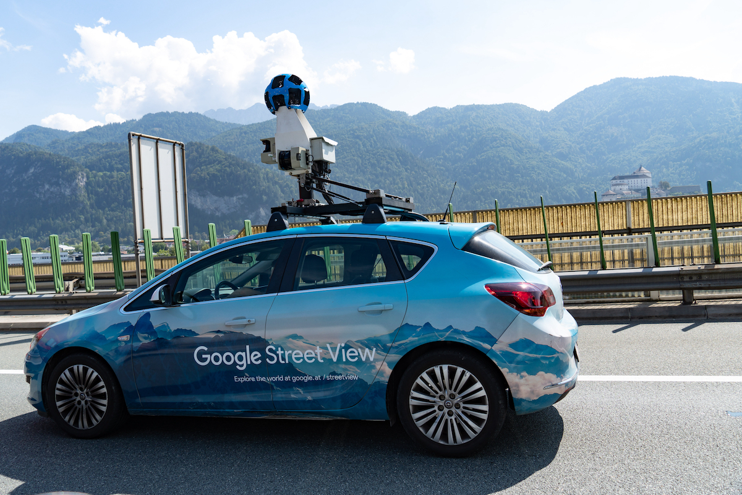

Slide 20


Slide 21
Thank you!

