Slide 1
COMPUTER ETHICS

Slide 2
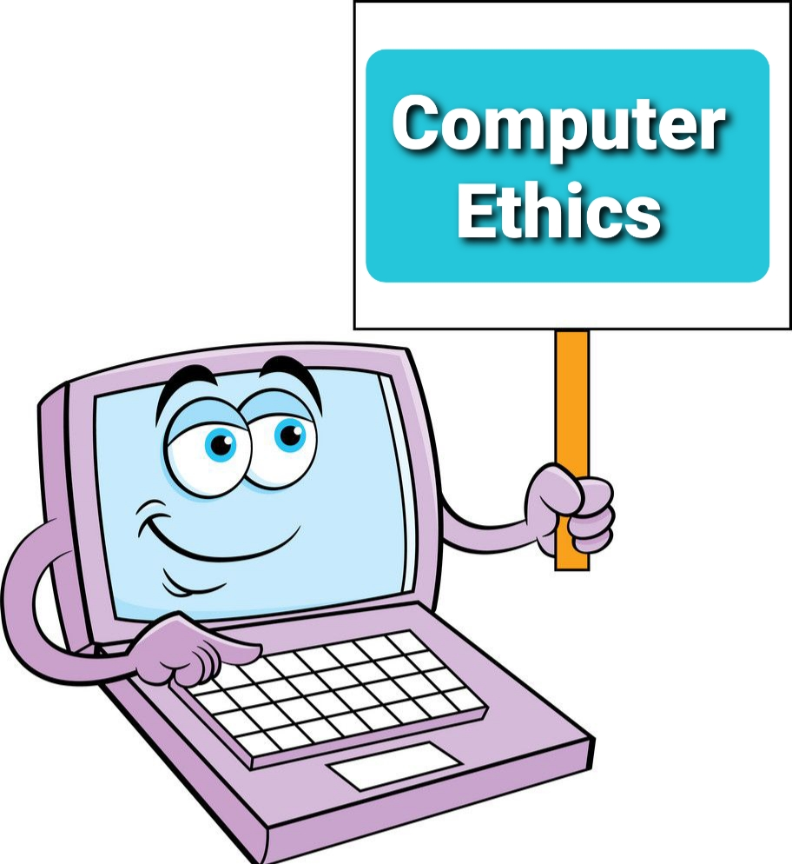
Computer Ethics
Computer ethics is a part of practical philosophy concerned with how computing professionals should make decisions regarding professional and social conduct.
Computer ethics deals with the procedures, values and practices that govern the process of consuming computing technology and its related disciplines without damaging or violating the moral values and beliefs of any individual, organization or entity.

Slide 3
As technology advances , computers continue to have a greater impact on society.
Therefore, computer ethics promote the discussion of how much influence computers should have in areas such as artificial intelligence and human communication.
As the world of computers evolves, computer ethics continues to create ethical standards that address new issues raised by new technologies.

Slide 4
History of Computer Ethics
The concept of computer ethics originated in the 1940s with MIT professor Norbert Wiener, the American mathematician and philosopher. While working on anti-aircraft artillery during World War II, Wiener and his fellow engineers developed a system of communication between the part of a cannon that tracked a warplane, the part that performed calculations to estimate a trajectory, and the part responsible for firing.[1] Wiener termed the science of such information feedback systems, "cybernetics," and he discussed this new field with its related ethical concerns in his 1948 book.

Slide 5
1950 - Wiener's second book, “The Human Use of Human Beings”. Delved deeper into the ethical issues surrounding information technology and laid out the basic foundations of computer ethics
1973, the Association for Computing Machinery (ACM) adopted its first code of ethics. SRI International's Donn Parker, an author on computer crimes, led the committee that developed the code.
1978 - the Right to Financial Privacy Act was adopted by the United States Congress, drastically limiting the government's ability to search bank records.

Slide 6

1979 - During the next year Terrell Ward Bynum, the professor of philosophy at Southern Connecticut State University as well as Director of the Research Center on Computing and Society there, developed curriculum for a university course on computer ethics.
1983 - the journal held an essay contest on the topic of computer ethics and published the winning essays in its best-selling 1985 special issue, “Computers and Ethics”.
1984 - the United States Congress passed the Small Business Computer Security and Education Act, which created a Small Business Administration advisory council to focus on computer security related to small businesses

Slide 7
1985 - James Moor, professor of philosophy at Dartmouth College in New Hampshire, published an essay called "What is Computer Ethics?" In this essay Moor states the computer ethics includes the following: "(1) identification of computer-generated policy vacuums, (2) clarification of conceptual muddles, (3) formulation of policies for the use of computer technology, and (4) ethical justification of such policies.

Slide 8
1988 - Robert Hauptman, a librarian at St. Cloud University, came up with "information ethics", a term that was used to describe the storage, production, access and dissemination of information. Near the same time, the Computer Matching and Privacy Act was adopted and this act restricted United States government programs identifying debtors. 1992 - ACM adopted a new set of ethical rules called "ACM code of Ethics and Professional Conduct" which consisted of 24 statements of personal responsibility.

Slide 9
1995 - Krystyna Górniak-Kocikowska, a professor of philosophy at Southern Connecticut State University, Coordinator of the Religious Studies Program, as well as a senior research associate in the Research Center on Computing and Society, came up with the idea that computer ethics will eventually become a global ethical system and soon after, computer ethics would replace ethics altogether as it would become the standard ethics of the information age.

Slide 10
1999 - Deborah Johnson revealed her view, which was quite contrary to Górniak-Kocikowska's belief, and stated that computer ethics will not evolve but rather be our old ethics with a slight twist.
Post 20th century - as a result to much debate of ethical guidelines, many organizations such as ABET[15] offer ethical accreditation to University or College applications such as "Applied and Natural Science, Computing, Engineering and Engineering Technology at the associate, bachelor, and master levels" to try and promote quality works that follow sound ethical and moral guidelines.

Slide 11
2018 - The Guardian and The New York Times reported that Facebook took data from 87 million Facebook users to sell to Cambridge Analytica. 2019 - Facebook started a fund to build an ethics center at the Technical University of Munich, located in Germany. This was the first time that Facebook funded an academic institute for matters regarding computer ethics.

Slide 12
2018 - The Guardian and The New York Times reported that Facebook took data from 87 million Facebook users to sell to Cambridge Analytica. 2019 - Facebook started a fund to build an ethics center at the Technical University of Munich, located in Germany. This was the first time that Facebook funded an academic institute for matters regarding computer ethics.

Slide 13
Computer crime, privacy, anonymity, freedom, and intellectual property fall under topics that will be present in the future of computer ethics
Concerns
Ethical considerations have been linked to the Internet of Things (IoT) with many physical devices being connected to the internet.
Virtual Crypto-currencies in regards to the balance of the current purchasing relationship between the buyer and seller.[

Slide 14
Autonomous technology such as self-driving cars forced to make human decisions. There is also concern over how autonomous vehicles would behave in different countries with different culture values.
Security risks have been identified with cloud-based technology with every user interaction being sent and analyzed to central computing hubs. Artificial intelligence devices like the Amazon Alexa and Google Home are collecting personal data from users while at home and uploading it to the cloud. Apple's Siri and Microsoft's Cortana smartphone assistants are collecting user information, analyzing the information, and then sending the information back to the user.

Slide 15
Internet Privacy
Computers and information technology have caused privacy concerns surrounding collection and use of personal data. For example, Google was sued in 2018 for tracking user location without permission, also In July 2019, Facebook reached a $5 billion settlement with the U.S. Federal Trade Commission for violating an agreement with the agency to protect user privacy.
A whole industry of privacy and ethical tools has grown over time, giving people the choice to not share their data online. These are often open source software, which allows the users to ensure that their data is not saved to be used without their consent.

Slide 16
Internet Privacy
Computers and information technology have caused privacy concerns surrounding collection and use of personal data. For example, Google was sued in 2018 for tracking user location without permission, also In July 2019, Facebook reached a $5 billion settlement with the U.S. Federal Trade Commission for violating an agreement with the agency to protect user privacy.
A whole industry of privacy and ethical tools has grown over time, giving people the choice to not share their data online. These are often open source software, which allows the users to ensure that their data is not saved to be used without their consent.

Slide 17
The effects of Infringing copying
The effects of infringing copying in the digital realm, particularly studied in computer software and recorded music industries, have raised significant concerns among empirically-oriented economists. While the software industry manages to thrive despite digital copying, the recorded music sector witnesses a sharp decline in revenues, especially with the rise of file-sharing of MP3 files. Establishing the impact of unpaid consumption on paid consumption is challenging due to difficulties in obtaining data on unpaid consumption and drawing causal inferences.

Slide 18
Empirical studies consistently suggest a depressing impact on paid music consumption, indicating a likely contribution to the downturn in recorded music sales. The emergence of cyberlockers and rapid technological changes further complicate the analysis of revenue impacts on content industries, highlighting the need for ongoing research and a nuanced approach to copyright policy that considers user welfare effects and rewards distribution to artists and creators.

Slide 19
Ethical standards
Various national and international professional societies and organizations have produced code of ethics documents to give basic behavioral guidelines to computing professionals and users. They include:
Association for Computing Machinery
- ACM Code of Ethics and Professional Conduc
Australian Computer Society
- ACS Code of Ethics[26]
- ACS Code of Professional Conduct[

Slide 20
British Computer Society
- BCS Code of Conduct[28]
- Code of Good Practice (retired May 2011)
German Informatics Society
- Ethical Guidelines of the German Informatics Society (revised June 29, 2018)
Computer Ethics Institute
- Ten Commandments of Computer Ethics
IEEE (Institute of Electrical and Electronics Engineers)
- IEEE Code of Ethics
- IEEE Code of Conduct
League of Professional System Administrators
- The System Administrators' Code of Ethics

Slide 21
Thank you!

