Slide 1



eccomerce_churn_dashboard
View in Power BI
Last data refresh:
8/16/2025 11:53:13 AM UTC
Downloaded at:
8/16/2025 11:53:49 AM UTC

Slide 2
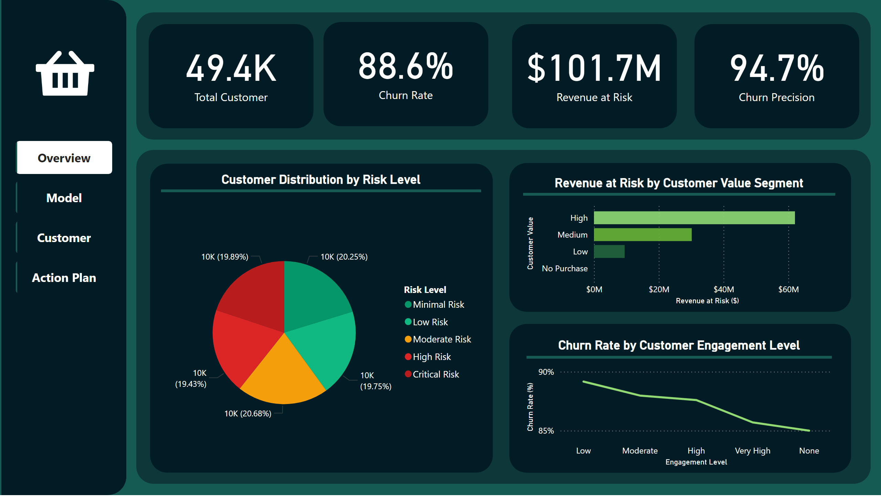
Overview
Notes:
Total Customer
No alt text provided
shape
No alt text provided
Total Customer
No alt text provided
shape
No alt text provided
Total Customer
No alt text provided
shape
No alt text provided
Total Customer
No alt text provided
shape
No alt text provided
shape
No alt text provided
Customer Distribution by Risk Level
No alt text provided
shape
No alt text provided
Churn Rate by Customer Engagement Level
No alt text provided
shape
No alt text provided
Revenue at Risk by Customer Value Segment
No alt text provided
shape
No alt text provided
pageNavigator
No alt text provided
image
No alt text provided
shape
No alt text provided
shape
No alt text provided
shape
No alt text provided

Slide 3
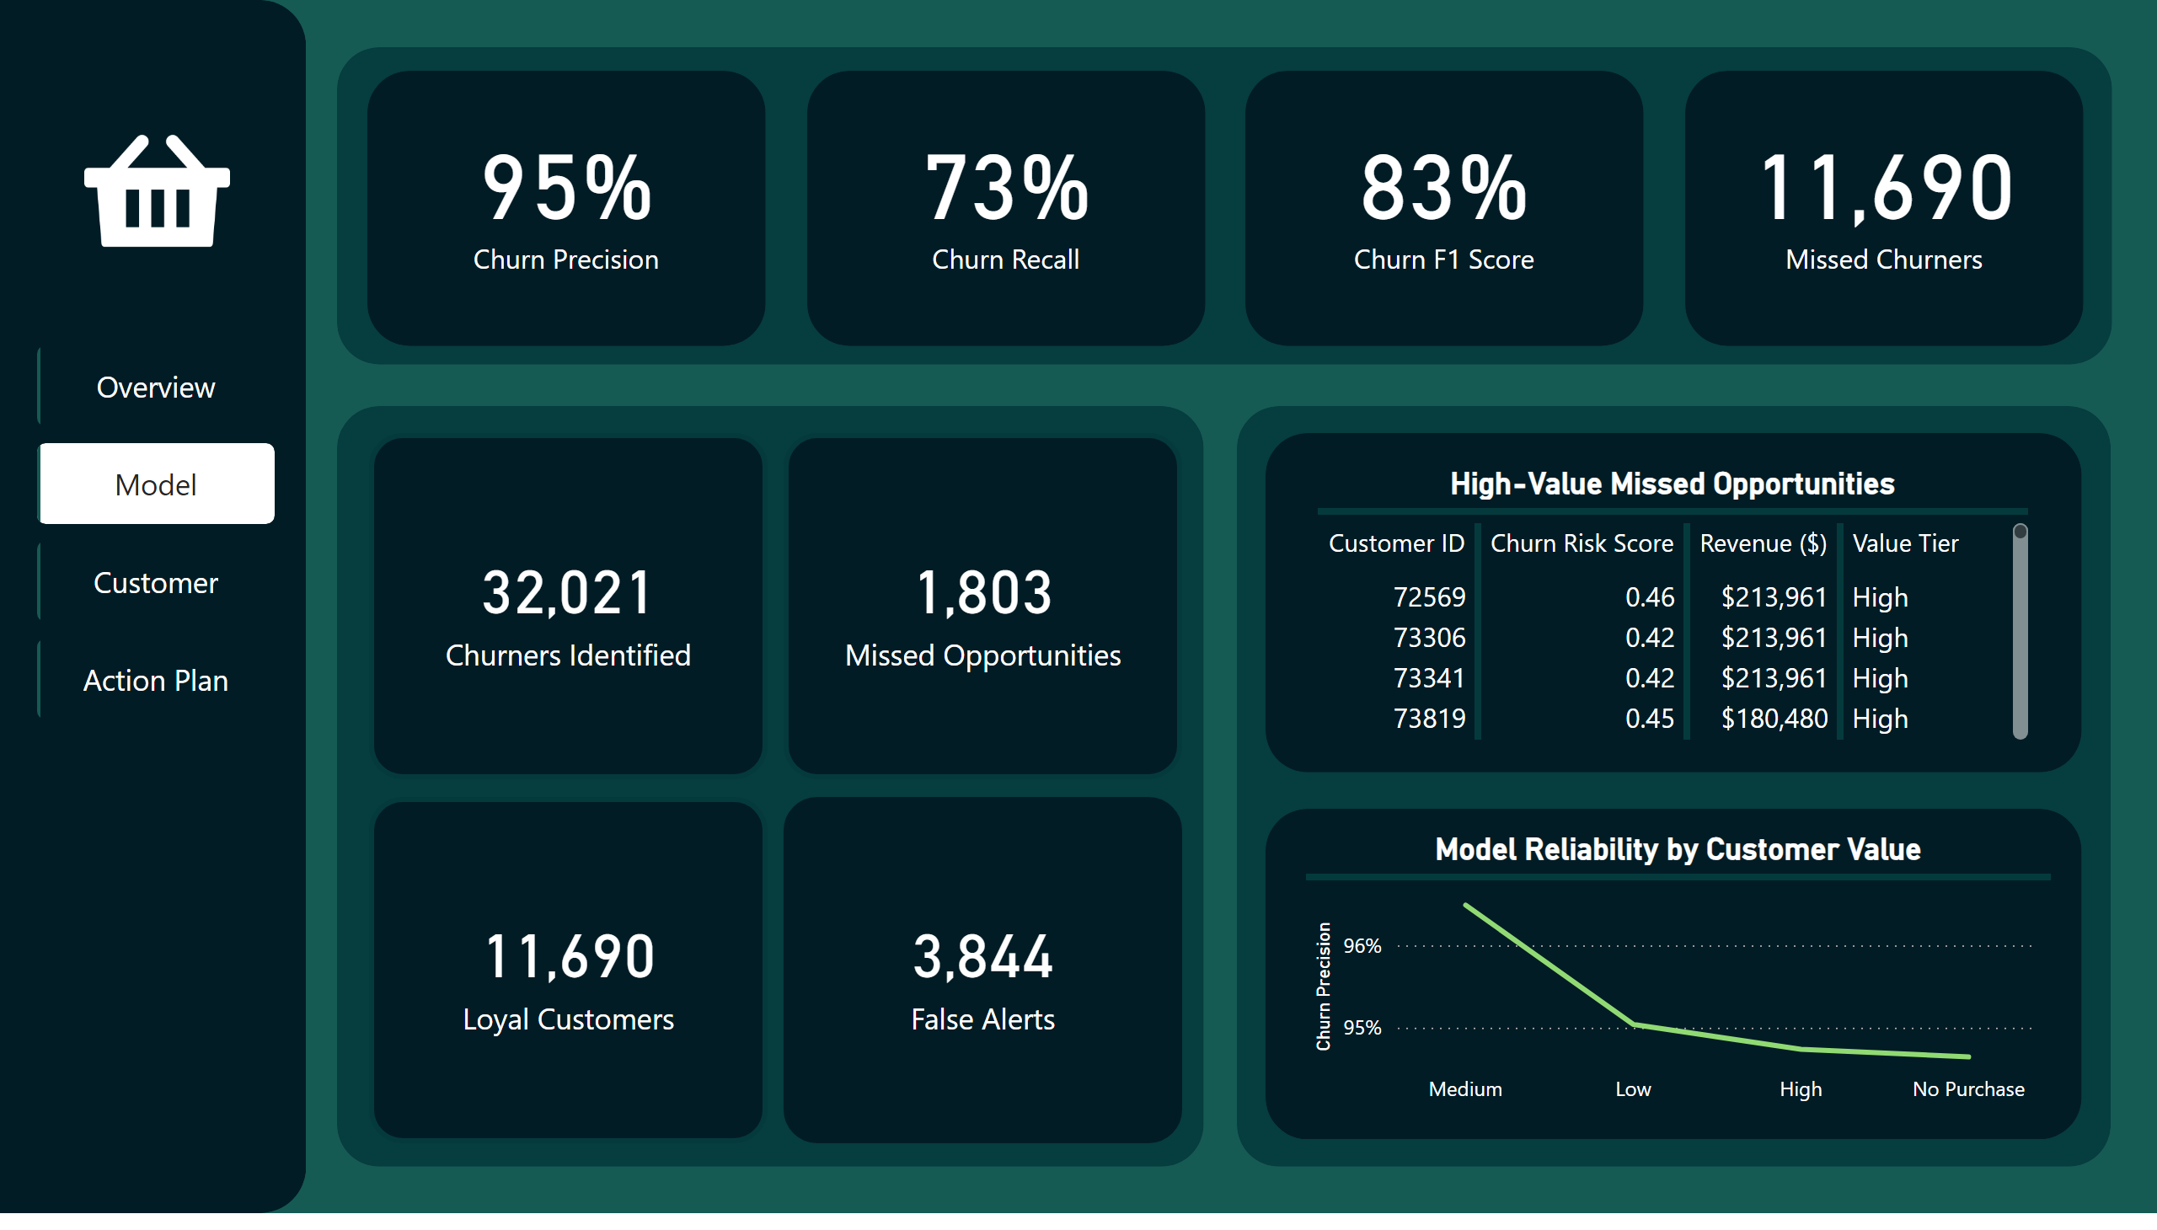
Model
Notes:
Total Customer
No alt text provided
shape
No alt text provided
Total Customer
No alt text provided
shape
No alt text provided
Total Customer
No alt text provided
shape
No alt text provided
Total Customer
No alt text provided
shape
No alt text provided
shape
No alt text provided
shape
No alt text provided
shape
No alt text provided
image
No alt text provided
pageNavigator
No alt text provided
shape
No alt text provided
Model Reliability by Customer Value
No alt text provided
shape
No alt text provided
card
No alt text provided
card
No alt text provided
card
No alt text provided
card
No alt text provided
shape
No alt text provided
shape
No alt text provided
High-Value Missed Opportunities
No alt text provided

Slide 4
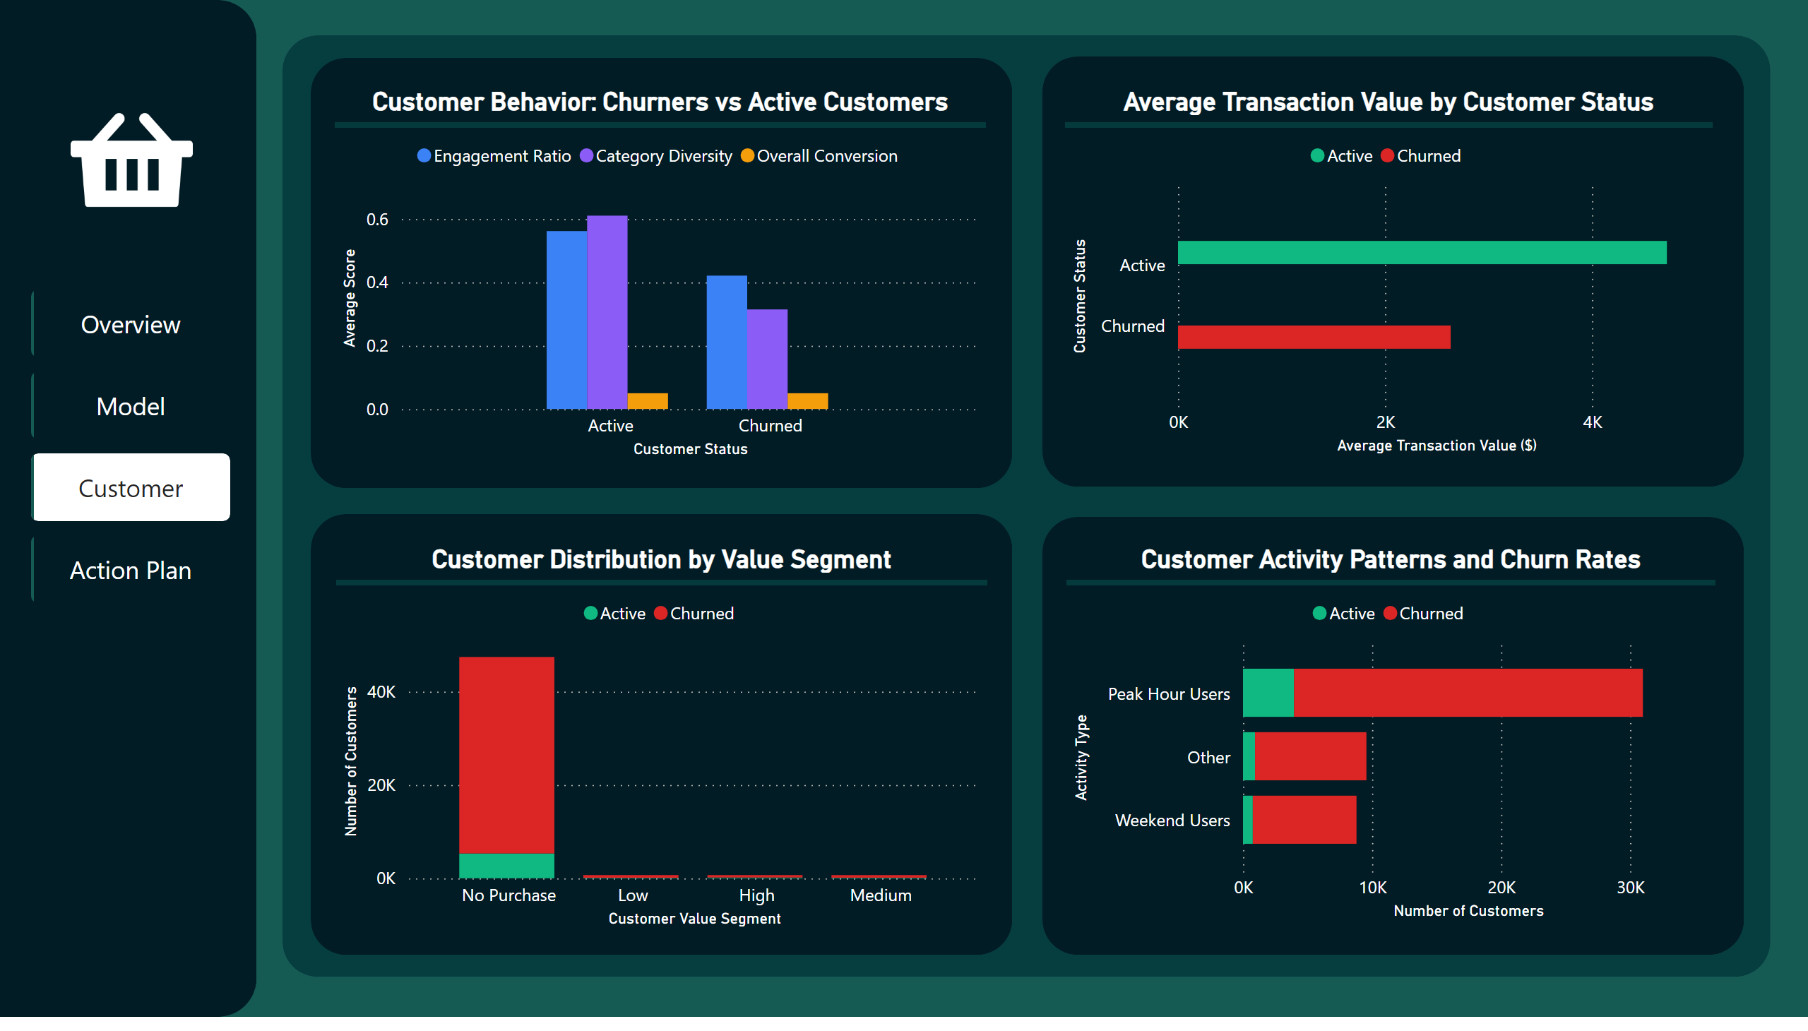
Customer
Notes:
shape
No alt text provided
shape
No alt text provided
image
No alt text provided
pageNavigator
No alt text provided
shape
No alt text provided
Customer Behavior: Churners vs Active Customers
No alt text provided
shape
No alt text provided
Customer Distribution by Value Segment
No alt text provided
shape
No alt text provided
Customer Activity Patterns and Churn Rates
No alt text provided
shape
No alt text provided
Average Transaction Value by Customer Status
No alt text provided
shape
No alt text provided

Slide 5
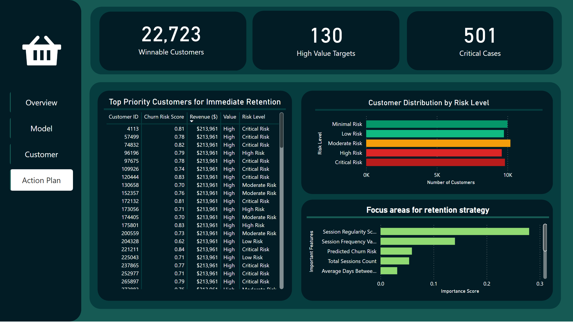
Action Plan
Notes:
Total Customer
No alt text provided
shape
No alt text provided
Total Customer
No alt text provided
shape
No alt text provided
Total Customer
No alt text provided
shape
No alt text provided
shape
No alt text provided
shape
No alt text provided
shape
No alt text provided
image
No alt text provided
pageNavigator
No alt text provided
Focus areas for retention strategy
No alt text provided
shape
No alt text provided
Top Priority Customers for Immediate Retention
No alt text provided
shape
No alt text provided
Customer Distribution by Risk Level
No alt text provided
shape
No alt text provided
shape
No alt text provided

