Slide 1


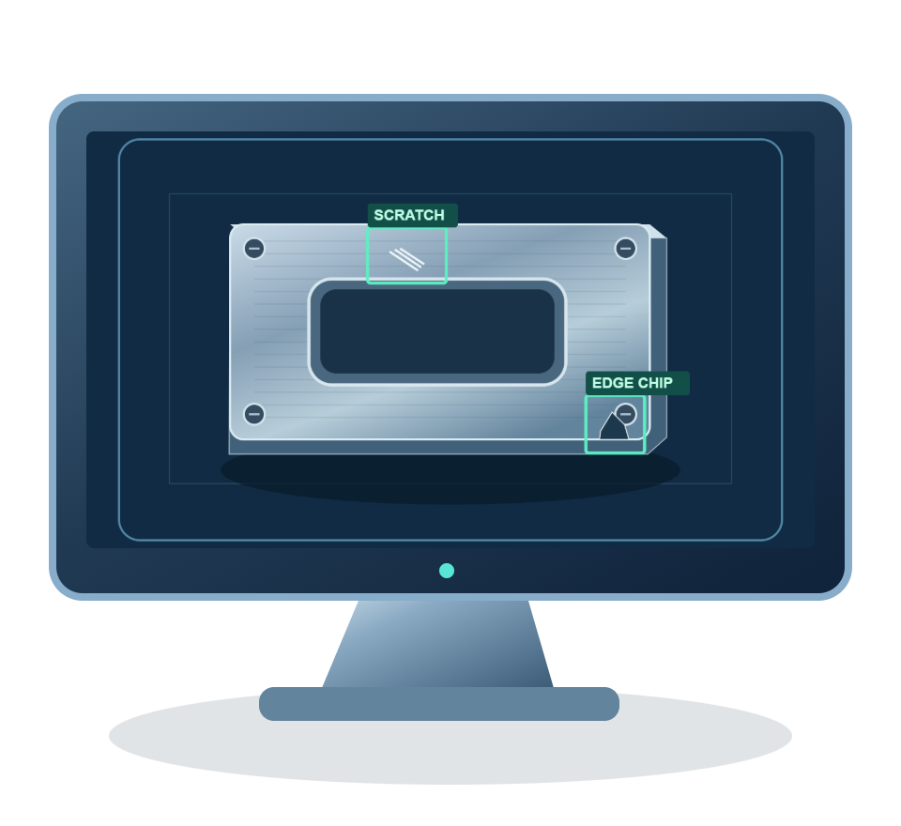
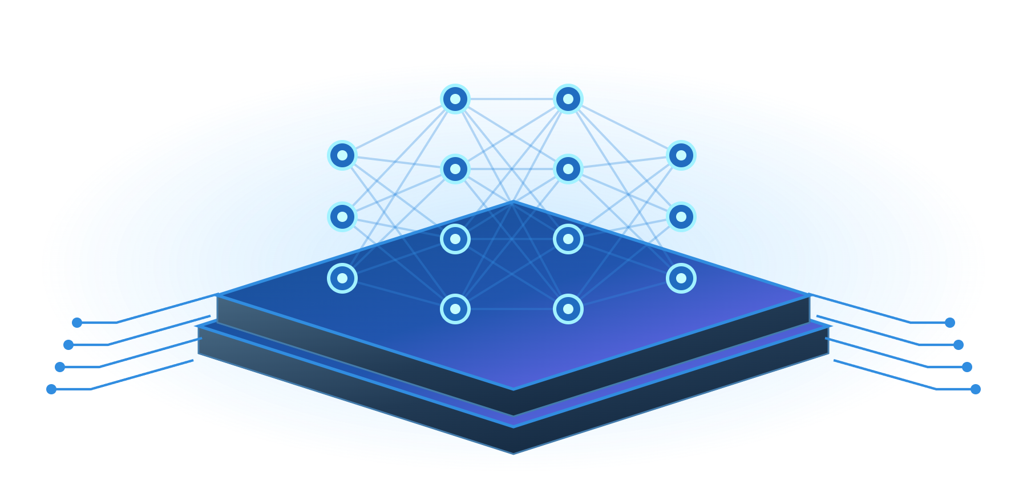


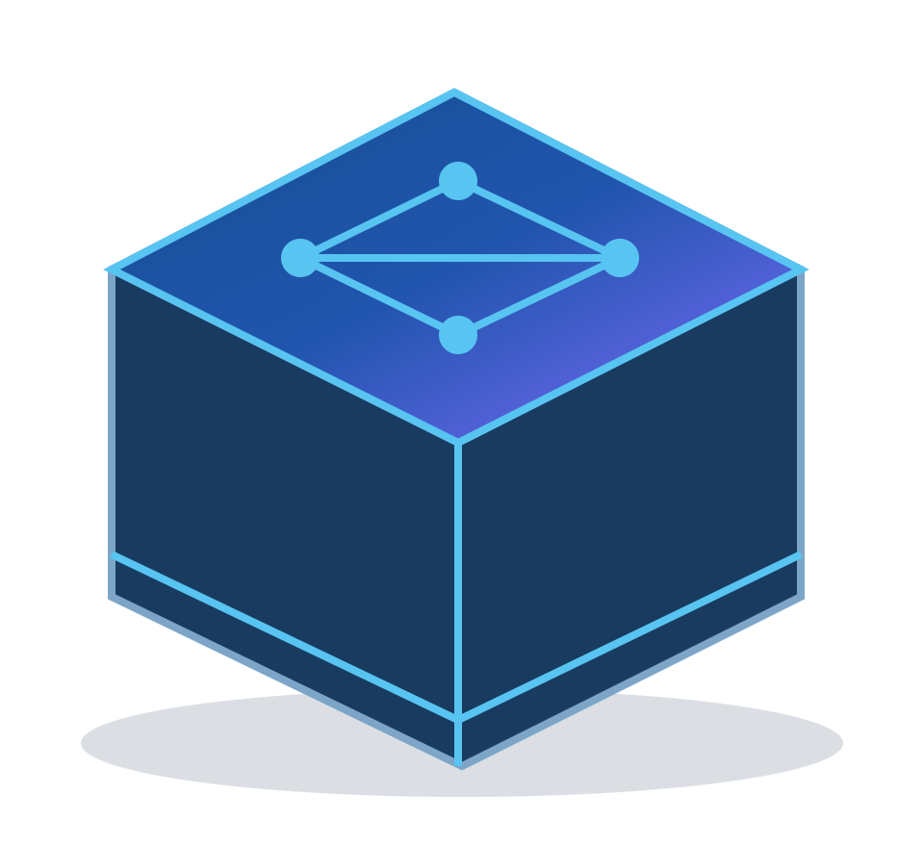
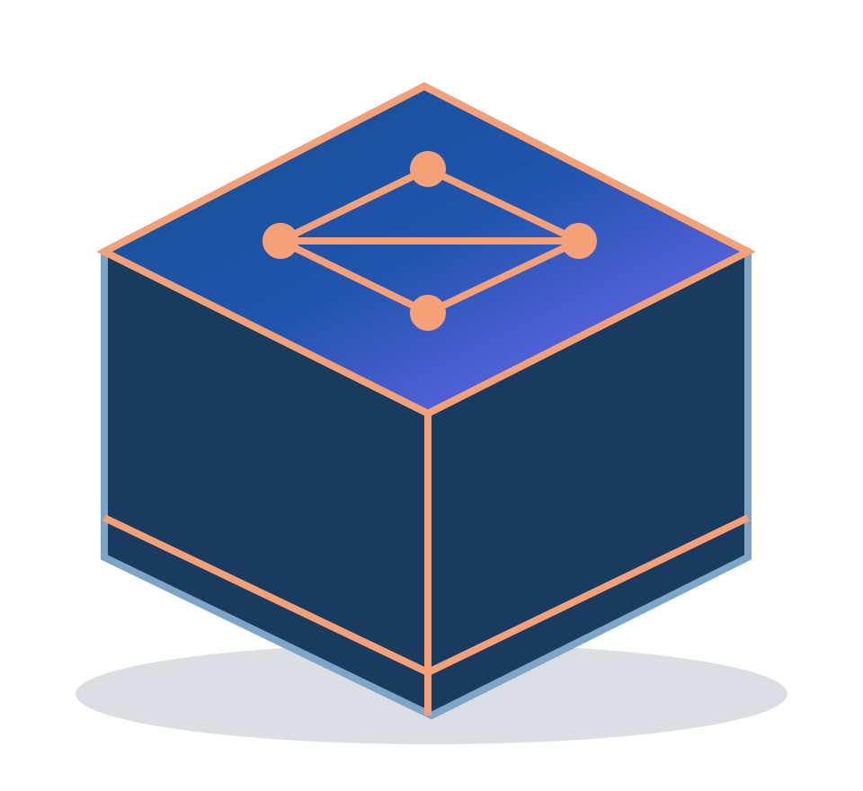
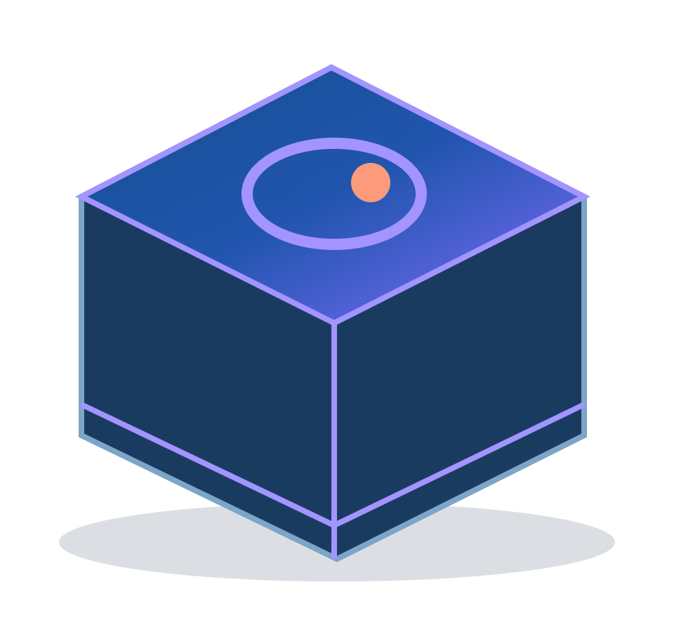
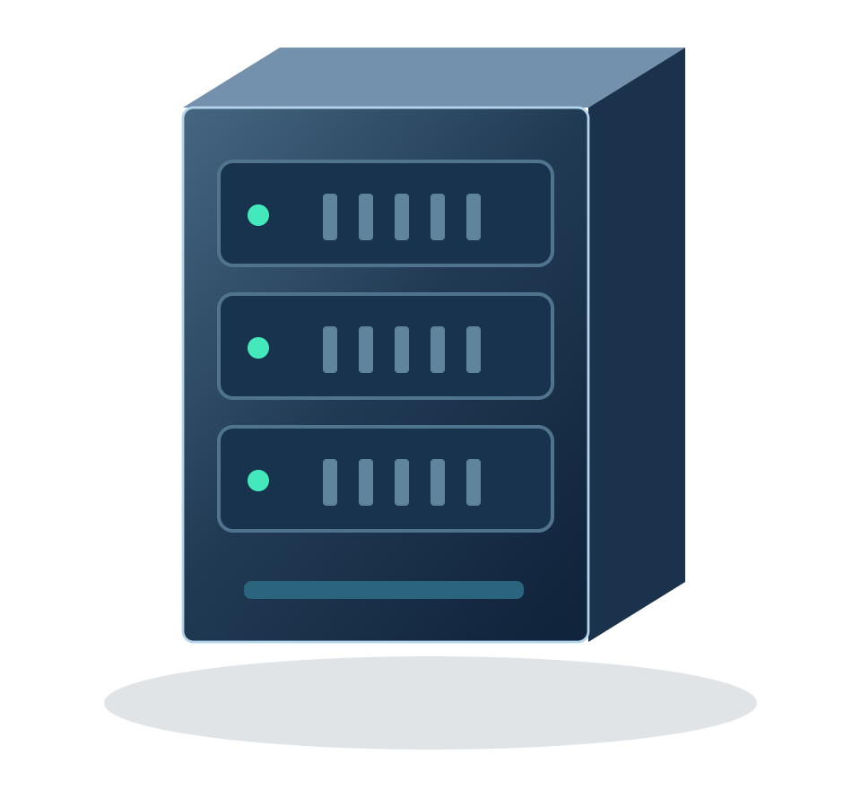

HAWKEYEPLUS / INDUSTRIAL VISION AI
HawkeyePlus Platform Architecture
Connect industrial images, model training, validation and release in one platform
01
Data & Annotations
Visual Training Hub
02
Validation & Delivery
Dataset
Model
Training
Evaluate & Infer
Metrics · Prediction preview
Model Export
Convert · Package · Download
Images + Labels / Masks
Model Registry
Import
Annotate
Preview
Product versions · Activation
Job Setup
GPU Selection
Training Monitor
Multi-framework Training
Compute & Asset Foundation
PaddlePaddle
PyTorch
anomalib
Compute
Data & Assets
Detect · Classify · Segment
Detect · Segment
Anomaly Detection
GPU / Python
Images · Weights · Logs
Management
Project ownership · User roles · Environment checks · GPU status · Storage quotas · Activity logs
HawkeyePlus · AI Model Training Platform
WD CONFIDENTIAL
01
Notes:
HawkeyePlus combines dataset, model and training configurations, then starts the selected Python training backend. It manages jobs, monitoring, validation and model assets rather than implementing a new training algorithm. PaddlePaddle covers PaddleDetection/PaddleClas/PaddleSeg; PyTorch covers TorchDet/TorchSeg; anomalib is the PyTorch-based TorchAnomaly adapter. Compute selection does not imply distributed cluster scheduling.
Editable native text, panels and lines; independent illustration images. UI presets do not imply completed hardware validation. Full model/backbone list: Supported_Models.md.
Sources:
README.md
docs/ARCHITECTURE.md
docs/FEATURES.md
src/lib/frameworks.ts
src/lib/yaml-merge.ts
src/app/api/training-jobs/route.ts
src/app/api/checkpoints/export/route.ts
src/app/api/deployed-models/route.ts
src/app/api/deployed-models/active/route.ts
src/lib/model-yaml.ts
torchtrain/torchtrain/det/models.py
torchtrain/torchtrain/seg/models.py
docs/tem_report/assets/01_raw.png
docs/tem_report/assets/03_added.png
docs/tem_report/assets/11_napari_ui.png
docs/tem_report/assets/12b_train_job_redacted.png
docs/tem_report/assets/13_train_curve.png

Slide 2
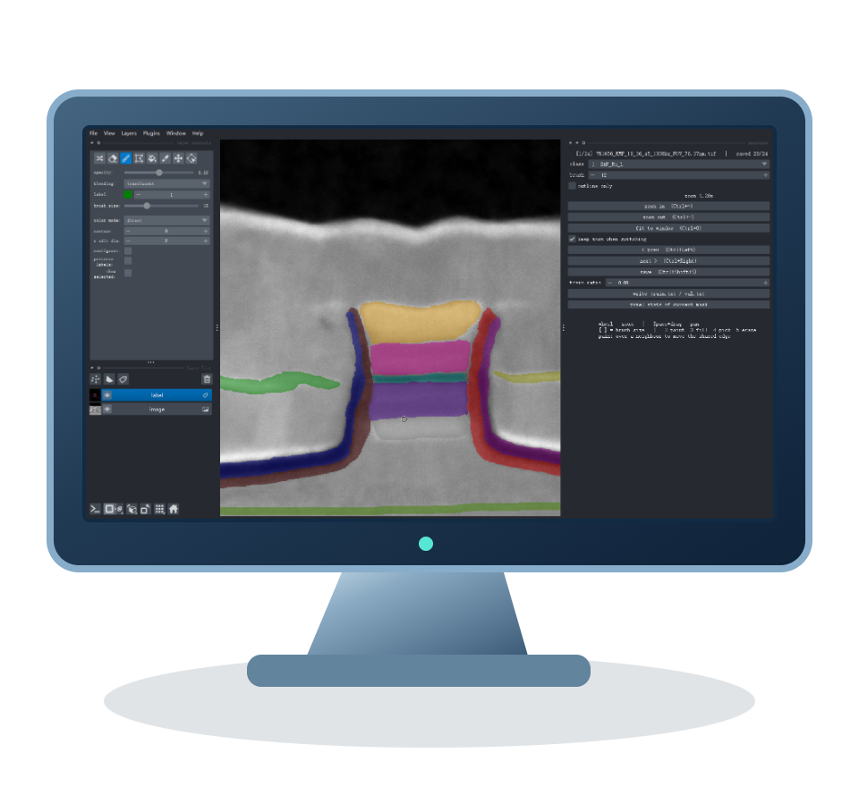
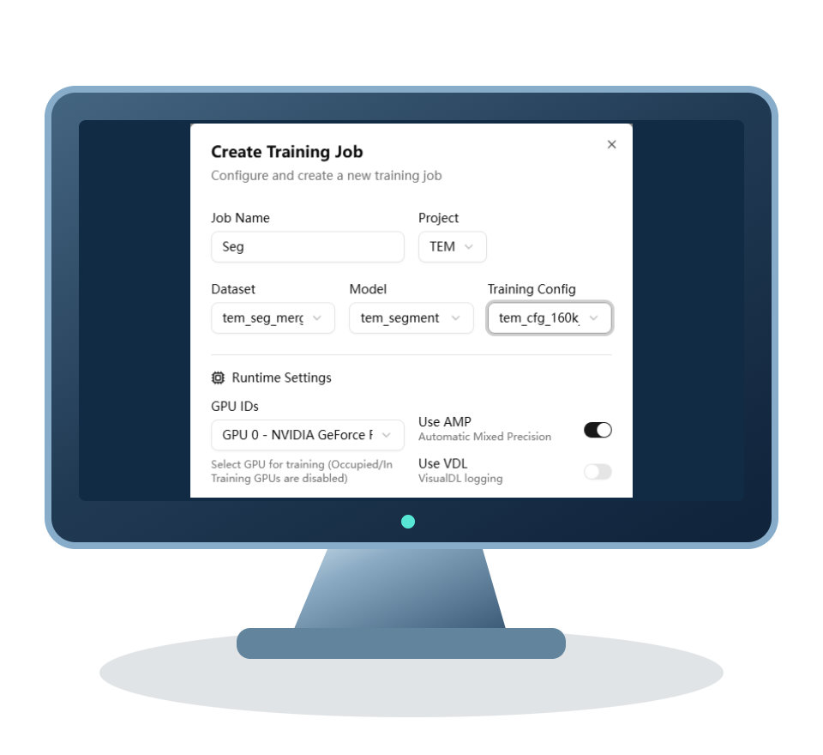
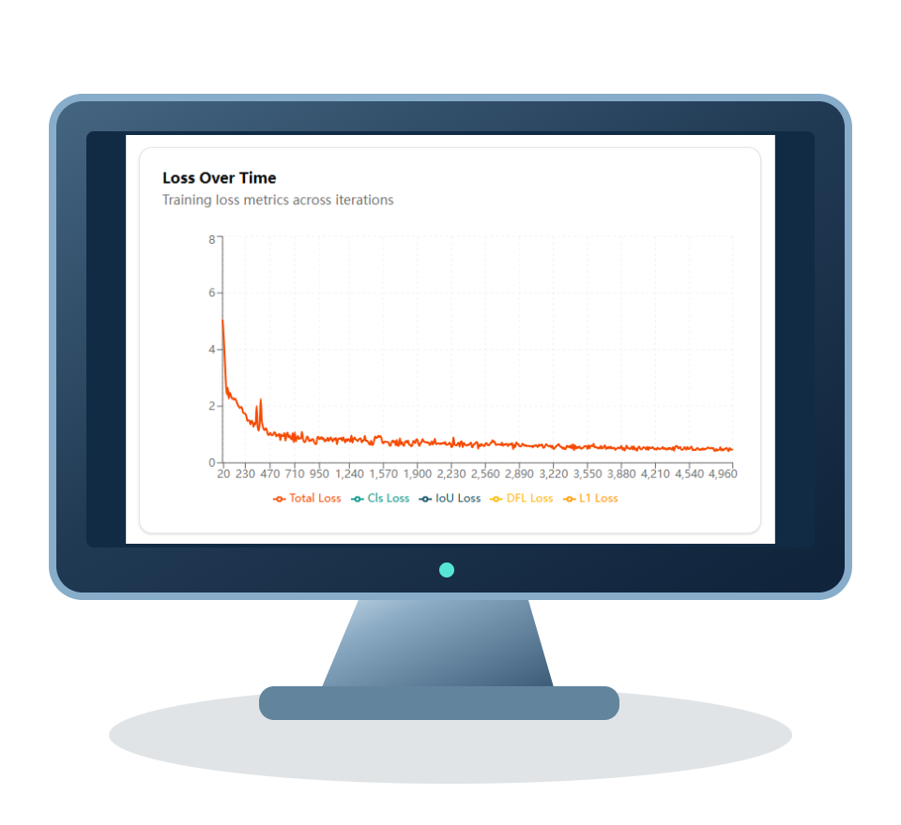
HAWKEYEPLUS / INDUSTRIAL VISION AI
A Visual Lifecycle: From Data to Models
Bring preparation, training and validation into a shared model-development workflow
01
Prepare Data
02
Configure
03
Training Monitor
04
Validate
05
Deliver Models
Import images & labels
Dataset + Model + Parameters
Run jobs · Track training
Evaluate · Preview predictions
Export · Register versions
Convert formats · Review samples
Reusable templates · Visual setup
Progress · Loss · Metrics
Inspect results · Assess readiness
Select the active product model
Use validation results to refine data and configuration
Four vision tasks. One shared training platform.
Object Detection
Image Classification
Semantic Segmentation
Anomaly Detection
Locate objects and defects
Recognize categories and quality
Map regions and boundaries
Learn from normal samples
Simplify adoption / Reuse training knowledge / Build model assets
HawkeyePlus · AI Model Training Platform
WD CONFIDENTIAL
02
Notes:
The workflow combines repository examples and conceptual detection graphics. Napari is the companion desktop segmentation annotation tool, separate from the web rectangle annotation tool. Export support varies by backend; PaddleClas has no platform export entrypoint. Model release registers configurations and weights, versions and the active model; it does not automatically deploy to production machines. The feedback path represents a user revising data and configuration.
Editable native text, panels and lines; independent illustration images. UI presets do not imply completed hardware validation. Full model/backbone list: Supported_Models.md.
Sources:
README.md
docs/ARCHITECTURE.md
docs/FEATURES.md
src/lib/frameworks.ts
src/lib/yaml-merge.ts
src/app/api/training-jobs/route.ts
src/app/api/checkpoints/export/route.ts
src/app/api/deployed-models/route.ts
src/app/api/deployed-models/active/route.ts
src/lib/model-yaml.ts
torchtrain/torchtrain/det/models.py
torchtrain/torchtrain/seg/models.py
docs/tem_report/assets/01_raw.png
docs/tem_report/assets/03_added.png
docs/tem_report/assets/11_napari_ui.png
docs/tem_report/assets/12b_train_job_redacted.png
docs/tem_report/assets/13_train_curve.png

Slide 3


HAWKEYEPLUS / INDUSTRIAL VISION AI
Object Detection | Industrial Defect Localization
Locate defects and identify their classes with bounding boxes and confidence scores
Locate & Classify Defects
PaddleDetection
7 presets
PP-YOLOE · YOLOv3 · PicoDet · RT-DETR
Faster R-CNN · RetinaNet · CenterNet
TorchDet
4 presets
Faster R-CNN · RetinaNet · FCOS · SSD / SSDLite
Output: Boxes · Classes · Confidence
SSD variants: VGG16 → SSD300; MobileNetV3 → SSDLite320
Illustrative output, not a model prediction
COCO Images & Labels
Training & Metric Tracking
Detection Preview
Box labels · Classes
mAP / mAP50 · Training curves
Locate defects · Inspect classes
Presets are backend-specific; PP-YOLOE and RT-DETR are not TorchDet models.
HawkeyePlus · AI Model Training Platform
WD CONFIDENTIAL
03
Notes:
Detection models are read directly from DETECTION_PRESETS and TORCH_DET_PRESETS. PaddleDetection has seven preset families; TorchDet has four. SSD/VGG16 uses SSD300; SSD/MobileNetV3-Large uses SSDLite320. TorchDet supports COCO detector-head transfer for Faster R-CNN, RetinaNet and FCOS; SSD falls back to ImageNet backbone initialization. PP-YOLOE, YOLOv3, PicoDet, RT-DETR and CenterNet are not TorchDet families. Defect boxes are illustrative, not inference results or benchmark evidence.
Editable native text, panels and lines; independent illustration images. UI presets do not imply completed hardware validation. Full model/backbone list: Supported_Models.md.
Sources:
README.md
docs/ARCHITECTURE.md
docs/FEATURES.md
src/lib/frameworks.ts
src/lib/yaml-merge.ts
src/app/api/training-jobs/route.ts
src/app/api/checkpoints/export/route.ts
src/app/api/deployed-models/route.ts
src/app/api/deployed-models/active/route.ts
src/lib/model-yaml.ts
torchtrain/torchtrain/det/models.py
torchtrain/torchtrain/seg/models.py
docs/tem_report/assets/01_raw.png
docs/tem_report/assets/03_added.png
docs/tem_report/assets/11_napari_ui.png
docs/tem_report/assets/12b_train_job_redacted.png
docs/tem_report/assets/13_train_curve.png

Slide 4
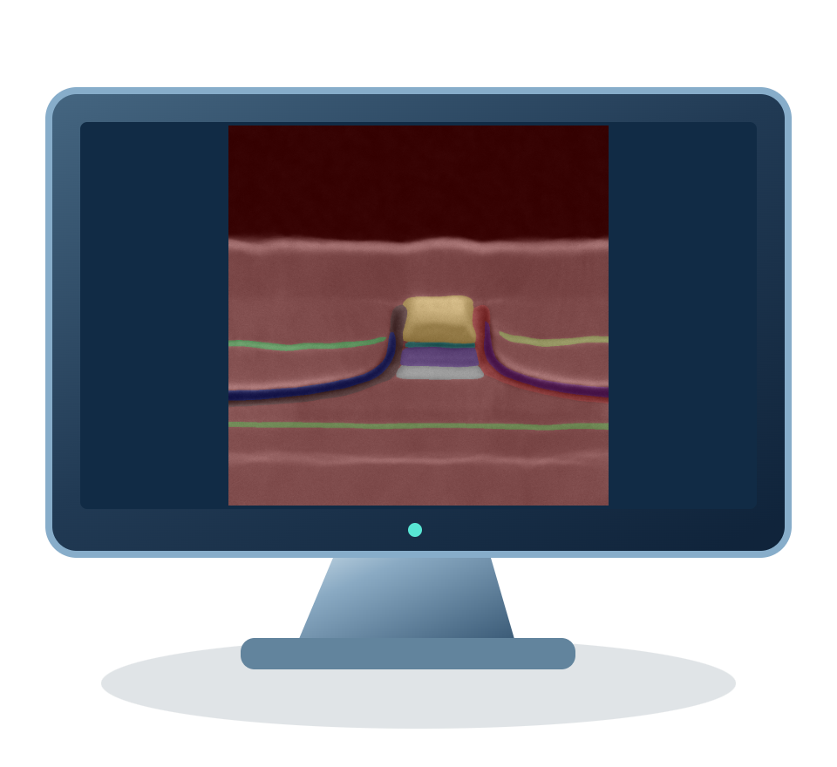
HAWKEYEPLUS / INDUSTRIAL VISION AI
Segmentation Models | Pixel-level Understanding
TEM images illustrate segmentation across compact, encoder-decoder and Transformer architectures
Pixel-level Prediction Example
PaddleSeg
7 presets
PP-LiteSeg · BiSeNetV2 · OCRNet · UNet · DeepLabV3+
SegFormer-B0 · FCN
TorchSeg
4 presets
UNet · DeepLabV3 (UI: DeepLabV3+) · FCN · LR-ASPP
Regions · Boundaries · Label masks
TEM segmentation example from this project
TorchSeg maps DeepLabV3P to torchvision DeepLabV3, not a V3+ decoder.
Dataset Layout
Evaluation Metrics
Applications
Images + masks + train / validation splits
mIoU · Dice · Accuracy
Defect regions · Microstructure · Boundaries
HawkeyePlus · AI Model Training Platform
WD CONFIDENTIAL
04
Notes:
PaddleSeg has seven current UI architectures. TorchSeg has four UI presets. The TorchSeg UI calls one preset DeepLabV3+ (config key DeepLabV3P), but the runtime uses torchvision DeepLabV3 without a V3+ decoder. DeepLabV3 is also a runtime alias, not a fifth UI preset. TEM images are project examples, not a benchmark for all models.
Editable native text, panels and lines; independent illustration images. UI presets do not imply completed hardware validation. Full model/backbone list: Supported_Models.md.
Sources:
README.md
docs/ARCHITECTURE.md
docs/FEATURES.md
src/lib/frameworks.ts
src/lib/yaml-merge.ts
src/app/api/training-jobs/route.ts
src/app/api/checkpoints/export/route.ts
src/app/api/deployed-models/route.ts
src/app/api/deployed-models/active/route.ts
src/lib/model-yaml.ts
torchtrain/torchtrain/det/models.py
torchtrain/torchtrain/seg/models.py
docs/tem_report/assets/01_raw.png
docs/tem_report/assets/03_added.png
docs/tem_report/assets/11_napari_ui.png
docs/tem_report/assets/12b_train_job_redacted.png
docs/tem_report/assets/13_train_curve.png

Slide 5
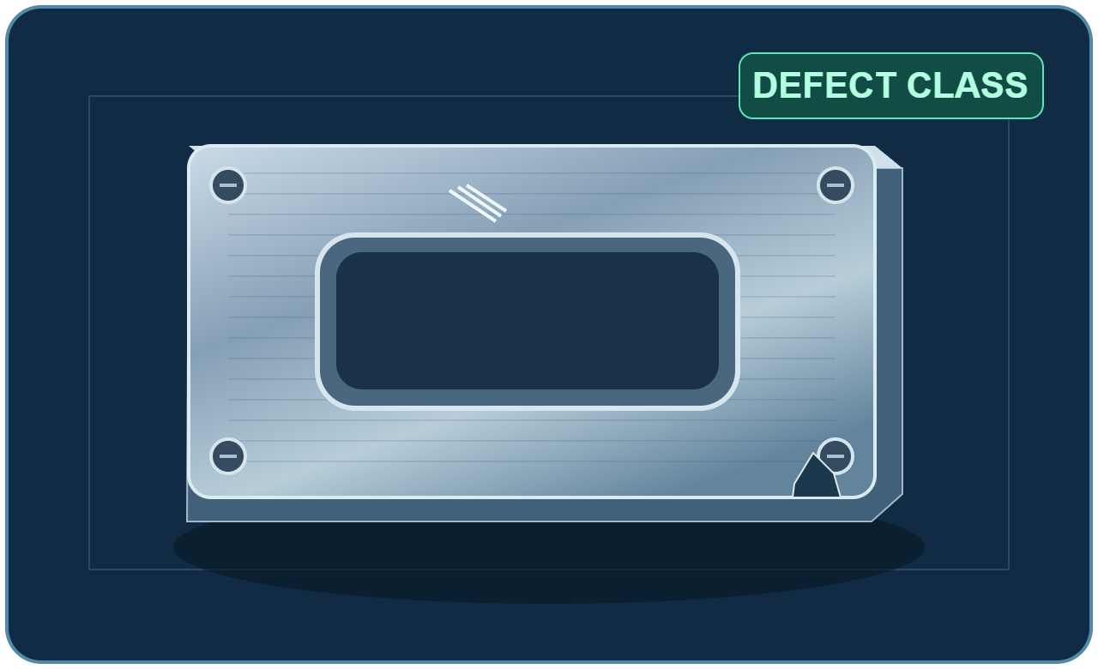
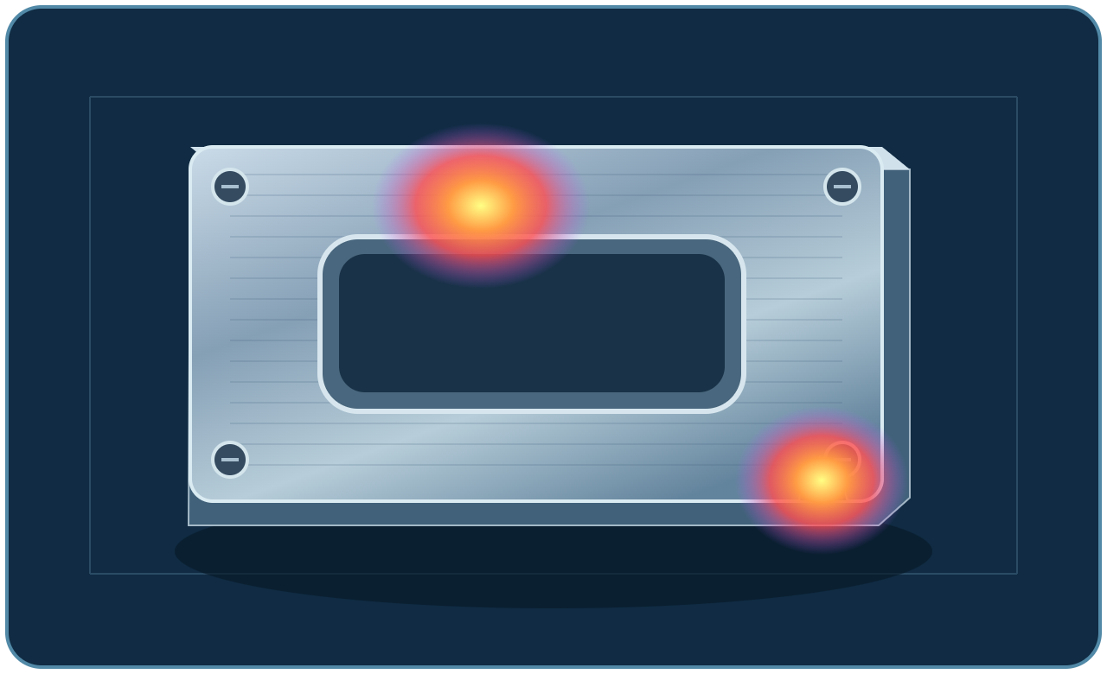
HAWKEYEPLUS / INDUSTRIAL VISION AI
Classification & Anomaly Detection
From image-level labels to learning normal appearance, reuse the same model-development workflow
PaddleClas | Image Classification
TorchAnomaly | Anomaly Detection
Learn labeled categories; predict image-level classes
Learn normal appearance; produce anomaly scores and heatmaps
Illustrative classification
Illustrative anomaly heatmap
9 Classification Variants
5 anomalib Presets
ResNet18 · ResNet34 · ResNet50 · ResNet101
PatchCore · PaDiM · STFPM · EfficientAD
MobileNetV3 Small / Large (x1.0)
PP-LCNet x1.0 · PP-HGNet Small
SuperSimpleNet
Swin Transformer Tiny (patch4 / window7 / 224)
Current UI presets only; custom YAML compatibility depends on the selected backend.
HawkeyePlus · AI Model Training Platform
WD CONFIDENTIAL
05
Notes:
The nine PaddleClas choices are listed by exact configuration name in Supported_Models.md. The five TorchAnomaly presets are PatchCore, PaDiM, STFPM, EfficientAD and SuperSimpleNet. Training uses normal images. ReverseDistillation is not a current UI preset. Classification and anomaly images are conceptual illustrations. Environment/version compatibility still applies.
Editable native text, panels and lines; independent illustration images. UI presets do not imply completed hardware validation. Full model/backbone list: Supported_Models.md.
Sources:
README.md
docs/ARCHITECTURE.md
docs/FEATURES.md
src/lib/frameworks.ts
src/lib/yaml-merge.ts
src/app/api/training-jobs/route.ts
src/app/api/checkpoints/export/route.ts
src/app/api/deployed-models/route.ts
src/app/api/deployed-models/active/route.ts
src/lib/model-yaml.ts
torchtrain/torchtrain/det/models.py
torchtrain/torchtrain/seg/models.py
docs/tem_report/assets/01_raw.png
docs/tem_report/assets/03_added.png
docs/tem_report/assets/11_napari_ui.png
docs/tem_report/assets/12b_train_job_redacted.png
docs/tem_report/assets/13_train_curve.png

