Slide 1

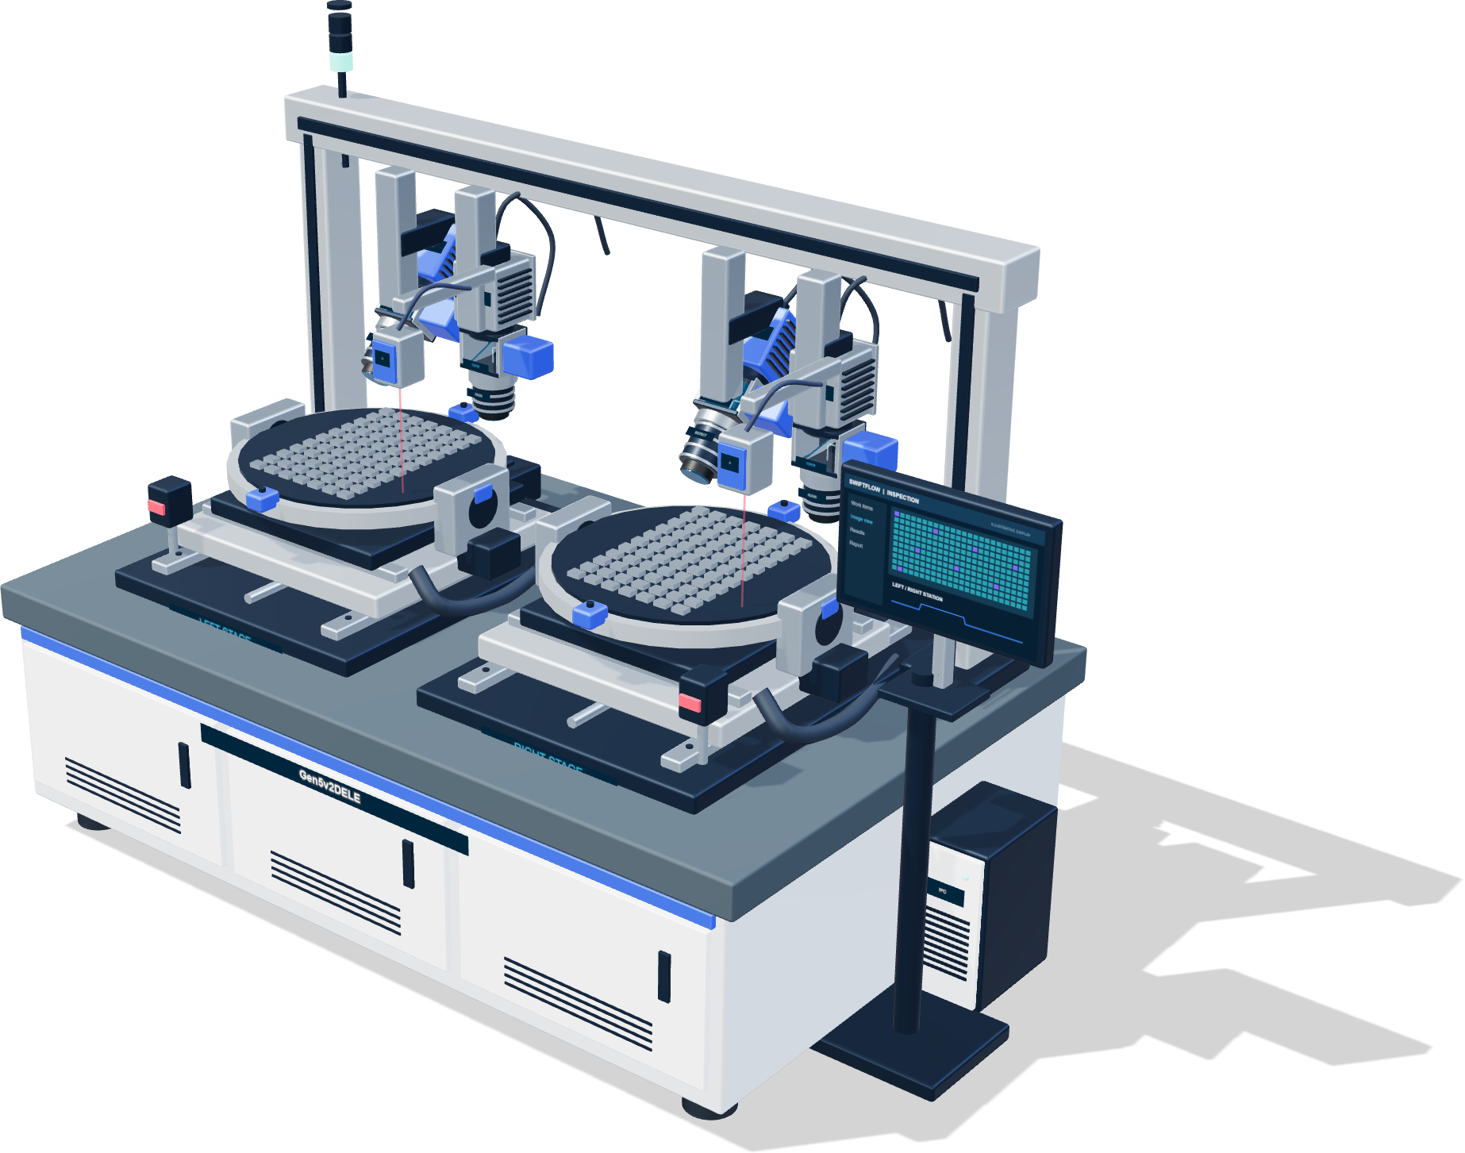

PLATFORM ARCHITECTURE & STANDARDIZED WORKFLOWS
SwiftFlow + HawkeyePlus
Standardized Inspection & Measurement
Architecture, Workflows & Integrated Delivery
+
SwiftFlow
HawkeyePlus
Equipment, processes and execution
Data, models and validation
From hardware design to algorithms and production workflows
2026.10
SwiftFlow + HawkeyePlus | Industrial Vision Engineering
WD CONFIDENTIAL
01 / 20
Notes:
Introduce the complete title: SwiftFlow + HawkeyePlus — Standardized Inspection & Measurement: Architecture, Workflows & Integrated Delivery. Explain the shared concept and rationale, then the execution platform and model-development platform, followed by joint acceptance and a delivery baseline.

Slide 2
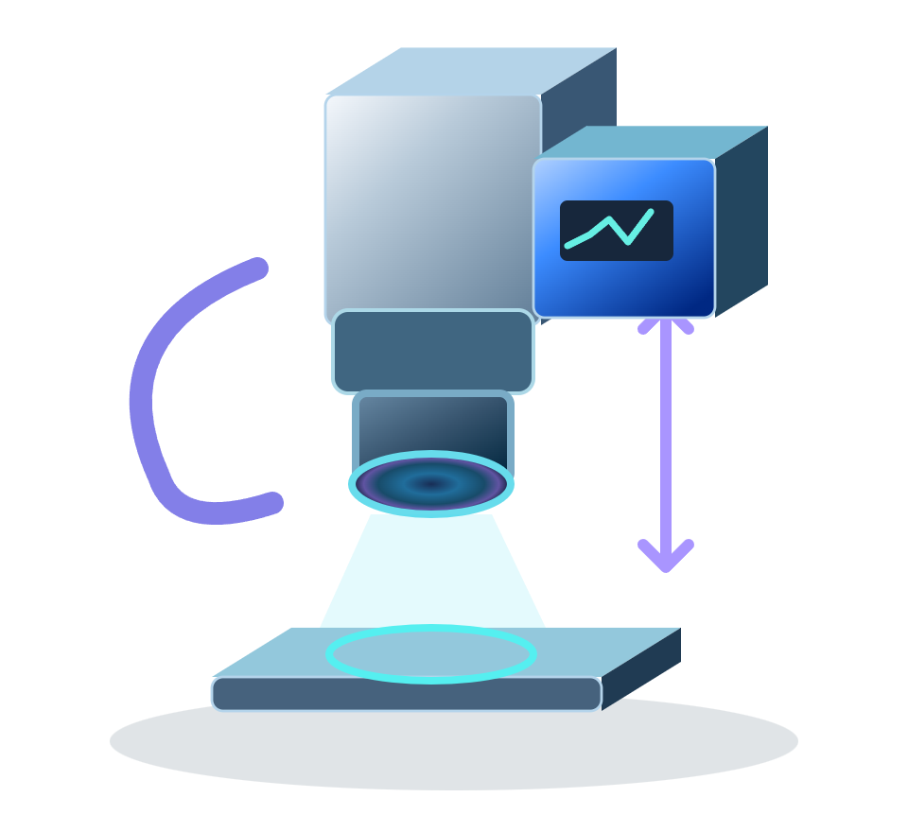

ROADMAP / SWIFTFLOW + HAWKEYEPLUS
Presentation Roadmap
Start with a shared method, then explore the two platforms and their handoff
01
Vision & Rationale
02
SwiftFlow
Establish a shared engineering method
Equipment, workflows and algorithm execution
Platform roles
Equipment integration
Why standardize
Workflow design
03–06
07–10
03
HawkeyePlus
04
Integrated Delivery
Industrial vision model development and validation
From development results to production readiness
Model development
Adaptation & acceptance
Model portfolio
Shared delivery assets
11–16
17–18
Closing: Summary & Discussion
19–20
SwiftFlow + HawkeyePlus | Industrial Vision Engineering
WD CONFIDENTIAL
02 / 20
Notes:
The presentation has four chapters: Vision & Rationale, SwiftFlow, HawkeyePlus, and Integrated Delivery, followed by a summary and discussion. Each agenda card links to its chapter divider in slideshow mode.

Slide 3
CHAPTER 01 / OVERVIEW
01
Vision & Rationale
Establish a shared engineering method
How do hardware, workflows and algorithms work as one method?
01.1
01.2
01.3
Platform roles
Why standardize
Standard workflow
SwiftFlow + HawkeyePlus | One shared method, two complementary platforms
SwiftFlow + HawkeyePlus | Industrial Vision Engineering
WD CONFIDENTIAL
03 / 20
Notes:
Chapter transition: Vision & Rationale. Focus: Establish a shared engineering method. Guiding question: How do hardware, workflows and algorithms work as one method?.

Slide 4
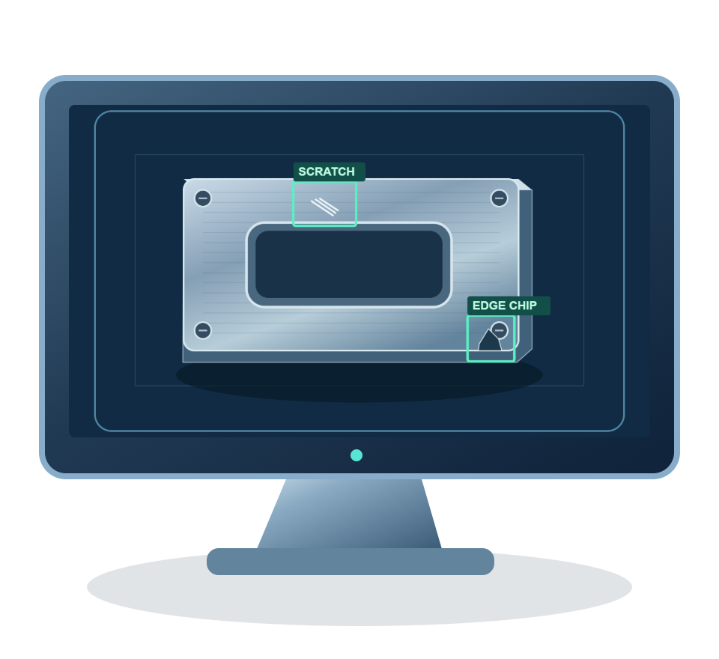
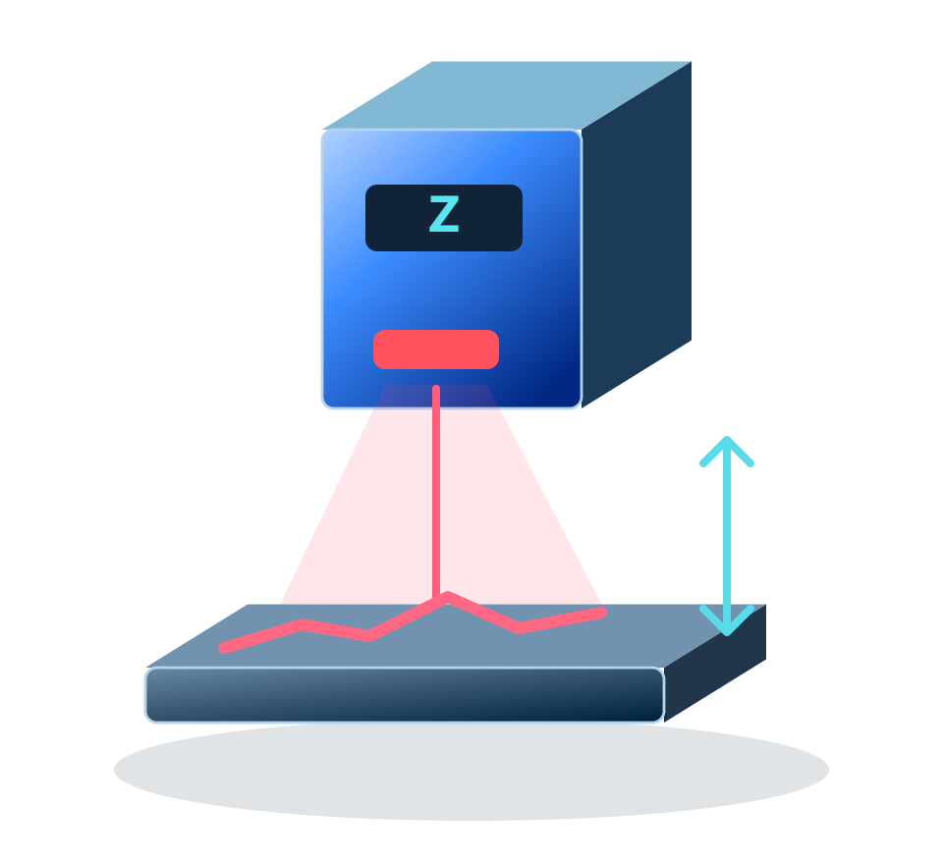

CHAPTER 01 / VISION & RATIONALE
One Standard Workflow for Inspection & Measurement
Connect hardware design, inspection workflows and algorithm development through two complementary platforms
SwiftFlow
HawkeyePlus
Equipment integration
Samples
Data & annotations
Workflow orchestration
Model training
Models
Inspection execution
Validation & release
Turn hardware, algorithms and process logic into executable workflows
Turn industrial images into validated, deliverable models
Shared method: Define the goal → Design & build → Adapt & validate → Standardize delivery
Inspection
Measurement
Traceable delivery
Defect location · Type · Decision
Dimensions · Height · Geometry
Configuration · Version · Evidence
SwiftFlow + HawkeyePlus | Industrial Vision Engineering
WD CONFIDENTIAL
04 / 20
Notes:
Two complementary platforms support one engineering method. SwiftFlow organizes equipment, workflows, classical vision, inference and results into execution. HawkeyePlus manages training data, model development, evaluation and versions. The arrows represent curated samples and validated model handoffs, not an already implemented automatic connector.
Sources and interpretation:
HawkeyePlus: docs/ARCHITECTURE.md; docs/FEATURES.md; src/lib/model-yaml.ts; model registry routes.
SwiftFlow: docs/Architecture.md; docs/Flow_Engine_Internals.md; InferenceSessionFactory.cs; ModelInstanceConfig.cs.
Illustrations and project examples are not performance, accuracy or production-acceptance evidence. Native text, panels and lines are editable; pictures are independently replaceable.

Slide 5
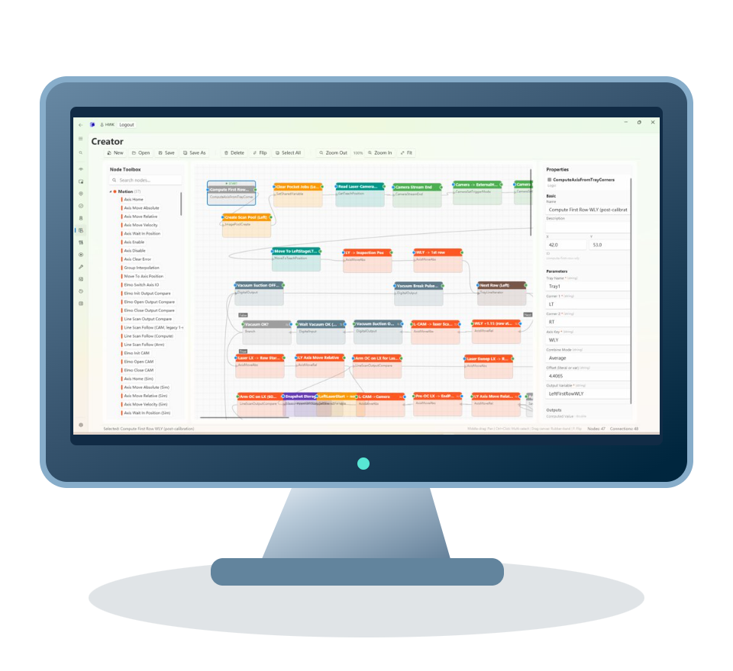

CHAPTER 01 / VISION & RATIONALE
Why a Shared Engineering Method Matters
Make inputs, deliverables and acceptance criteria clear at every step
Align engineering inputs
Reuse proven work
Make acceptance explicit
Align hardware, imaging and algorithm needs
Turn proven knowledge into reusable assets
Reproduce results on production equipment
Common design inputs
Reusable deliverables
Shared acceptance criteria
Inspection / measurement goals
Device and workflow configuration
Independent samples and references
Image quality and calibration
Models and algorithm parameters
Quality, timing and traceable results
Standardization gives handoffs, reuse and maintenance a shared baseline
Define the method and delivery agreements; use both platforms to execute them
SwiftFlow + HawkeyePlus | Industrial Vision Engineering
WD CONFIDENTIAL
05 / 20
Notes:
A shared method reduces repeated handoff work between hardware, process and algorithm engineering. These are design motivations, not measured claims about a team's productivity. Common inputs, reusable assets and joint acceptance make the required inputs, outputs and completion criteria clear.
Sources and interpretation:
HawkeyePlus: docs/ARCHITECTURE.md; docs/FEATURES.md; src/lib/model-yaml.ts; model registry routes.
SwiftFlow: docs/Architecture.md; docs/Flow_Engine_Internals.md; InferenceSessionFactory.cs; ModelInstanceConfig.cs.
Illustrations and project examples are not performance, accuracy or production-acceptance evidence. Native text, panels and lines are editable; pictures are independently replaceable.

Slide 6
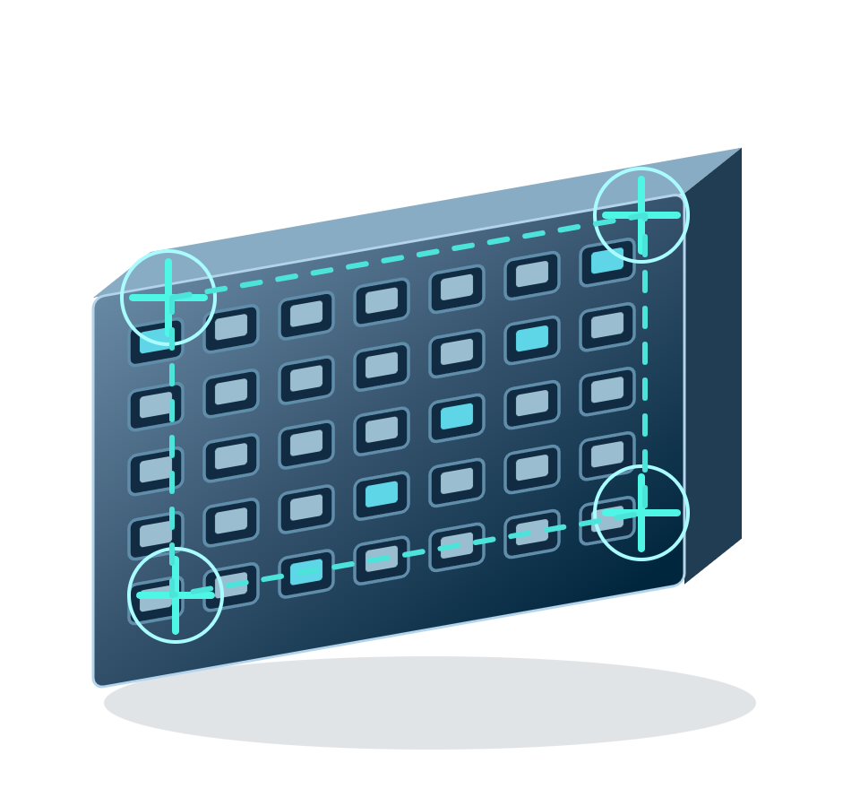
CHAPTER 01 / VISION & RATIONALE
From Engineering Goals to Standardized Delivery
Recommended workflow: clear inputs, engineering responsibilities and reviewable deliverables
01
02
03
04
05
06
Define goals
Design hardware
Design workflows
Develop algorithms
Validate jointly
Deliver a baseline
What to inspect or measure
Camera, optics and lighting
Positioning, capture and timing
Classical vision / geometry
Site samples and references
Configuration, models, versions
Quality, timing and constraints
Motion, sensing and calibration
Exceptions and result handling
AI training and validation
Quality, metrology and timing
Traceable results and iteration
Requirements & acceptance
Hardware design & samples
Flow & device configuration
Parameters / model package
Acceptance evidence
Reusable engineering assets
SwiftFlow
Equipment integration, commissioning, calibration, workflow execution and results
HawkeyePlus
Training data, model development, evaluation and model version management
Shared deliverables: hardware + workflow + algorithm baselines + acceptance evidence
SwiftFlow + HawkeyePlus | Industrial Vision Engineering
WD CONFIDENTIAL
06 / 20
Notes:
This is a recommended engineering workflow, not a claim of an automated release system. Engineers design the hardware and imaging setup; SwiftFlow provides integration, commissioning, calibration and execution. Algorithms may be classical vision/numerical measurement or AI models developed in HawkeyePlus. Joint acceptance uses independent samples, detection errors and cycle-time checks, plus calibration, units and reference agreement for measurement.
Sources and interpretation:
HawkeyePlus: docs/ARCHITECTURE.md; docs/FEATURES.md; src/lib/model-yaml.ts; model registry routes.
SwiftFlow: docs/Architecture.md; docs/Flow_Engine_Internals.md; InferenceSessionFactory.cs; ModelInstanceConfig.cs.
Illustrations and project examples are not performance, accuracy or production-acceptance evidence. Native text, panels and lines are editable; pictures are independently replaceable.

Slide 7
CHAPTER 02 / OVERVIEW
02
SwiftFlow
Equipment, workflows and algorithm execution
How can equipment and algorithms become an executable workflow?
02.1
02.2
02.3
Equipment integration
Workflow design
Inspection & measurement
SwiftFlow + HawkeyePlus | One shared method, two complementary platforms
SwiftFlow + HawkeyePlus | Industrial Vision Engineering
WD CONFIDENTIAL
07 / 20
Notes:
Chapter transition: SwiftFlow. Focus: Equipment, workflows and algorithm execution. Guiding question: How can equipment and algorithms become an executable workflow?.

Slide 8

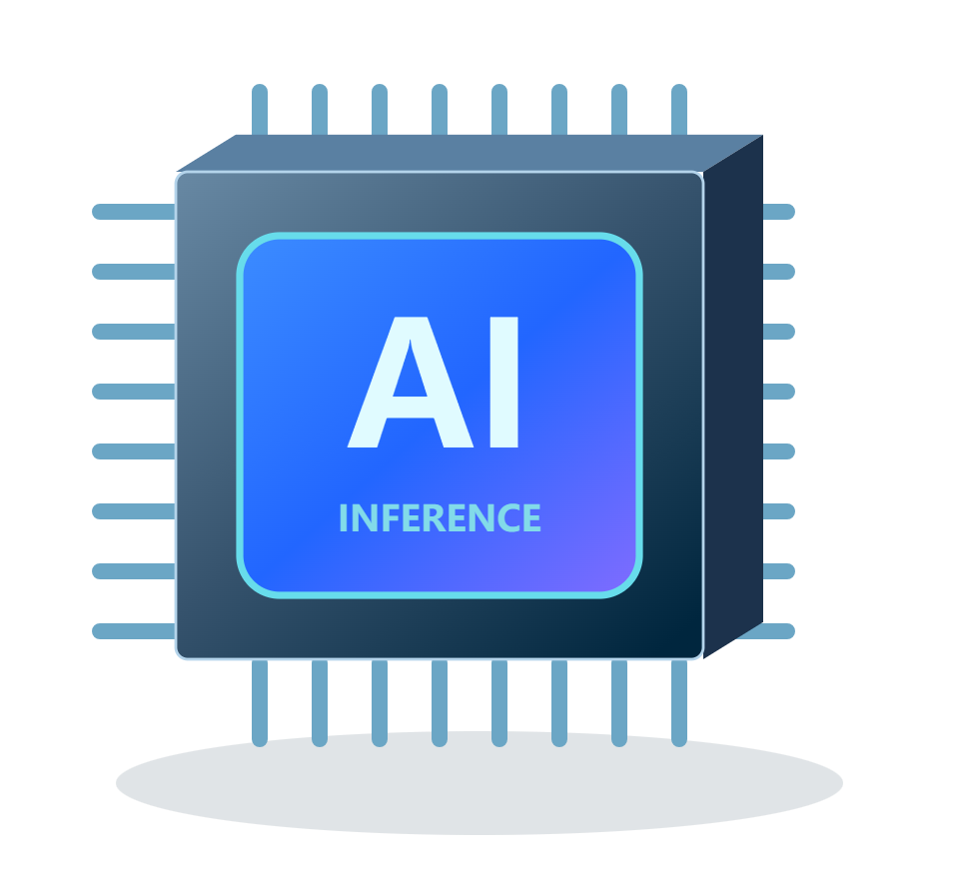

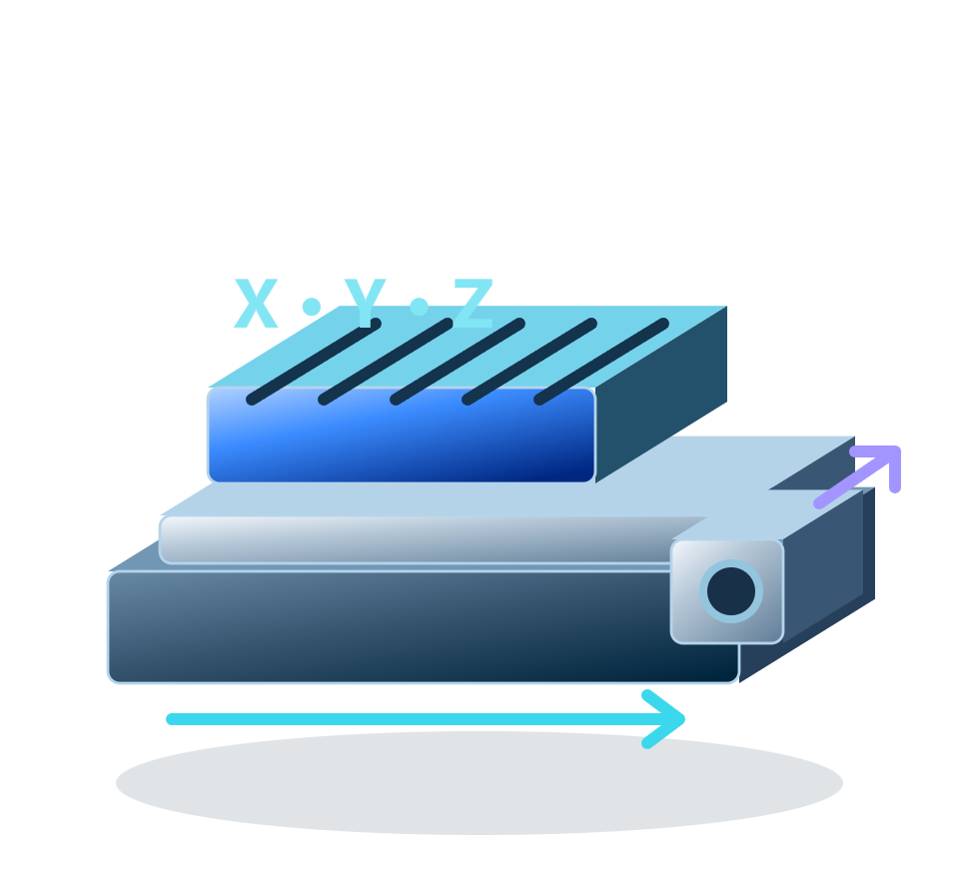


CHAPTER 02 / SWIFTFLOW
SwiftFlow | Equipment & Process Execution
Use configurable workflows to connect equipment, classical vision, inference and results
Workflow design
Shared execution engine
Algorithms & results
Visual authoring
Sequential / parallel execution · Shared data
Classical vision + Model inference
Reusable process flows
Run control · Failure handling
Measurement + Result storage
Unified equipment integration
Standard interfaces · Multiple instances · Vendor adapters
Industrial cameras
Motion control
Controlled lighting
Height sensing
Optics / metrology
IO / Line communication
Cross-cutting support: logs & alarms · timing · traceability · storage · simulation
SwiftFlow + HawkeyePlus | Industrial Vision Engineering
WD CONFIDENTIAL
08 / 20
Notes:
SwiftFlow is the workflow and execution foundation within HawkeyeUltra. Data-defined workflows combine equipment, vision, inference and result nodes, including subflows, parallel coordination and run control. Vendor-neutral interfaces and instance routing connect devices. Logs, timing, storage and results support execution.
Sources and interpretation:
HawkeyePlus: docs/ARCHITECTURE.md; docs/FEATURES.md; src/lib/model-yaml.ts; model registry routes.
SwiftFlow: docs/Architecture.md; docs/Flow_Engine_Internals.md; InferenceSessionFactory.cs; ModelInstanceConfig.cs.
Illustrations and project examples are not performance, accuracy or production-acceptance evidence. Native text, panels and lines are editable; pictures are independently replaceable.

Slide 9
CHAPTER 02 / SWIFTFLOW
From Hardware Design to Executable Workflows
Translate hardware choices, commissioning and process knowledge into reusable configuration and workflows
Engineering design inputs
Configuration & workflow implementation
Map device instances
Commission & calibrate
Reuse parameters & flows
Camera / Optics / Lighting / Motion / Sensors
Define field of view, resolution, timing and calibration
Locate
Capture
Analyze
Decide & record
Deliver reusable engineering assets
Device mappings & configuration · Calibration · Workflows · Process parameters · Result definitions
SwiftFlow + HawkeyePlus | Industrial Vision Engineering
WD CONFIDENTIAL
09 / 20
Notes:
Engineers start with camera, optics, lighting, motion and measurement-device design. Machine configuration maps physical devices to logical instances; commissioning and calibration establish input quality. Workflow nodes then organize positioning, acquisition, analysis and decisions. Deliverables include mappings, calibration and reusable process configuration. SwiftFlow is not a CAD or optical-design tool.
Sources and interpretation:
HawkeyePlus: docs/ARCHITECTURE.md; docs/FEATURES.md; src/lib/model-yaml.ts; model registry routes.
SwiftFlow: docs/Architecture.md; docs/Flow_Engine_Internals.md; InferenceSessionFactory.cs; ModelInstanceConfig.cs.
Illustrations and project examples are not performance, accuracy or production-acceptance evidence. Native text, panels and lines are editable; pictures are independently replaceable.

Slide 10

CHAPTER 02 / SWIFTFLOW
One Workflow Foundation for Inspection & Measurement
Combine classical vision, AI and metrology as needed, sharing acquisition, orchestration and traceability
Inspection: locate defects and decide
Measurement: produce defined metrics
Image → Classical vision / AI → Decision
Calibration → Capture / segmentation → Measurement
Output: location, class and pass/fail
Output: dimensions, height and geometry
Shared foundation: acquire data → run algorithms → apply rules → retain results
Measurement requires calibration, units and reference validation; AI can assist localization or segmentation
SwiftFlow + HawkeyePlus | Industrial Vision Engineering
WD CONFIDENTIAL
10 / 20
Notes:
Inspection and measurement share acquisition, orchestration and traceability, but produce different outputs. Inspection produces locations, classes and decisions; measurement produces defined dimensions, heights or geometric metrics. AI may assist localization or segmentation, but physical measurements still require calibration, units and measurement logic. Classical vision and laser/geometric measurement do not require AI training.
Sources and interpretation:
HawkeyePlus: docs/ARCHITECTURE.md; docs/FEATURES.md; src/lib/model-yaml.ts; model registry routes.
SwiftFlow: docs/Architecture.md; docs/Flow_Engine_Internals.md; InferenceSessionFactory.cs; ModelInstanceConfig.cs.
Illustrations and project examples are not performance, accuracy or production-acceptance evidence. Native text, panels and lines are editable; pictures are independently replaceable.

Slide 11
CHAPTER 03 / OVERVIEW
03
HawkeyePlus
Industrial vision model development and validation
How do we turn data into validated, deliverable models?
03.1
03.2
03.3
Model development
Model portfolio
Validation & versions
SwiftFlow + HawkeyePlus | One shared method, two complementary platforms
SwiftFlow + HawkeyePlus | Industrial Vision Engineering
WD CONFIDENTIAL
11 / 20
Notes:
Chapter transition: HawkeyePlus. Focus: Industrial vision model development and validation. Guiding question: How do we turn data into validated, deliverable models?.

Slide 12





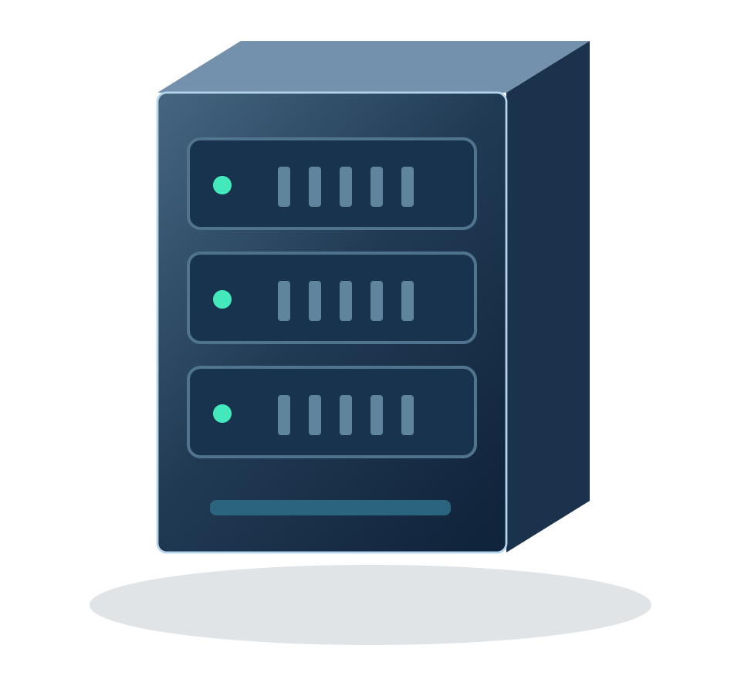
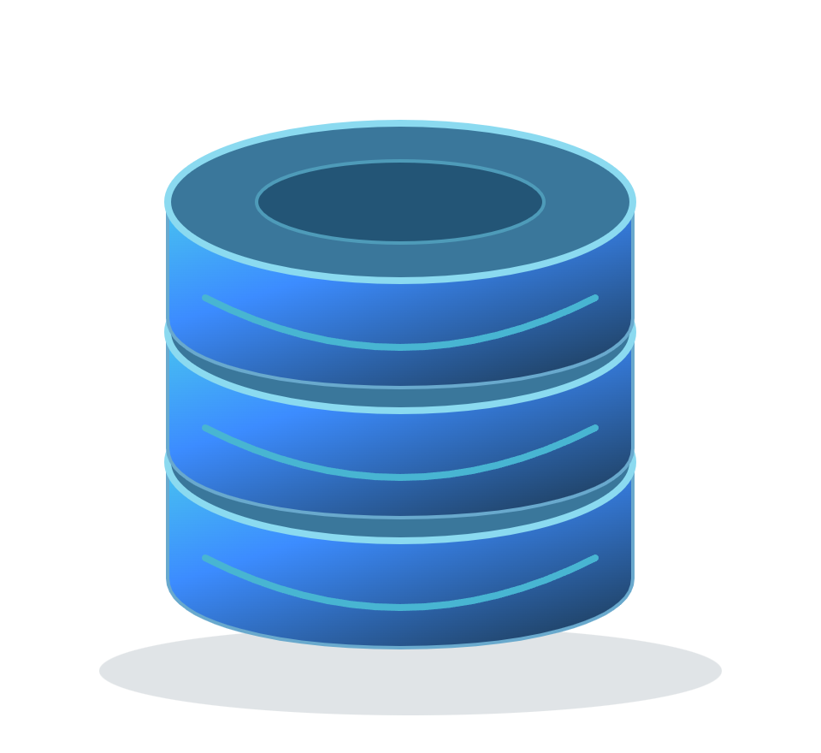
CHAPTER 03 / HAWKEYEPLUS
HawkeyePlus | Industrial Vision Model Development
Connect industrial images, model training, validation and release in one platform
01
Data & Annotations
Visual Training Hub
02
Validation & Delivery
Dataset
Model
Training
Evaluate & Infer
Metrics · Prediction preview
Model Export
Convert · Package · Download
Images + Labels / Masks
Model Registry
Import
Annotate
Preview
Product versions · Activation
Job Setup
GPU Selection
Training Monitor
Multi-framework Training
Compute & Asset Foundation
PaddlePaddle
PyTorch
anomalib
Compute
Data & Assets
Detect · Classify · Segment
Detect · Segment
Anomaly Detection
GPU / Python
Images · Weights · Logs
Management
Project ownership · User roles · Environment checks · GPU status · Storage quotas · Activity logs
SwiftFlow + HawkeyePlus | Industrial Vision Engineering
WD CONFIDENTIAL
12 / 20
Notes:
HawkeyePlus combines dataset, model and training configurations, then starts the selected Python training backend. It manages jobs, monitoring, validation and model assets rather than implementing a new training algorithm. PaddlePaddle covers PaddleDetection/PaddleClas/PaddleSeg; PyTorch covers TorchDet/TorchSeg; anomalib is the PyTorch-based TorchAnomaly adapter. Compute selection does not imply distributed cluster scheduling.
These are training-platform capabilities. Integration into SwiftFlow requires runtime adaptation and acceptance.
Sources and interpretation:
HawkeyePlus: docs/ARCHITECTURE.md; docs/FEATURES.md; src/lib/model-yaml.ts; model registry routes.
SwiftFlow: docs/Architecture.md; docs/Flow_Engine_Internals.md; InferenceSessionFactory.cs; ModelInstanceConfig.cs.
Illustrations and project examples are not performance, accuracy or production-acceptance evidence. Native text, panels and lines are editable; pictures are independently replaceable.

Slide 13
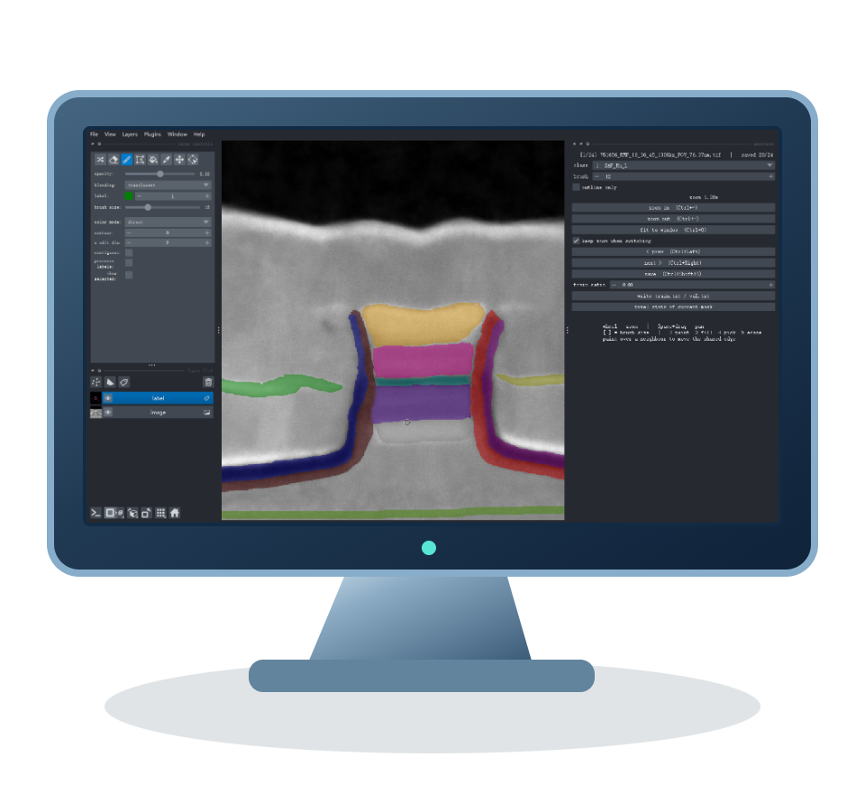
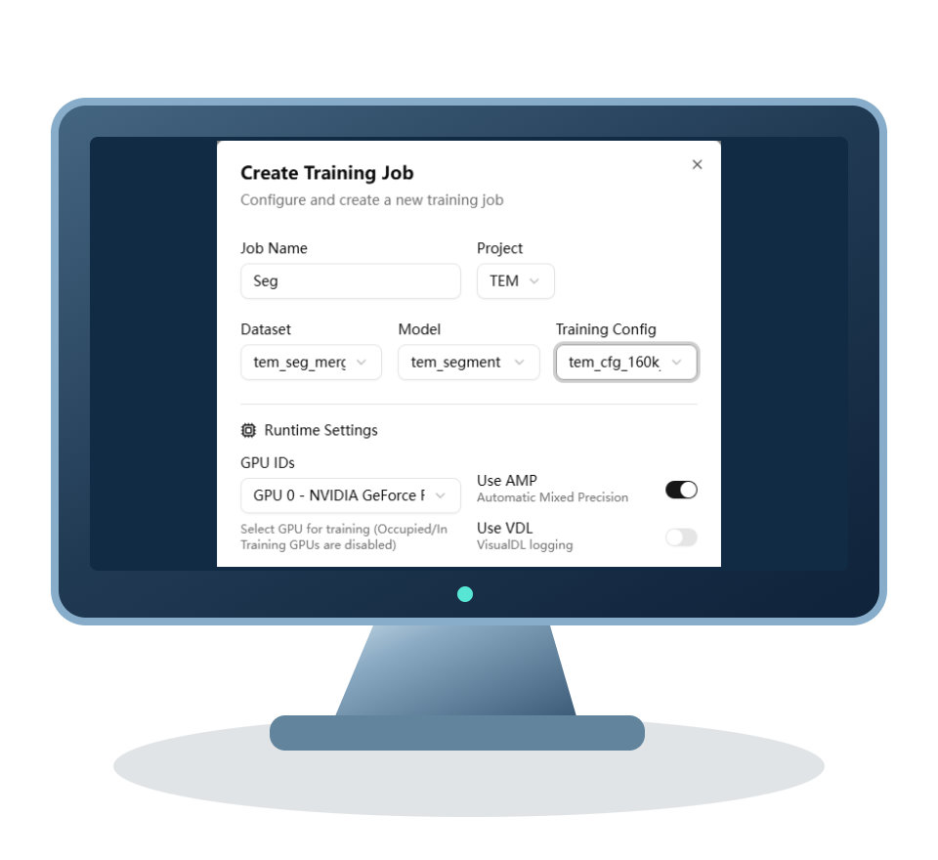
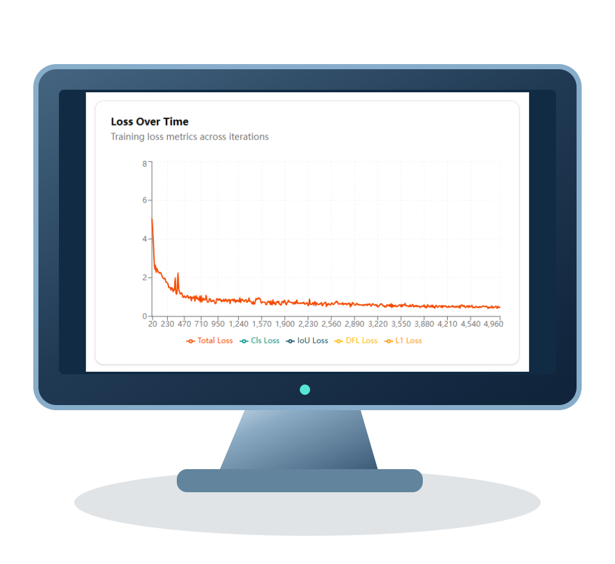
CHAPTER 03 / HAWKEYEPLUS
A Visual Lifecycle: From Data to Models
Bring preparation, training and validation into a shared model-development workflow
01
Prepare Data
02
Configure
03
Training Monitor
04
Validate
05
Deliver Models
Import images & labels
Dataset + Model + Parameters
Run jobs · Track training
Evaluate · Preview predictions
Export · Register versions
Convert formats · Review samples
Reusable templates · Visual setup
Progress · Loss · Metrics
Inspect results · Assess readiness
Select the active product model
Use validation results to refine data and configuration
Four vision tasks. One shared training platform.
Object Detection
Image Classification
Semantic Segmentation
Anomaly Detection
Locate objects and defects
Recognize categories and quality
Map regions and boundaries
Learn from normal samples
Simplify adoption / Reuse training knowledge / Build model assets
SwiftFlow + HawkeyePlus | Industrial Vision Engineering
WD CONFIDENTIAL
13 / 20
Notes:
The workflow combines repository examples and conceptual detection graphics. Napari is the companion desktop segmentation annotation tool, separate from the web rectangle annotation tool. Export support varies by backend; PaddleClas has no platform export entrypoint. Model release registers configurations and weights, versions and the active model; it does not automatically deploy to production machines. The feedback path represents a user revising data and configuration.
These are training-platform capabilities. Integration into SwiftFlow requires runtime adaptation and acceptance.
Sources and interpretation:
HawkeyePlus: docs/ARCHITECTURE.md; docs/FEATURES.md; src/lib/model-yaml.ts; model registry routes.
SwiftFlow: docs/Architecture.md; docs/Flow_Engine_Internals.md; InferenceSessionFactory.cs; ModelInstanceConfig.cs.
Illustrations and project examples are not performance, accuracy or production-acceptance evidence. Native text, panels and lines are editable; pictures are independently replaceable.

Slide 14

CHAPTER 03 / HAWKEYEPLUS
Object Detection | Industrial Defect Localization
Locate defects and identify their classes with bounding boxes and confidence scores
Locate & Classify Defects
PaddleDetection
7 presets
PP-YOLOE · YOLOv3 · PicoDet · RT-DETR
Faster R-CNN · RetinaNet · CenterNet
TorchDet
4 presets
Faster R-CNN · RetinaNet · FCOS · SSD / SSDLite
Output: Boxes · Classes · Confidence
SSD variants: VGG16 → SSD300; MobileNetV3 → SSDLite320
Illustrative output, not a model prediction
COCO Images & Labels
Training & Metric Tracking
Detection Preview
Box labels · Classes
mAP / mAP50 · Training curves
Locate defects · Inspect classes
Presets are backend-specific; PP-YOLOE and RT-DETR are not TorchDet models.
SwiftFlow + HawkeyePlus | Industrial Vision Engineering
WD CONFIDENTIAL
14 / 20
Notes:
Detection models are read directly from DETECTION_PRESETS and TORCH_DET_PRESETS. PaddleDetection has seven preset families; TorchDet has four. SSD/VGG16 uses SSD300; SSD/MobileNetV3-Large uses SSDLite320. TorchDet supports COCO detector-head transfer for Faster R-CNN, RetinaNet and FCOS; SSD falls back to ImageNet backbone initialization. PP-YOLOE, YOLOv3, PicoDet, RT-DETR and CenterNet are not TorchDet families. Defect boxes are illustrative, not inference results or benchmark evidence.
These are training-platform capabilities. Integration into SwiftFlow requires runtime adaptation and acceptance.
Sources and interpretation:
HawkeyePlus: docs/ARCHITECTURE.md; docs/FEATURES.md; src/lib/model-yaml.ts; model registry routes.
SwiftFlow: docs/Architecture.md; docs/Flow_Engine_Internals.md; InferenceSessionFactory.cs; ModelInstanceConfig.cs.
Illustrations and project examples are not performance, accuracy or production-acceptance evidence. Native text, panels and lines are editable; pictures are independently replaceable.

Slide 15
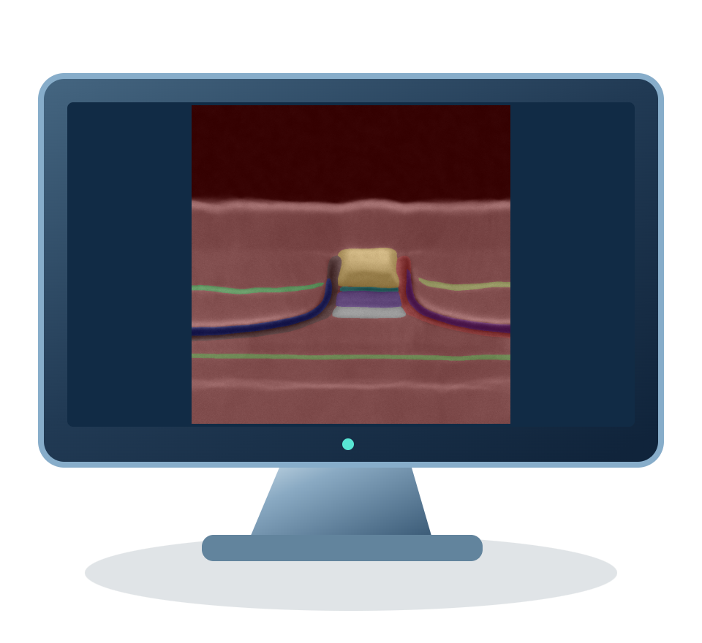
CHAPTER 03 / HAWKEYEPLUS
Segmentation Models | Pixel-level Understanding
TEM images illustrate segmentation across compact, encoder-decoder and Transformer architectures
Pixel-level Prediction Example
PaddleSeg
7 presets
PP-LiteSeg · BiSeNetV2 · OCRNet · UNet · DeepLabV3+
SegFormer-B0 · FCN
TorchSeg
4 presets
UNet · DeepLabV3 (UI: DeepLabV3+) · FCN · LR-ASPP
Regions · Boundaries · Label masks
TEM segmentation example from this project
TorchSeg maps DeepLabV3P to torchvision DeepLabV3, not a V3+ decoder.
Dataset Layout
Evaluation Metrics
Applications
Images + masks + train / validation splits
mIoU · Dice · Accuracy
Defect regions · Microstructure · Boundaries
SwiftFlow + HawkeyePlus | Industrial Vision Engineering
WD CONFIDENTIAL
15 / 20
Notes:
PaddleSeg has seven current UI architectures. TorchSeg has four UI presets. The TorchSeg UI calls one preset DeepLabV3+ (config key DeepLabV3P), but the runtime uses torchvision DeepLabV3 without a V3+ decoder. DeepLabV3 is also a runtime alias, not a fifth UI preset. TEM images are project examples, not a benchmark for all models.
These are training-platform capabilities. Integration into SwiftFlow requires runtime adaptation and acceptance.
Sources and interpretation:
HawkeyePlus: docs/ARCHITECTURE.md; docs/FEATURES.md; src/lib/model-yaml.ts; model registry routes.
SwiftFlow: docs/Architecture.md; docs/Flow_Engine_Internals.md; InferenceSessionFactory.cs; ModelInstanceConfig.cs.
Illustrations and project examples are not performance, accuracy or production-acceptance evidence. Native text, panels and lines are editable; pictures are independently replaceable.

Slide 16


CHAPTER 03 / HAWKEYEPLUS
Classification & Anomaly Detection
From image-level labels to learning normal appearance, reuse the same model-development workflow
PaddleClas | Image Classification
TorchAnomaly | Anomaly Detection
Learn labeled categories; predict image-level classes
Learn normal appearance; produce anomaly scores and heatmaps
Illustrative classification
Illustrative anomaly heatmap
9 Classification Variants
5 anomalib Presets
ResNet18 · ResNet34 · ResNet50 · ResNet101
PatchCore · PaDiM · STFPM · EfficientAD
MobileNetV3 Small / Large (x1.0)
PP-LCNet x1.0 · PP-HGNet Small
SuperSimpleNet
Swin Transformer Tiny (patch4 / window7 / 224)
Current UI presets only; custom YAML compatibility depends on the selected backend.
SwiftFlow + HawkeyePlus | Industrial Vision Engineering
WD CONFIDENTIAL
16 / 20
Notes:
The nine PaddleClas choices are listed by exact configuration name in Supported_Models.md. The five TorchAnomaly presets are PatchCore, PaDiM, STFPM, EfficientAD and SuperSimpleNet. Training uses normal images. ReverseDistillation is not a current UI preset. Classification and anomaly images are conceptual illustrations. Environment/version compatibility still applies.
These are training-platform capabilities. Integration into SwiftFlow requires runtime adaptation and acceptance.
Sources and interpretation:
HawkeyePlus: docs/ARCHITECTURE.md; docs/FEATURES.md; src/lib/model-yaml.ts; model registry routes.
SwiftFlow: docs/Architecture.md; docs/Flow_Engine_Internals.md; InferenceSessionFactory.cs; ModelInstanceConfig.cs.
Illustrations and project examples are not performance, accuracy or production-acceptance evidence. Native text, panels and lines are editable; pictures are independently replaceable.

Slide 17
CHAPTER 04 / OVERVIEW
04
Integrated Delivery
From development results to production readiness
How do delivery packages and joint validation connect both platforms?
04.1
04.2
04.3
Adaptation & acceptance
Shared delivery assets
Results & version traceability
SwiftFlow + HawkeyePlus | One shared method, two complementary platforms
SwiftFlow + HawkeyePlus | Industrial Vision Engineering
WD CONFIDENTIAL
17 / 20
Notes:
Chapter transition: Integrated Delivery. Focus: From development results to production readiness. Guiding question: How do delivery packages and joint validation connect both platforms?.

Slide 18
CHAPTER 04 / INTEGRATED DELIVERY
Connect Development and Production with a Standard Handoff
Adapt and jointly validate model deliverables before using them in inspection or measurement workflows
HawkeyePlus
Adaptation & joint acceptance
SwiftFlow
Match the input
Image shape, channels and preprocessing
Match the output
Labels, thresholds and output decoding
Validate on site
Independent samples, measurement references and timing
Validated model & version
Inference & decisions in the workflow
Recommended delivery baseline
Hardware baseline
Workflow
Model package
Acceptance
Setup · Calibration · References
Steps · Parameters · Rules
Version · Labels · Thresholds
Samples · Evidence · Records
SwiftFlow + HawkeyePlus | Industrial Vision Engineering
WD CONFIDENTIAL
18 / 20
Notes:
Use a model handoff package and joint acceptance. HawkeyePlus exports supported inference artifacts and registers product versions with an active-model query API. SwiftFlow currently implements ONNX (including the YOLO path) and Paddle backends. Its configuration includes labels, input shape, channel order, normalization, thresholds and output decoding. Training support is not direct runtime compatibility: verify operators, I/O and preprocessing/postprocessing per model. Torch checkpoints are not direct inference artifacts; TorchSharp is reserved, and the current task enum has detection, classification and segmentation, but no dedicated anomaly decoder. Anomaly deployment needs additional adaptation. No existing automatic registry synchronization or feedback connector is assumed. The delivery baseline is a proposed engineering convention.
Sources and interpretation:
HawkeyePlus: docs/ARCHITECTURE.md; docs/FEATURES.md; src/lib/model-yaml.ts; model registry routes.
SwiftFlow: docs/Architecture.md; docs/Flow_Engine_Internals.md; InferenceSessionFactory.cs; ModelInstanceConfig.cs.
Illustrations and project examples are not performance, accuracy or production-acceptance evidence. Native text, panels and lines are editable; pictures are independently replaceable.

Slide 19
SUMMARY / KEY TAKEAWAYS
Build a Reusable Standard Workflow
Organize engineering around a shared method, complementary platforms and a defined delivery baseline
One engineering method
Two complementary platforms
A standard delivery baseline
Start with inspection or measurement goals
SwiftFlow connects equipment and execution
Deliver configuration, models and evidence
Define inputs and outputs across disciplines
HawkeyePlus develops and validates models
Validate on site and retain versions and results
Define the goal → Engineer the solution → Validate jointly → Deliver traceably
The goal: help users deliver inspection and measurement through a consistent engineering approach
SwiftFlow + HawkeyePlus | Industrial Vision Engineering
WD CONFIDENTIAL
19 / 20
Notes:
Recap three ideas: one engineering method, two complementary platforms and a standard delivery baseline. Emphasize clear inputs, outputs and acceptance evidence, with reusable configuration and model assets. The recommended engineering method is distinct from an automatic software connector.

Slide 20
SWIFTFLOW + HAWKEYEPLUS
Thank You
Questions & Discussion
From hardware design to inspection and measurement delivery
Which use case should we prioritize?
How should we define acceptance and delivery?
Which workflows, models and knowledge can we reuse?
One shared method · Two complementary platforms · Reusable engineering deliverables
SwiftFlow + HawkeyePlus | Industrial Vision Engineering
WD CONFIDENTIAL
20 / 20
Notes:
Close the presentation and discuss priority use cases, acceptance and delivery baselines, and reusable workflows and models. The discussion prompts do not imply an agreed implementation scope or production commitment.

