Slide 1
Chapter 20: Database System Architectures Part-III 18.8.26

Slide 2
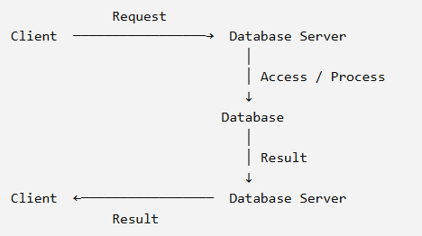
Server System Architecture
A database system often follows a client–server model
Client → sends requests
Server → processes the requests and provides results/data
Database → stores the data
Therefore, server system architecture explains how clients interact with a database server

Slide 3
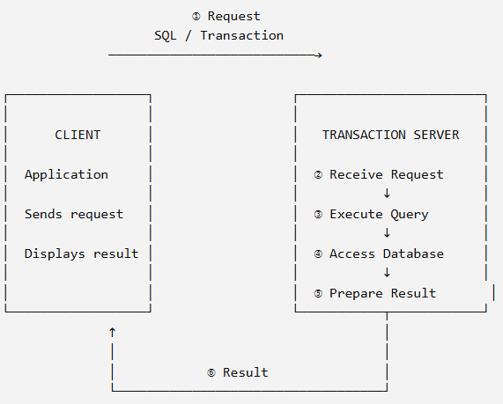
Two Types of Server Systems
Transaction-server systems
Data-server systems
Transaction-Server System:
A transaction server, also called a query server, receives requests from clients, executes the requested operations, and sends the results back

Slide 4
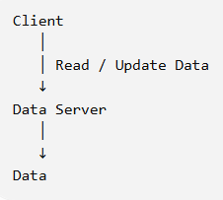
Two Types of Server Systems(Cont’d)
Data-server systems:
A data server allows clients to directly request operations on data
The client may request to:
read data
update data
create data
delete data

Slide 5
Two Types of Server Systems(Cont’d)
Data-server systems(Cont’d):
Example: File Server,
A client requests: “Give me this file.” The server provides the file
A client may also request: “Update this file.” The server updates the data
Database data servers can work with smaller units of data, such as: pages, tuples, objects
They can also provide: indexing, transaction management, consistency

Slide 6
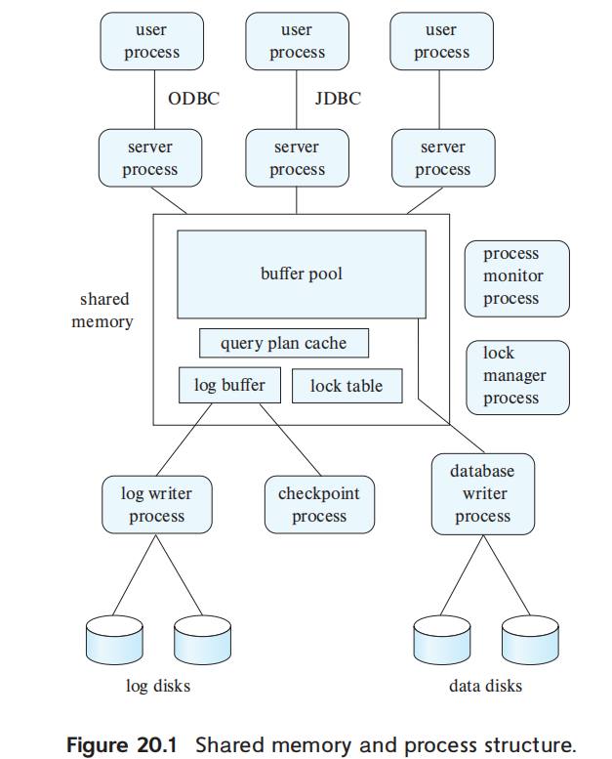
Transaction-Server Architecture
A transaction-server architecture is a database system in which multiple processes work together to receive, execute, and manage transactions
Example,
Student → Login → Transaction Server → Database
Result

Slide 7
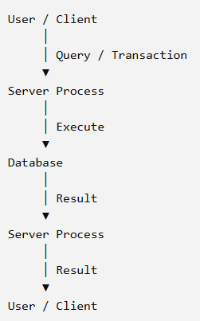
Transaction-Server Architecture(Cont’d)
Server Process
These are processes that receive user queries (transactions), execute them, and send the results back

Slide 8
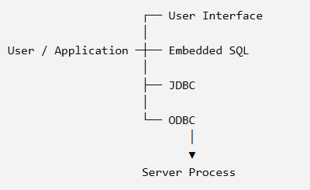
Transaction-Server Architecture(Cont’d)
Server Process(Cont’d)
How is the query sent to the server process?

Slide 9

Transaction-Server Architecture(Cont’d)
Server Process(Cont’d)
How does a DBMS process user queries?
Suppose there are three users. A DBMS uses three processes.
One user session → One server process

Slide 10

Transaction-Server Architecture(Cont’d)
Server Process(Cont’d)
How does a DBMS process user queries?
Suppose there are three users. A DBMS uses three processes
Some DBMS use
A few DBMS use
One user session → One server process(separate processes)
Three users session → One server process(only one process)
How can a single process handle the queries from Users A, B, and C simultaneously?”

Slide 11
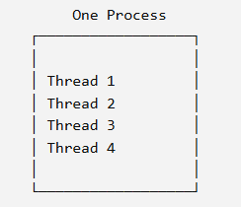
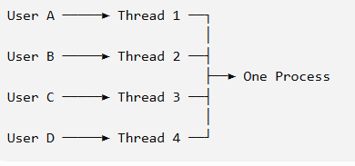
Transaction-Server Architecture(Cont’d)
Server Process(Cont’d)
Thread:
In one process, many threads can execute multiple queries concurrently

Slide 12
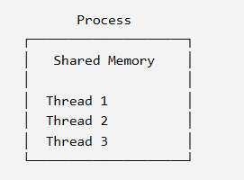
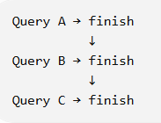

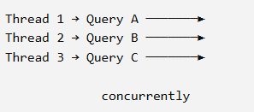
Transaction-Server Architecture(Cont’d)
Server Process(Cont’d)
Thread(Cont’d):
Same virtual-memory space
Multiple threads execute concurrently
Suppose multiple users send multiple
request concurrently
thread is not used
threads used

Slide 13
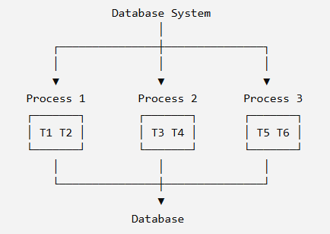
Transaction-Server Architecture(Cont’d)
Server Process(Cont’d)
Hybrid Architecture:
Many database systems use a hybrid architecture

Slide 14
Transaction-Server Architecture(Cont’d)
Server Process:These are processes that receive user queries (transactions), execute them, and send the results back. The queries may be submitted to the server processes from a user interface, or from a user process running embedded SQL, or via JDBC, ODBC, or similar protocols. Some database systems use a separate process for each user session, and a few use a single database process for all user sessions, but with multiple threads so that multiple queries can execute concurrently. (A thread is similar to a process, but multiple threads execute as part of the same process, and all threads within a process run in the same virtual-memory space. Multiple threads within a process can execute concurrently.) Many database systems use a hybrid architecture, with multiple processes, each one running multiple threads.

Slide 15
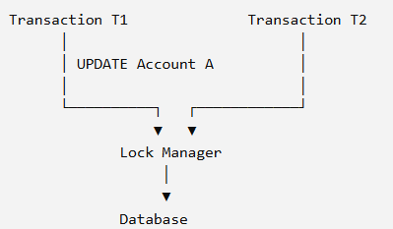
Transaction-Server Architecture(Cont’d)
Lock manager process: Lock manager process is responsible for controlling concurrent access to database data.
Lock: temporary prevent
Reponsibilities: lock grant, lock release, deadlock detection

Slide 16
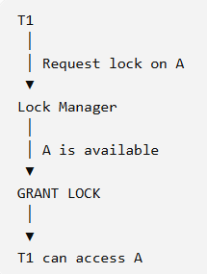
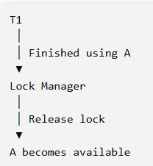
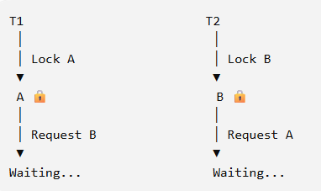
Transaction-Server Architecture(Cont’d)
Lock manager process(Cont’d):
Lock Grant: access permission for data
Transaction T1: “Can I use this data?”
Lock Release: release locked data
Detection: detect the deadlock

Slide 17
Transaction-Server Architecture(Cont’d)
Lock manager process: This process implements lock manager functionality, which includes lock grant, lock release, and deadlock detection
Database writer process: There are one or more processes that output modified buffer blocks back to disk on a continuous basis
Log writer process: This process outputs log records from the log record buffer to stable storage. Server processes simply add log records to the log record buffer in shared memory, and if a log force is required, they request the log writer process to output log records (recall that a log force causes the log contents in memory to be output to stable storage)
Checkpoint process: This process performs periodic checkpoints
Process monitor process: This process monitors other processes, and if any of them fails, it takes recovery actions for the process, such as aborting any transaction being executed by the failed process and then restarting the process.

Slide 18
Transaction-Server Architecture(Cont’d)
The shared memory contains all shared data, such as:
Buffer pool
Lock table
Log buffer, containing log records waiting to be output to the log on stable storage.
Cached query plans, which can be reused if the same query is submitted again.
All database processes can access the data in shared memory. Since multiple processes may read or perform updates on data structures in shared memory, there must be a mechanism to ensure mutual exclusion
Mutual Exclusion:
To ensure that a data structure is modified by at most one process at a time, and no process is reading a data structure while it is being written by other processes.

Slide 19
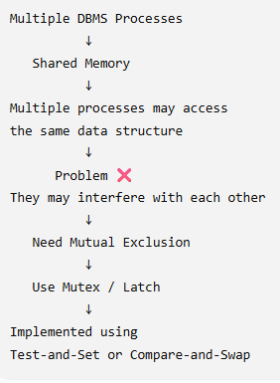
Why Mutual Exclusion Is Needed in Multiple DBMS Processes?
The atomic instructions can be used for mutual exclusion.

Slide 20
Mutex Vs Latch
Both are used in DBMS for concurrency control.
 | Mutex | Latch
Concept | Mutual exclusion lock | Short-term internal lock
Main purpose | Protect a critical section/resource | Protect in-memory DB structures
Duration | Can be relatively long | Usually very short
Used by | Threads/processes | Mainly DBMS internal operations
Example | Only one thread accesses a shared resource | Protecting a buffer-pool page/frame or hash-table entry

Slide 21
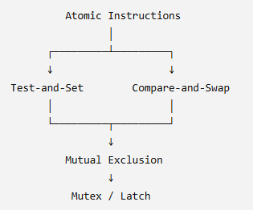
Atomic Instruction
What is an atomic instruction?
An atomic instruction is an instruction that is performed as one indivisible operation.(Atomic = cannot be interrupted in the middle)
When a process executes an atomic instruction:Either the entire operation happens, or it does not happen at all.
Another process cannot interfere between the steps of that operation.
Concept
Methods

Slide 22


Atomic Instruction(Cont’d)
Suppose two processes(P1 and P2) trying to get the same lock.
Virtual Memory address M = 0, 0 means: Lock is free
M = 1, 1 means: Lock is occupied
Without an atomic operation
P1 and P2 both check the lock:
Then both set it to 1:
Now both P1 and P2 think they own the lock. So they might both enter the critical section:
Test and Set atomic instruction

Slide 23
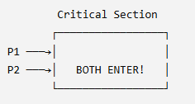
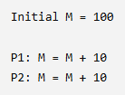

Atomic Instruction(Cont’d)
This is called a race condition that cause mutual exclusion failure.
A race condition happens when two or more processes access or modify the same shared data at nearly the same time, and the final result depends on which process happens first.
E.g.,
Test and Set atomic instruction
no race condition

Slide 24
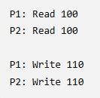
Atomic Instruction(Cont’d)
Test and Set atomic instruction
race condition

Slide 25
Atomic Instruction(Cont’d)
How to solve race condition by test and set atomic instruction?
Test-and-Set combines:
Read the value + set it to 1 into one atomic operation: test-and-set(M)
P1 executes first
Initially: M = 0
P1: test-and-set(M)
The operation does:
Read M → 0
Set M → 1
Return 0
P1 receives 0 → "I got the lock"
Test and Set atomic instruction
Then P2 executes
test-and-set(M)
Now: M = 1
Read M → 1
Set M → 1
Return 1
Therefore:
P2 receives 1 → "I did NOT get the lock"

Slide 26
Atomic Instruction(Cont’d)
How to solve race condition by test and set atomic instruction?
Test-and-Set combines:
Read the value + set it to 1 into one atomic operation: test-and-set(M)
P1 executes first
Initially: M = 0
P1: test-and-set(M)
The operation does:
Read M → 0
Set M → 1
Return 0
P1 receives 0 → "I got the lock"
Test and Set atomic instruction
Then P2 executes
test-and-set(M)
Now: M = 1
Read M → 1
Set M → 1
Return 1
Therefore:
P2 receives 1 → "I did NOT get the lock"

Slide 27
Atomic Instruction(Cont’d)
Basic Idea
Imagine I put a book on a table and say:
“If the table is empty, put my book there.”
But someone else may put a book there first.
So I need to do:
Check → If it is still empty → Put my book
What does compare mean?
Check whether two values are the same.
What does swap mean?
Replace the old value with a new value.
Compare and Swap

Slide 28
Atomic Instruction(Cont’d)
compare-and-swap(M, Vo, Vn)
E.g., compare-and-swap(M, 0, 101)
If M is currently 0, change M to 101.
Success Case
Suppose:
M = 0
P1 wants the lock.
P1's ID is 101
Compare and Swap
Symbol | Meaning
M | Memory location
Vo | Old/expected value
Vn | New value

Slide 29
Atomic Instruction(Cont’d)
Step 1 — Compare
Current M = 0
Expected Vo = 0
Are they equal?
0 = 0
Step 2 — Swap/change
Because they match:
Swap 101, M = 101
P1 gets the lock (success)
Compare and Swap
I expect the lock to be free (M = 0). If it is still free, put my ID (101) into M.

Slide 30
Atomic Instruction(Cont’d)
Failure
suppose P2 wants the same lock.
But M = 101
P2 executes: compare-and-swap(M, 0, 202)
Step 1 — Compare
Current M = 101
Expected Vo = 0
Are they equal?
101 != 0 (Compare fails)
CAS → FAILURE
P2 knows: Someone else already has the lock.
Compare and Swap

Slide 31
Exercise-1
Initially: M = 0
P1 executes: test-and-set(M)
Then P2 executes: test-and-set(M)
What value does P1 receive?
What is the value of M after P1?
What value does P2 receive?
What is the value of M after P2?
Which process gets the lock?

Slide 32
Exercise-2
Initially: M = 0
P1 and P2 execute test-and-set(M) concurrently.
Assume P1's atomic operation happens first.
Why can't both P1 and P2 receive 0?

Slide 33
Exercise-3
Initially: M = 0
P1's ID: 101
P1 executes: CAS(M, 0, 101)
Does the comparison succeed?
What is M afterward?
Does P1 get the lock?

