Slide 1
PU MYEIK LMS System

Slide 2
KPTMYK- Mg Min Han Set Naing KPTMYK- Mg Soe Kyaw Hein KPTMYK- Ma Yadanar Win KPTMYK- Ma Ei Phyo Myat KPTMYK-001330 Ma Thin Nandar Hsu
MEMBERS

Slide 3
Project Description Objectives System Requirements ER Diagram Advantages Conclusion Limitations References
Contents

Slide 4
Project Description
PU Myeik LMS is a web-based Learning Management System developed to support and manage online teaching and learning activities at the university.
The system consists of three main user roles: Admin, Teacher, and Student.
Admin can add and manage teacher and student accounts, view user lists, and monitor the total number of users.
Students can join classes, access learning materials, view and download lecture files, and submit assignments online.
User, class, lecture, assignment and submission data can be systematically stored and managed in a database.
The system reduces the time and effort required for traditional teaching and learning activities.
PU Myeik LMS system makes the teaching and learning process easier, faster, and more efficient.

Slide 5
Objective
To provide an easy and efficient online learning platform for students and teachers
To allow teachers to create classes and upload lecture , assignments
To allow students to access learning materials and submit assignments and ‌and then download lecture files
To reduce the time and effort required for traditional teaching and learning activities

Slide 6
System Requirements
Software Requirements Development Environment: Visual Studio Code or NuSphere PhpED Web Browser: Any modern browser (recommended: Google Chrome or Mozilla Firefox) Operating System: Windows 10 or later Web Server Stack: XAMPP 3.3.0 Programming Language: PHP 8.0 or later Database: MySQL

Slide 7
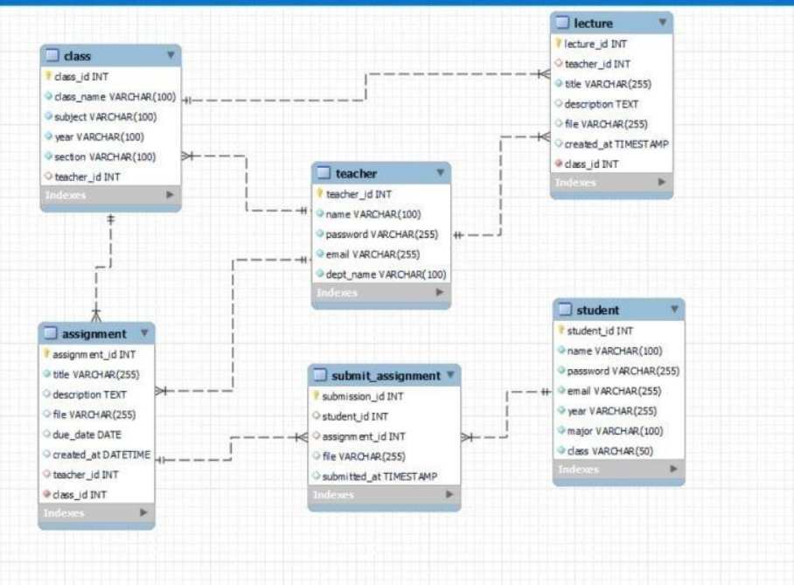
ER Diagram

Slide 8
Advantages
Students can access learning materials anytime and anywhere.
Lectures, assignments and learning resources are managed in one system.
Reduces manual work for teachers and students.
Teachers and students can communicate through the system.
Teachers can monitor students’ learning activities and progress. ‎

Slide 9
Limitation
The system requires a stable Internet connection.
Server or system errors may interrupt learning activities.
Students need a suitable device such as a smartphone, tablet or computer.
The system needs regular updates, maintenance and technical support.
User accounts and learning data need proper security protection. ‎

Slide 10
Conclusion
In conclusion, PU Myeik LMS is a useful Learning Management System for Students, Teachers, and Admins.
It allows Students to easily access learning materials and assignments, while Teachers can efficiently manage courses and monitor students’ learning progress.
For Admins, the system provides centralized management of users, courses, and system information.
Therefore, PU Myeik LMS makes the overall teaching and learning process more convenient, organized, and efficient.

Slide 11
Reference
[1] https://www.britishcouncil.org.mm/online-learning-hub
[2] https://learninghub.com/
[3] https://www.learninghub.ca/
[4] PHP 5 for DUMMIES, Janet Valade
[5] Beginning PHP and MySQL from Novice to Professional, W. Jason Gilmore

Slide 12
THANK YOU

