Slide 1
GA Individual Project NYC Taxi Shareability & Fare Prediction
Hans han 02/03/2016

Slide 2
Contents
What the project is about. (1 min)
Why did I choose this project? (1 min)
The results and demo. (2 mins)
What steps did I go through? (3 mins)
What I’ve learnt about the data? (1 min)
Things that I’d like to continue to improve. (2 mins)

Slide 3
What is this Project about?
To predict the taxi fare price based on historical data
To classify taxi trips for their probability of shareability based on a average 10 minute waiting window using historical data
To quantify the benefits of sharing based historical data (in- progress)
Visualizations to help users better understand the complexity and volume of data

Slide 4
Why did I choose this project?
Big publicly available, rich dataset with many visualizations done on it previously
Not many interactive visualizations using this data
Not many predictive models using this data
Good practice with geo location data and mapping them
Apply CRISM-DM methodology and combine machine learning and visualization

Slide 5
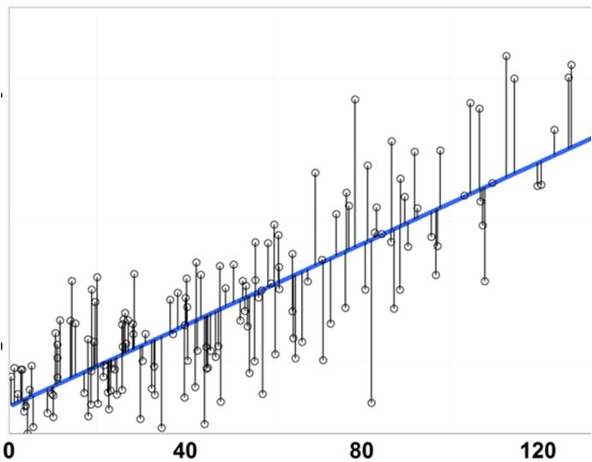
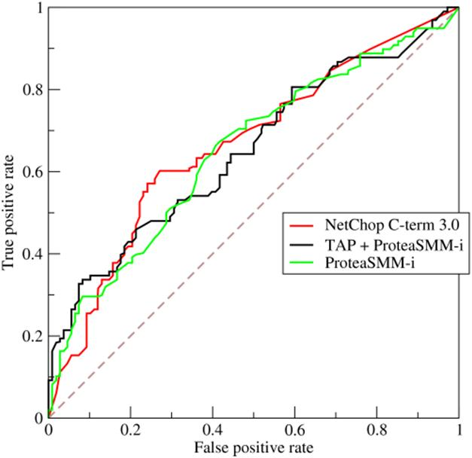
The Results and Demo
Taxi fare prediction
R^2: Average 0.78
Mean Squared Error: $2.31
Taxi shareability prediction
Accuracy: 0.77
Area Under the Curve: 0.76
Demo of results

Slide 6





Steps to Get Through 1
The data
New York City Taxi Trips for February 2013
Trip data and fare data
14 million raw observations
National Oceanic and Atmosphere Administration
Hourly rain fall for February 2013
The software stack
Python/Anaconda: Jupyter Notebook
Html, CSS for web contents and styling
JavaScript for user interactions with web
Leaflet (JavaScript library) for geo location data
D3 for slider control
Flask for linking python with web development

Slide 7
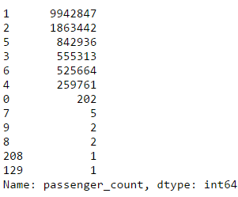
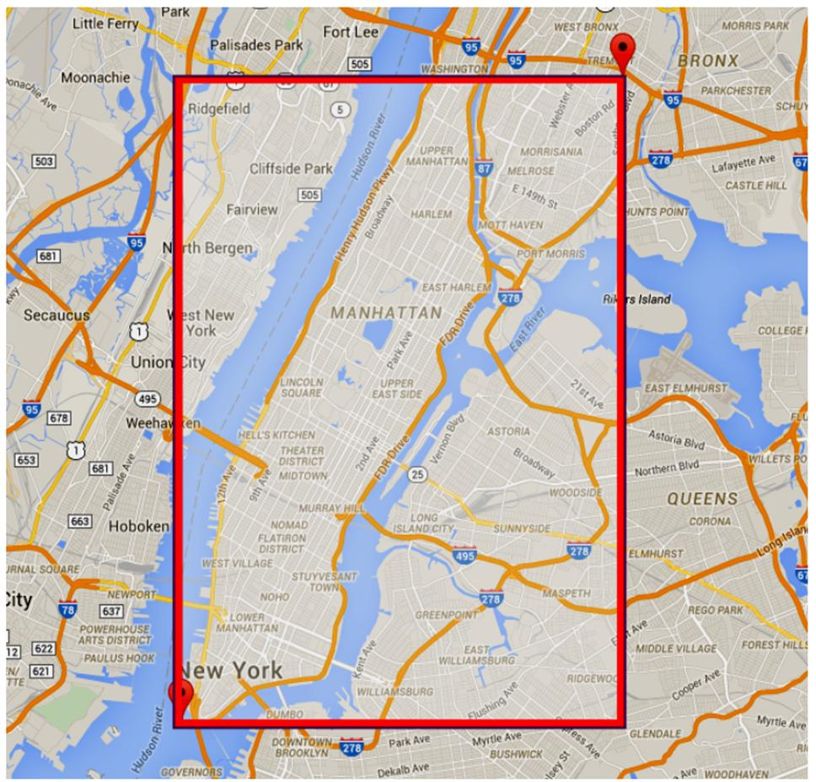
Steps to Go Through 2
Summarizing data
Data types
Statistical summaries
Cleaning data
Erroneous entries in all dimensions
Null values in geo locations
Rescoping project
Manhattan area (longitude and latitude)
Single passenger trips only (71%)
Trip time constraint
Wrangle data
Merge on columns between 3 datasets

Slide 8
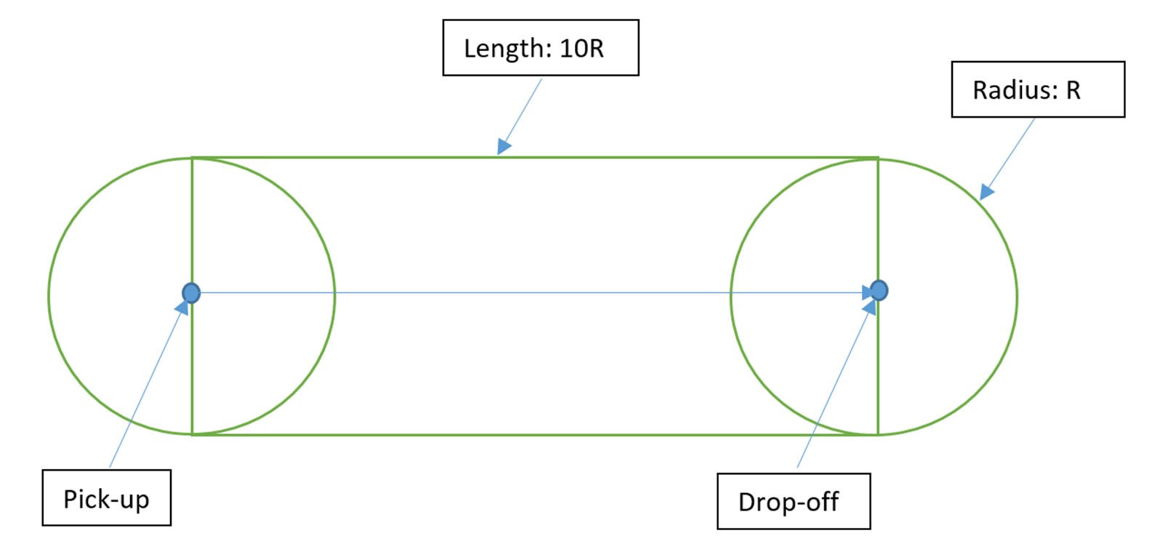
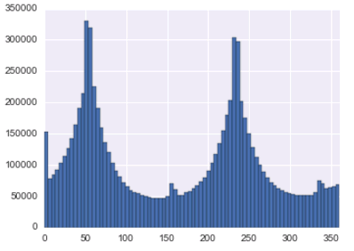
Things that I Tried or Learned
Shareable trips for each trip
Too complex, simplified twice
Time and space domains
Direction of travel
Two prominent ones
Day of the week
Much less traffic on Sundays
Hours of the day
Lowest at 4am
Peaks at 8am and 6pm
Obvious time-series cycles within

Slide 9
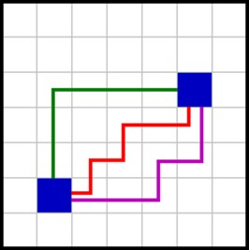

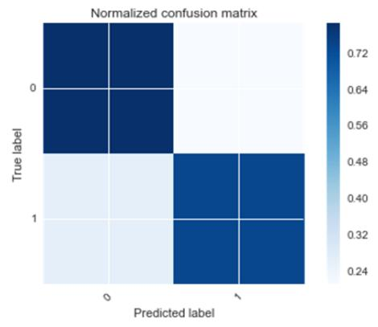
Steps to Go Through 3
Feature engineering
Manhattan distance (pun!)
Haversine distance
Angle of travel direction
Modelling
Regression
Classification
Cross-validation
Train-test split
K-fold CV
Model Performance
R^2 across 5-folds: SD of .001
Confusion Matrix

Slide 10
Future Improvements
Run a year’s worth of data to capture seasonality with Spark
Combine the two web apps into one and improve user friendliness
Include potential shareability savings based on a year’s data
Enrich with other datasets such as subway entry and exit locations and neighbourhood geojson boundaries on Open NYC Data website
Better predictive model for probability to share within a acceptable time window
Better look at the raw data and explore for more interesting insights and ideas to work on

Slide 11
Thank You! Questions?

