Slide 1








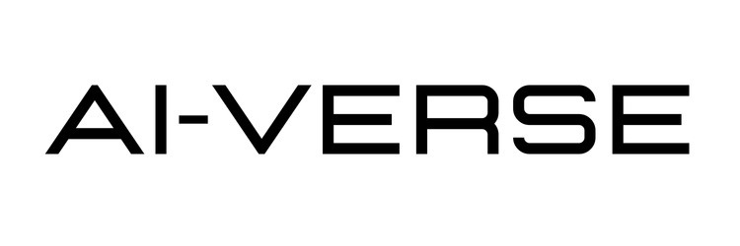
IETE Student Forum
Amrita Vishwa Vidyapeetham
Team Name :
COSMOS
Team Leader Name :
Track : Agentic AI
Hanshitha K

Slide 2



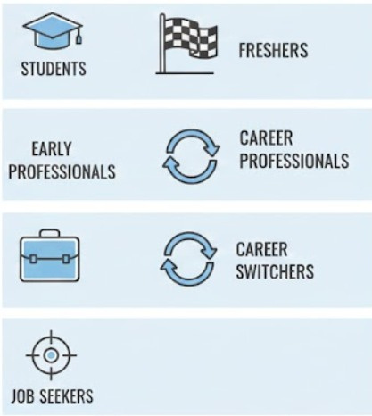
CareerPilot AI
Turning Career Uncertainty Into Direction
Targeted Audience
An agentic, AI-powered career mentorship platform designed to navigate uncertainty in a fast-changing job market
Unlike traditional career tools that offer static advice or one-time recommendations, it acts as a long-term virtual mentor
Continuously plans, adapts, and guides career decisions as the user’s skills, goals, and circumstances evolve
Treats career growth as a dynamic, evolving journey rather than a static checklist
Maintains persistent career memory, learning from progress, interviews, and
rejections
Recalculates the next best strategy during uncertainty or setbacks
Reduces decision paralysis and job-search stress by turning failures into actionable feedback

Slide 3


Opportunity & Differentiation
USP of the Proposed Solution
How Does It Solve the Problem?
True Agentic Proactivity: Adapts plans after rejections and sends smart nudges automatically. Multi-Agent Collaboration: Resume, jobs, roadmap, interviews, and networking agents work together. Real-Time & India-Focused Insights: Uses live market trends, hackathons, and role demands. Lightweight & Accessible: Simple web app using free tools—affordable and scalable.
Proactive Career Guidance: Reduces indecision and job- search stress through structured planning. Resume-Based Skill Gap Analysis: Identifies missing skills and suggests in-demand learning paths. Automated Job Workflow: Handles job discovery, deadline tracking, and application monitoring. Networking Support: Generates personalized outreach for referrals and connections.
How Is It Different from Existing Ideas?
Beyond Job Portals: Traditional platforms are passive listings requiring high manual effort. Beyond Chatbots: Existing AI tools lack memory, planning, and adaptive actions. Agentic Intelligence: CareerPilot AI thinks, plans, acts, and learns using multi-agent design. Persistent Career Memory: Stores progress, rejections, and outcomes for long-term guidance.

Slide 4






Key Features
Self-Assessment & Career Paths
Smart quizzes + resume analysis → 3-5 personalized career suggestions
Resume Analysis & Skill Gaps
Extracts skills, highlights weaknesses, explains rejections
Job Matching & Trend Insights
Matches skills to in-demand roles, shows readiness scores
Skill Roadmaps & Projects
Personalized learning plans with timelines and courses
Application Tracking & Automation
Tracks applications, deadlines, rejections, adapts plans
Networking & Referrals
Finds relevant connections, generates outreach messages
Mock Interviews
Role-specific practice with PYQs and feedback
Progress & Feedback Loop
Weekly dashboard with persistent career memory
Stress Reduction
Automates repetitive tasks, provides supportive guidance

Slide 5
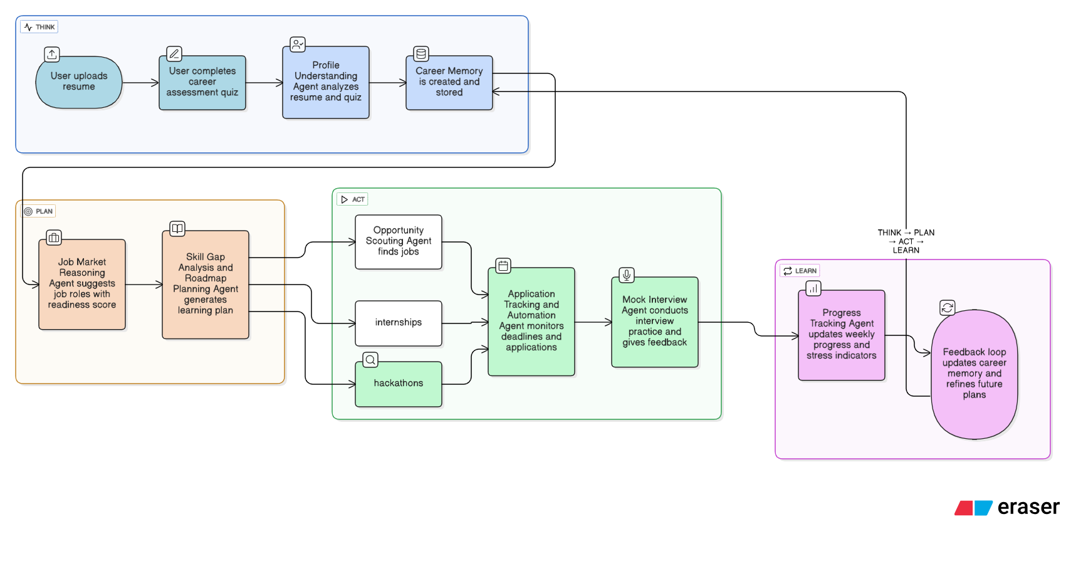
Process Flow
From resume upload to career success

Slide 6






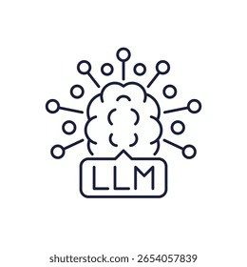
AI TECHNOLOGIES
  Agentic Framework: LangGraph + Lang Chain with React loops for autonomous planning, actions.
  LLM Engine: Google Gemini 2.5 Flash alternatives for guidance, roadmaps, messaging, and interviews.
  Supervisor Agent: Central brain that routes tasks, manages sub-agents, and adapts career plans over time.
  Specialized Sub-Agents: Resume Analyzer, Job Matcher, Skill Planner, Application Tracker, Networking, Mock Interview.
  Document Processing: PyPDF for resume parsing, skill extraction, and feedback analysis.
  Live Data & Search: Rapid APIs for job trends, skills demand, and hackathons.
  Persistent Memory: Supabase to store career history, progress, and rejection insights.
  Learning Feedback Loop: Continuously refines recommendations based on user actions and outcomes.
  User Interface: react chat + dashboard for guidance, tracking, alerts, and reports.
System Infrastructure
  Frontend: React.js + Tailwind CSS
  Backend: Node.js + Express
  Agentic Orchestration: Custom agent workflow (LangGraph-inspired)
  LLM: Google Gemini 2.5 Flash
  Memory & State: Supabase (user data + session memory)
  Search & Jobs: Rapid APIs
  Deployment: Lovable Hosting
  Version Control: GitHub
  Vite: A high-performance build tool and development server.

Slide 7
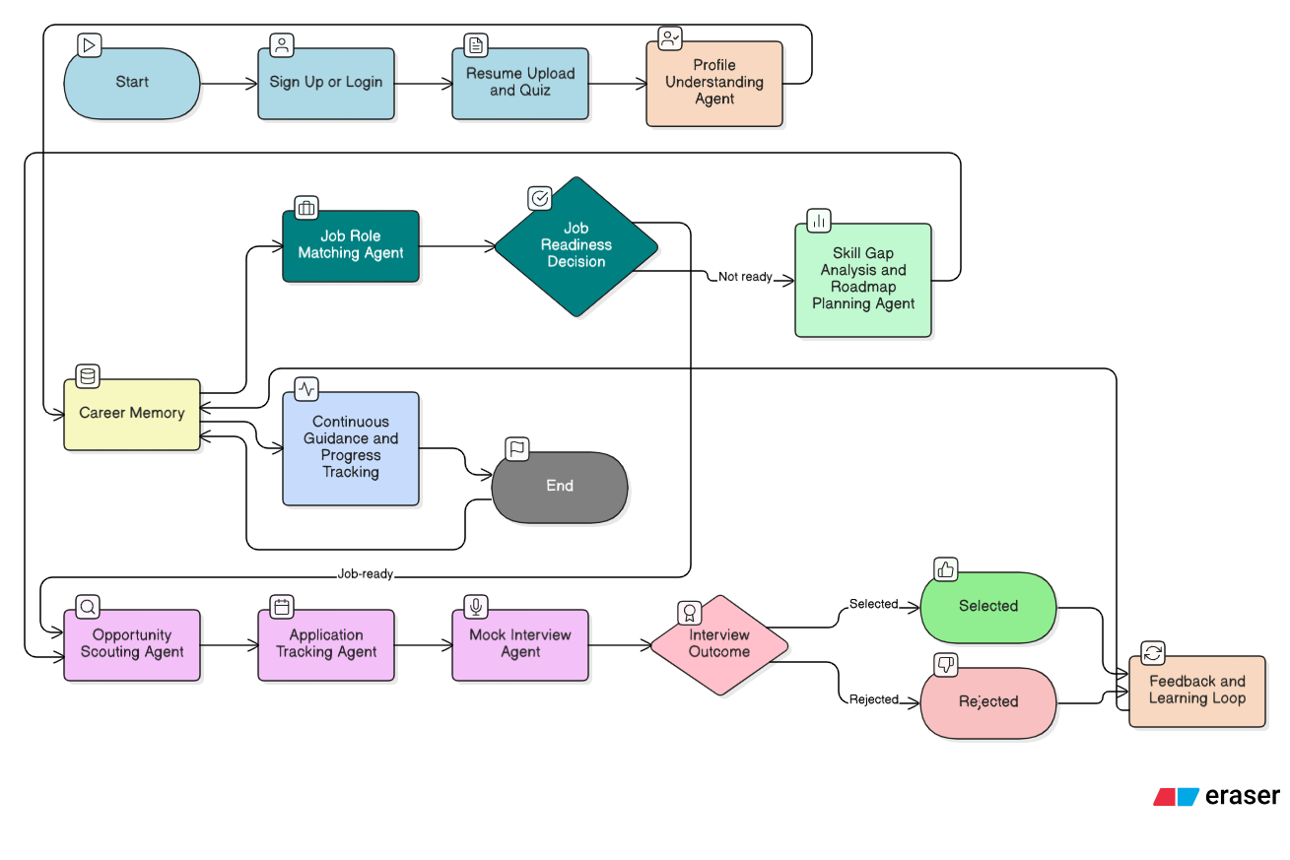
System Architecture

Slide 8


IMPACT
Social & Educational Impact
Technical Impact
USP of the Proposed Solution
  Reduces career confusion and anxiety among students & freshers
  Converts rejections into structured improvement plans
  Democratizes career mentorship (no paid counselors needed)
  Demonstrates real-world agentic AI, not prompt-based chat
  Shows multi-agent coordination with memory
  Practical application of LangGraph in production-like workflow
Institutional / Industry Impact
USP of the Proposed Solution
  Can be adopted by colleges for placement support
  Helps companies pre-screen candidates via readiness scores
  Reduces recruiter workload through better-prepared applicants

Slide 9
FUTURE SCOPE
Short-Term
  LinkedIn & GitHub integration
  Real-time internship & hackathon alerts
  Interview scheduling & calendar sync
Long-Term Vision
  Autonomous Career Copilot
  AI agents negotiate interviews, referrals, and learning paths
  Personalized lifelong career intelligence system
Mid-Term
  Company-specific interview agents
  Salary negotiation guidance
  Behavioral + technical interview simulations

Slide 10
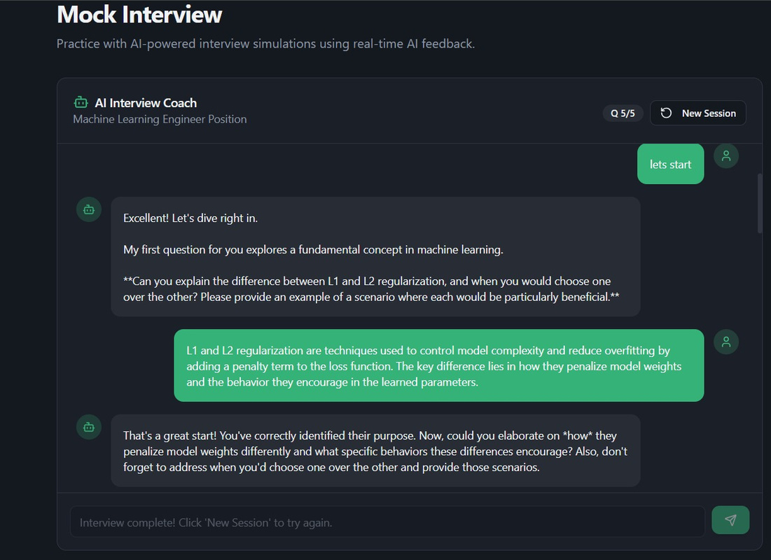
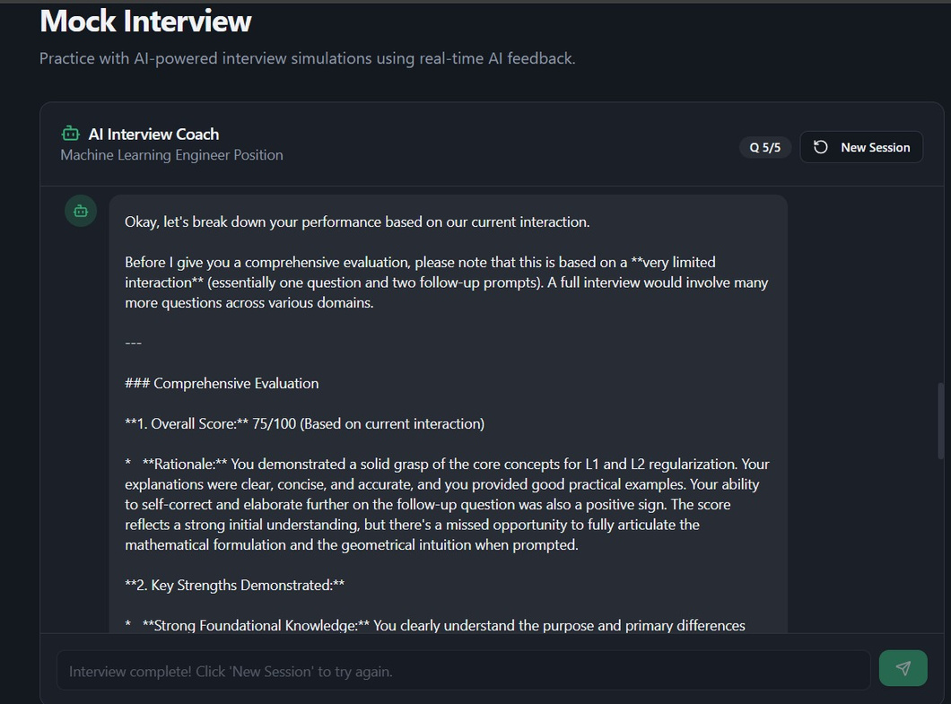

Slide 11
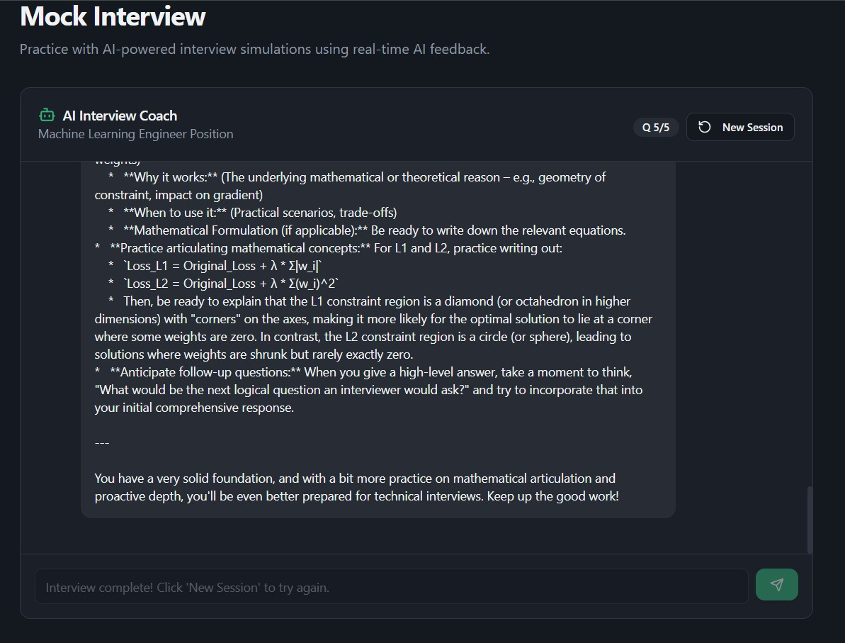

Slide 12

Thank You!
COSMOS
Agentic AI

