Slide 1
ENCODER AND DECODER GENERATOR PYTHON PROJECT
By :
S.Dharanish (23ITR027)
P.S.Giri Vignesh (23ITR046)
P.Hansiga (23ITR051)

Slide 2
ABSTRACT
This project explores an encoder and decoder system using the Lempel-Ziv-Welch (LZW) method for efficient, lossless data compression.
The LZW algorithm compresses data by building a dictionary of recurring patterns, enabling shorter representations of repetitive sequences.
Our encoder compresses data by identifying these patterns, while the decoder reconstructs the original data using the same dictionary logic.
This approach maintains data integrity, making it suitable for storage and transmission applications.
The presentation highlights the theory behind LZW, our implementation challenges, and a performance analysis that showcases LZW's compression efficiency compared to traditional methods.

Slide 3
INTRODUCTION
The project focuses on building an encoder and decoder system using the Lempel-Ziv-Welch (LZW) algorithm, a technique for compressing data without losing any information.
The LZW method works by creating a dictionary of patterns found in the data, which allows it to represent repeating sequences with shorter codes.
This approach helps reduce file sizes while preserving the data exactly as it was.
The project demonstrates how the LZW algorithm works and highlights its usefulness in applications like data storage and transmission where efficient, lossless compression is essential.

Slide 4
ENCODER DECODER
DATA STRUCTURE
Efficient sqlite3-Python collaboration for clear data manipulation
SYSTEM ARCHITECTURE
CODE OVERVIEW
The project make uses of Limpel-Ziv-Welch to encode and decode

Slide 5
FEATURES
Bulk Encoding Decoding
User Interface Design
FUNCTIONALITIES
Data Compression
Dynamic Dictionary Building

Slide 6
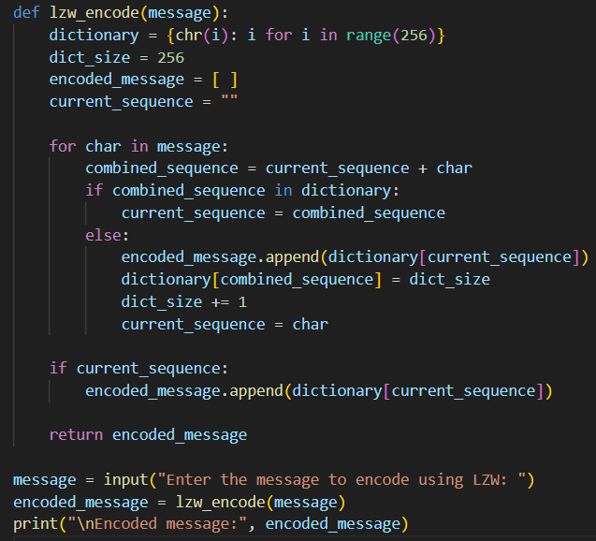
PYTHON CODE encoder.py

Slide 7
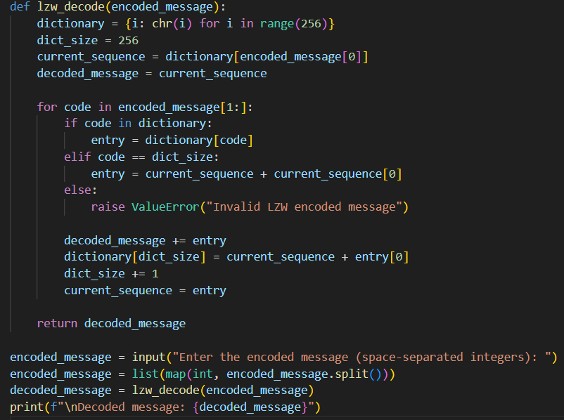
decoder.py

Slide 8
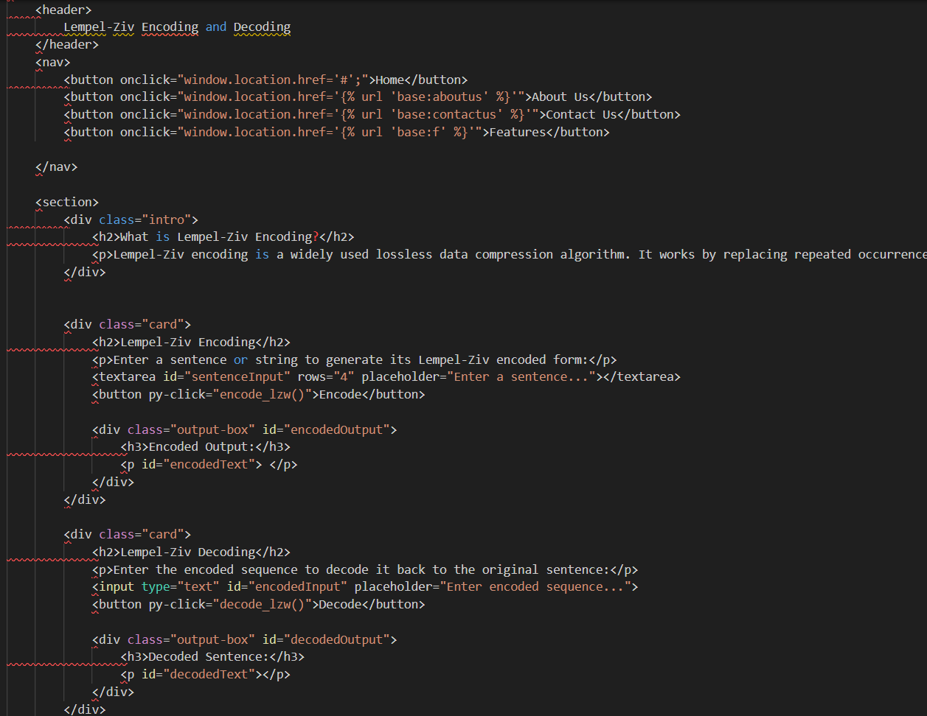
home.py

Slide 9
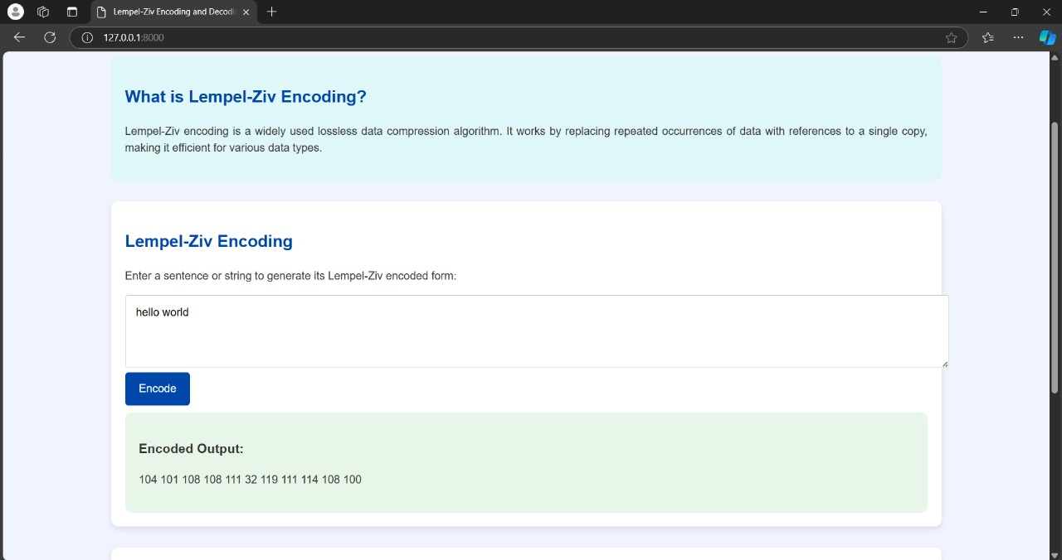
OUTPUT

Slide 10
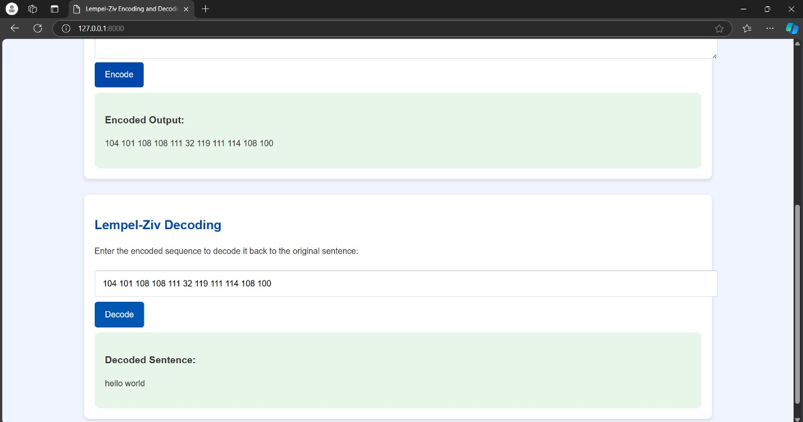

Slide 11
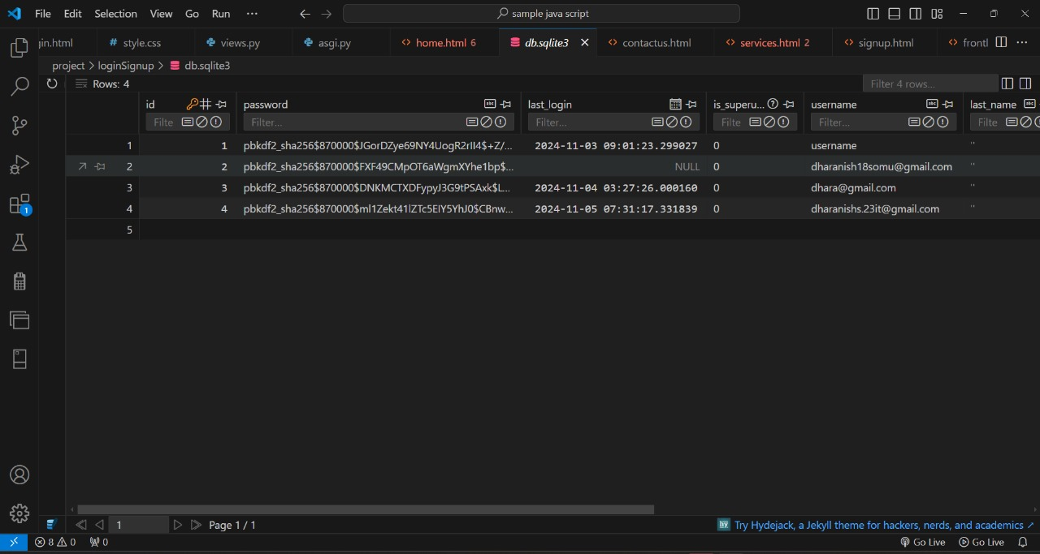

Slide 12
CONCLUSION
This project successfully demonstrates the Lempel-Ziv-Welch (LZW) algorithm’s effectiveness in lossless data compression through a functional encoder-decoder system.
By creating a dynamic dictionary of recurring data patterns, the LZW method achieves significant data size reduction while preserving the integrity of the original information.
The project highlights the algorithm’s adaptability and efficiency, making it ideal for applications where storage and bandwidth savings are crucial.
Overall, this encoder and decoder system exemplifies the practical benefits of LZW compression and its potential for broader use in file handling, data storage, and communication technologies.
Future improvements could focus on optimizing dictionary management and expanding compatibility with various file types.

