Slide 1



Bank Management System
PROJECT MEMBERS : P.Hansiga – 23ITR051
S.Dharanish – 23ITR027
P.S.Giri Vignesh – 23ITR046
JAIHARI D (19ITR028)
PROJECT GUIDE : Ms.K.Sruthi

Slide 2

The Bank Management System is designed to simplify and automate common banking operations.
The system will enable users to create and manage accounts, deposit and withdraw funds, and view account details.
It ensures secure and efficient handling of transactions, with features like validation for duplicate accounts, limits on withdrawals, and incentives for large deposits.
The goal is to provide a reliable and user-friendly platform for managing banking activities.

Slide 3
Objectives
The objective of the Bank Management System is to develop a comprehensive software solution that facilitates the management of banking operations, including account creation, transaction processing, and balance inquiries.
The system aims to provide a secure, efficient, and intuitive platform for users to perform key banking functions with minimal complexity. It will include features like duplicate account prevention, transaction validation, and special handling of large deposits and withdrawals.
Additionally, the system seeks to improve accuracy in financial operations, reduce manual errors, and ensure smooth and reliable management of customer data.
3

Slide 4
Software / Hardware Tools used
SOFTWARE TOOLS :
Visual Studio
Abstract Window Toolkit (AWT)
GitHub
Sqlite
4

Slide 5
Implementation Details
User Interaction: AWT frontend captures user input and sends HTTP requests to Spring Boot.
Request Handling: Spring Boot processes the requests and performs operations.
Database Interaction: Sqlite stores and retrieves data based on requests.
Response Handling: Spring Boot sends responses back to the AWT frontend.
UI Update: AWT updates the user interface based on backend responses.
5

Slide 6
Modules
Base bank management system code
Cibil Score calculation
AWT creation
Database connectivity

Slide 7
Full Code Link
https://docs.google.com/document/d/1C9b0C6tzsV1_o1tVQw6R6OElB16l2KvS/edit?usp=sharing&ouid=115355936330916650124&rtpof=true&sd=true

Slide 8
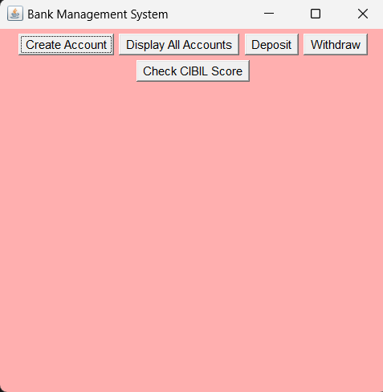
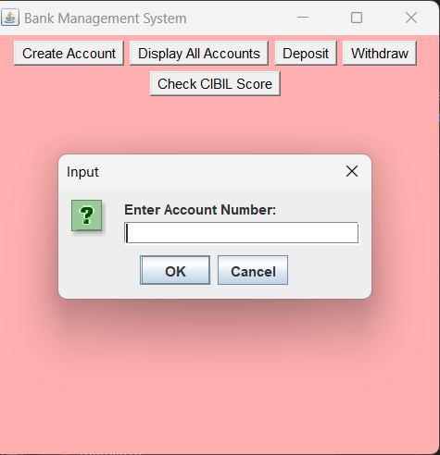
OUTPUT
Hhhhhhhhhhhhhhhhhhhhhhhhhhhhh

Slide 9
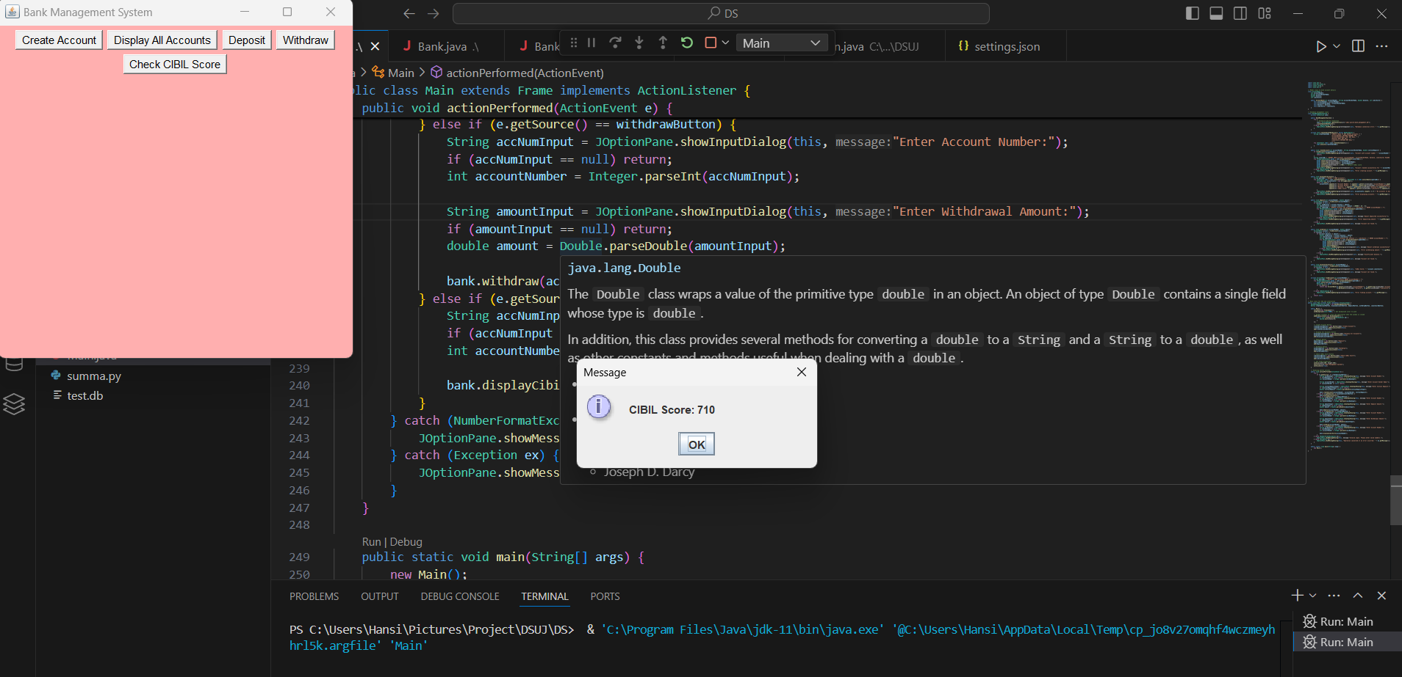

Slide 10
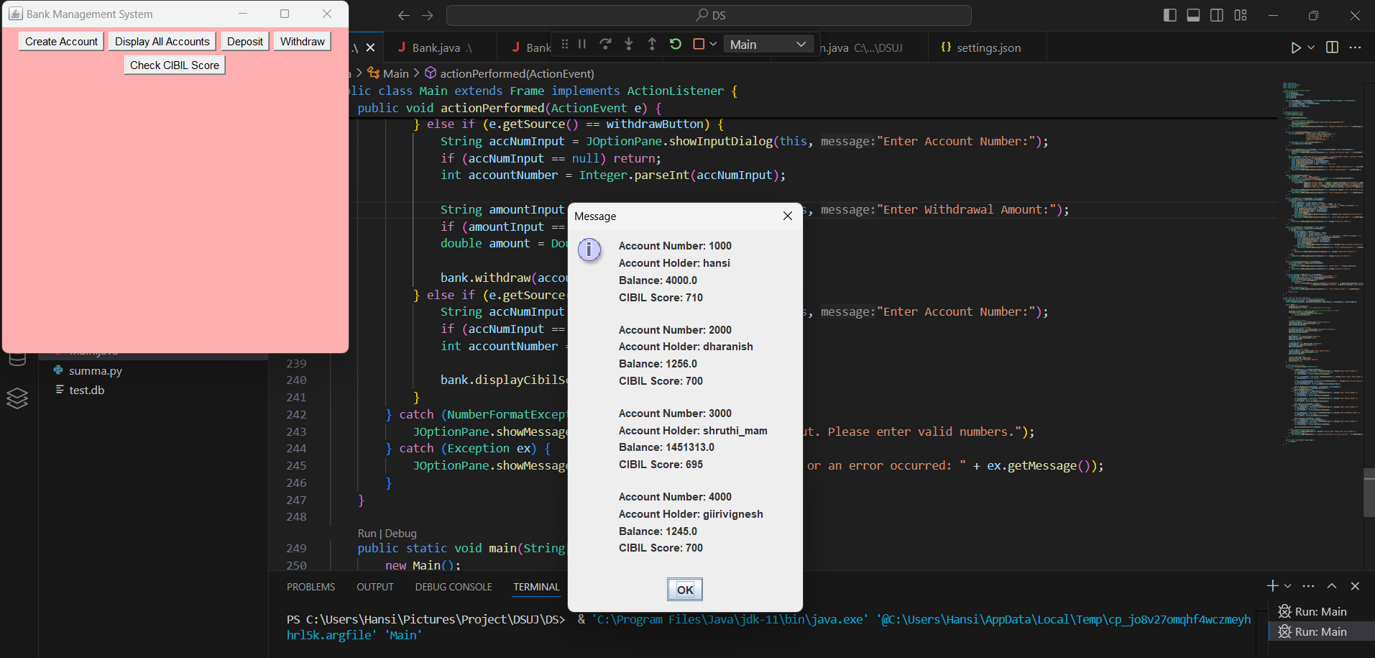

Slide 11
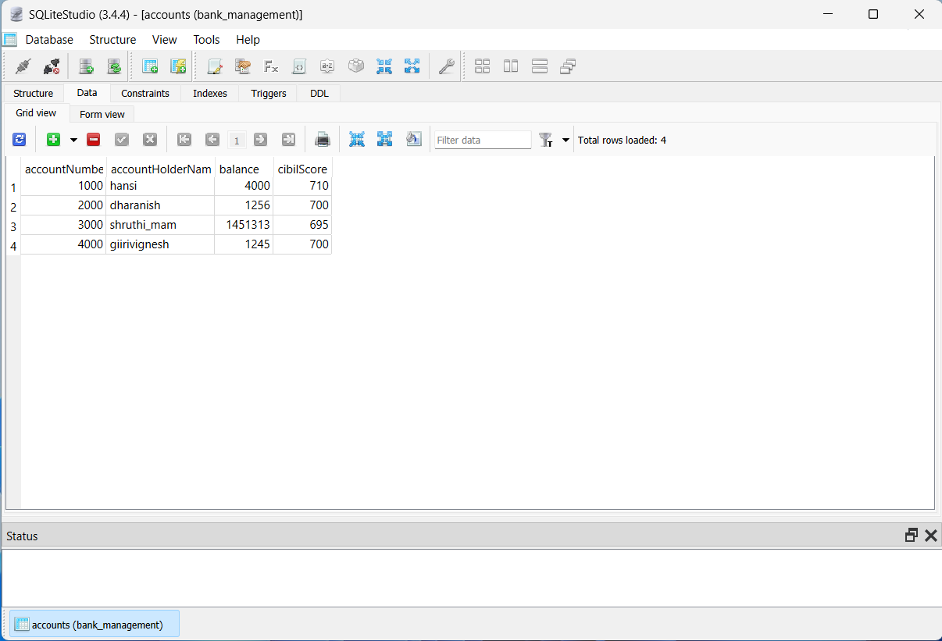

Slide 12
Thank you!

