Slide 1
Calendar
EECS 448 - Project 2

Slide 2
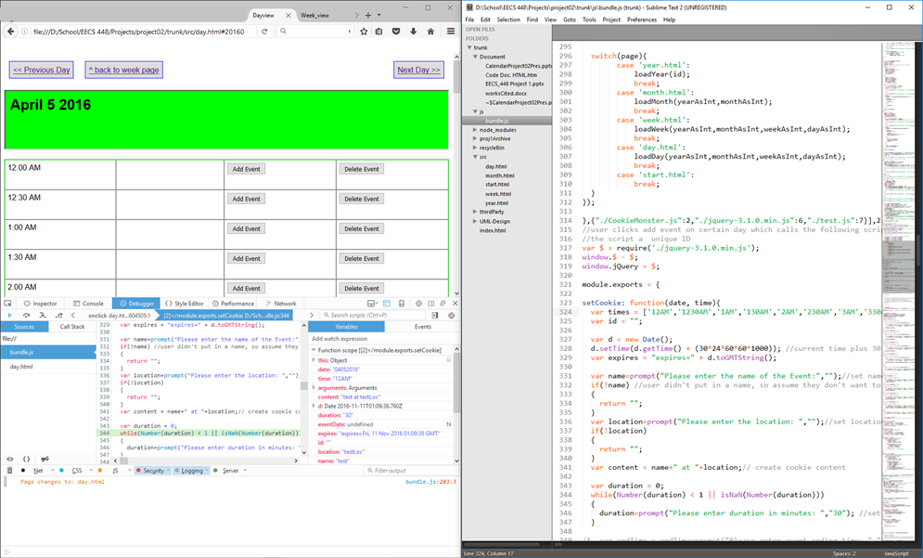
Platform/Language – HTML/JavaScript

Slide 3
Division of work
Paul – combining, bug-hunting, feature research
Deema – multi-day events, UML
Hans – multi-day events, bug hunting
Cara – repeating events, bug hunting

Slide 4
Challenges
Some unfamiliarity with bundling JavaScript
Ended up just modifying the existing bundle.js and archiving the individual .js files
Some overlap of projects

Slide 5
Features that didn’t make it
Icons in week and month pages that show days that have details associated with them
Cross-browser compatibility (currently Firefox exclusive)
Highlighting overlapping time boxes

Slide 6
Retrospective
Start project earlier to have time to add more features
Set deadlines for different parts of the project

