Slide 1
Calendar
EECS 448 - Project 1

Slide 2
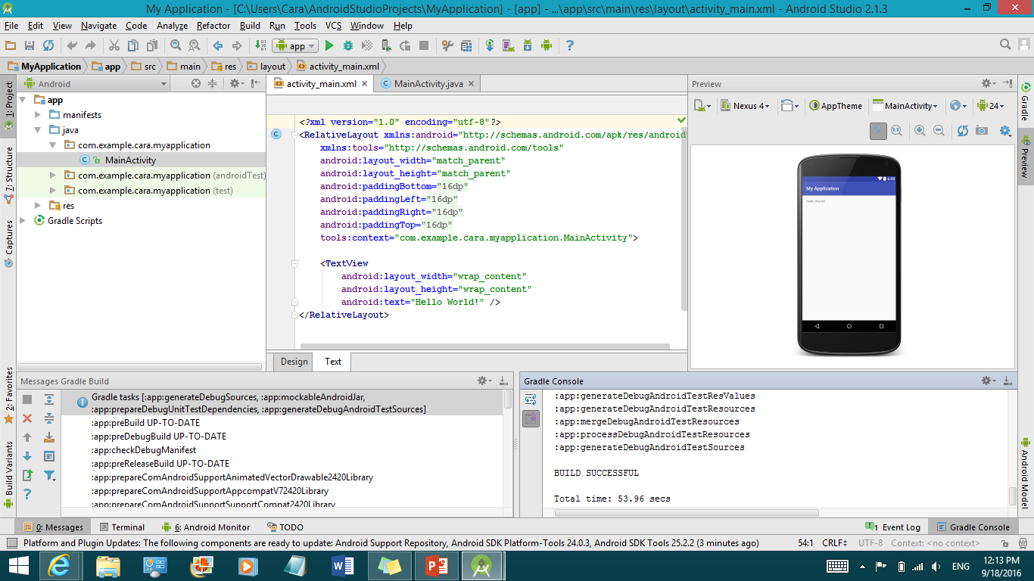
Platform/Language – Android Studio/Java

Slide 3
Division of work
Paul – Saving across sessions; page navigation
Deema – layout/navigation of year page
Hans – database storage of details; merging of projects
Cara – layout of the month/week/day pages; handling date changes

Slide 4
Challenges
Some unfamiliarity with Android Studio and/or Java
Some overlap of projects
Last-minute merging

Slide 5
Features that didn’t make it
Icons in week and month pages that show days that have details associated with them

Slide 6
Retrospective
Start project earlier to have time to add more features
Set deadlines for different parts of the project
Divide work so that merging is easier and can happen earlier

