Slide 1
Navigating the future of online shopping
Python- SQL exploration

Slide 2
Basic Questions

Slide 3
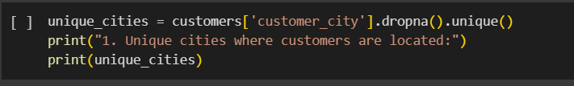

1- List all unique cities where customers are located

Slide 4

1- List all unique cities where customers are located

Slide 5
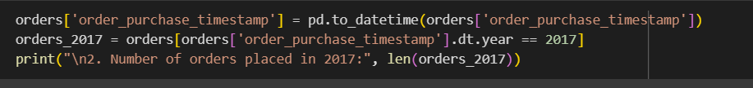
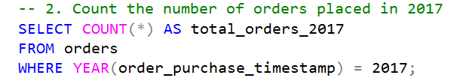
2- Count the number of orders placed in 2017

Slide 6

2- Count the number of orders placed in 2017

Slide 7
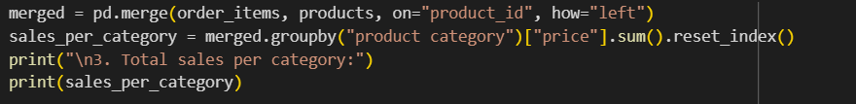
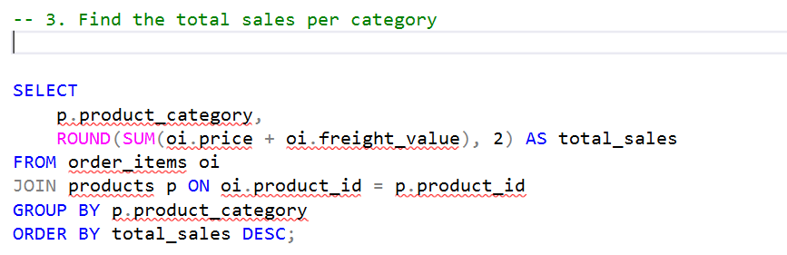
3- Find the total sales per category

Slide 8
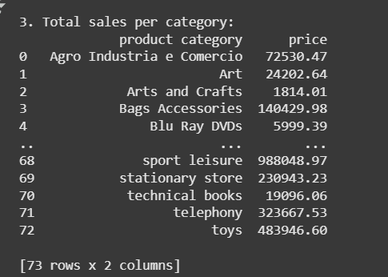
3- Find the total sales per category

Slide 9
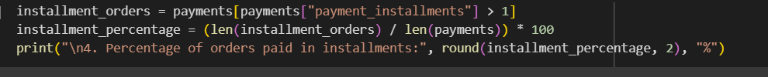
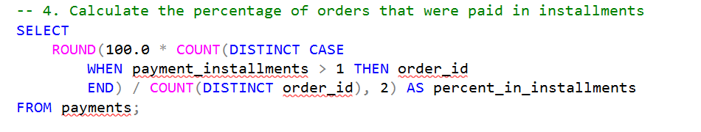
4- Calculate the percentage of orders paid in installments

Slide 10

4- Calculate the percentage of orders paid in installments

Slide 11
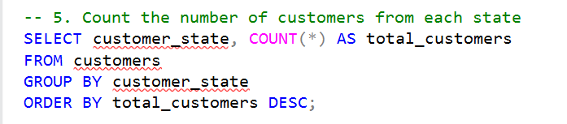
5: Count the number of customers from each state

Slide 12
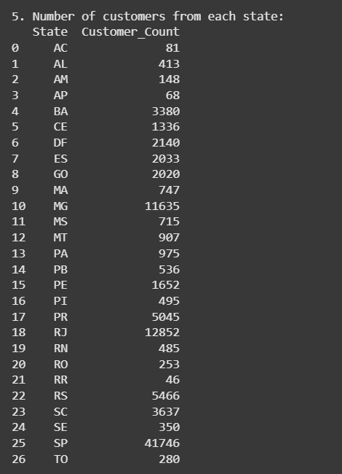
5: Count the number of customers from each state

Slide 13
Intermediate Questions

Slide 14
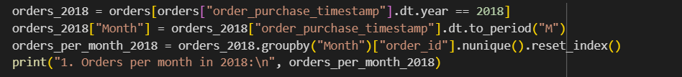
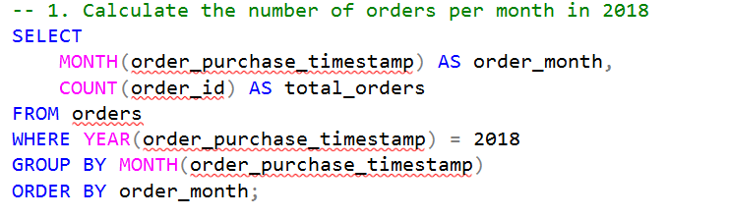
1- Calculate the number of orders per month in 2018.

Slide 15
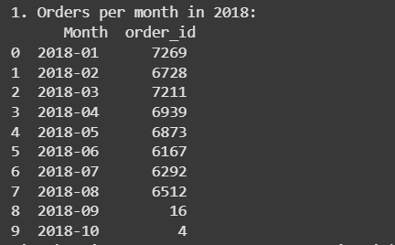
1- Calculate the number of orders per month in 2018.

Slide 16
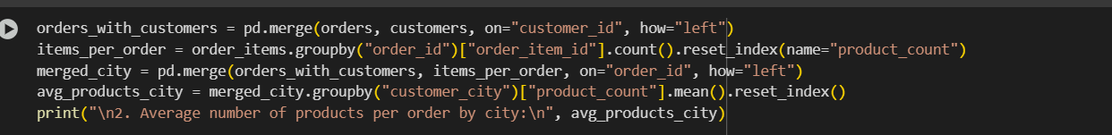
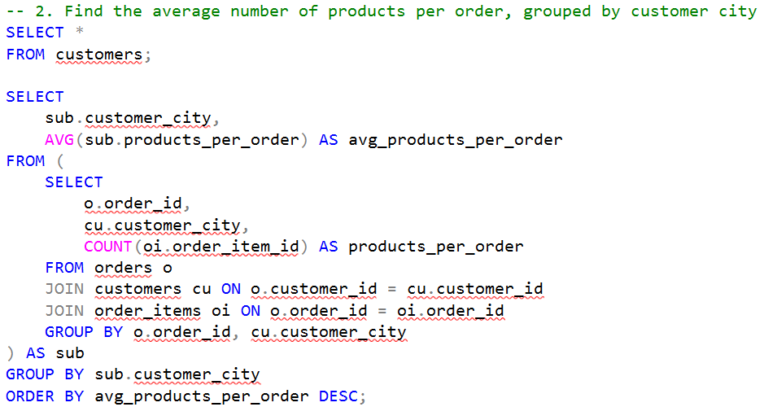
2- Find the average number of products per order, grouped by customer city.

Slide 17
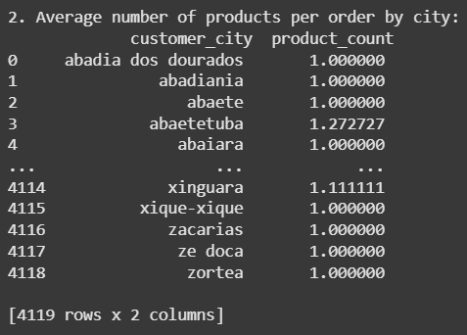
2- Find the average number of products per order, grouped by customer city.

Slide 18
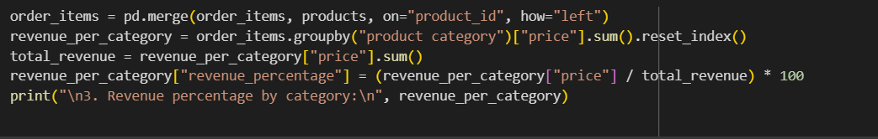
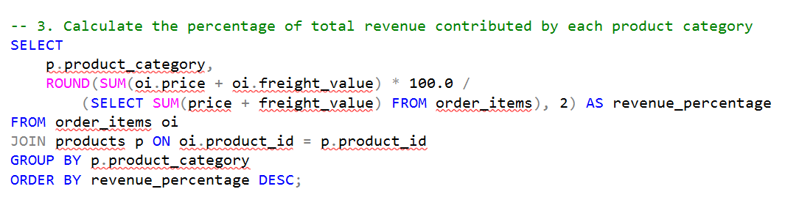
3- Calculate the percentage of total revenue contributed by each product category.

Slide 19
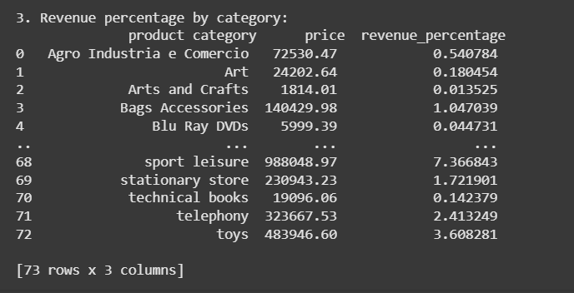
3- Calculate the percentage of total revenue contributed by each product category.

Slide 20
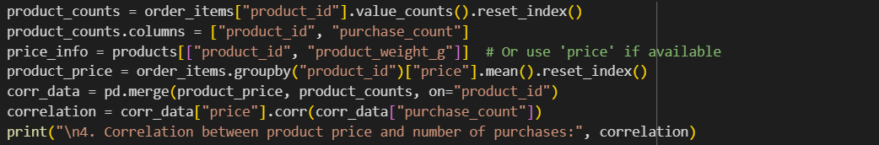
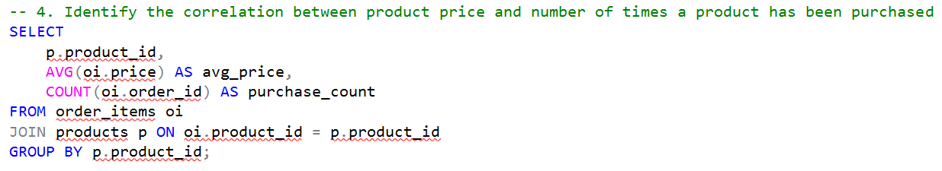
4- Identify the correlation between product price and the number of times a product has been purchased

Slide 21
4- Identify the correlation between product price and the number of times a product has been purchased

Slide 22
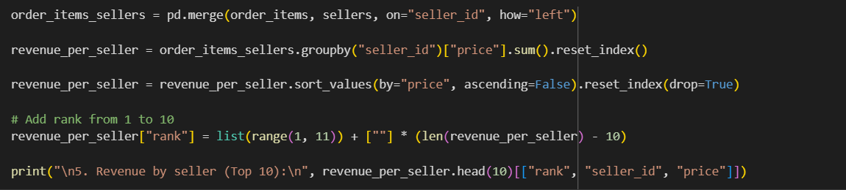
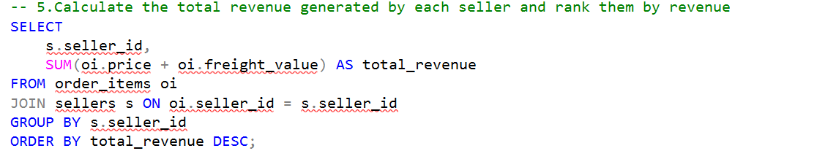
5- Calculate the total revenue generated by each seller, and rank them by revenue.

Slide 23
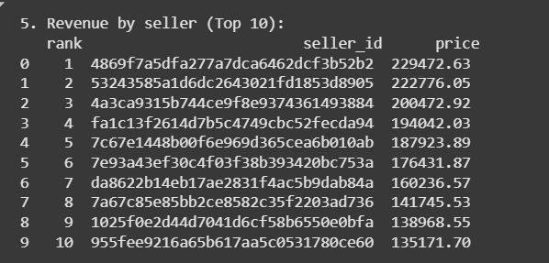
5- Calculate the total revenue generated by each seller, and rank them by revenue.

Slide 24
Advanced Questions

Slide 25
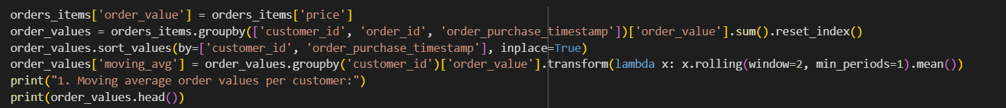
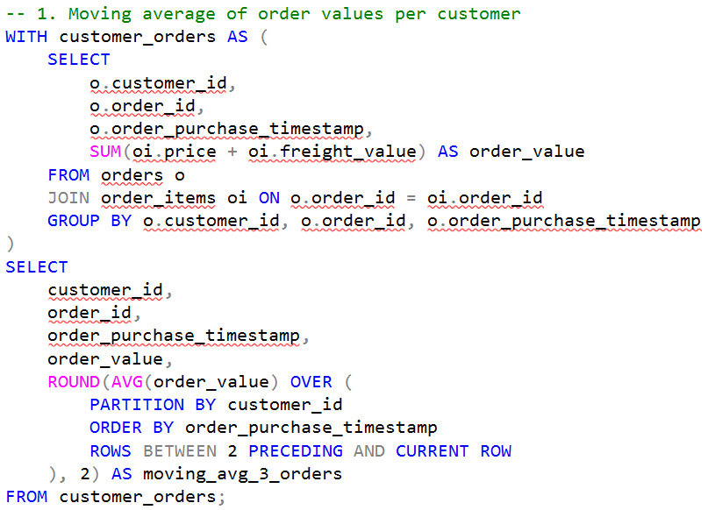
1- Calculate the moving average of order values for each customer over their order history.

Slide 26
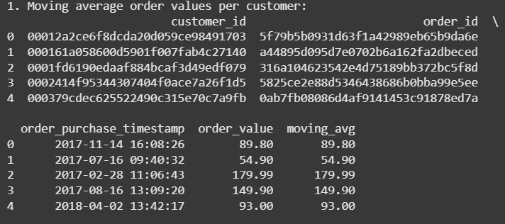
1- Calculate the moving average of order values for each customer over their order history.

Slide 27
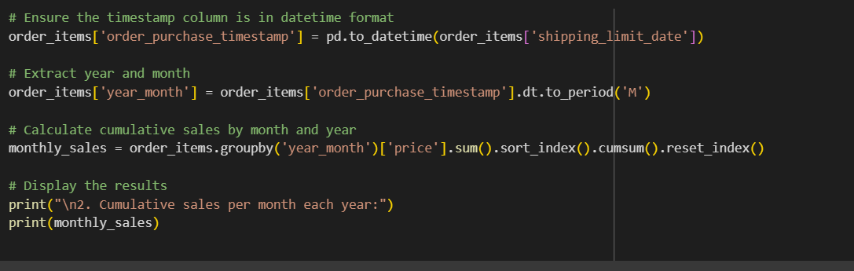
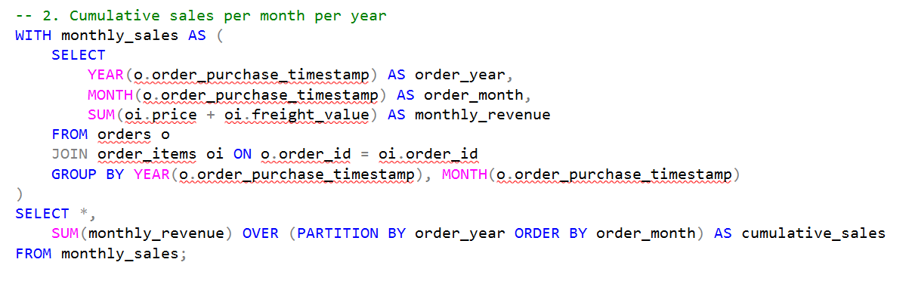
2- Calculate the cumulative sales per month for each year.

Slide 28
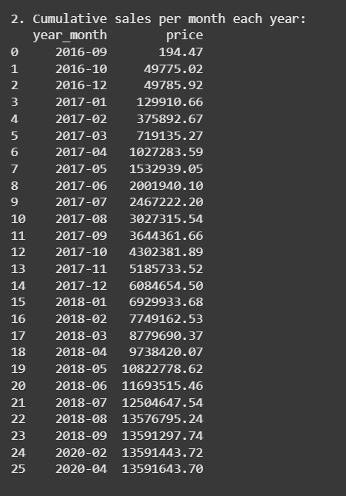
2- Calculate the cumulative sales per month for each year.

Slide 29
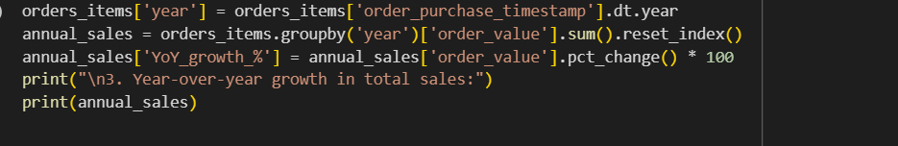
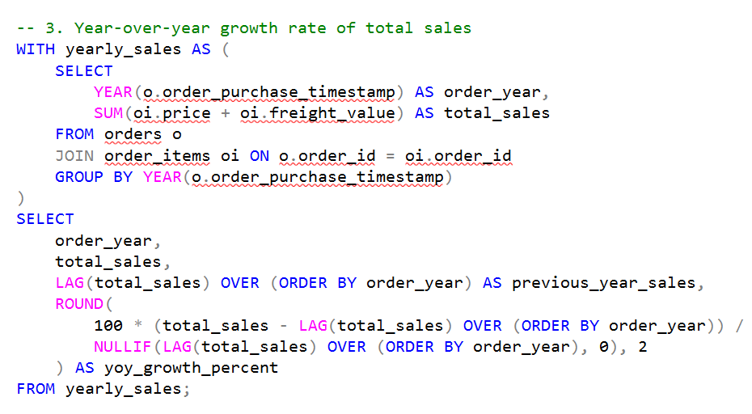
3-Calculate year over year growth rate of total sales

Slide 30
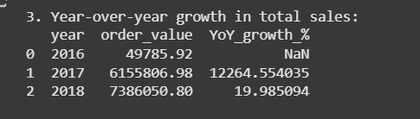
3-Calculate year over year growth rate of total sales

Slide 31
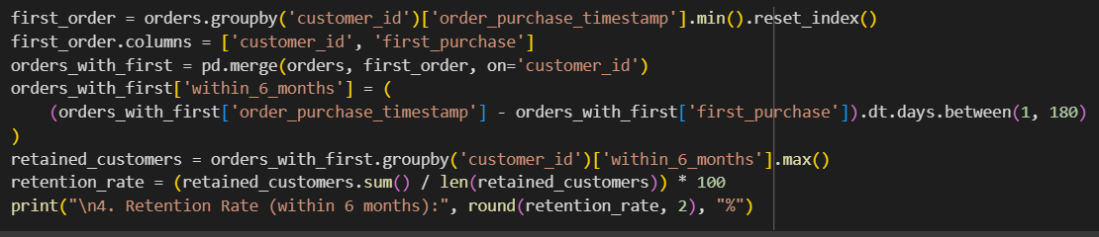
4- Calculate the retention rate of customers, defined as the percentage of customers who make another purchase within 6 months of their first purchase

Slide 32
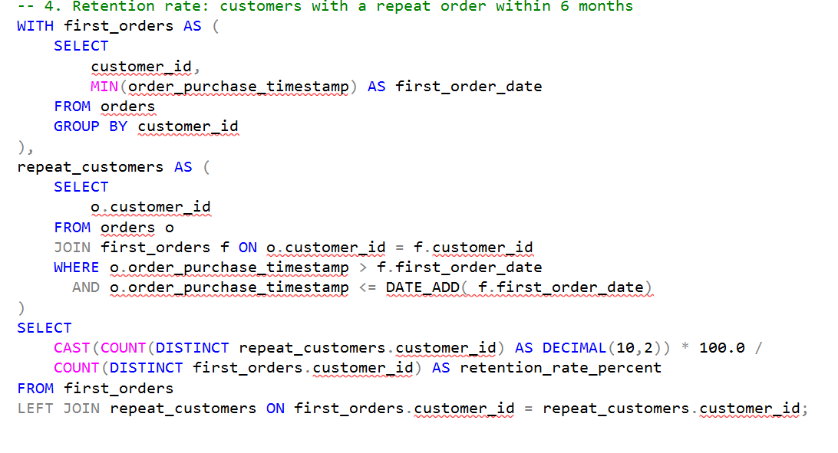

Slide 33
4- Calculate the retention rate of customers, defined as the percentage of customers who make another purchase within 6 months of their first purchase

Slide 34
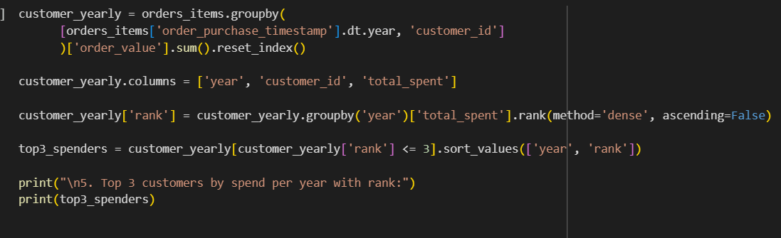
5- Identify the top 3 customers who spent the most money in each year

Slide 35
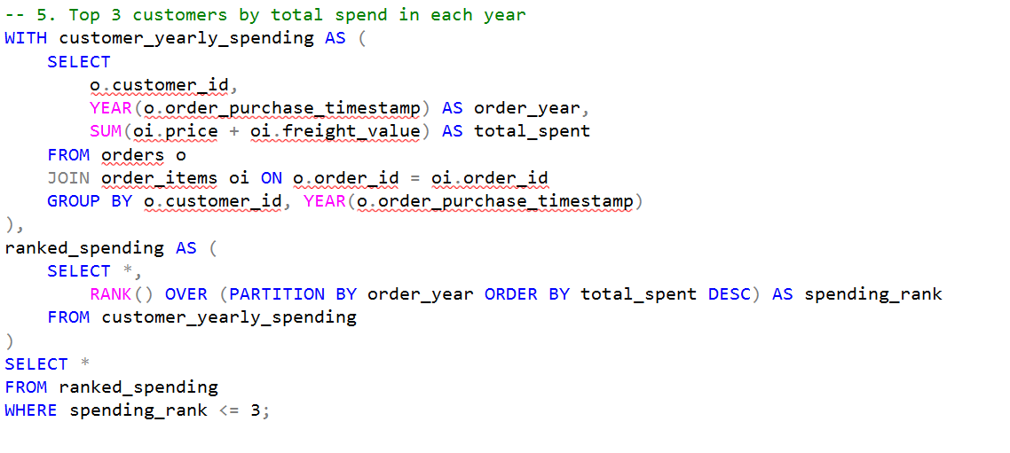

Slide 36
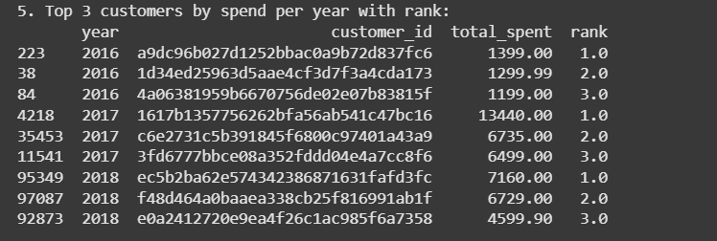
5- Identify the top 3 customers who spent the most money in each year

Slide 37
Thank you

