Slide 1
Who wants to be a Millionaire?
By- Srilatha & Hansika

Slide 2
Scrum
We used Scrum to help with the website's process and project team members' duties.

Slide 3
User
Goal
To replicate the game show “Who wants to be a Millionaire”.
Requirements
Login with PHP
List of questions with PHP
Leaderboard of winners
Text file for storing username and respective cash prize

Slide 4
Design
Database Design
We need a username and score so we just store it in a data.txt as
Name, score
Example:
Hansika, 1000

Slide 5
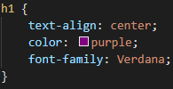
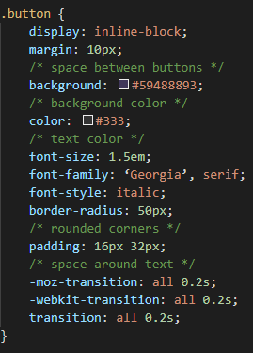

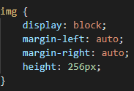

Style.css
H1 Text
img
Body
Button

Slide 6
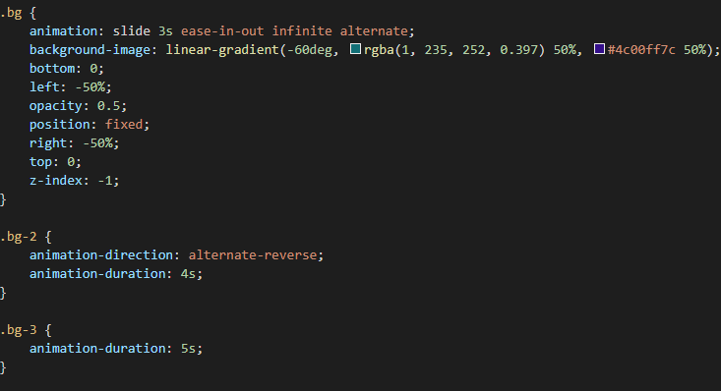
Style.css | Part 2
Background

Slide 7
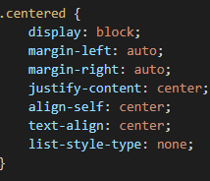
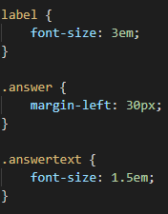
Style.css | Part 3
Centered
Label

Slide 8
DEMO TIME

Slide 9
Source Code

Slide 10
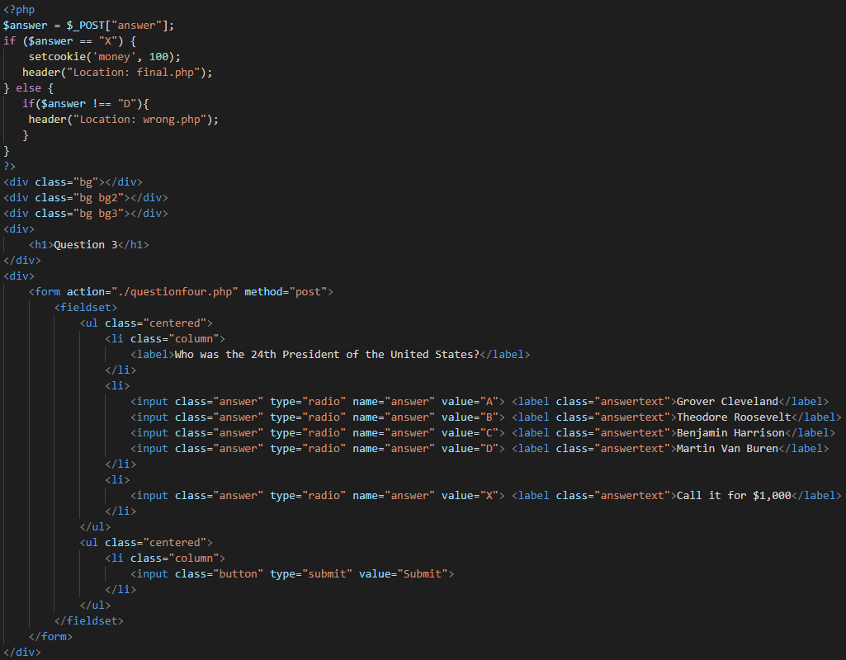

Slide 11
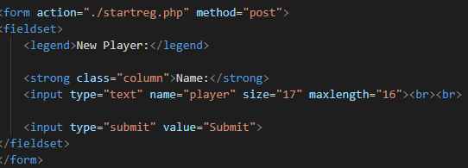
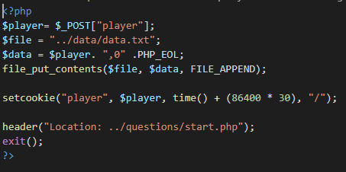
Registration and startreg.php

Slide 12
THANK YOU!

