Slide 1

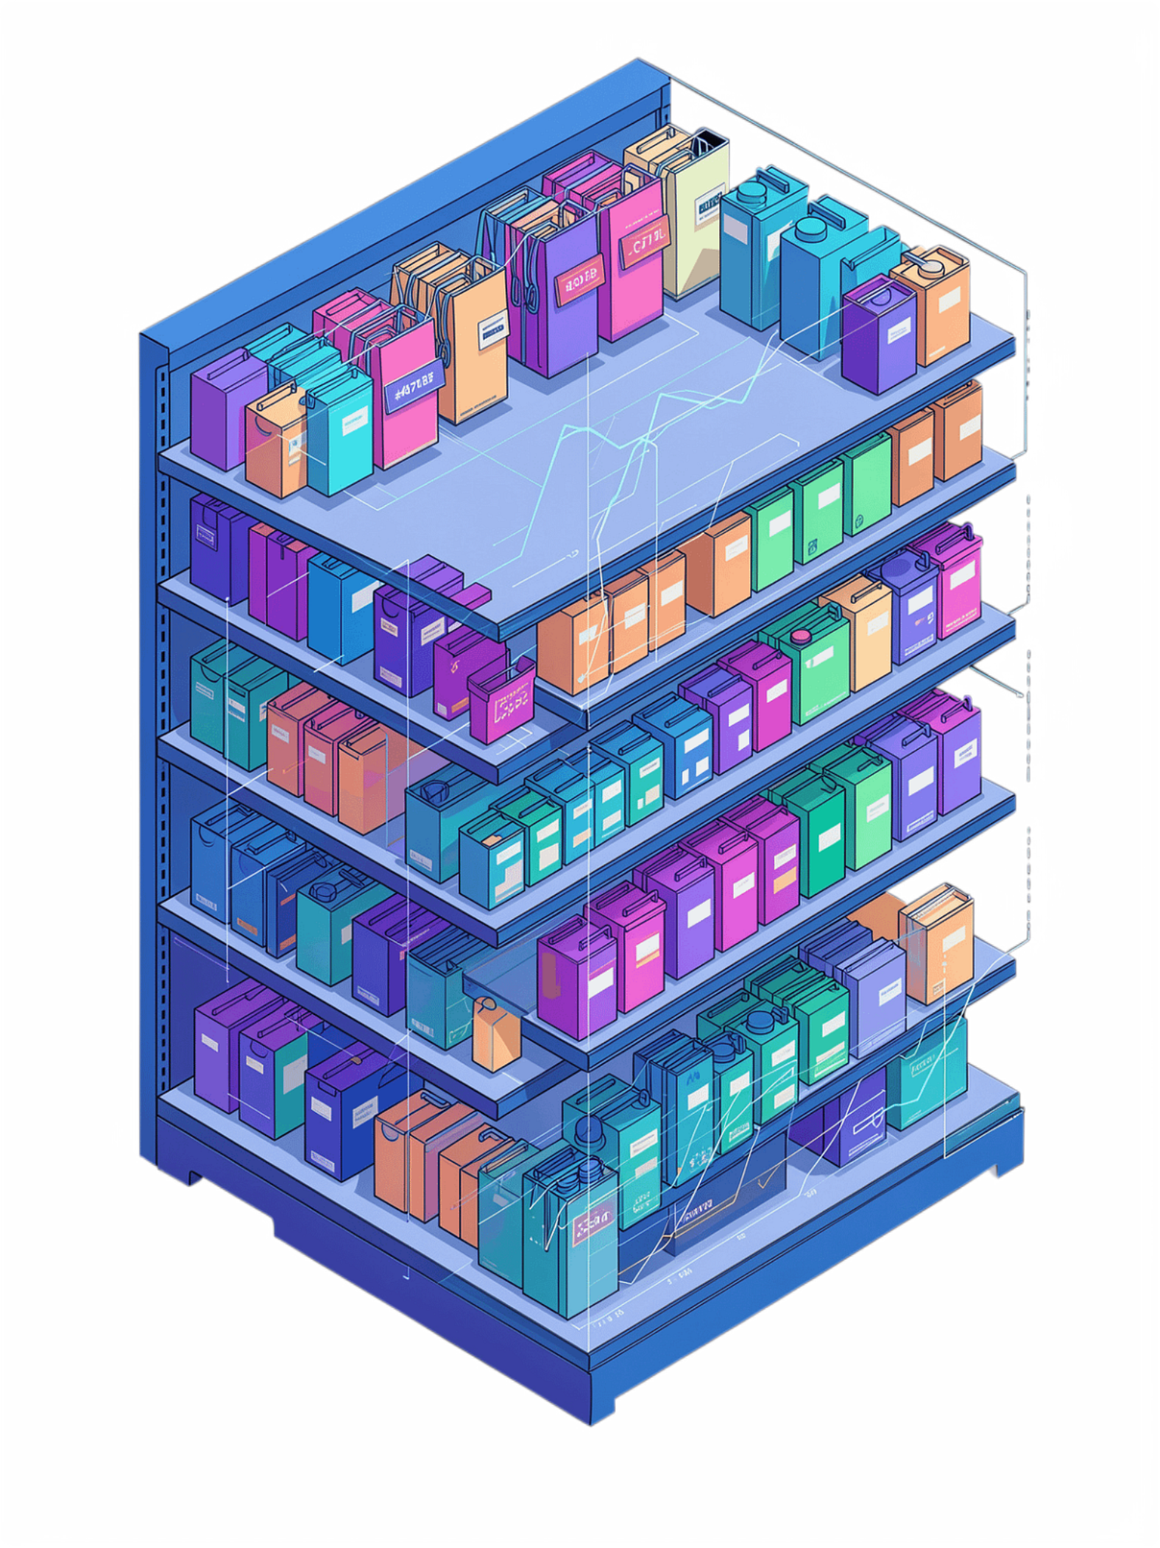
AI-Powered Retail Demand Prediction
Literature Review and Research Gap Analysis
Team Members
T.L. Hansika (2510030330)
B. Siri (2510030325)
M. Mounika (2510030343)
K. Sindhu (2510030195)
Department: Computer Science Engineering
Year: 2

Slide 2
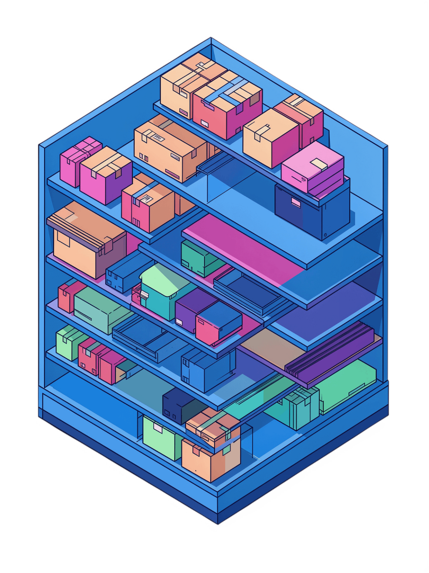
Project Relevance and Motivation
The Problem
Retailers face overstocking (excess inventory costs) and stockouts (lost sales and customer dissatisfaction) simultaneously.
Why It Matters
Demand shifts due to seasonality, promotions, weather, and special events—traditional forecasting approaches may struggle to adapt when demand patterns change due to seasonality, promotions, weather and special events
The Gap
Prediction accuracy alone is insufficient; retailers need understandable, actionable recommendations they can act on immediately.
Our research transforms demand forecasting from a static prediction task into an adaptive decision-support system.

Slide 3
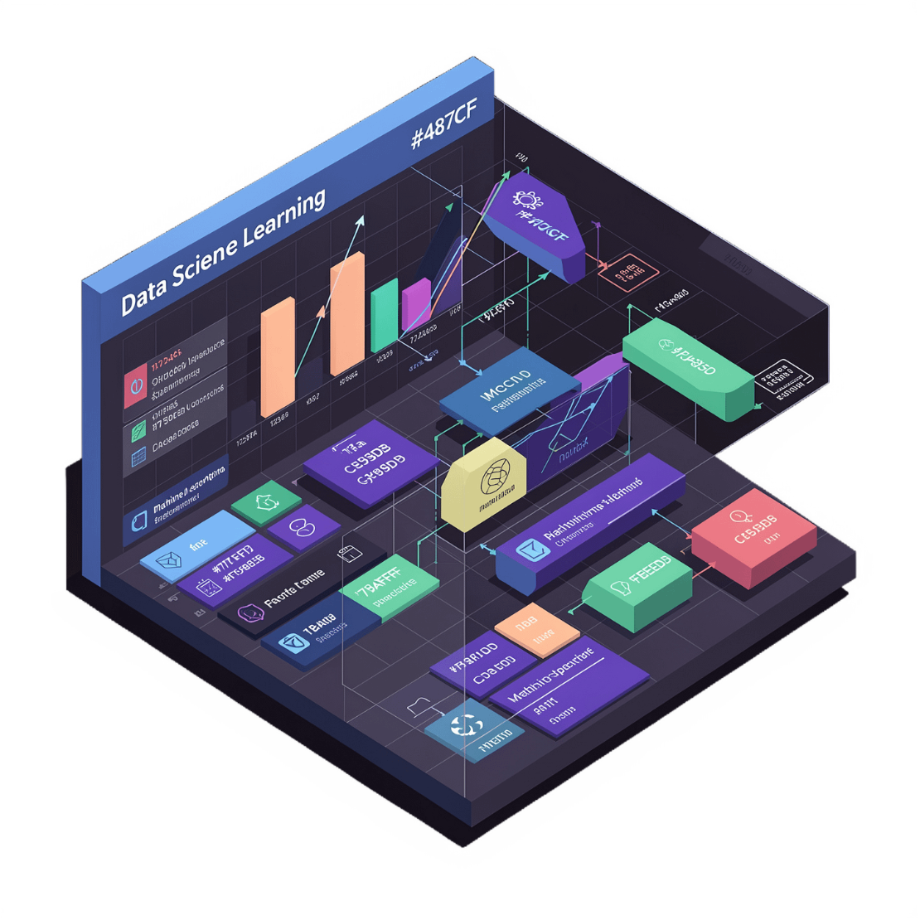
Existing Approaches in Retail Demand Forecasting
Statistical Methods
ARIMA, exponential smoothing — effective for stable patterns but struggle with sudden changes.
Machine Learning
XGBoost, random forests — capture nonlinear relationships; limited context awareness.
Deep Learning
LSTMs, Transformers — model temporal dependencies; often lack interpretability.
Explainable AI & Anomaly Detection
SHAP, LIME, Isolation Forests — powerful individually but rarely integrated into forecasting pipelines.
s
Adaptive Learning
Online learning and periodic retraining can address changing demand patterns and model drift.

Slide 4
LITERATURE REVIEW — STUDIES 1–3
Deep Learning, Retail Forecasting & Supply Chain AI
Study
Problem
Method
Key Finding
Eglite & Birzniece (2022)
Deep Learning for Retail Sales
LSTMs, CNNs, RNNs, Transformers
DL improves accuracy but lacks explainability; limited contextual integration discussion.
Fildes, Ma & Kolassa (2022)
Retail Forecasting: Research & Practice
Statistical, causal, and ML models
Causal models outperform benchmarks; ML evidence still limited; gap in new product forecasting.
Douaioui et al. (2024)
ML & DL for Demand Forecasting
XGBoost, neural networks, ensemble
Ensemble approaches improve accuracy; integration of external features remains challenging.

Slide 5
LITERATURE REVIEW — STUDIES 4–6
Explainability, Adaptive Forecasting & Semantic XAI
Study
Focus
Achievement
Not Addressed
Hu et al. (2025)
Explainable Latent Auto-encoder
6.8% accuracy gain; interpretable predictions; real-world deployment (JD.com)
Event-aware forecasting; anomaly detection; model adaptation
Lei, Jun & Jackson (2026)
Predict-then-Correct Loop
9.52% RMSE improvement; handles demand pattern shifts; online correction
Explainability; event-aware context; anomaly detection integration
Rožanec & Mladenić (2021)
Semantic XAI for Demand Forecasting
Enriches explanations with real-world events; recommends new datasets
Anomaly detection; inventory optimization; model retraining automation

Slide 6
Comparative Analysis: Existing Studies vs. Proposed System
Capability
S1
S2
S3
S4
S5
S6
Proposed
Historical Sales
✓
✓
✓
✓
✓
✓
✓
Weather & Context
◐
✓
◐
◐
✓
✓
✓
Events & Festivals
✗
◐
✗
✗
✓
◐
✓
Anomaly Detection
✗
✗
✗
✗
✗
✗
✓
Explainability (XAI)
✗
✗
✗
✗
✓
✓
✓
Inventory Recommendation
✗
✗
✗
✗
✓
◐
✓
Model Adaptation
✗
✗
✗
✓
◐
✗
✓
Legend: ✓ = Fully addressed | ◐ = Partially addressed | ✗ = Not addressed

Slide 7
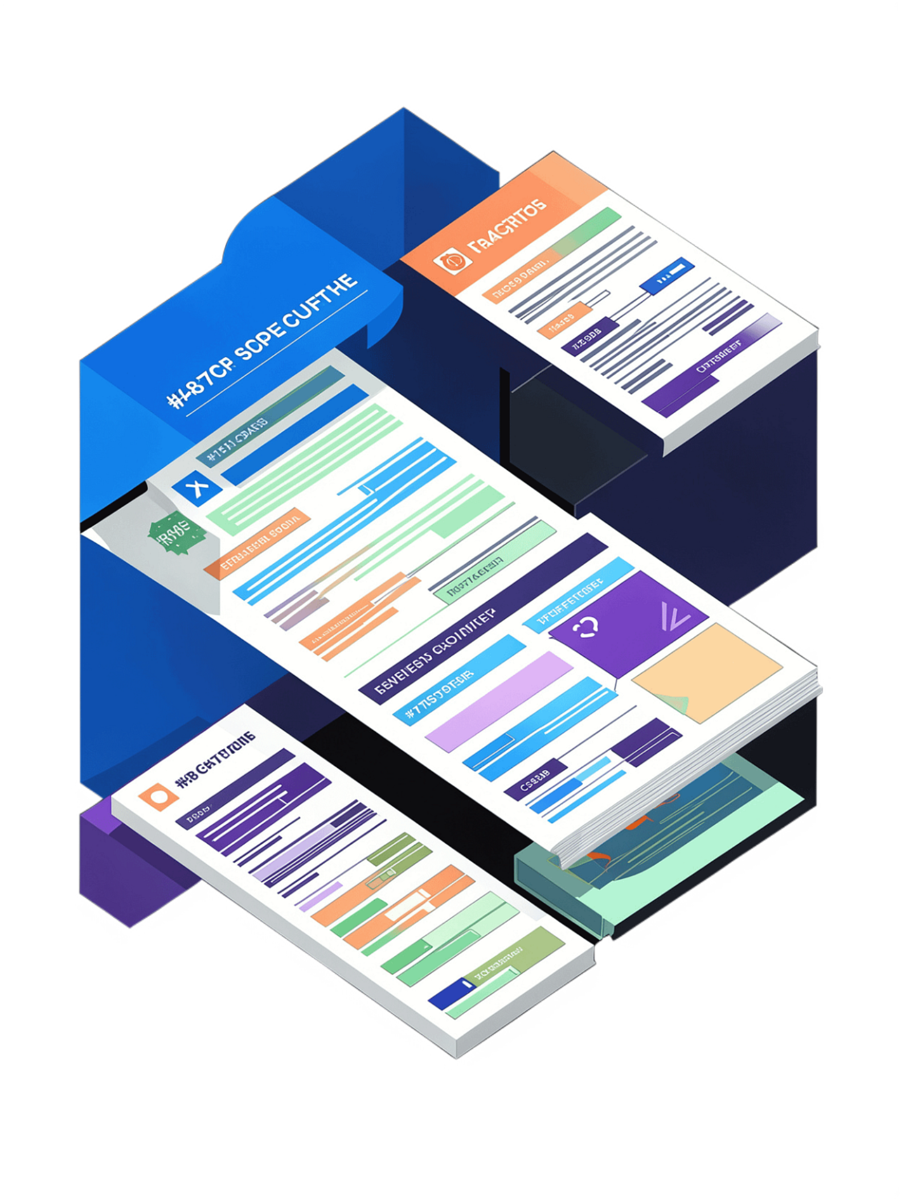

Critical Analysis and Research Gaps
What Works in Literature
The Critical Limitation
Deep learning captures temporal patterns effectively across time-series retail data
Retailers need integrated solutions that connect all these capabilities into one actionable pipeline.”
Contextual features improve accuracy when weather, promotions, and events are included
Explainability techniques like SHAP build stakeholder trust in model outputs
Existing studies solve individual problems — forecasting, explainability, anomaly detection, adaptation — in isolation. Retailers need integrated solutions that connect all these capabilities into one actionable pipeline.

Slide 8
Research Gaps Identified from Literature
1
Accuracy vs. Action
Forecasting focuses on prediction accuracy rather than actionable inventory decisions (Fildes et al., 2022)
2
Fragmented Context
Events, promotions, and weather are treated separately rather than integrated (Rožanec & Mladenić, 2021)
3
No Embedded Anomaly Detection
Anomaly detection is rarely embedded within forecasting pipelines (Hu et al., 2025)
4
Black-Box Models
High-performing models lack explainability for business stakeholders (Eglite & Birzniece, 2022)
5
Model Drift
Models trained on historical data become outdated when customer behavior shifts (Lei et al., 2026)
6
No Integrated Framework
Among the selected studies, these capabilities are not cohesively integrated into a single framework

Slide 9


Existing vs. Proposed Approach
Traditional Forecasting Pipeline
Our Integrated System Pipeline
Predict
Explain
Detect Anomalies
Inventory Decision
Why this matters: Retailers don't just need accurate predictions — they need to understand why demand changes, detect unusual patterns, make inventory decisions, and adapt when customer behavior shifts.
Historical Data
Prediction Result
Accuracy-focused. Retailers receive a number — with no explanation, no anomaly alert, and no inventory guidance.

Slide 10

What Is NEW in Our Project?
CORE INNOVATION
PREDICT → EXPLAIN → DETECT → RECOMMEND → ADAPT
Event-Aware Forecasting
Context-Aware Prediction
Understands festivals, holidays, weekends, and special events
Integrates sales with weather, promotions, and seasonal patterns
Demand Anomaly Detection
Explainable AI (SHAP)
Detects unusual demand spikes or drops automatically via Isolation Forest
Explains the major factors contributing to each prediction
Dynamic Inventory Recommendation
Self-Adaptive Model
Converts predictions into recommended stock levels via rule-based engine
Monitors errors periodically and retrains on recent data automatically

Slide 11
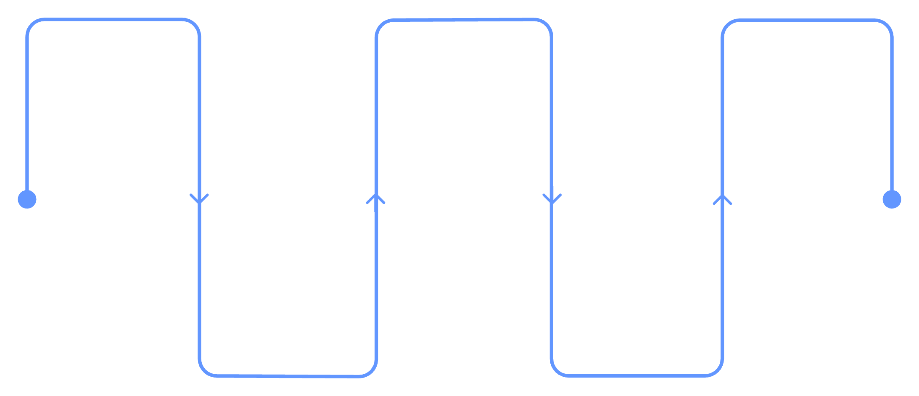

Proposed System Architecture & Gap-to-Solution Mapping
Data Sources
Predict
Optimize & Monitor
Sales, weather, events, promotions
ML demand (XGBoost / LSTM)
Rules, recommendations, retrain trigger
Gap → Solution Mapping
Every proposed component is directly motivated by a gap identified in the reviewed literature — ensuring our system is grounded in evidence, not assumption.
Detect & Explain
Preprocess
Feature engineering and cleaning
Anomalies (IF) and SHAP explanations
Feedback Loop: Actual Sales → Prediction Error → Triggers Retraining → Improved Future Predictions
Gap 1 (Accuracy only) → Rule-Based Inventory Engine
Gap 2 (Fragmented context) → Event & Context Feature Integration
Gap 3 (No anomaly detection) → Isolation Forest Module
Gap 4 (Black-box models) → SHAP Explainability Layer
Gap 5 (Model drift) → Periodic Error Monitoring & Retraining
Gap 6 (No unified framework) → End-to-End Integrated Pipeline

Slide 12
Thank you!!

