Slide 1
OO Design Patterns
K.R.U.H. Karunarathna
20APC4610
Department of Computing and Information Systems

Slide 2
Design Patterns
Reusable solution to a commonly occurring problems within a given context in software design.
Design patterns are divided into 3 main categories.
Creational patterns
Structural patterns
Behavioral patterns

Slide 3
Creational Patterns
Creational design patterns are concerned with the way of creating objects. These design patterns are used when a decision must be made at the time of instantiation of a class.
Types of creational design patterns.
There are following 6 types of creational design patterns.
Factory Method Pattern
Abstract Factory Pattern
Singleton Pattern
Prototype Pattern
Builder Pattern
Object Pool Pattern

Slide 4
Prototype Pattern
Prototype is a creational design pattern that allows cloning objects, even complex ones, without coupling to their specific classes.
All prototype classes should have a common interface that makes it possible to copy objects even if their concrete classes are unknown.
Usage of Prototype Pattern
When the classes are instantiated at runtime.
When the cost of creating an object is expensive or complicated.
When you want to keep the number of classes in an application minimum.
When the client application needs to be unaware of object creation and representation.

Slide 5
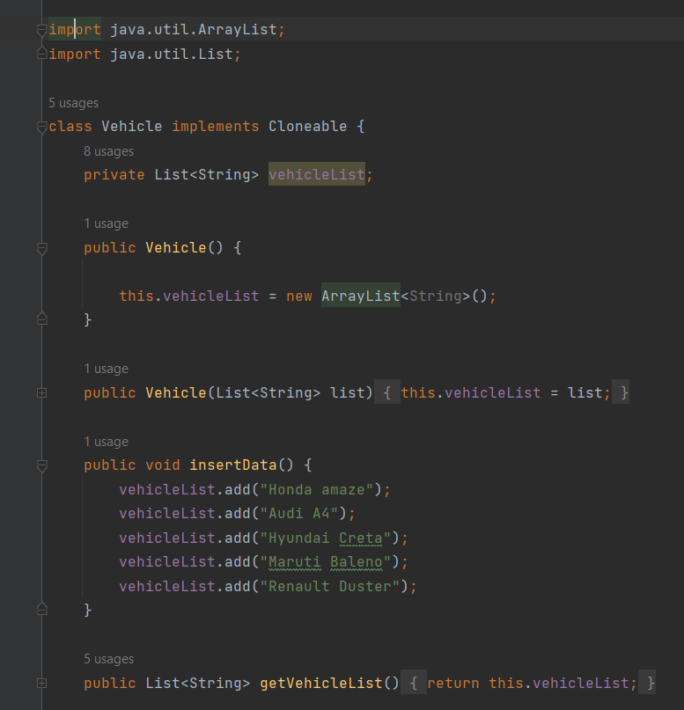
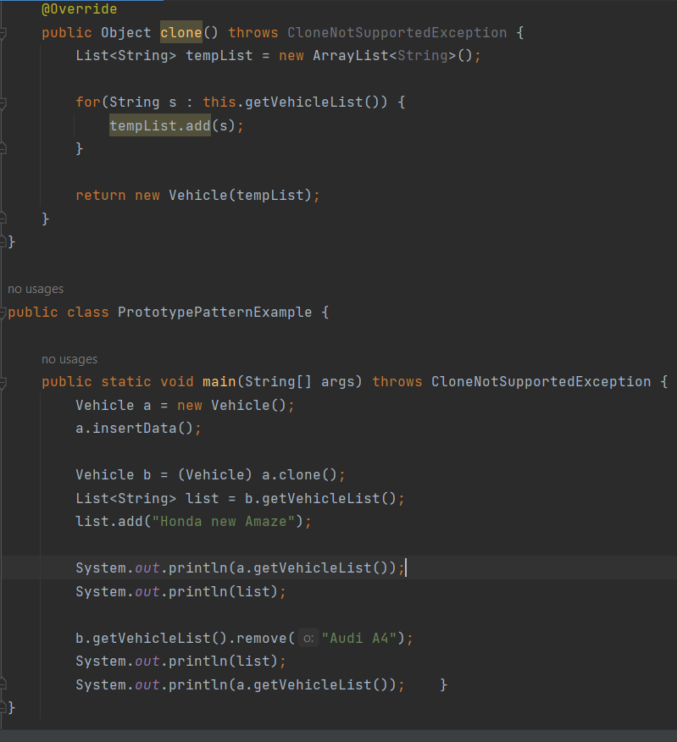
Example of Prototype Design Pattern

Slide 6
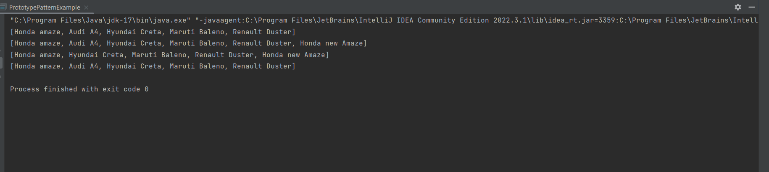
Output

Slide 7
Structural patterns
Structural design patterns are concerned with how classes and objects can be composed, to form larger structures.
The structural design patterns simplifies the structure by identifying the relationships.
These patterns focus on, how the classes inherit from each other and how they are composed from other classes.
Types of structural design patterns.
There are following 7 types of structural design patterns.
Adapter Pattern
Bridge Pattern
Composite Pattern
Decorator Pattern
Facade Pattern
Flyweight Pattern
proxy Pattern

Slide 8
Decorator Pattern
Decorator is a structural pattern that allows adding new behaviors to objects dynamically by placing them inside special wrapper objects, called decorators.
Using decorators you can wrap objects countless number of times since both target objects and decorators follow the same interface.
Usage of Decorator Pattern
It is used:
When you want to transparently and dynamically add responsibilities to objects without affecting other objects.
When you want to add responsibilities to an object that you may want to change in future.
Extending functionality by sub-classing is no longer practical.

Slide 9
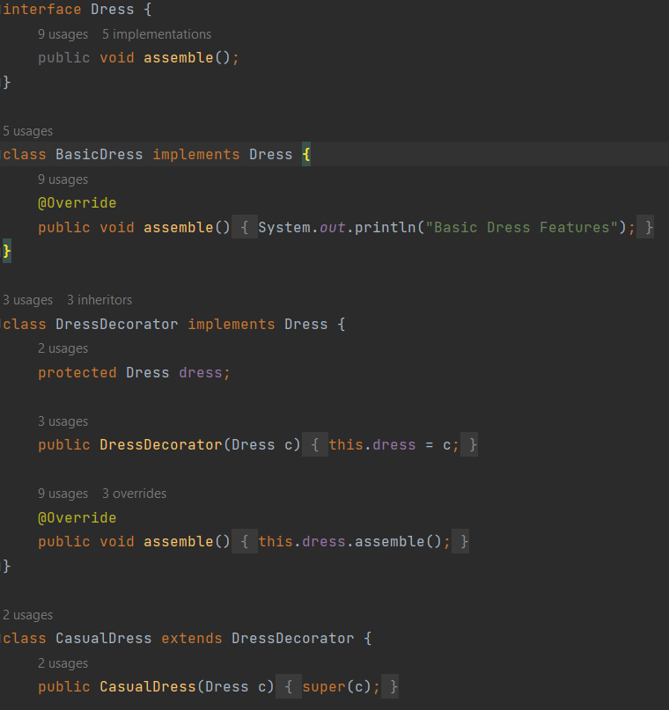
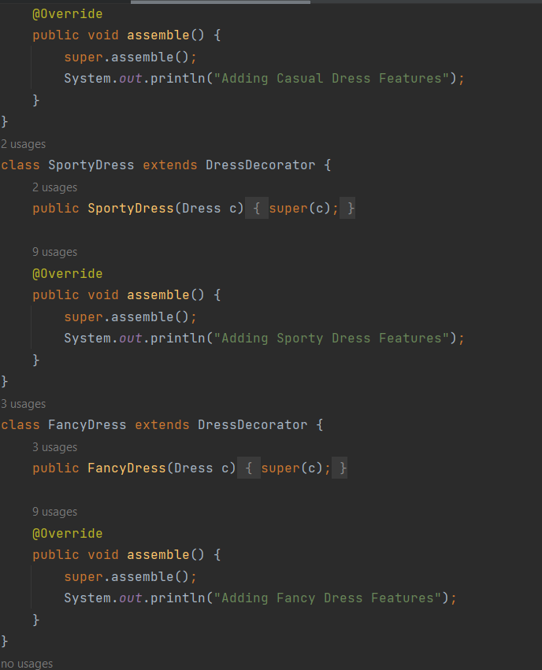
Example of Decorator Pattern

Slide 10
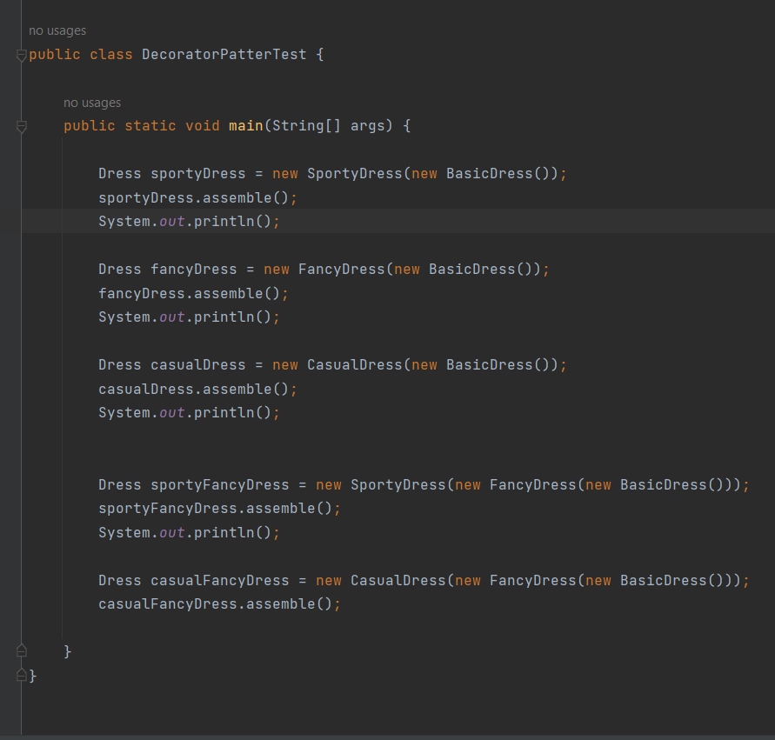
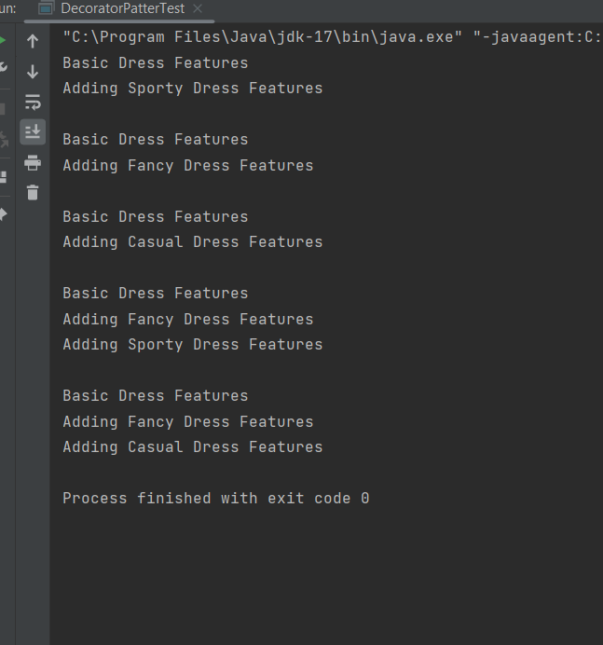
Output

Slide 11
Behavioral patterns
Behavioral design patterns are concerned with the interaction and responsibility of objects.
In these design patterns, the interaction between the objects should be in such a way that they can easily talk to each other and still should be loosely coupled.
There are 12 types of behavioral design patterns:
Chain of Responsibility Pattern
Command Pattern
Interpreter Pattern
Iterator Pattern
Mediator Pattern
Memento Pattern
Observer Pattern
State Pattern
Strategy Pattern
Template Pattern
Visitor Pattern
Null Object

Slide 12
Strategy Pattern
Strategy is a behavioral design pattern that turns a set of behaviors into objects and makes them interchangeable inside original context object.
The original object, called context, holds a reference to a strategy object. The context delegates executing the behavior to the linked strategy object.
Usage:
When the multiple classes differ only in their behaviors.e.g. Servlet API.
It is used when you need different variations of an algorithm.

Slide 13
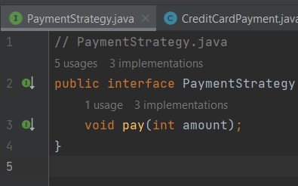
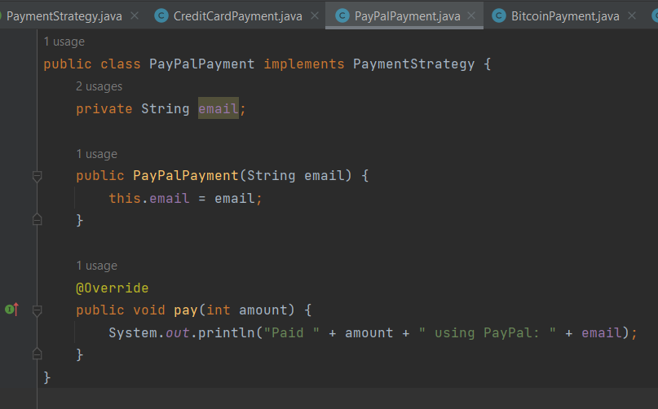
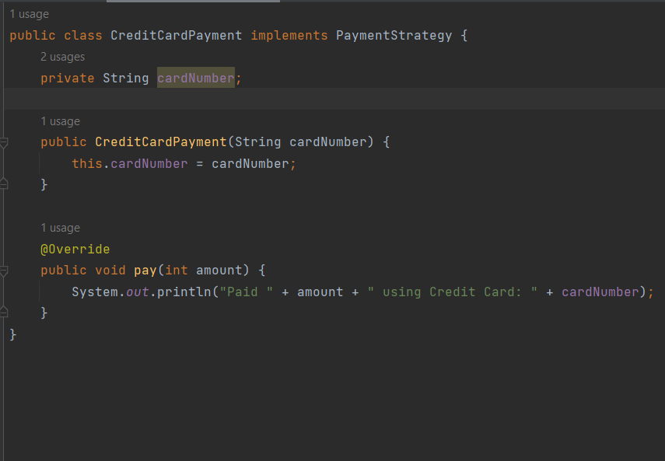
Example of Strategy Pattern

Slide 14
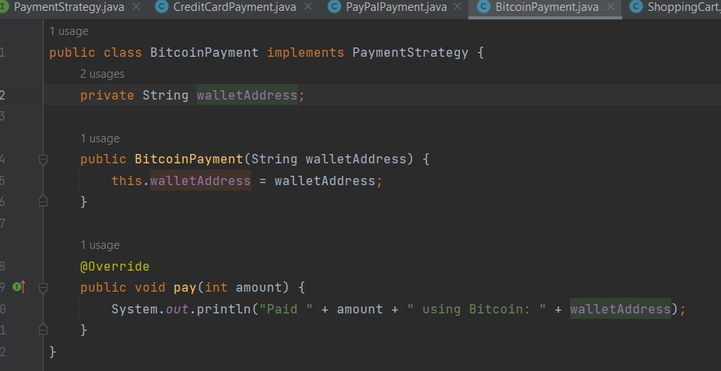
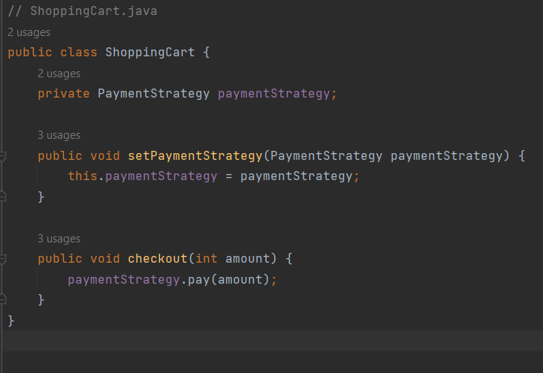

Slide 15
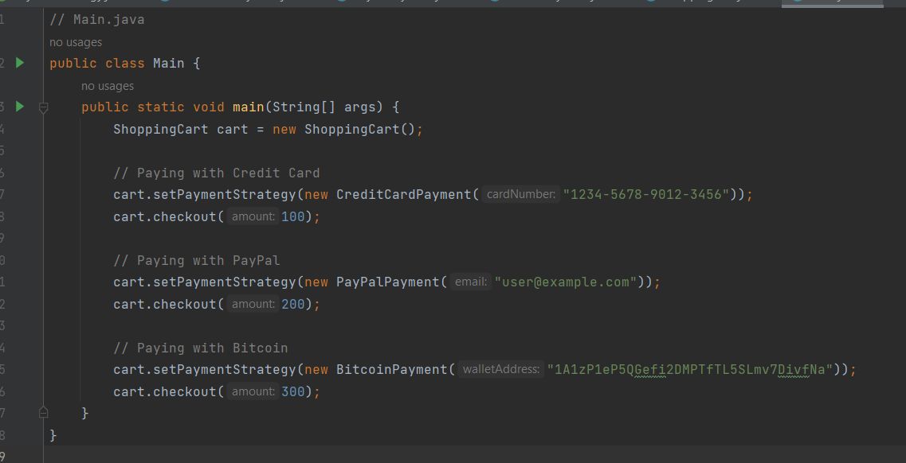
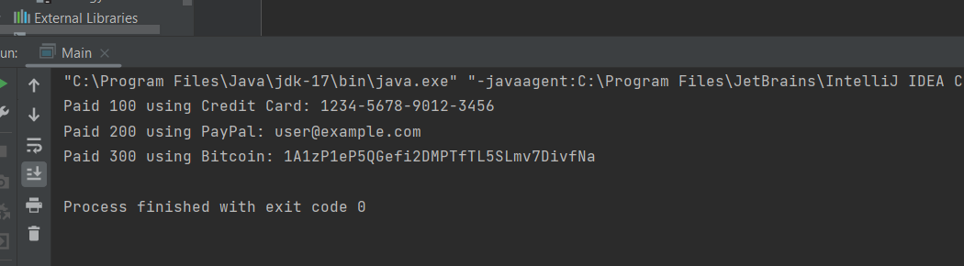
Output

Slide 16
Thank You

