Slide 1
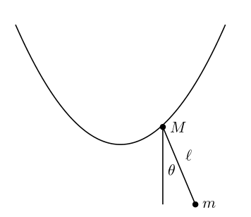


$$m_{1}$$
r
$$m_{2}$$

