Slide 1
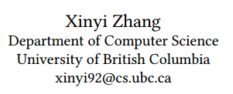
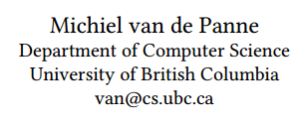
Data-driven Autocompletion for Keyframe Animation
于泽汉
118039910141

Slide 2
1. Introduction
Animation is a beautiful art form that has evolved artistically and technically for over many years
Artists still spend many hours posing and defning key frames or poses to choreograph motions
a typical animator at Pixar
around only 4 seconds of animation every one or two weeks
Over the years, many researchers have explored ways to help support and automate the animation process
an ideal system should support and accelerate the workﬂow
while still allowing for precise art-direction of motions by the animator

Slide 3
1. Introduction
In this paper, they explore a data-driven method for motion-aware inbetweening
sparser keyframes
faster experimentation
Given a set of target key frames and their associated times
automatically synthesizes interpolating frames between keys
yielding an output motion that follows the movement patterns that it has seen during training
as well as allowing for a degree of extrapolation
Autoregressive Recurrent Neural Network (ARNN)

Slide 4
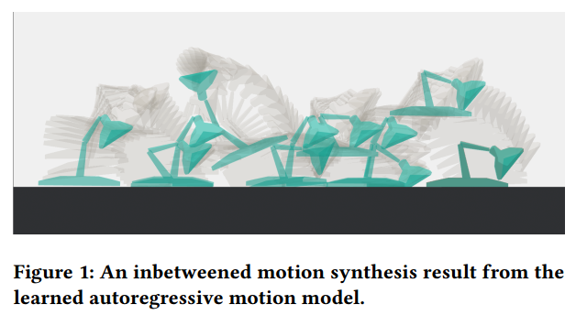
Example

Slide 5
2. Related Work
Hand-drawn In-Betweening
graph-based representation of strokes to find correspondences
geometric interpolation to create natural, arc shaped motion between keys
Physics-based Methods for Animation
excel at producing realistic and plausible motions
inherently difcult to control
Data-driven Motion Synthesis
Motion graphs organize large datasets of motion clips into a graph
New motions can be generated by traversing walks on the graph
can follow high-level constraints placed by the user
Motion blending techniques can generate new motions
Satisfying high-level control parameters by interpolating between motion examples
Deep Learning for Motion Synthesis
Ecurrent Neural Networks (RNNs)
Encoder-Recurrent-Decoder Network

Slide 6
3. Method Review
Create the dataset for training
use simulation to generate a set of jumping motions
preprocess the simulation data
During training
feed the ARNN network keyframes of sequences
learn to reproduce the corresponding animation sequence
using a custom loss function
Once the network is trained
users can synthesize new animations
by providing a sequence of input keyframes

Slide 7
3. Method Review
Inputs
a sequence of n key frames
X = {X0, X1, ..., Xn }
timing information describing the temporal location of keys
T = {T0,T1, ...,Tn }
Outputs
a fnal interpolating sequence of frames
Y = {Y0,Y1, ...,Ym }
length m = Tn - T0 + 1

Slide 8
4. The Animation Database
Physics-based Method for Generating Animations
The Articulated Lamp Model
Control Scheme for Jumping
Finding Motions with Simulated Annealing

Slide 9
4.1 Physics-based Method for Generating Animations
To efciently train an expressive network
we need a sufficiently-sized motion database
containing a variety of jumping motions
Creating such a dataset of jumps by hand would be impractical
a physics-based solution to generate our motion samples
Build a physics-based model of the Luxo character in Bullet with actuated joints
use simulated annealing to search for control policies that make Luxo hop oﬀ the ground

Slide 10
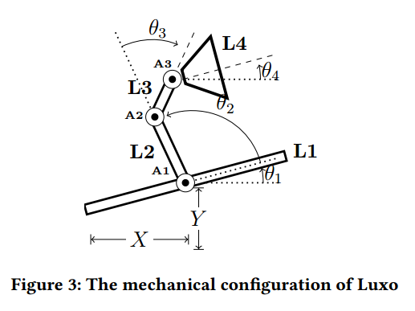
4.2 The Articulated Lamp Model
4 links and 6 DOF
Euip each joint with a PD controller

Slide 11
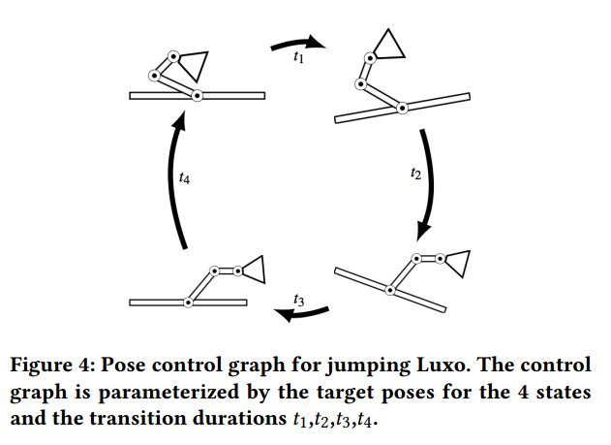
4.3 Control Scheme for Jumping
periodic controller synthesis technique
a simple fnite state machine (FSM)
a cyclic sequence of timed state transitions
the FSM behavior is governed by
a set of transition duration parameters
the target poses for each state

Slide 12
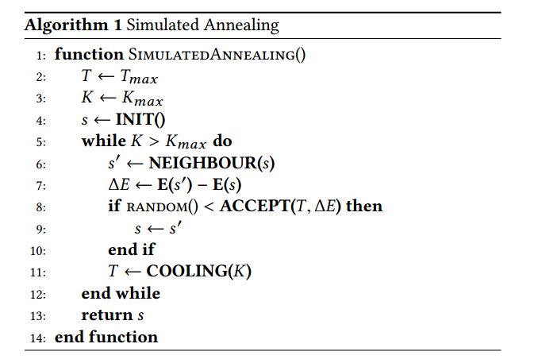
4.4 Finding Motions with Simulated Annealing
The Energy Function
Picking Neighboring Candidate Solutions
Temperature And Acceptance Probability

Slide 13
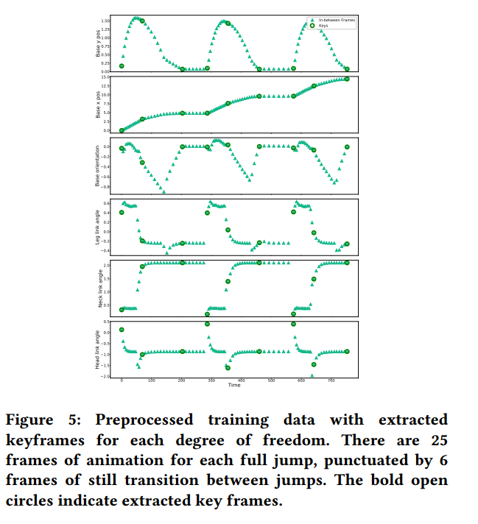
5. Data Preprocessing
The raw simulated data
generated from the above procedure
consists of densely sampled pose information for jumps
Neet to be preprocessed into a suitable format
includes plausible keyframes for training

Slide 14
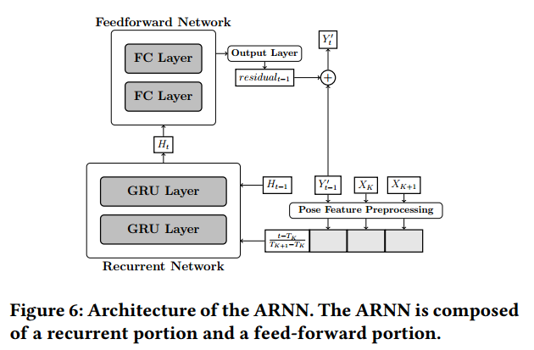
6. ARNN Network
Pose Feature Preprocessing
Recurrent Network
GRU (Gated Recurrent Unit) Layer
Feedforward Network
FC (Fully Connected) Layer
Output
Ouput Layer

Slide 15
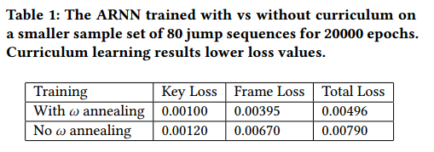
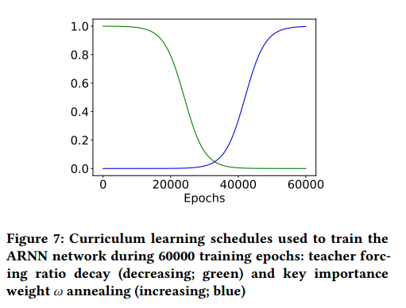


7. TRAINING
Performance
130 hours
NVIDIA GTX 1080 GPU
Curriculum Learning
Loss Function
key loss
frame prediction loss

Slide 16
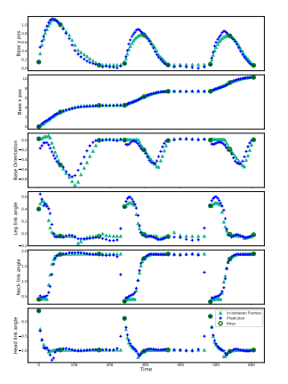
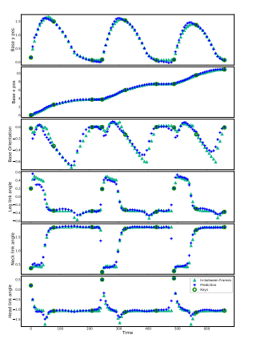
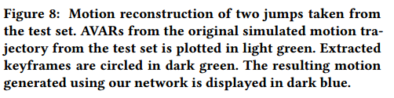
8. Results

Slide 17
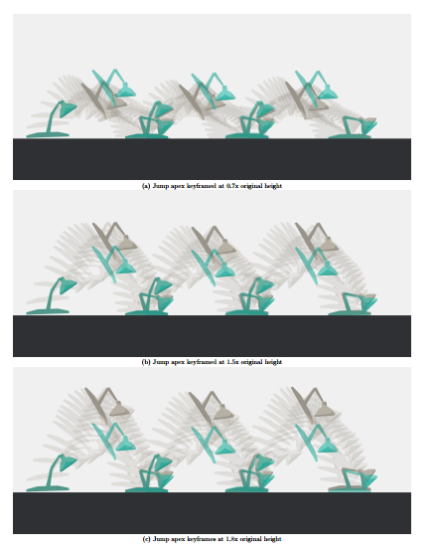
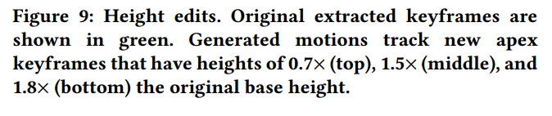
8. Results

Slide 18
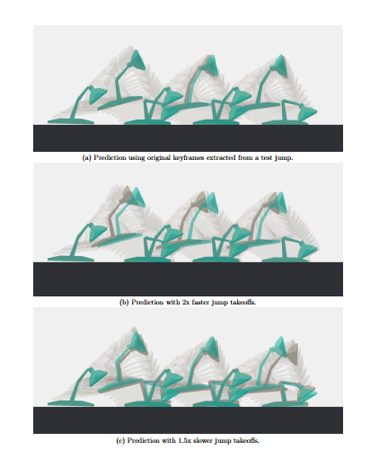
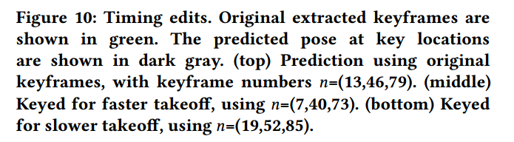
8. Results

Slide 19


8. Results

Slide 20
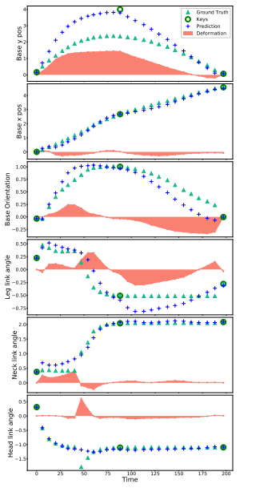

8. Results

Slide 21
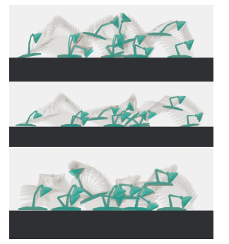
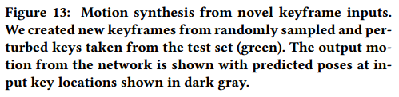
8. Results

Slide 22
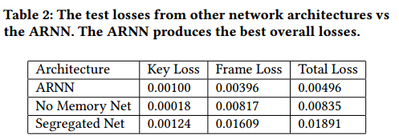
9. Comparison to Other Architectures

Slide 23
谢谢！

