Slide 1
tmp
tmp
nullptr
nullptr
nullptr
head
head
head
①
②
③
Notes:
0445 两数相加 II

Slide 2
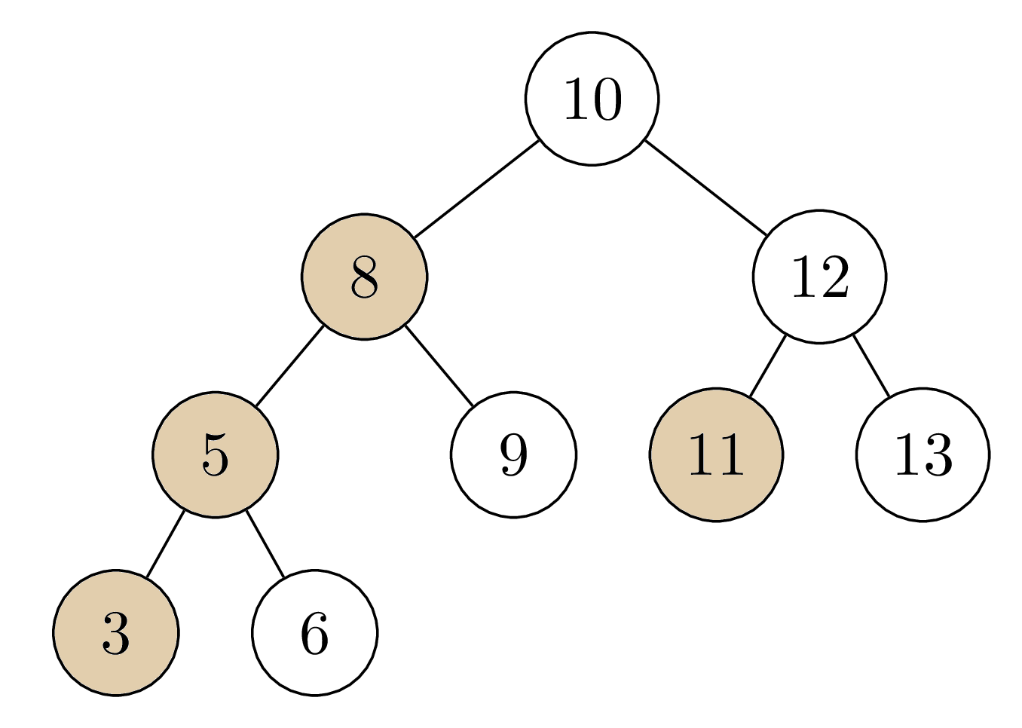
递减数 |  |  | 11 | 8 | 5 | 3
 |  | 13
 |  | 12 | 11 | 9 | 6
stack |  | 10 |  | 8 | 5 | 3
root | MAX | 13 | 11 | 9 | 6
 |  | 12 | 10 | 8 | 5
[ 10, 12, 13, 11, 8, 9, 5, 6, 3 ]
反转的后序遍历数组
根→右→左
stack<int> stk;
int root = INT_MAX;
for (int i=postorder.size()-1; i>=0; --i) {
int cur = postorder[i];
while (!stk.empty() && cur<stk.top()) {
root = stk.top();
stk.pop();
}
if (cur>root) {
return false;
}
stk.push(cur);
}
return true;
Notes:
JZ-33 二叉搜索树的后序遍历序列 – 单调栈

Slide 3
递减数 |  |  | 8
 |  | 13
 |  | 12 | 11
stack |  | 10 | 8
root | MAX | 13
 |  | 12
 |  | 10
[ 10, 12, 13, 8, 11, 9, 5, 6, 3 ]
反转的后序遍历数组
根→右→左
stack<int> stk;
int root = INT_MAX;
for (int i=postorder.size()-1; i>=0; --i) {
int cur = postorder[i];
while (!stk.empty() && cur<stk.top()) {
root = stk.top();
stk.pop();
}
if (cur>root) {
return false;
}
stk.push(cur);
}
return true;
Notes:
JZ-33 二叉搜索树的后序遍历序列 – 单调栈

Slide 4
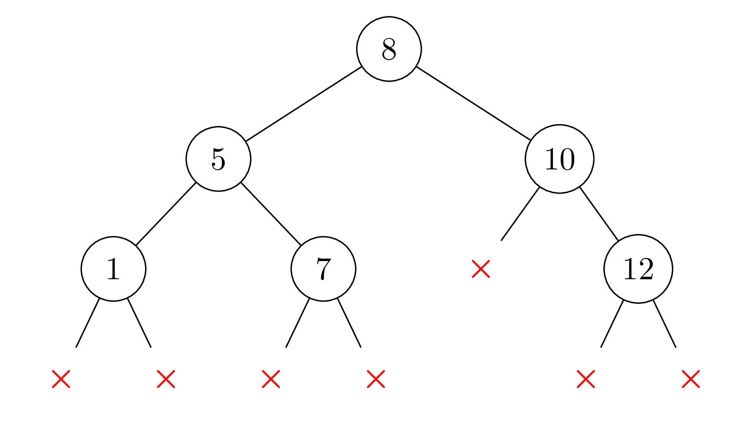
0, (-∞, +∞)
idx | 0 | 1 | 2 | 3 | 4 | 5
num | 8 | 5 | 1 | 7 | 10 | 12
1, (-∞, 8)
4, (8, +∞)
2, (-∞, 5)
3, (5, 8)
5, (8, 10)
5, (10, +∞)
3, (-∞, 1)
3, (1, 5)
4, (7, 8)
6, (10, 12)
4, (5, 7)
Notes:
1008 前序遍历构造二叉搜索树

Slide 5
b1 | [b1] | b2 | [b2] |  | cnt+
0 | 1 | 4 | 3 | b1++
1 | 2 | 4 | 3 | b1++
2 | 6 | 4 | 3 | b2++ | 2
2 | 6 | 5 | 4 | b2++ | 2
2 | 6 | 6 | 5 | b2++ | 2
2 | 6 | 7 | 7 | b1++
3 | 8 | 7 | 7 | b2++ | 1
3 | 8 | 8 | 9 | b1++
4 | × | 9 | 10 | b2++
 |  | 10 | ×
i | 0 | 1 | 2 | 3
 | 1 | 2 | 6 | 8
b1 | ↑
 |  | ↑
 |  |  | ↑
 |  |  | ↑
 |  |  | ↑
 |  |  | ↑
 |  |  |  | ↑
 |  |  |  | ↑
 |  |  |  |  | ↑
i | 4 | 5 | 6 | 7 | 8 | 9
 | 3 | 4 | 5 | 7 | 9 | 10
b2 | ↑
 | ↑
 | ↑
 |  | ↑
 |  |  | ↑
 |  |  |  | ↑
 |  |  |  | ↑
 |  |  |  |  | ↑
 |  |  |  |  |  | ↑
 |  |  |  |  |  |  | ↑
while (b1<=e1 && b2<=e2) {
if (arr[b1] <= arr[b2])
tmp[i++] = arr[b1++];
else {
tmp[i++] = arr[b2++];
inv_cnt += ((e1+1)-b1);
}
}
while (b1<=e1)
tmp[i++] = arr[b1++];
while (b2<=e2)
tmp[i++] = arr[b2++];
Notes:
JZ-51 数组中的逆序对

Slide 6
①
 |  | c | o | d | e |  | i | s |  | f | u | n
②
 | n | u | f |  | s | i |  | e | d | o | c
start
end
③
n | u | f | f |  | s | i |  | e | d | o | c
idx
start
end
for (start=0; start<s.size(); ++start) {
if (s[start] == ' ')
continue;
if (idx != 0)
s[idx++] = ' ';
end = start;
while (end<s.size() && s[end]!=' ')
s[idx++] = s[end++];
reverse(s.begin()+idx-(end-start), s.begin()+idx);
start = end;
}
s.erase(s.begin()+idx, s.end());
④
f | u | n | f |  | s | i |  | e | d | o | c
⑤
idx
⑥
⑦
start
③
end
⑧
⑨
④
⑤
f | u | n |  |  | s | i |  | e | d | o | c
⑩
idx
start, end
⑥
f | u | n |  |  | s | i |  | e | d | o | c
idx
start
end
⑦
f | u | n |  | s | i | i |  | e | d | o | c
idx
start
end
⑧
f | u | n |  | i | s |  |  | e | d | o | c
idx
start
end
⑨
f | u | n |  | i | s |  | c | o | d | e | c
idx
start
end
⑩
f | u | n |  | i | s |  | c | o | d | e
idx
Notes:
0151 翻转字符串里的单词 + JZ-58-1 翻转单词顺序

Slide 7
 | 1 | 2 | 3 | 4 | 5 | 6 | 7 | 8 | 9 | 10 | 11 | 12 | 13 | 14 | 15 | 16 | 17 | 18 | 19
1 | 1 | 1 | 1 | 1 | 1 | 1
2 | 0 | 1 | 2 | 3 | 4 | 5 | 6 | 5 | 4 | 3 | 2 | 1
3 | 0 | 0 | 1 | 3 | 6 | 10 | 15 | 21 | 25 | 27 | 27 | 25 | 21 | 15 | 10 | 6 | 3 | 1
Notes:
JZ-60 n个骰子的点数

Slide 8
 | 0 | 1 | 2 | 3 | 4 | 5
 | p | w | w | k | e | w |  | 长度 | max
 | ↑↑
1 | ↑ |  | ↑ |  |  |  |  | 2 | 2
2 |  | ↑ | ↑ |  |  |  |  | 1 | 2
3 |  |  | ↑ |  |  | ↑ |  | 3 | 3
Notes:
0003 无重复字符的最长子串

Slide 9
④
D
mid
mid
mid
②
B
1
2
3
4
①
A
left
left
right
left
right
③
C
ListNode* left=nullptr, *mid=head, *right;
while (mid) {
right = mid->next;
mid->next = left;
left = mid;
mid = right;
}
return left;
A
①
B
②
C
③
D
④
Notes:
0206 反转链表

Slide 10
dum
1
2
3
4
5
6
7
8
pre
start
end
next
②
②
③
③
③
dum
1
2
3
4
5
6
7
8
pre
start
③
end
next
④
pre
end
④

