Slide 1
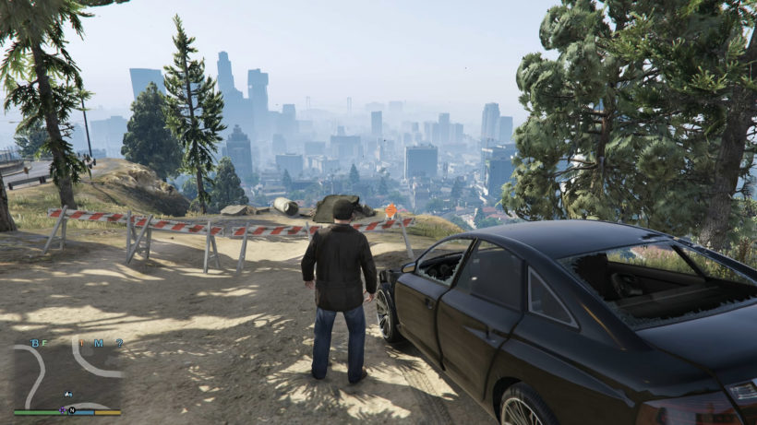
30
PLAY
EDIT
ped_01
pos
REC
ped_02
rot
camera
ped_name ...
scale
ped
disabled
anim
vehicle
ped_05
wpn
walk
start
300
end
360
events
MISC

