Slide 1
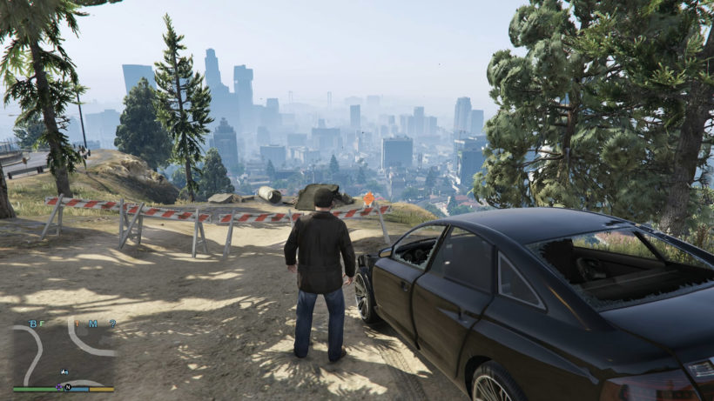
315
30
PLAY
EDIT
ped_01
pos
REC
SPWN
ped_02
rot
REND
PREV
ped_name ...
scale
camera
disabled
anim
ped
ped_05
waypoint
walk
vehicle
300
360
new
600
2000
200
1200
event
search
MISC
1210
300

Slide 2
315
30
PLAY
EDIT
ped_04
anim
REC
SPWN
ped_02
rot
REND
PREV
ped_03
scale
ped_04
anim
ped_05
weapon
ped
ped_06
speek
ped_07
waypoint
walk
600
2000
200
1200
300
360
search
1210
300

Slide 3
315
30
EDIT
search
Rotation
Scale
search
Animation
Ped
walk
ped_01
dance
ped_02
run
ped_03
walk
Weapon
ped_04
Speek
ped_05
Waypoint
Vehicle
Camera
1210
300

