Slide 1
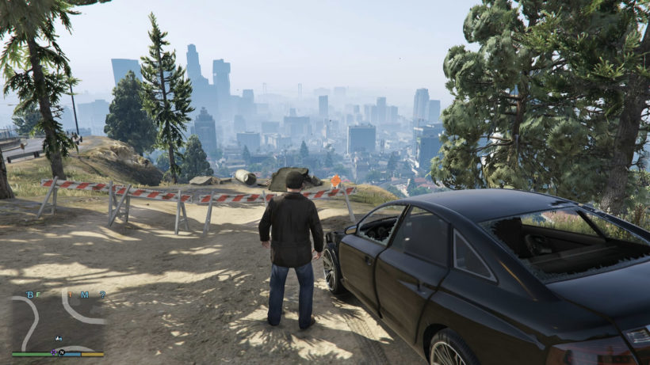
315
30
PLAY
EDIT
ped_01
pos
REC
SPWN
ped_02
rot
ped_name ...
scale
camera
disabled
anim
ped
vehicle
ped_05
waypoint
walk
events
300
360
new
600
2000
200
1200
MISC
search
1210
300

