Slide 1

MACHINE LEARNING · REGRESSION PROJECT
Agriculture: Crop Yield Prediction
Using Ridge, Lasso, and Elastic Net Regression
Team
UNDER THE GUIDENCE OF
Thipireddy Hansini
2520030095 | Section 8
Sakili Poojitha Reddy
2520030110 | Section 8
Shaik Asif
Assistant Professor, CSE

Slide 2

Problem Statement
Crop yield depends on many interacting factors: soil nutrients, rainfall, temperature, humidity, fertilizer and pesticide usage.
TARGET VARIABLE
yield
Task: Supervised Regression
Traditional estimation methods (averages, simple rules) struggle to capture non-linear, multi-variable relationships in agricultural data.
MODELS COMPARED
1. Ridge Regression (L2)
Machine Learning regression can learn statistical relationships between agricultural / environmental factors and crop yield.
2. Lasso Regression (L1)
3. Elastic Net (L1 + L2)
This project predicts crop yield and compares three regularized linear regression techniques on a real multi-source agricultural dataset.
Why regularization? Later analysis shows several predictors (e.g. area, fertilizer, pesticide) are highly correlated — regularization controls coefficient size and reduces overfitting from this multicollinearity.
Crop Yield Prediction · Ridge, Lasso & Elastic Net
2

Slide 3



Dataset Identification
19,689 × 9
30 × 5
720 × 5
crop_yield.csv
state_soil_data.csv
state_weather_data_1997_2020.csv
Dataset | Rows | Columns | Purpose
crop_yield.csv | 19,689 | 9 | Crop / yield records and agricultural inputs (area, production, fertilizer, pesticide)
state_soil_data.csv | 30 | 5 | State-level soil nutrient profile (N, P, K, pH)
state_weather_data_1997_2020.csv | 720 | 5 | State-year weather (temperature, rainfall, humidity), 1997–2020
Data period: 1997–2020 (based on the uploaded weather and crop-yield records). All three files cover the same 30 Indian states, enabling a join on state (and state + year for weather).
Crop Yield Prediction · Ridge, Lasso & Elastic Net
3

Slide 4

Dataset Snapshot
crop_yield.csv (sample rows)
19,689 × 9
crop | year | season | state | area | production | fertilizer | pesticide | yield
Arecanut | 1997 | Whole Year | Assam | 73,814 | 56,708 | 7,024,878 | 22,882.3 | 0.796
Coconut | 1997 | Whole Year | Assam | 19,656 | 126,905,000 | 1,870,662 | 6,093.4 | 5238.05
Cotton(lint) | 1997 | Kharif | Assam | 1,739 | 794 | 165,501 | 539.1 | 0.421
state_soil_data.csv (sample rows)
30 × 5
state_weather_data_1997_2020.csv (sample rows)
720 × 5
state | N | P | K | pH
Andhra Pradesh | 78 | 45 | 22 | 6.8
Arunachal Pradesh | 55 | 15 | 35 | 5.5
Assam | 60 | 18 | 38 | 5.8
state | year | avg_temp_c | rainfall_mm | humidity_%
Andhra Pradesh | 1997 | 28.21 | 1,191.08 | 69.56
Andhra Pradesh | 1998 | 28.21 | 1,100.41 | 71.95
Andhra Pradesh | 1999 | 28.03 | 603.67 | 66.91
Note: The crop_yield.csv row for Coconut (Assam, 1997) already hints at a key EDA finding — Coconut yield (5238) is measured on a very different numeric scale from most other crops (see Slide 6).
Crop Yield Prediction · Ridge, Lasso & Elastic Net
4

Slide 5

Data Integration & Preprocessing
How the three files are joined
Preprocessing Steps Applied
crop_yield.csv
Whitespace cleanup: season and crop values in crop_yield.csv contain trailing spaces (e.g. ‘Kharif ’, ‘Whole Year ’); stripped before grouping/encoding.
Merged
Modeling Table
Missing values: Checked with .isnull().sum() on all three files: 0 missing values found in crop_yield.csv, state_soil_data.csv and state_weather_data_1997_2020.csv.
state_soil_data.csv
state_weather_data.csv
Duplicate records: 0 duplicate rows found in any of the three source files.
crop_yield joins soil data on state, and weather data on state + year.
Post-merge check: After merging on state (+ year), the combined table also has 0 missing values — every state/year in crop_yield.csv had a matching soil and weather record.
Result: 19,689 × 16 merged rows, 0 missing values — every crop_yield record retains its state's soil profile and its state-year weather.
Categorical encoding: crop (55 categories), season (6), state (30) one-hot encoded.
Feature scaling: All numeric predictors standardized (zero mean, unit variance) with StandardScaler before Ridge / Lasso / Elastic Net.
Why scaling matters: Ridge, Lasso and Elastic Net penalize coefficient magnitude directly, so unscaled features (fertilizer in millions vs. pH in single digits) would be penalized unfairly without standardization.
Crop Yield Prediction · Ridge, Lasso & Elastic Net
5

Slide 6
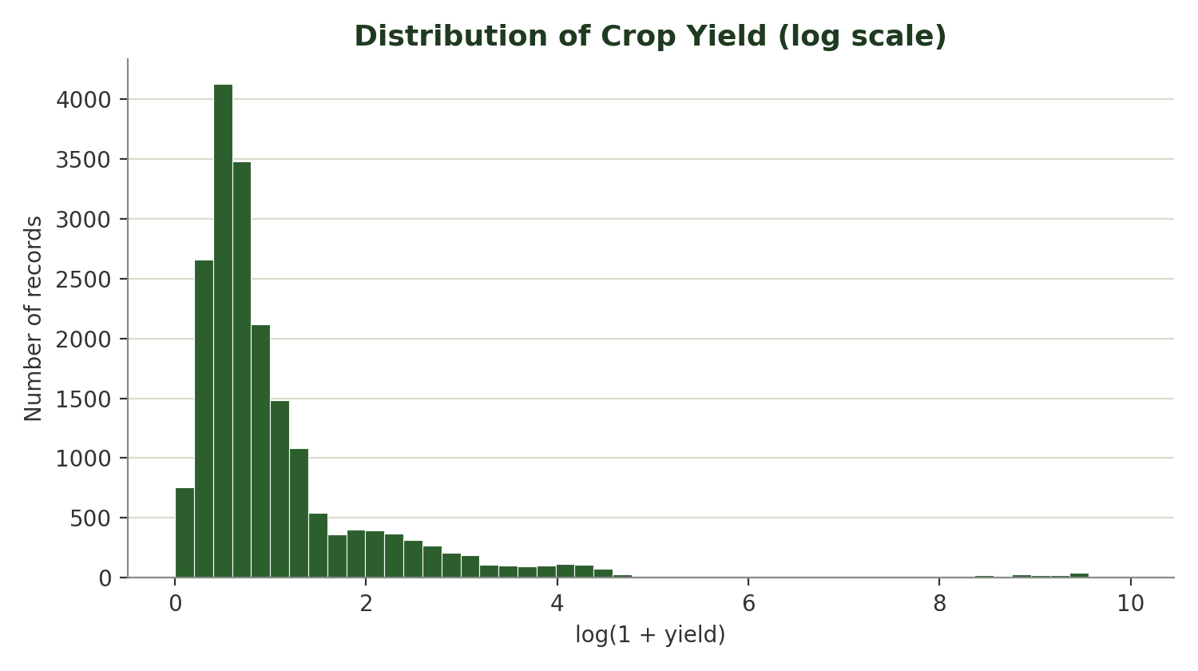
EDA: Crop Yield Distribution
EXPLORATORY DATA ANALYSIS
Mean yield
79.95
Median yield
1.03
Std. deviation
878.31
Max yield
21,105 (Coconut, Telangana, 2014)
Key takeaways:
• Yield is strongly right-skewed; most records sit below 2.4.
• Coconut (172 of 19,689 rows) is reported in a much larger unit than most crops and drives the extreme upper tail / outliers.
x-axis uses log(1 + yield) because raw yield ranges from 0 to 21,105 — plotting it directly would compress almost all records into a single bar.
Crop Yield Prediction · Ridge, Lasso & Elastic Net
6

Slide 7
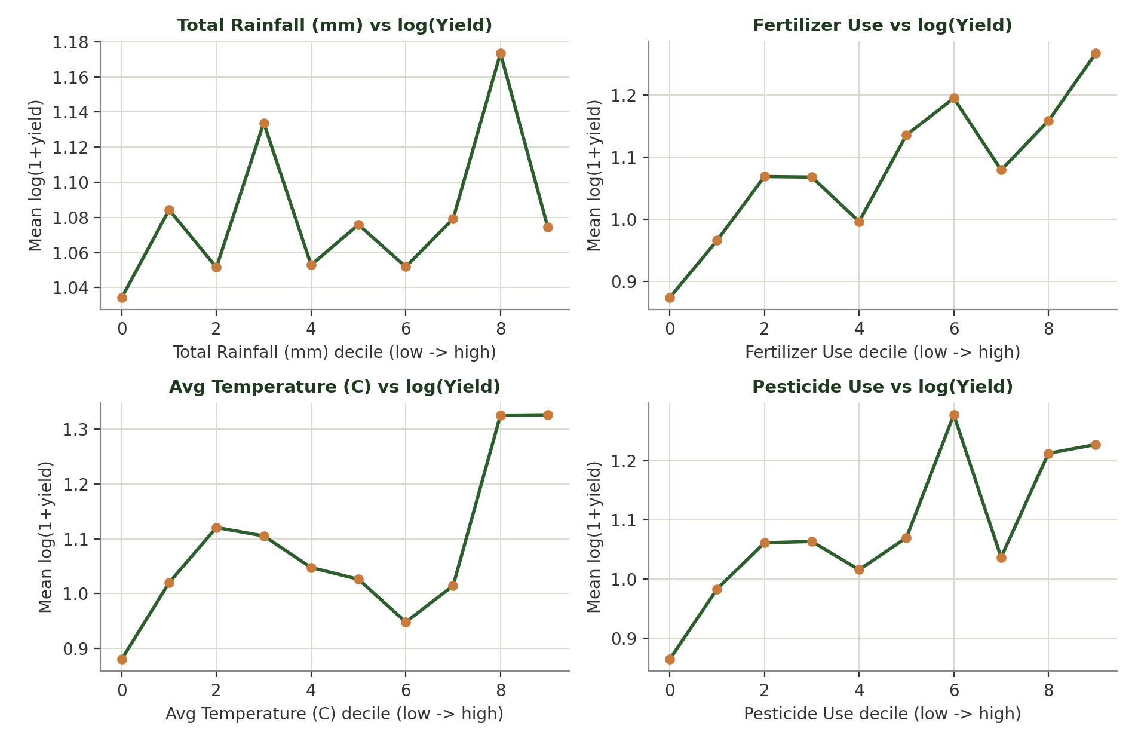
EDA: Agricultural Factors vs. Yield
EXPLORATORY DATA ANALYSIS
Observations
Records were grouped into deciles of each factor and the mean log(yield) was plotted per decile.
• Fertilizer and pesticide show a mild upward trend across deciles.
• Rainfall and temperature show noisy, non-monotonic patterns — no clear linear trend at this aggregation level.
• This matches the very weak individual correlations with yield found in Slide 9 (all below 0.07 in magnitude).
Crop Yield Prediction · Ridge, Lasso & Elastic Net
7

Slide 8
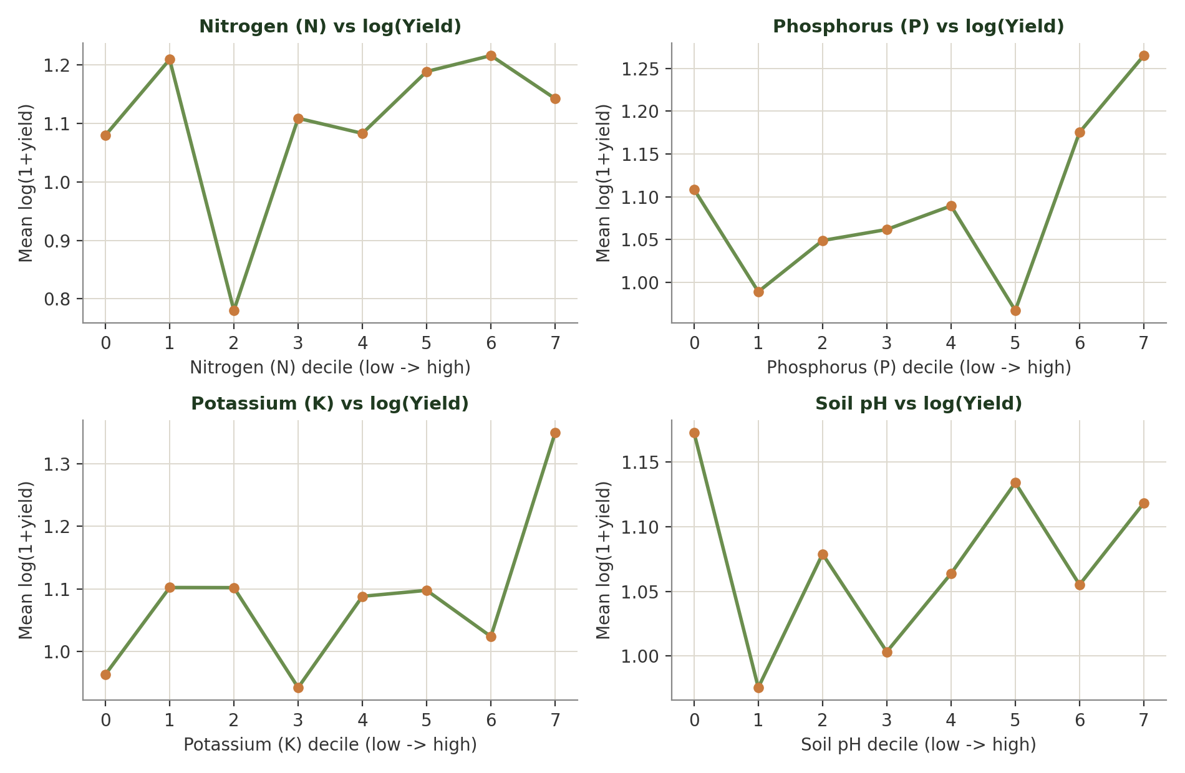
EDA: Soil Factors vs. Yield
EXPLORATORY DATA ANALYSIS
Observations
N, P, K and pH are state-level averages (one value per state), so their relationship with row-level yield is naturally weak and noisy.
• None of the four soil variables shows a consistent monotonic trend with mean log(yield).
• Potassium (K) and Phosphorus (P) show a rise only in the highest decile, not a steady trend.
• On their own, soil variables are weak predictors of yield — confirmed by the correlation analysis on Slide 9.
Crop Yield Prediction · Ridge, Lasso & Elastic Net
8

Slide 9

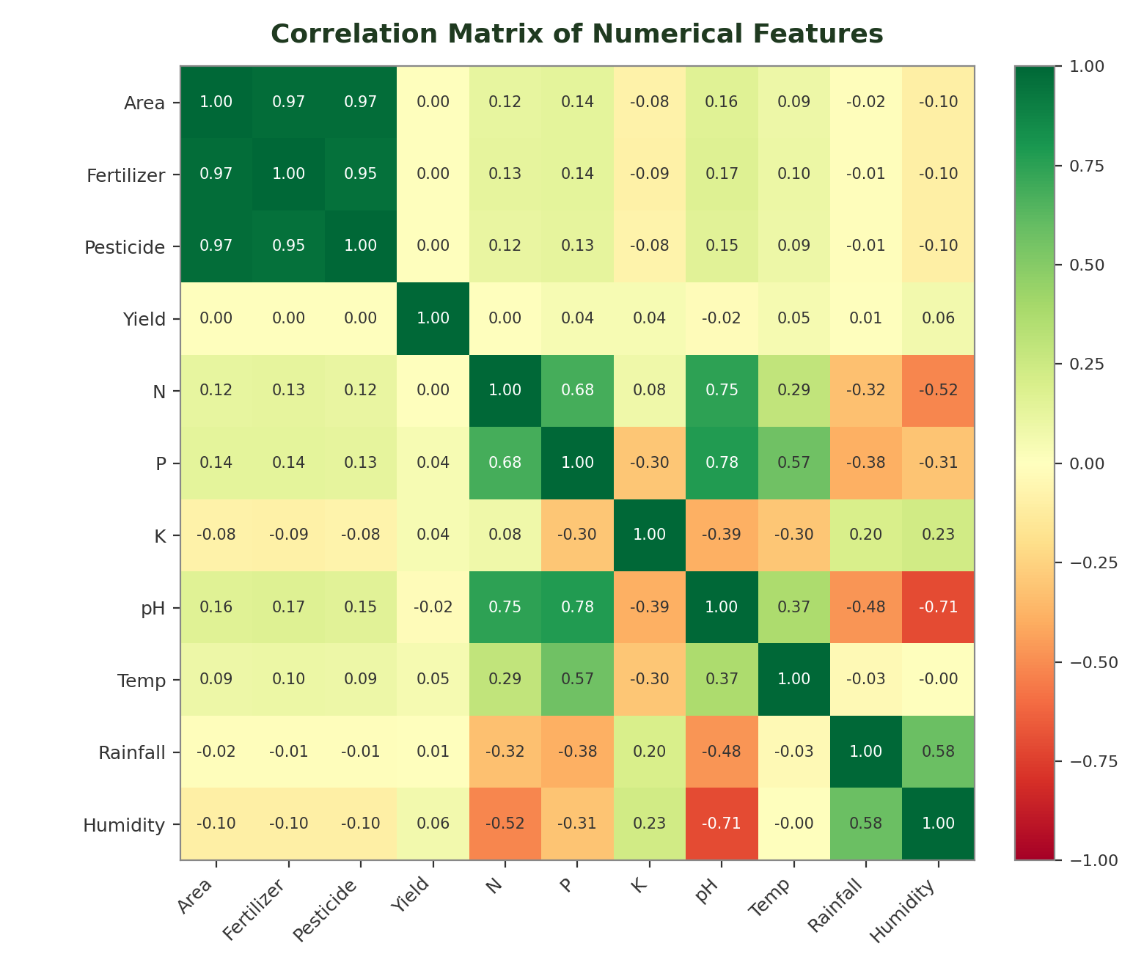
EDA: Correlation Analysis
EXPLORATORY DATA ANALYSIS
Multicollinearity detected
• area ↔ fertilizer: r = 0.97
• area ↔ pesticide: r = 0.97
• fertilizer ↔ pesticide: r = 0.95
These three inputs move almost together (larger farmland → proportionally more fertilizer & pesticide), which is exactly the scenario Ridge, Lasso and Elastic Net are designed to handle.
Correlation with yield (weak)
Every individual numeric feature correlates weakly with yield: humidity (0.06), temperature (0.05), K (0.04), P (0.04), rainfall (0.01), fertilizer (0.003), area (0.002), pesticide (0.002), N (0.001), pH (−0.02).
This does not mean these features are useless — yield depends on non-linear combinations and, most strongly, on crop identity (see Slide 12 model coefficients). It does mean simple linear correlation alone under-represents each factor's contribution.
Crop Yield Prediction · Ridge, Lasso & Elastic Net
9

Slide 10

Feature Engineering
Numerical Features (10) — scaled
Categorical Features (3) — one-hot encoded
• area
• fertilizer
crop
55 unique values
• pesticide
• N (soil nitrogen)
season
6 (Kharif, Rabi, Whole Year, Summer, Autumn, Winter)
• P (soil phosphorus)
• K (soil potassium)
• pH (soil pH)
• avg_temp_c
state
30 unique values
• total_rainfall_mm
• avg_humidity_percent
→ One-hot encoding expands these 3 columns into ~100 total input columns (with numeric features included) after encoding.
Excluded: production. yield is derived largely from production and area (correlation of production with yield = 0.57, while production correlates only 0.04 with area). Including production as a predictor would leak the target into the input and produce an unrealistically easy prediction task, so it is dropped from the feature set.
Final pipeline: 10 numeric features → StandardScaler | 3 categorical features → One-Hot Encoding | Combined via a scikit-learn ColumnTransformer feeding Ridge / Lasso / Elastic Net.
Crop Yield Prediction · Ridge, Lasso & Elastic Net
10

Slide 11

Methodology
Data
Collection
Data
Integration
Data
Cleaning
EDA
Feature
Engineering
Encoding &
Scaling
Train /
Test Split
Model
Training
Model
Evaluation
Model
Comparison
Ridge Regression
Lasso Regression
Elastic Net
Crop Yield Prediction
Split strategy: chronological (year-based), not random. Records from 1997–2015 form the training set (15,404 rows, 78.2%); records from 2016–2020 form the test set (4,285 rows, 21.8%). Because the data spans 24 years, a random split would let the model “see” future years during training — a chronological split better reflects the real task of predicting yield for years not yet observed.
Crop Yield Prediction · Ridge, Lasso & Elastic Net
11

Slide 12

Models
Ridge Regression
Lasso Regression
Elastic Net
L2 Regularization
L1 Regularization
L1 + L2 Regularization
Loss = RSS + λ Σβ²
Loss = RSS + λ Σ|β|
Loss = RSS + λ[αΣ|β| + (1−α)Σβ²]
Shrinks coefficient magnitude toward zero but rarely to exactly zero
Can shrink some coefficients exactly to zero
Combines Ridge's stability with Lasso's feature selection
Handles multicollinearity by spreading weight across correlated features
Performs automatic feature selection
Especially useful when many features are correlated (area, fertilizer, pesticide)
Keeps all features in the model
In this dataset, 56 of 100 encoded features were reduced to zero
α controls the L1/L2 balance
Crop Yield Prediction · Ridge, Lasso & Elastic Net
12

Slide 13




Model Evaluation
MAE
MSE
RMSE
R²
Mean Absolute Error
Mean Squared Error
Root Mean Squared Error
Coefficient of Determination
Average absolute difference between predicted and actual yield.
Average of squared errors — penalizes larger mistakes more heavily.
Square root of MSE — expressed in the same unit as yield.
Proportion of variance in yield explained by the model (0–1, higher is better).
Evaluation Plan
1. Split the merged dataset chronologically (train: 1997–2015, test: 2016–2020).
2. Fit Ridge, Lasso and Elastic Net on the same scaled / encoded training features, tuning each model's regularization strength via 5-fold cross-validation.
3. Score every model on the identical held-out test set using MAE, MSE, RMSE and R², and compare (Slide 14).
Crop Yield Prediction · Ridge, Lasso & Elastic Net
13

Slide 14
Model Comparison
Model | MAE | MSE | RMSE | R²
Ridge | 56.06 | 91,545.3 | 302.57 | 0.874
Lasso | 53.07 | 89,691.4 | 299.49 | 0.876
Elastic Net | 55.33 | 90,432.4 | 300.72 | 0.875
(cross-validated λ selection; test set = 2016–2020 records, chronological split)
Best model: Lasso Regression
Lasso achieves the lowest MAE, MSE and RMSE and the highest R² (0.876) among the three models on the chronological test set.
Its L1 penalty reduced 56 of the 100 encoded features to exactly zero — effectively performing feature selection while matching or slightly beating Ridge and Elastic Net on predictive accuracy.
Crop Yield Prediction · Ridge, Lasso & Elastic Net
14

Slide 15





Conclusion
Addressed crop yield prediction using real multi-source agricultural data (crop records, soil profiles, weather) for 30 Indian states, 1997–2020.
PRACTICAL VALUE
Supporting agricultural planning with data-driven yield estimates
Merged 19,689 crop-yield rows with state soil and state-year weather data into a single 19,689 × 16 modeling table with zero missing values.
Improving fertilizer / pesticide resource allocation
Compared Ridge, Lasso and Elastic Net specifically because area, fertilizer and pesticide were found to be highly correlated (r ≥ 0.95) — a textbook multicollinearity scenario.
Understanding which factors matter most for yield
Assisting data-driven crop management decisions
On a chronological 2016–2020 test set, all three models perform similarly (R² ≈ 0.87–0.88); Lasso is marginally best (R² = 0.876) while also zeroing out 56 of 100 encoded features.
Note: predictions support planning and are not a substitute for agronomic expertise or field-level assessment.
Crop Yield Prediction · Ridge, Lasso & Elastic Net
15

Slide 16
THANK YOU

