Slide 1


AI-Powered Mutual Fund Portfolio Analysis
SOA PROJECT | FINAL PRESENTATION
Investment Tracking System built on a Service-Oriented Architecture
UNDER THE GUIDANCE OF
TEAM MEMBERS
Dr. Venkateswari Ketineni
Department of Computer Science and Engineering
KLH CSE Bowrampet Campus
P Hansini - 2420030239
G Sreevarsha - 2420030241
Mani Charan Chava - 2420030545
Notes:
Welcome. This is the final presentation of our SOA project: an AI-powered mutual fund portfolio analysis and investment tracking system. Introduce the guide and the three team members.

Slide 2



Problem Statement
THE PROBLEM
Investors need a single place to monitor and understand their mutual fund investments.
The system tracks investments, analyzes portfolio performance, evaluates risk and diversification, and generates insights from historical fund data and machine learning.
It tells users quickly whether the portfolio is performing well and how much risk it carries.
Track
Analyze
Monitor SIPs, transactions and holdings in one view
Measure returns and performance from historical data
Evaluate risk
Get insights
Assess risk level and diversification
AI-driven view of how the portfolio is doing
Notes:
Investors need one place to see how their mutual fund portfolio is doing and how risky it is. Our system tracks, analyzes, evaluates risk and gives insights using historical data and machine learning.

Slide 3



Objectives
Data collection and preprocessing
Prepare mutual fund, NAV, market, holding and SIP transaction data for accurate analysis.
Financial feature extraction
Derive returns, volatility, risk, Sharpe ratio, expense ratio and asset allocation.
Investment tracking
Track SIPs, buy/sell transactions, units held, current NAV, portfolio value and profit/loss.
Interactive dashboard
View portfolio overview, returns, risk analysis, fund comparison and historical trends.
Performance analysis
Rank and compare mutual funds based on historical data.
Notes:
Five objectives: prepare the data, extract financial features, track investments, give an interactive dashboard, and rank and compare funds.

Slide 4
Literature Survey
Paper | Methodology | Inference | Limitation / future work
S. R. Das & R. K. Jain: Mutual Fund Performance: A Synthesis of Taxonomic and Methodological Issues | Classified funds and compared returns, fund flows and performance measures | Category, returns, flows and risk-adjusted performance matter for evaluation | Broad methodology; a software system can put these analyses into practice
Nima Vafai & David Rakowski: The Sources of Portfolio Volatility and Mutual Fund Performance | Analyzed volatility using security-level variances and covariances | Portfolio volatility depends on relationships between securities | Extend to other markets and practical investor portfolios
S. R. S. Prasad et al.: A Critical Analysis of Selected Mutual Funds in India | Applied statistical performance measures to daily NAV data | Funds can be compared through historical NAV and performance measures | Limited to selected funds; extend to more categories and larger datasets
Common thread: performance and risk are well studied, but rarely delivered as one practical, integrated tool.
Notes:
Three representative studies. Together they show that performance and risk analysis is well studied, but rarely delivered as one practical, integrated tool.

Slide 5



Problem Gap Identification
Limited integrated portfolio analysis
Hard to identify underperforming funds
Limited risk and diversification analysis
No benchmark-based performance comparison
Limited modular and scalable architecture
Need for centralized tracking and analysis
Notes:
Six gaps we found in existing approaches. These motivate a centralized, modular system.

Slide 6


Innovation and Novelty
Microservices-based architecture
Real-time portfolio insights
API-based service communication
Independent User, Fund, Portfolio, Analysis and Notification services.
Updated portfolio value, profit/loss, NAV and performance information.
Services talk through REST APIs, demonstrating SOA principles.
Each service can be developed, scaled and replaced independently: the core idea of SOA.
Notes:
Three ideas set the project apart: a microservices-based design, real-time portfolio insights, and API-based communication that demonstrates SOA principles.

Slide 7
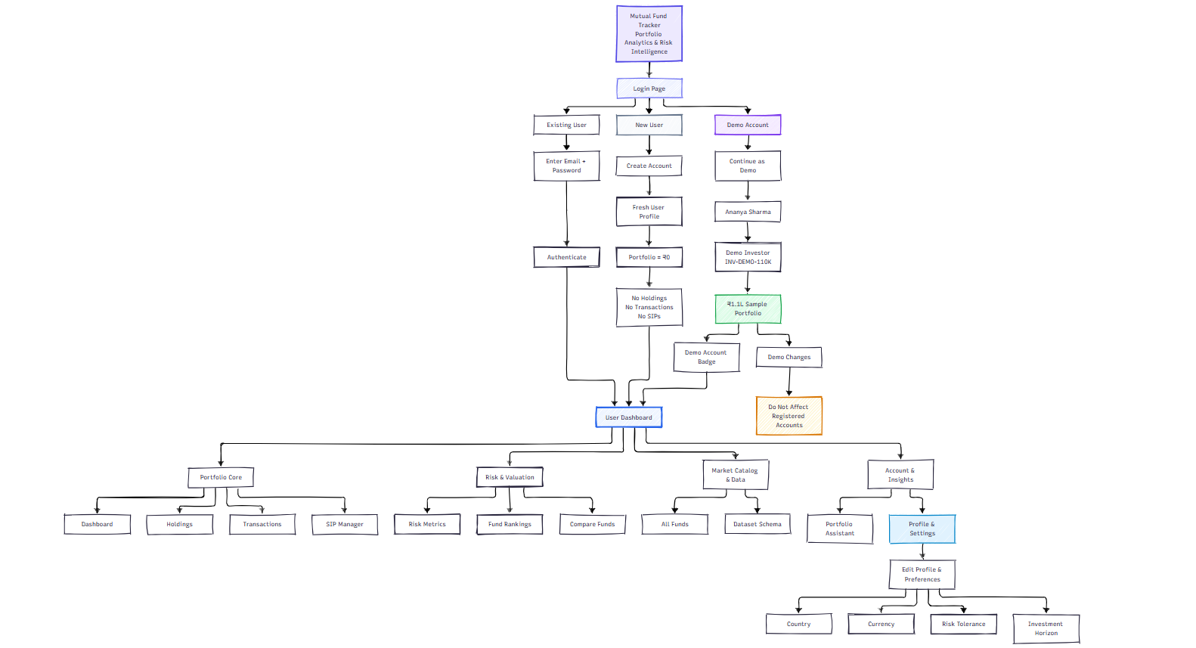
System Architecture
3
Entry paths
Existing, new and demo user
4
Module groups
Portfolio, Risk, Market Data, Account
Notes:
Users reach the dashboard through three paths: existing user login, new account, or the demo account. From the dashboard there are four module groups: Portfolio Core, Risk and Valuation, Market Catalog and Data, and Account and Insights.

Slide 8
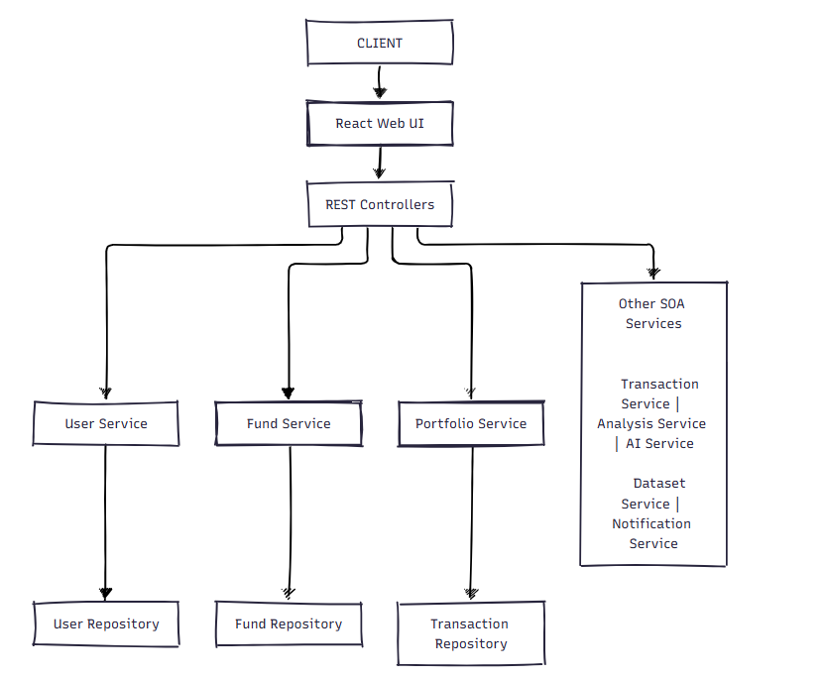
SOA Architecture
Presentation
React web UI sends user requests to the backend.
1
API layer
REST controllers expose each service to the client.
2
Service layer
User, Fund, Portfolio, Transaction, Analysis, AI, Dataset and Notification services.
3
Data layer
Repositories persist and fetch entities through JPA.
4
Notes:
A layered request flow: the React UI calls REST controllers, which delegate to independent services, which use repositories to persist data.

Slide 9


Services and Responsibilities
User Service
Fund Service
Portfolio Service
Transaction Service
Registration, authentication, profile and preferences
Mutual fund catalog, NAV and category data
Holdings, portfolio value and profit/loss
Buy/sell transactions and SIP mandates
Analysis Service
AI Service
Dataset Service
Notification Service
Returns, risk, Sharpe ratio, ranking and comparison
Personalized portfolio insights and assistant
Dataset processing and schema
Alerts and updates to the user
Notes:
Eight independent services, each with one clear responsibility. They communicate through REST APIs.

Slide 10


Technology Stack
Backend
Database
Frontend
Intelligence
Java
H2
React
Machine learning
Spring Boot
MySQL
Vite
Risk and Sharpe metrics
Spring Data JPA
Tailwind CSS
AI assistant
REST APIs
Recharts
Mostly open-source technologies; no specialized hardware required.
Notes:
Java and Spring Boot for the backend, H2 and MySQL for data, React with Vite, Tailwind and Recharts for the frontend, plus machine learning and an AI assistant. Mostly open-source.

Slide 11
Methodology
1
Requirement analysis
2
SOA design
3
Backend and database
Portfolio tracking, fund management, SIPs, transactions, analytics and AI assistance.
Split into User, Fund, Portfolio, Transaction, Analysis, AI and Notification services.
Entities and REST APIs built with Java, Spring Boot, JPA and H2.
4
Frontend development
5
Analysis and AI
6
Testing and demo
Interactive interface with React, Vite, Tailwind CSS and Recharts.
Returns, risk, diversification and performance, plus personalized AI insights.
Authentication, transactions, SIPs, analytics, AI responses and dataset processing.
Notes:
Six steps from requirements to demonstration.

Slide 12
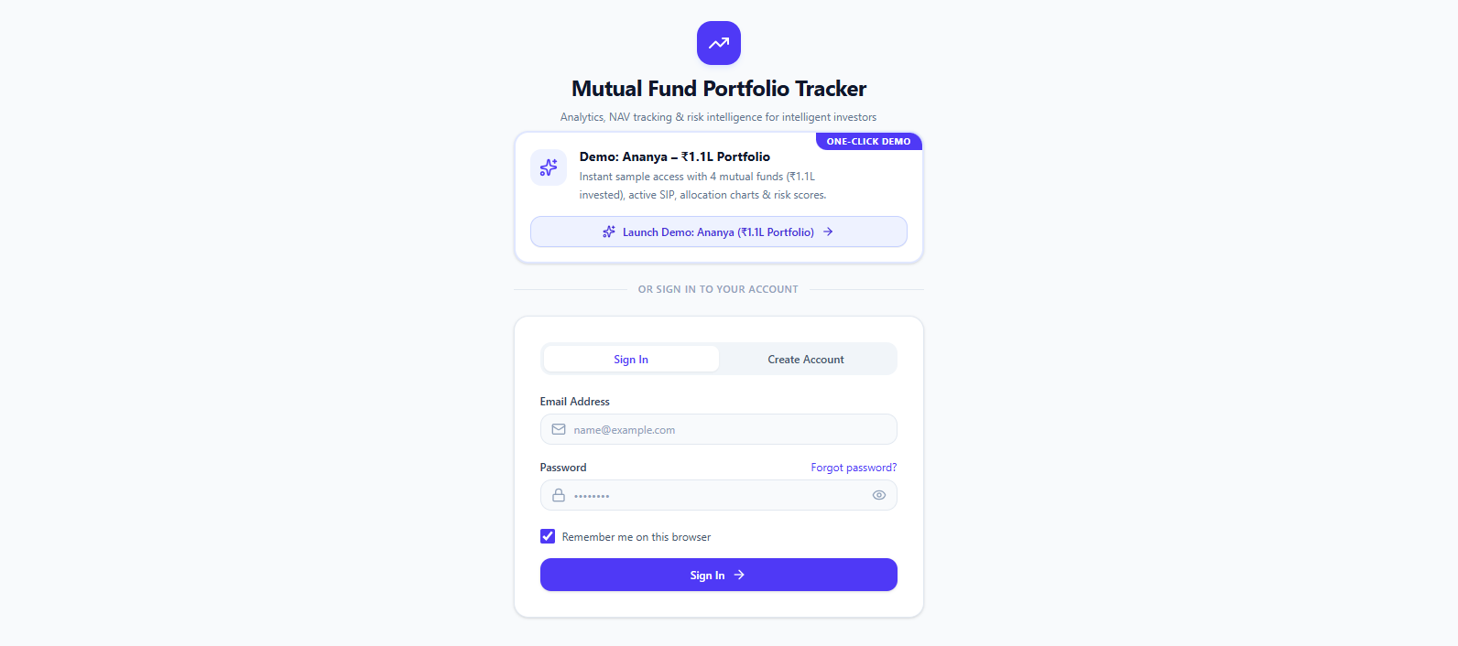


Implementation: Secure Access
Existing user
Sign in with email and password.
New user
Create an account and start with an empty portfolio.
One sign-in screen, three ways in. Demo changes never touch registered accounts.
Demo account
Explore a ₹1.1L sample portfolio; changes stay isolated.
Notes:
Live walk-through point: show the login screen and the three entry paths.

Slide 13
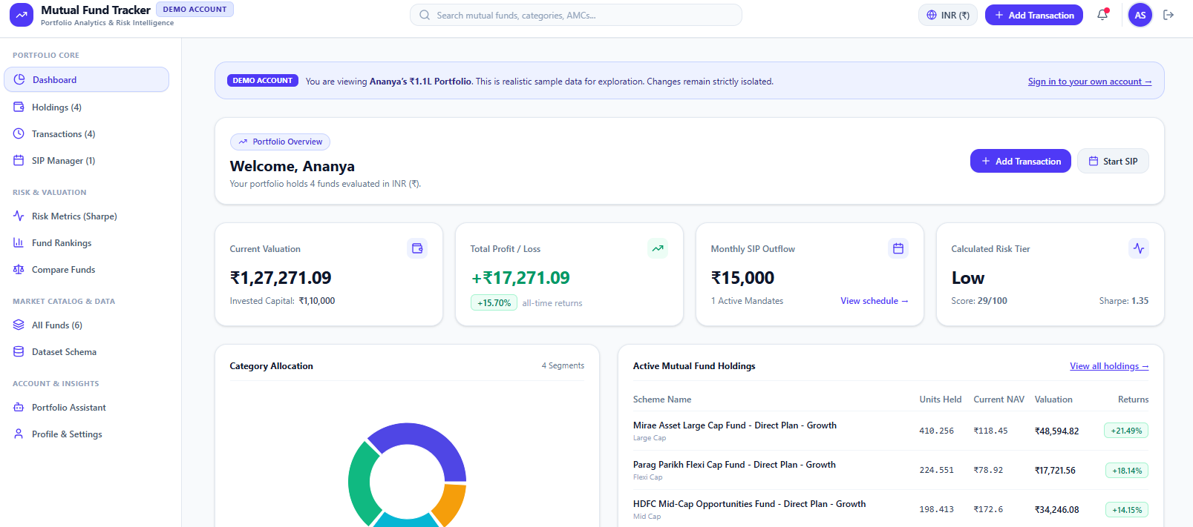
Implementation: Dashboard
Portfolio overview
Valuation, profit/loss, SIP outflow and risk tier
Category allocation
Donut chart of how money is spread
Active holdings
Modules: Holdings, Transactions, SIP Manager, Risk Metrics, Fund Rankings, Compare Funds, All Funds, Portfolio Assistant
Units, current NAV, valuation and returns
Notes:
Show the dashboard: KPI cards, category allocation donut chart and active holdings table. The sidebar groups all modules.

Slide 14
Demo Portfolio at a Glance
Current valuation
Total profit / loss
Monthly SIP outflow
Risk tier (score 29/100)
₹1,27,271
+₹17,271
₹15,000
Low
Invested: ₹1,10,000
+15.70% all-time returns
1 active mandate
Sharpe ratio 1.35
What the dashboard tells the user
All three visible holdings are in profit
Large-cap fund leads at +21.49%
Low risk tier with a Sharpe ratio of 1.35
Source: built-in demo account (sample data).
Notes:
Figures come from the built-in demo account (sample data): valuation ₹1,27,271.09 on ₹1,10,000 invested, profit ₹17,271.09 (15.70 percent), monthly SIP ₹15,000, Low risk tier with score 29 of 100 and Sharpe ratio 1.35.

Slide 15

Feasibility
Technical
Java, Spring Boot, REST APIs, MySQL and React are available and well suited to the project.
Operational
Users can easily track investments, view portfolio performance and analyze risk through the system.
Economic
Built mostly on open-source technologies, with no specialized hardware required.
Notes:
The project is feasible technically, operationally and economically.

Slide 16


Conclusion and Future Scope
WHAT WE DELIVERED
FUTURE SCOPE
Centralized tracking of holdings, transactions and SIPs
Live NAV and market data feeds
Returns, risk and diversification analysis
Benchmark-based performance comparison
Fund ranking and comparison on historical data
More fund categories and larger datasets
SOA-based modular services with REST APIs and an AI assistant
Production-grade database and deployment
Notes:
We delivered a centralized, modular portfolio tracker with analysis and AI insights. Future work: live market data, benchmark comparison, broader datasets and production-grade deployment.

Slide 17
Thank You
Questions and discussion
TEAM
P Hansini | G Sreevarsha | Mani Charan Chava
Guide: Dr. Venkateswari Ketineni, Department of CSE, KLH Bowrampet Campus
Notes:
Thank the audience and invite questions.

