Slide 1
HYbrid Desktop
Name: Jiahe Chen (psyjc3, 4255607)
Supervisor: Koleva Boriana

Slide 2
What is Hybrid Desktop?
A new studying environment which aims to make good use of the advantages of both physical and electronic desktops by using Mixed Reality technology.

Slide 3
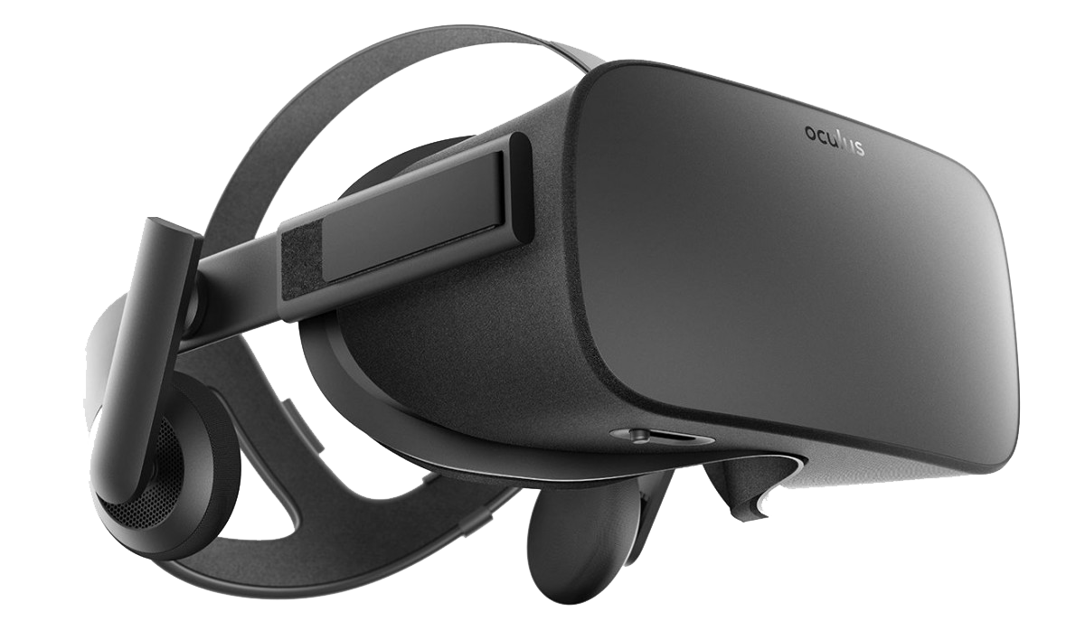
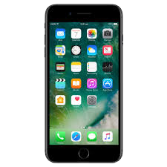
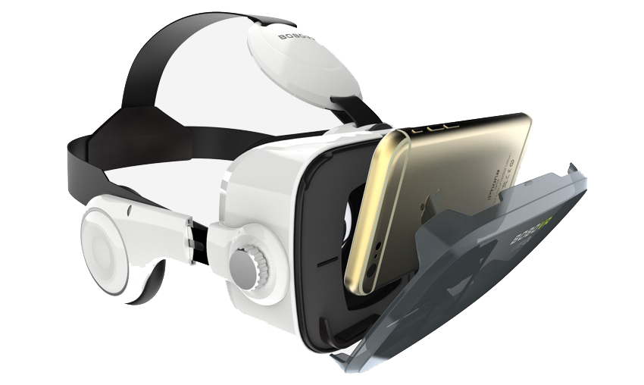
Background information
Based on some research, Mixed reality can make great contribution in Education industrial.
But the price of VR devices such as Oculus is really expensive.
All most every university students have a smart phone.
Thinking about using smart phone and a simple VR headset to let students get involved in this new mixed world.

Slide 4
Demonstration
QR code as a start.
Leap Motion Control
Virtual button usage (Switching PDF, and update document list)
Bulletin Board (Demo the “add task” example)
Electronic Annotation (Implementing with Hybrid Desktop Website)

Slide 5
Limitation
The accuracy of Leap Motion gesture recognition still needs some improvement.
Leap Motion with Unity Development has more powerful and available APIs.
Implementing Leap Motion with iPhone, the IOS device is really different.
The current VR headset is heavy and cumbersome, and the view should be broader.
Digital objects could be more stable.

Slide 6
Further work
Leap Motion with iPhone still needs a lot of improvement
Hybrid desktop can be fully implemented with the online studying systems.
It can really change the way student used to study.

Slide 7
Questions?

Slide 8
Thank you!

