Slide 1

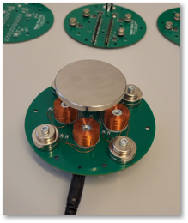
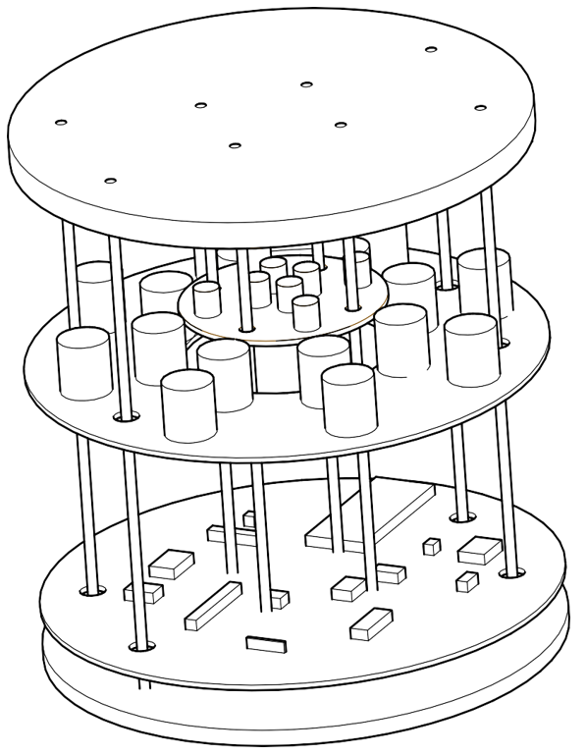
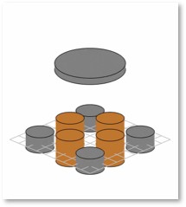
Take-Home Maglev Labs to Promote Self-Efficacy
Topic
Development and assessment of a new type of personal lab for engineering students
Team
ITK Trondheim
Hans Alvar Engmark
Morten Dinhoff Pedersen
3 MSc students
ITK Ålesund
Robin T. Bye et al.
External
Alberto Morselli, UNIPD, Padova, Italy
Implementation roadmap
January – June: Design and build a system, produce learning material
and deploy simple levitation control algorithms
June - July: Design our assessment method
(surveys, behavioral observation, interviews, etc.)
August: Execute a 2-day mini-course for students at IE
Aug. – Sept.: Analyze and disseminate results
Outcomes
Working system & teaching material
Workshop & dissemination report
Papers (Planned for IBCE24, others to be decided)
Expected impact
Assess its usefulness as a tool for improving self-efficacy among students
Adoption for use in ITK and other departments, and other universities
Pave the way for more labs built on the same principle
Kunnskap for ei betre verd
V2.0 with digital controller
Illustration of V3.0, courtesy Alberto Morselli
Simulation with perturbation
Date: 19.01.2024

