Slide 1


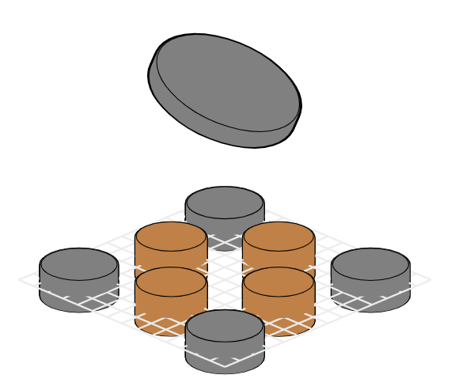
Take-Home Maglev Labs to Promote Self-Efficacy
Topic
Development and assessment of a new type of personal lab for engineering students
Implementation roadmap
January – June:
✓ Design and build a system
V2.6 (working)
V3.0 (finished design, in assembly)
✓ Produce learning material
Book on the system by master’s students →
✓ Deploy simple control algorithms
Implementations found in our GitHub repository
June - July:
○ Design our assessment method
August:
○ Execute a 2-day mini-course for students at IE
Aug. – Sept.:
○ Analyze and disseminate results
Outcomes
✓ Working system & teaching material
○ Workshop & dissemination report
Papers:
✗ IBCE24
✓ Maglev 2024
Kunnskap for ei betre verd
Date: 10.06.2024

