Slide 1
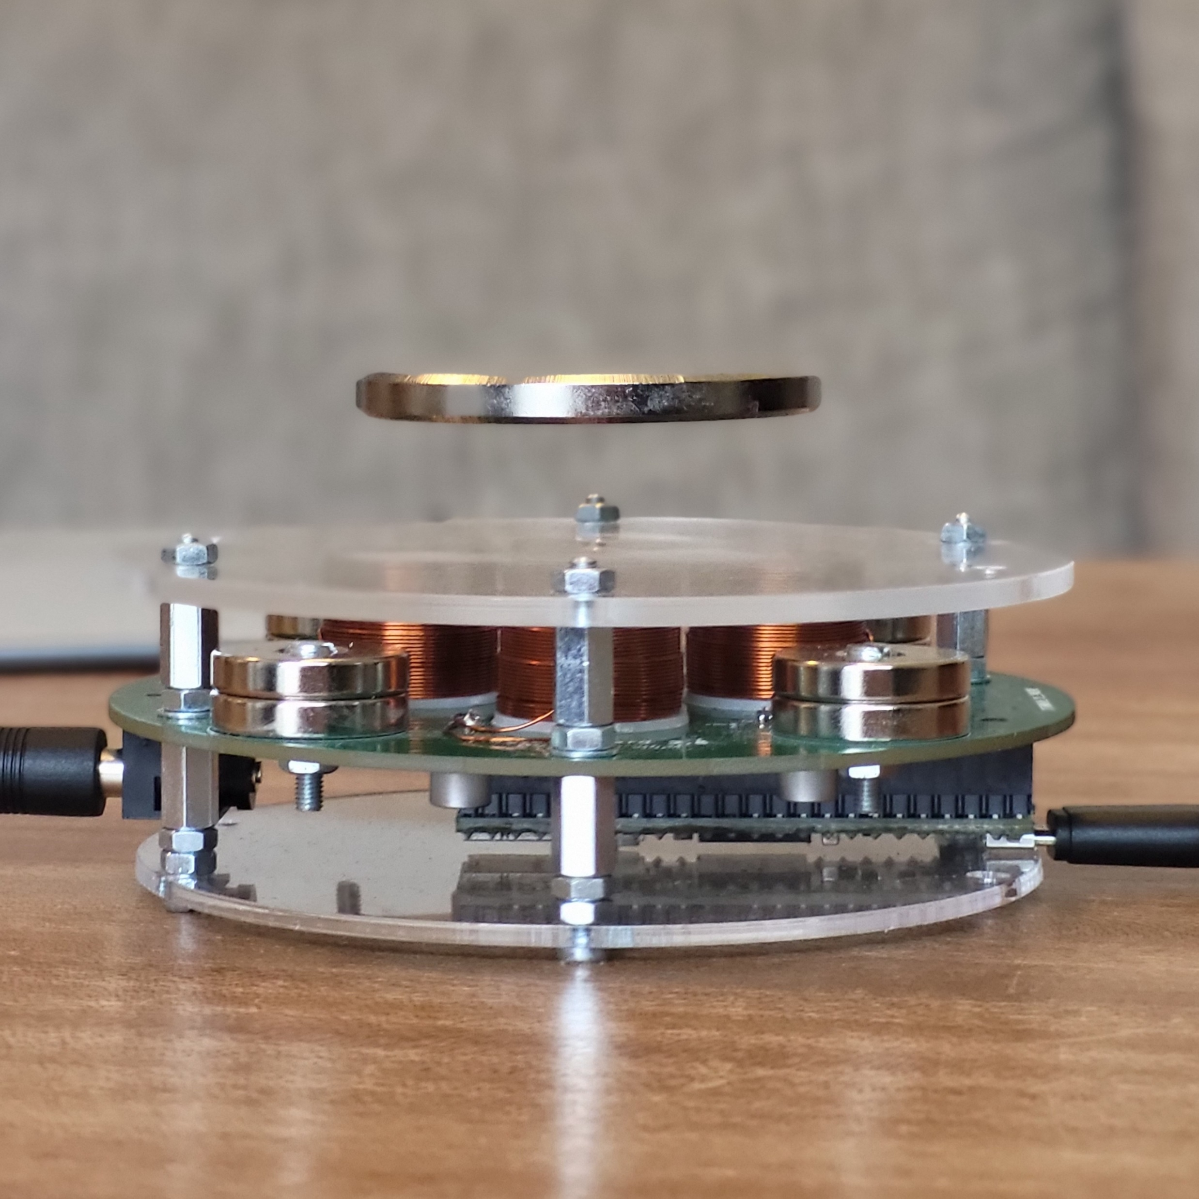
Magnetic Minds: An Interactive Learning Platform for Maglev Labs
NTNU
ITK
Purpose
Enhancing the value of take-home maglev labs previously funded by Excited by means of adaptive dynamic learning platform
Team
Hans Alvar Engmark and Morten Dinhoff Pedersen (ITK)
Lasse Mostad (ILU)
6 computer science students (IDI)
Implementation roadmap
Feb. to March Mapping out requirements and explore options
April to June Development and internal tests of the platform
July to August Finalization and preparation for assessment
Sept. to Dec. Field testing, collecting feedback data
Outcomes
A viable prototype for testing
Dissemination report from testing phase
Publications at conferences and informal workshop at NTNU
Expected impact
Assess its usefulness for improving engagement for students
Adoption for use with the take-home lab in courses at ITK
Extensions to other take-home labs
Levitating
magnet
Microcontroller
programmed
by students
A maglev lab
31.01.25

