Slide 1
2D VS 1D Convolution Layers For fast Keyword Spotting on Max78000

Slide 2
Dataset: Multilingual Spoken Words Corpus
English subset
31 Words:
'right', 'forward', 'dog', 'bed', 'five', 'stop', 'off', 'down', 'house', 'zero', 'marvin', 'bird', 'wow', 'left', 'eight', 'visual', 'seven', 'yes', 'two', 'six', 'three', 'backward', 'tree', 'follow', 'four', 'happy', 'learn', 'one', 'nine', 'cat', 'sheila’
Output labels:
Left
Right
Non of both
Category | Number of Utterances
Training | 69869
Testing | 13118
https://mlcommons.org/en/
Notes:
Wichtig Output!

Slide 3
Feature Set: MFCC
Using Librosa library
librosa.feature.melspectrogram
Audio sample of 16384 length
➔ 128 x 64 Features per word
128 windows
64 fft bins

Slide 4

State of the Art
[2]

Slide 5
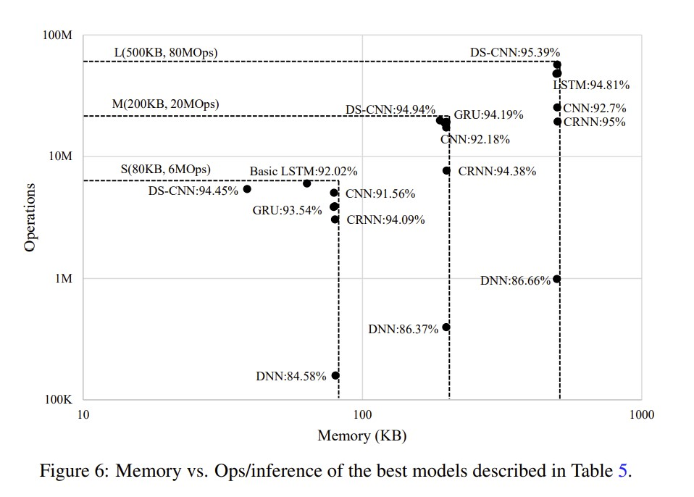
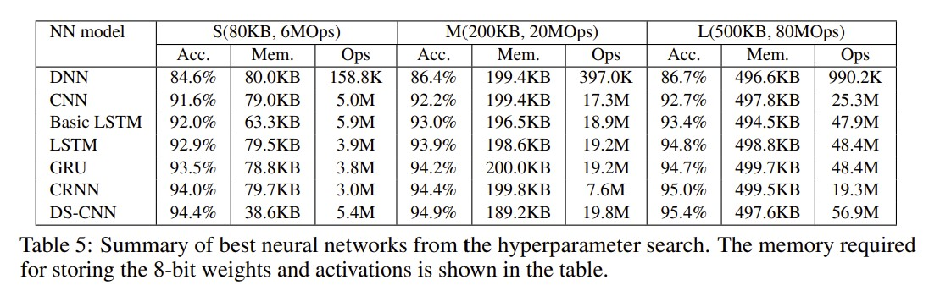
Hello Edge: Keyword Spotting on Microcontrollers [1]
Using Precomputed MFCCs
[1]
[1] https://arxiv.org/abs/1711.07128
[1]
Notes:
According to this paper Depthwise seperable CNNs are best performing 2D convolutional networks
But Depthwise cnn are not supporded by the CNN accelerator of the MAXIM78000, only by the Maxim78002
So we concentrate on the normal CNN of this Paper

Slide 6
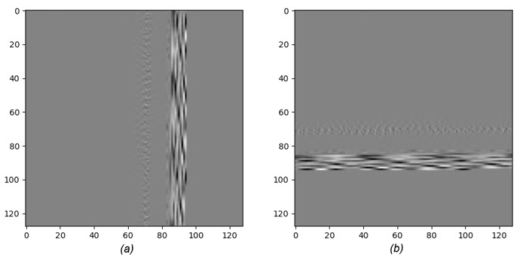
KWS20 on MAX78000
Segmented Audio Data (a) and its transpose (b) used as Input of the KWS20nets [2]
On Arm Cortex
On NN Accelerator
Notes:
For 1D convolution I have the paper by Analog Devices on Key word Spotting
There they are not using MFCC or Fourie Transform
They are using segmented audio data as an input for the CNN

Slide 7
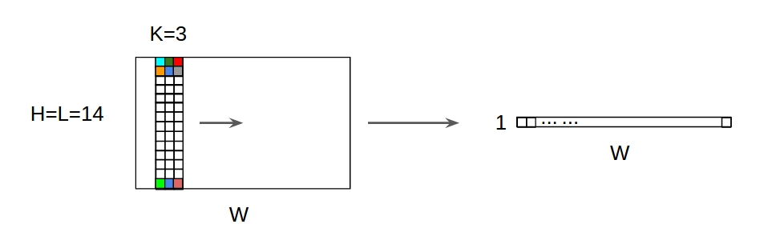
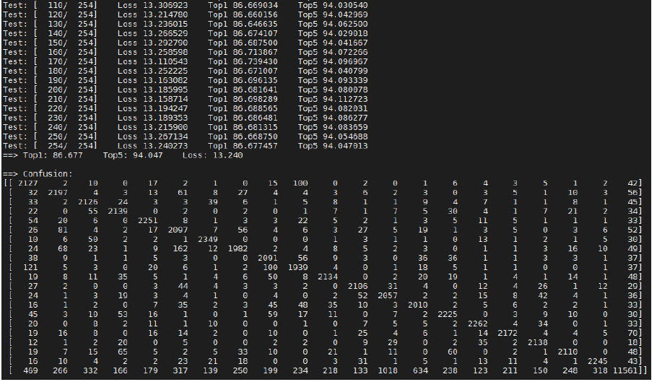
Keywords Spotting Using the MAX78000 [2]
Using only 1D Convolutions
Segments of audio as Channels
Visualization of a 1D-Con on 2D Input
https://stackoverflow.com/questions/42883547/intuitive-understanding-of-1d
-2d-and-3d-convolutions-in-convolutional-neural-n/44628011#44628011
[2] https://www.analog.com/en/design-notes/keywords-spotting-using-the-max78000.html
Confusion matrix of KWS20net-v3 on KWS20 [2]
Notes:
There Model is achieving excellent performance by using only 1D convolution layers

Slide 8
Model Starting Point
2D Convolutional Network [1]
1D Convolutional Network [2]
Multilayer CNN
Using 2D Convolution
Accuracy in Paper: 92%
Approved Network for KWS
Depthwise separable networks not supported on Max78000 (only on Max78002)
KWS20netv2
CNN with only 1D Convolutions
Accuracy in Paper: 87%
1D conv are faster then 2D conv
Notes:
As a starting point, I took the CNN for 2D convolution which is proven to be good at Key word spotting
And for 1D convolutions I took the KWS20net version 2
1D convolutions should be faster due to less calculations per layer,
but the accuracy of 2D networks could be better

Slide 9
Optimizing CNN Model for Maxim78000

Slide 10
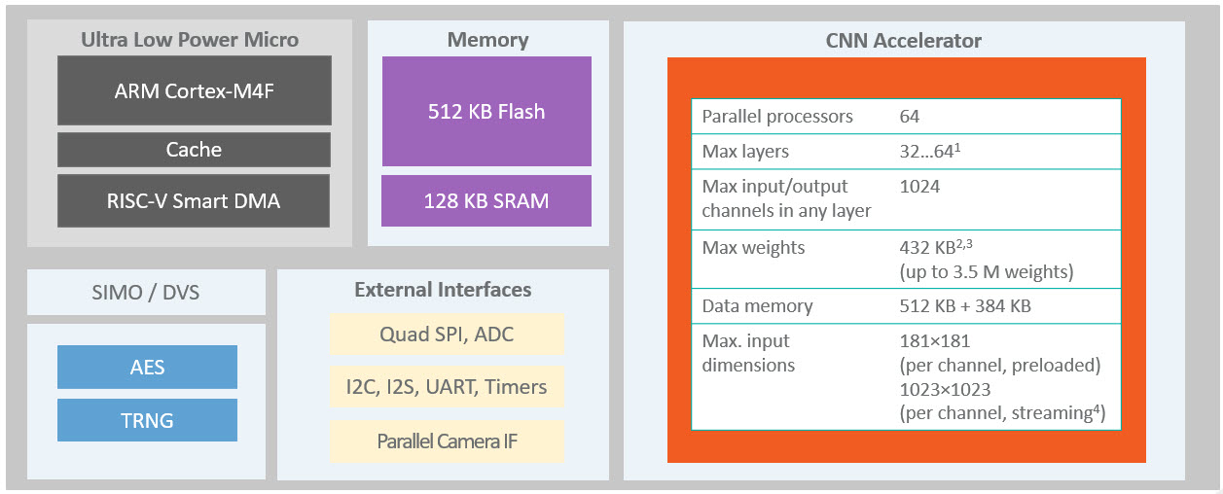
MAXIM 78000 Neuronal Network Accelerator constrains
Max Linear Layer input: 1024
RAM 2*32.8KB ¹
Max Input-offset
x8000
Max Output-offset
x8000
Max weights 432KB
1x1, 3x1, 3x3 Kernels
¹ Self experienced value, due to lack of documentation of the synthesis step
The architecture of the MAX78000 [2]
Notes:
Maxim comes with Arm cortex and a risk v microcontroller with its own Flash and Ram
The interesting part of the Maxim is the CNN accelerator which brings it own constrains for CNNs running on it
--name them
The cnn accelerator has its own ram but as I found out the max output-offset is limited to x8000
So that mean the maximum output size of a Layer which gets stored in the ram is 32.8KB

Slide 11
Reducing model size
Network Size (Layers, Width) | Acc (Top1) ² | Flash Max 432KB | RAM ¹ Max 32.8KB
CNN 6 64 | 92% | 135kB | 125KB
CNN 6 32 | 89% | 71kB | 62.4KB
CNN 5 64 | 87% | 98kB | 125KB
Tab 1: Comparison of the CNN model with different numbers of layers and or max number of channels. No model has been post-quantized. The max Flash and RAM values refer to the Maxim78000.
¹ Size of the largest layer output, used RAM between layers is roughly 2 as large (in and output)
² Accuracy on differentiating all 31 words
Notes:
So My first step after implementing the CNN of the Paper into pytorch using the AI8x library by Analog Devices
Was to reduce the Ram usage of the network so it can run on the Maxim
I found out that I have to reduce the width (number of channels) of the network and
I also have to use larger pool sizes of the Maxpool layers

Slide 12
Optimized CNN
Output 3x1
Combining Layer and Width
Layer reduction to 5
Reducing #Ops
Reducing channels and increasing Maxpool size
Reducing used RAM to 31.3KB
Largest layer output: 16 x 63 x 31
Limiting linear layer input to 966
Input 1x128x64
Notes:
I reduced the channel sizes of the first fiew layers and increased the number of Maxpools of the cnn from the paper
So it can fit on the Maxim

Slide 13
Variations of the optimized CNN
 | Linear Layer size | Max Channels | Flash [KB] | RAM [KB]¹ | Ops [M] | Inference time [us]
CNN for max | 966 | 64 | 53 | 31.3 | 5 | 1333
CNN smaller | 504 | 64 | 39 | 31.3 | 4.7 | 1328
CNN 32 | 504 | 32 | 14 | 15.65 | 1.4 | 814
Tab 2: Different Sizes of the optimized CNN in comparison. All networks are pre and post quantized
¹ Size of the largest layer output, used RAM between layers is roughly 2 as large (in and output)
Notes:
Now I want to see how I can speed up the Network by reducing its size it even further
It is possible by again reducing the channel sizes

Slide 14
CNN suffers under size reduction and a large pool of words
Linear s. / channels | Accuracy | TP rate | FP rate
966 / 64 | 86% | 0.881 | 0.160
506 / 64 | 84% | 0.779 | 0.085
506 / 32 | 78% | 0.701 | 0.157
Linear s. / channels | Accuracy | TP rate of "left" | TP rate of "right" | FP rate of "left" | FP rate of "right"
966 / 64 | 93% | 0.328 | 0.491 | 0.005 | 0.012
506 / 64 | 92% | 0.28 | 0.474 | 0.002 | 0.017
506 / 32 | 89% | 0.02 | 0.302 | 0 | 0.013
Tab 3: CNN in different sizes used to differentiate left and right
Tab 4: CNN in different sizes used to differentiate left and right and non of both
Notes:
As I trained the network on the dataset, I saw that…

Slide 15
Using KWS20net on MLCommos

Slide 16
KWS20net v2
Output 1 x 3
Using it on MFCCs
No good results for time-domain of ML Commos
Input 128 x 64
Notes:
The KWS20net version 2 looks like this…
We have 8 layers of 1d convolutions
I am using the network on MFCCs instead of directly on the time-domain because my results on that are unusable

Slide 17
Kws20nets on Time-domain
Network | ai8xkws20 | ai8xkws20v2 | ai8xkws20v3
Accuracy (Top 1) | 20% | 15% | 13%
Quanticed Accuracy | 10% | 7% | 4%
Tab 4: Spotting 31 different words => pure guessing has accuracy of 3.2%
KWS20netv2 on predicting "left" or "right" gets only an accuracy of 58%

Slide 18
Varieties of KWS20net-v2
 | Layers / Channels | Flash | RAM ¹ | Ops | Inference time
KWS20net v2 | 8 / 192 | 360KB | 8.2KB | 5.9M | 929us
smaller | 6 / 160 | 155KB | 8.2KB | 3.2M | 601us
less Depth | 4 / 160 | 152KB | 8.2KB | 2.3M | 285us
less Width | 6 / 80 | 46KB | 8.2KB | 1.0M | 259us
Tab 5: Different Sizes of the KWS20net v2 in comparison. All networks are pre and post quantized
¹ Size of the largest layer output, used RAM between layers is roughly 2 as large (in and output)
Notes:
To compare to the CNN, I also did size reduction to this network to speed it up
_______________Zeig was man sieht _________________

Slide 19
Accuracy of KWS20net does not suffer that much under size reduction
layer / channels | Accuracy | TP rate | FP rate
8 / 192 | 82% | 0.794 | 0.152
6 / 160 | 81% | 0.779 | 0.166
4 / 160 | 81% | 0.784 | 0.156
6 / 80 | 78% | 0.728 | 0.214
layer / channels | Accuracy | TP rate of "left" | TP rate of "right" | FP rate of "left" | FP rate of "right"
8 / 192 | 92% | 0.538 | 0.439 | 0.014 | 0.02
6 / 160 | 92% | 0.501 | 0.429 | 0.014 | 0.016
4 / 160 | 92% | 0.467 | 0.423 | 0.012 | 0.017
6 / 80 | 91% | 0.329 | 0.284 | 0.012 | 0.012
Tab 6: KWS20net in different sizes used to differentiate left and right
Tab 7: KWS20net in different sizes used to differentiate left and right and non of both
Notes:
But compared to the CNN the…

Slide 20
Speeding up networks with less Operations or/and less Ram usage

Slide 21
CNN can not be made much faster
Notes:
In comparison we see that the CNN cant be made much faster compared to the 1D convolutional network

Slide 22
1D Convolution is way more efficient
Notes:
We can also from the Data that

Slide 23
2D Convolution do have better Performance per network size
Notes:
But never the Less, 1D networks need more Flash memory for good results compared to the 2D networks as we can see in the Meas tp rate per network size

Slide 24
Conclusion
2D convolutions
1D convolutions
More Networks around
Less Flash Memory usage
Faster with same accuracy
More efficient
Less Ram usage

Slide 25
 | Layers / Channels | Flash [KB] | RAM [KB] ¹ | Ops [M] | Inference time [us] | Ops/Cycle ² | Accuracy | TP rate | FP rate | Accuracy | TP rate of "left" | TP rate of "right" | FP rate of "left" | FP rate of "right"
KWS20net v2 | 8 / 192 | 360 | 8.2 | 5.9 | 929 | 127.0 | 82% | 0.794 | 0.152 | 92% | 0.538 | 0.439 | 0.014 | 0.02
KWS20net Smaller | 6 / 160 | 155 | 8.2 | 3.2 | 601 | 106.5 | 81% | 0.779 | 0.166 | 92% | 0.501 | 0.429 | 0.014 | 0.016
KWS20net with less Depth | 4 / 160 | 152 | 8.2 | 2.3 | 285 | 161.4 | 81% | 0.784 | 0.156 | 92% | 0.467 | 0.423 | 0.012 | 0.017
KWS20net with less Width | 6 / 80 | 46 | 8.2 | 1 | 259 | 77.22 | 78% | 0.728 | 0.214 | 91% | 0.329 | 0.284 | 0.012 | 0.012
CNN for max | 4 / 64 | 53 | 31.3 | 5 | 1333 | 75.02 | 86% | 0.881 | 0.160 | 93% | 0.328 | 0.491 | 0.005 | 0.012
CNN smaller linear layer | 4 / 64 | 39 | 31.3 | 4.7 | 1328 | 70.78 | 84% | 0.779 | 0.085 | 92% | 0.28 | 0.474 | 0.002 | 0.017
CNN 32 | 4 / 32 | 14 | 15.65 | 1.4 | 814 | 34.40 | 78% | 0.701 | 0.157 | 89% | 0.02 | 0.302 | 0 | 0.013
¹ Size of the largest layer output, used RAM between layers is roughly 2 as large (in and output)
² To calculate the Operations per Cycle the maximal CNN accelerator frequency of 50MHZ is assumed

Slide 26
Demonstration of the KWS20net with less Depth

Slide 27
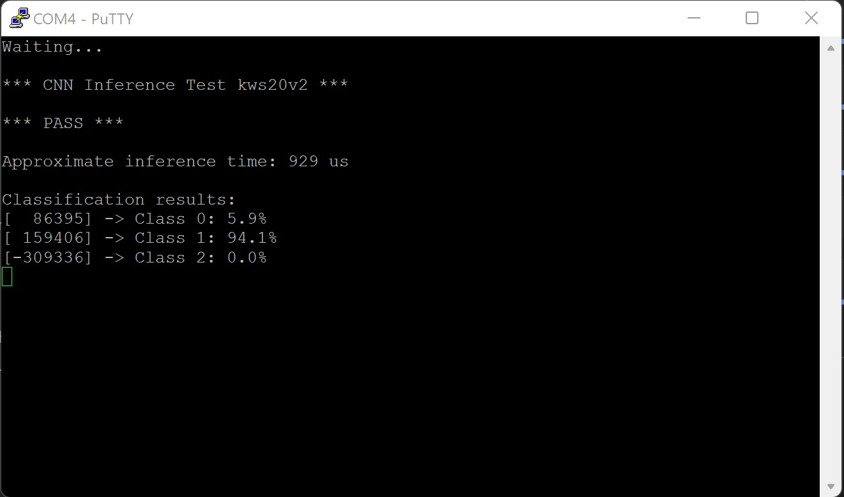

Slide 28
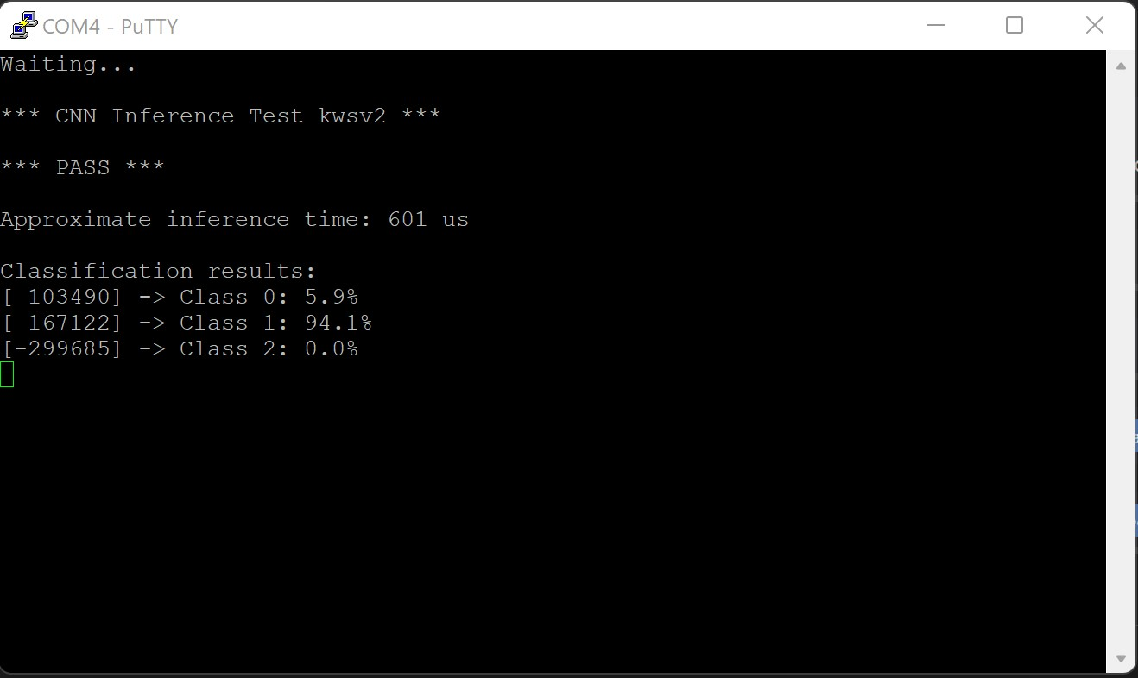

Slide 29
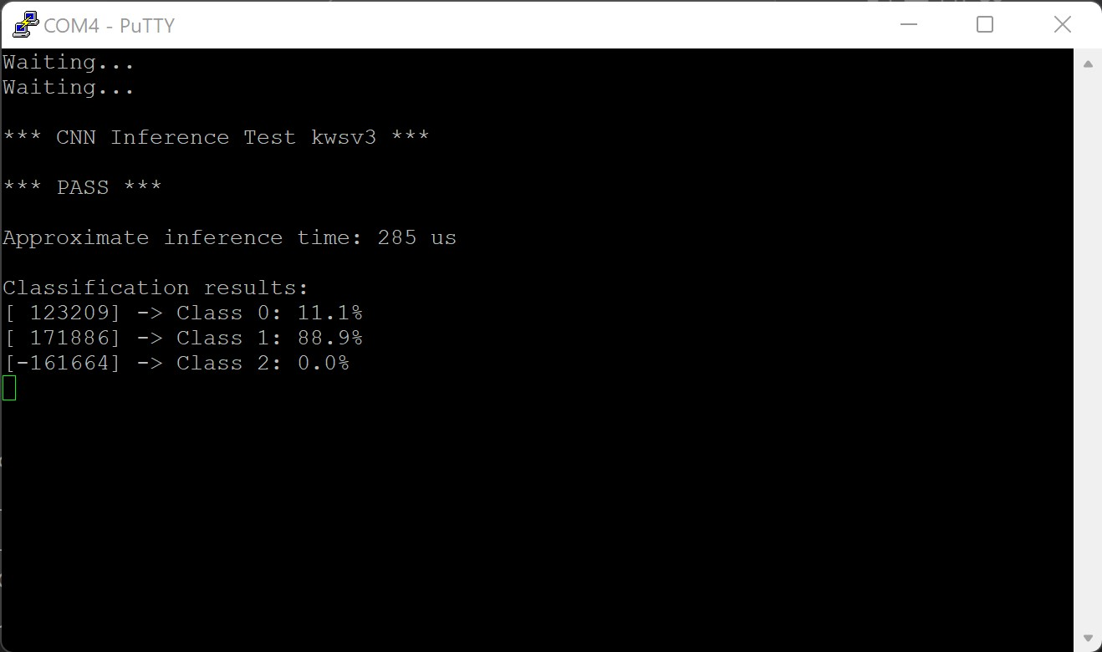

Slide 30
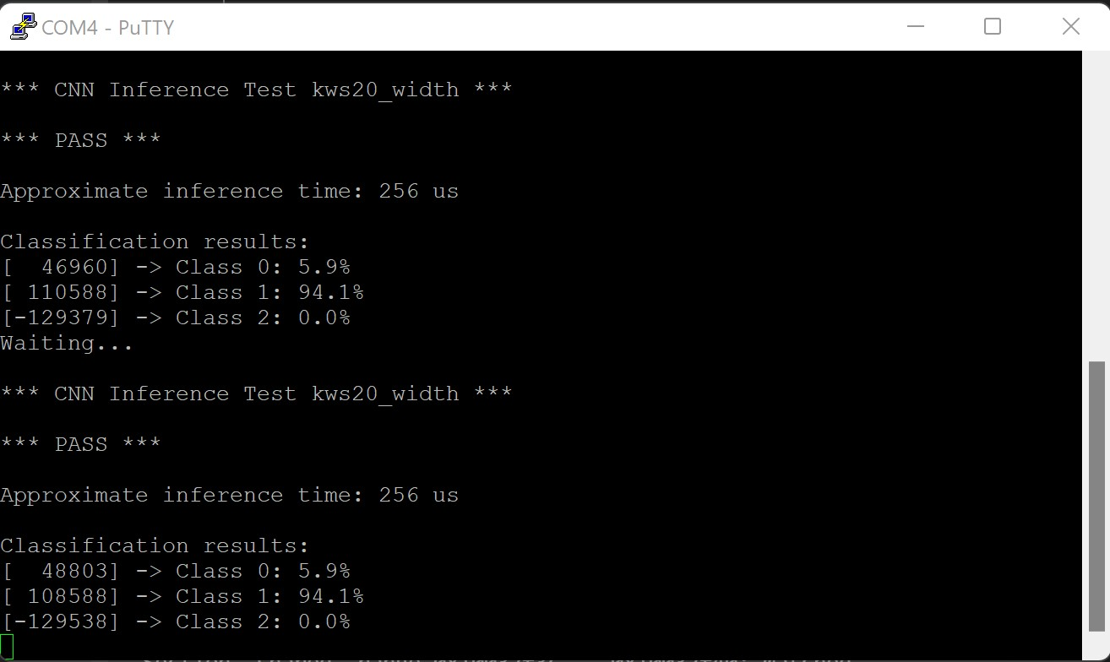

Slide 31
